Slide 1
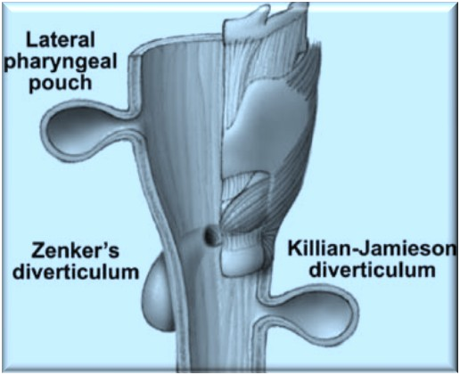
PHARYNGEAL POUCH

Slide 2
CONTENTS:
^{θ} Embryology and Anatomy
Introduction
Clas ification
Aetiology
Mechanism
Clinical features
Treatment
Future and controversies

Slide 3
Embryology and Anatomy:
^{θ} Pharyngeal Apparatus:
Cleft(Groove)(1^{st,} 2nd, 3rd and 4^{th)} ◊Ectoderm
Arch(1st , 2nd ,3rd , 4th and 6^{th)} ◊Mesoderm Pouch(1st, 2nd, 3rd and 4th )◊Endoderm
^{θ} Structures of head, neck and mediastinum

Slide 4
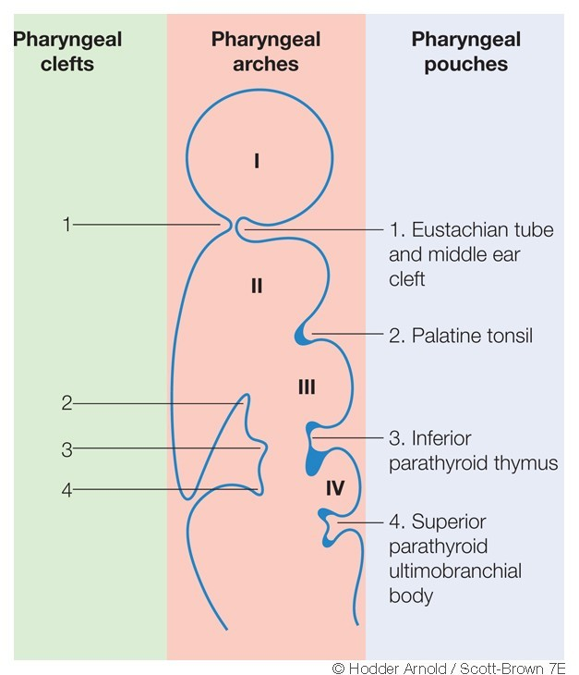

Slide 5
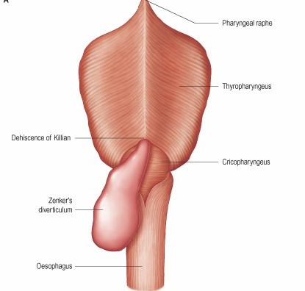
Three pharyngeal constrictor muscles:
♦
Develops from splanchnic mesoderm
♦
Migrates around the pharynx
♦
Partially deficient anterolaterally- neurovascular bundle to each branchial arch enters the pharynx
♦
Overlap each other Superior-innermost Inferior-outermost
♦
All inserts into posterior midline raphe

Slide 6
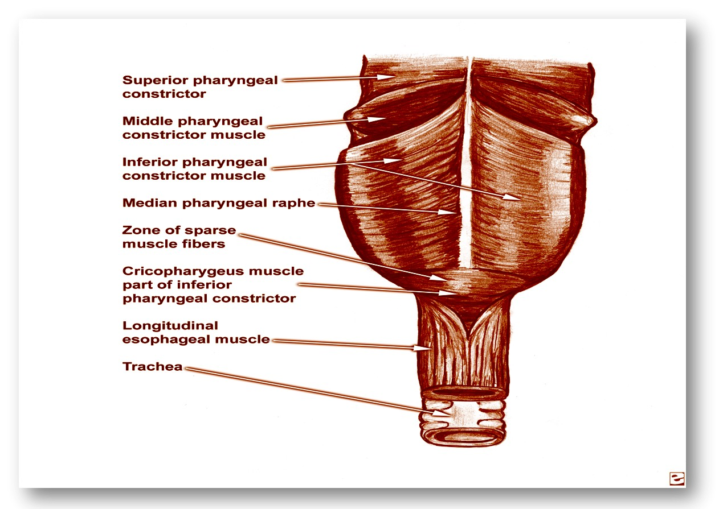
Pharyngeal Constrictor muscles:

Slide 7
Weak areas :
LATERAL :
Above the superior constrictor
Between the superior & middle constrictors
Between the middle & inferior constrictors
Below cricopharyngeus- Killian-jamieson’s area
(betn oblique & transverse fibers of cricopharyngeus muscle)
POSTERIOR:
Laimer-Hackermann’s area
(betn cricopharyngeus & superior most oesophageal circular muscle)
Killian’s dehiscence
(betn thyropharyngeus & cricopharyngeus )

Slide 8
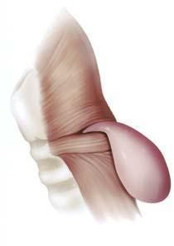
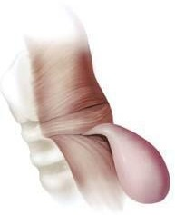
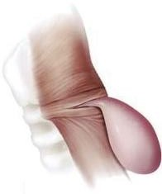
A. Killian's triangle: Region between the thyropharyngeus & cricopharyngeus
B. Laimer's triangle: Region between the cricopharyngeal and most
superior esophageal circular muscle
C. Killian-Jamieson's triangle: Region between the oblique and transverse fibers of the cricopharyngeal muscle

Slide 9
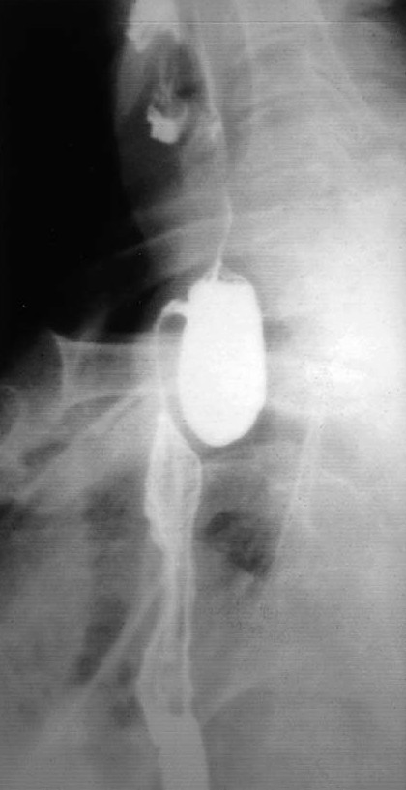
Introduction:
♦
Oesophageal diverticula – classifications
1.Anatomic location :
-Pharyngo-oesophageal
-Middle, thoracic or mid-oesophageal
-Lower or Epiphrenic 2.Mechanism of origin :
-Traction diverticula
-Pulsion diverticula
♦
♦

Slide 10
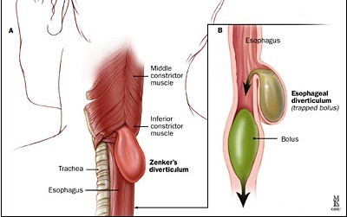
Traction diverticula:
θ
Pulling forces external to the oesophagus
-Inflammatory process
-Neoplastic process
θ
Usually anterior wall near the tracheal bifurcation
θ
Adhesions following surgery to fuse anterior cervical spine after trauma

Slide 11
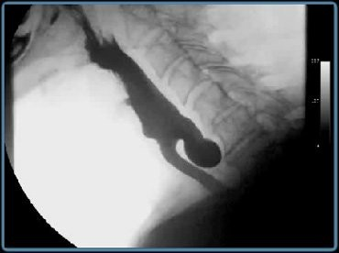
Pulsion diverticula:
♦
Herniation of oesophageal mucosa & submucosa
♦
Pseudodiverticulum
♦
Area of weakened musculature

Slide 12
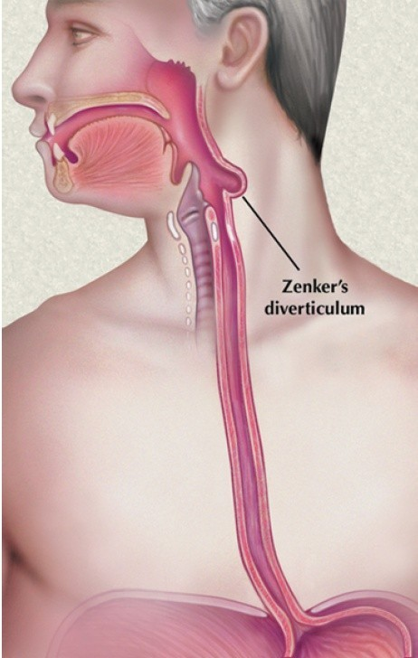
Pharyngo-oesophageal diverticula:
Pharyngeal:
-Majority arise above the cricopharyngeus muscle eg. posterior pharyngeal pulsion diverticulum (Zenker’s diverticulum)
-Most frequent
♦
Oesophageal:
-Arise below cricopharyngeus muscle
-Uncommon
θ

Slide 13
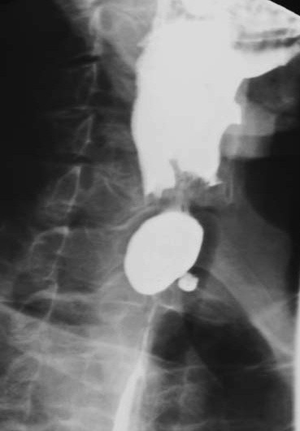
Pharyngo-oesophageal diverticula:
♦
Congenital or acquired:
♦
Multiple or single:
♦
Lateral or posterior:
♦
Size of the sac may vary from 1cm -12cm or more

Slide 14
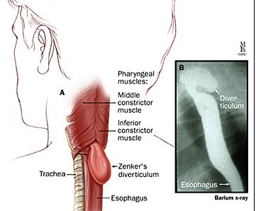
May present at any age
♦
♦
Most present in later life◊acquired origin
♦
Normally curable unless complicated by carcinoma

Slide 15
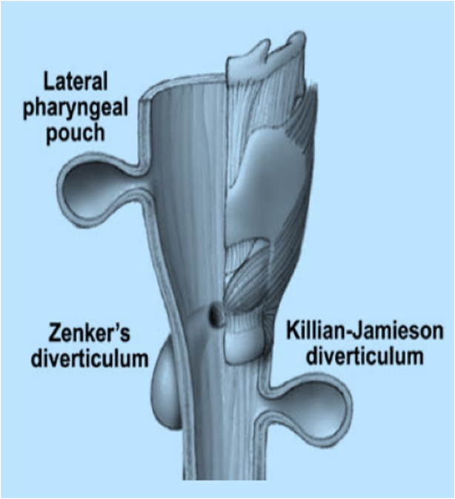
Classification of pharyngeal diverticula:
lateral:
Congenital
Acquired
  Normal bulges
  Traumatic
  Raised intrapharyngeal pressure (pharyngocoeles)
Posterior:
Congenital 2.Acquired
  Traumatic
  Raised intrapharyngo-oesophageal pressure
  Posterior pharyngeal pulsion diverticulum (Zenker’s diverticulum)
♦
♦

Slide 16
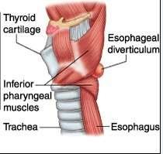
Lateral pouches:
Congenital
Acquired
Normal bulge
Traumatic
Raised intrapharyngeal pressure(pharyngocoele)

Slide 17
Lateral pouches:
♦
Uncommon
♦
Arise from the posterior faucial pillar or the pyriform fossa
θ
Contrast enhanced cineradiography
θ
Clinically –modified valsalva manoeuvre
♦
Divided into Congenital and Acquired- controversial

Slide 18
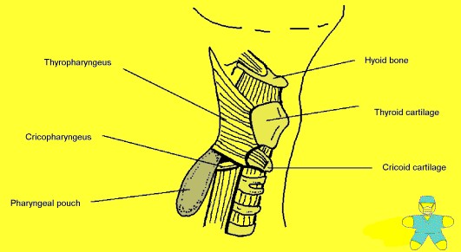
Congenital lateral pharyngeal diverticula:
♦
Extremely rare
Few cases reported First two decades of life
Recurrent infected neck swelling with previous treatment
Developmental defect in Branchial apparatus
Branchial pouch derivates Diagnosis: barrium swallow Treatment:excision of diverticulum
♦
♦
♦
♦
♦
♦
♦

Slide 19
Acquired lateral pharyngeal diverticula:
♦
Aetiology-argument still continues
♦
Basic defect – congenital weakness◊Congenital
♦
Precipitating factor -Raised intrapharyngeal pressure
-Muscular laxity
-Ageing
θ
Usually in adult◊Acquired

Slide 20
1.Normal bulges:
♦
Frequent & incidental findings on routine barium swallow
Small lateral pharyngeal bulge- Asymptomatic Early stage in the evolution of larger diverticula
Usually bilateral & asymptomatic◊thought as normal variants
Arise from-pyriform sinus or tonsillar fossa Modified valsalva manoeuvre
More common in elderly - reduced muscular tone
- loss of elasticity of tissues Radiological Contrast studies:
smooth,hemispherical prominences arising from the pyriform sinus or tonsillar fossa◊Pharyngeal ‘ears’
No treatment required
♦
♦
♦
♦
♦
♦
♦
♦

Slide 21
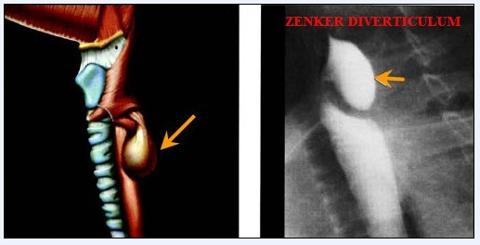
2.Traumatic:
♦
Self inflicted diverticula: Habitual criminals from India Repetitive introduction of piece of lead into the tonsillar fossa
♦
Probably lies between the middle & superior constrictors
♦
If not maintained, disappears rapidly

Slide 22
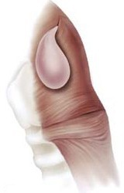
3. Pharyngoceles (Raised intra-pharyngeal pressure)
Large, occasionally symptomatic diverticula Usually unilateral but occasionally bilateral Predominantly in male (M/F=8:1)
First described by Wheeler (1886) Arise from precursor pharyngeal ‘ears’ Development
1. Frequent repetitive increase in intrapharyngeal pressure
♦
♦
♦
♦
♦
♦
Loss of muscle resilience
Both
Lateral pharyngocele: variable location above and lateral to the cricopharyngeus

Slide 23
Predisposing factors:
Younger patients- playing wind instruments, violent sneezing, or coughing
θ
Older patients- laxity of musculature
Both group: intrinsic weakness in the lateral wall Symptoms:
Dysphagia, food regurgitation, halitosis, foul taste,
nocturnal coughing, choking- food entrapment in the diverticulum Dyshphonia
-Spillage into larynx or
-Compression of recurrent laryngeal nerve
♦
♦

Slide 24
Signs:
♦
just anterior to SCM palpable lump, soft & compressible
Indirect laryngoscopy: slit like ostium in the region of the posterior faucial pillar or the pyriform sinus
Plain radiograph: translucency-lateral to PFS Ultrasonography:
Cine or videofluoroscopic technique with barium: rounded, contrast lined opacity communicating with the PFS or tonsillar fossa with neck
Direct pharyngoscopy:search for opening in those areas Treatment : Asymptomatic- no treatment, but follow up Symptomatic: excision of the diverticulum
♦
♦
♦
♦
♦
♦

Slide 25
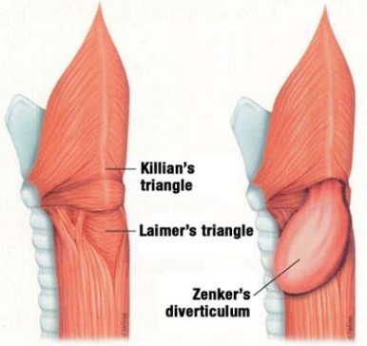
Posterior Pouches:
♦
More common
Posterior pharyngeal pulsion diverticulum (zenker’s diverticulum)- most common
♦
♦
Congenital Acquired
♦
Traumatic pharyngeal pseudodiverticulum
Diverticulum resulting from raised intrapharyngo-oesophageal pressure
Posterior pharyngeal pulsion diverticulum(zenker’s diverticulum)

Slide 26
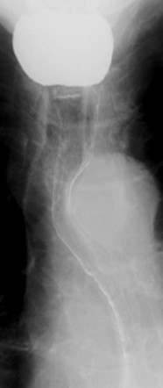
Congenital posterior pharyngeal pouch:
♦
Very rare
♦
First described in infants –symtoms similar to oesophageal atresia
♦
Radiological evidence of air in stomach in the absence of tracheo-oesophageal fistula◊oesophageal patency
♦
Whole diverticulum covered with muscle- distinguished from acquired pulsion diverticulum
♦
Treatment: excision of diverticulum

Slide 27
Acquired posterior pharyngeal pouch:
1.traumatic pharyngeal pseudodiverticulum:
Very rare condition
Usually presents in newborn infants but reported in adults too
Aetiological factor: hypopharyngeal trauma
either from damage caused by the obsterician’s finger during breech delivery or blind passage of the suction tubes
Spontaneous rupture of a retropharyngeal abscess in immunocompromised adult patient- reported case
♦
♦
θ

Slide 28
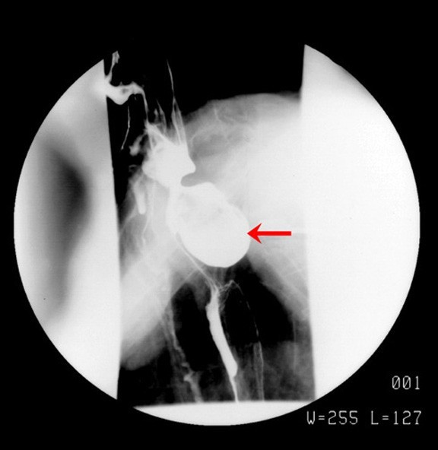
Abdominal radiograph- air in stomach◊ oesophageal atresia
♦
θ
Radiological appearance: irregular elongated tract originating in the pharynx & passing behind the oesophagus into the posterior mediastinum
♦
Treatment : not clearly defined Conservative treatment:
Deterioration of the general condition: surgical drainage of the pseudodiverticulum

Slide 29
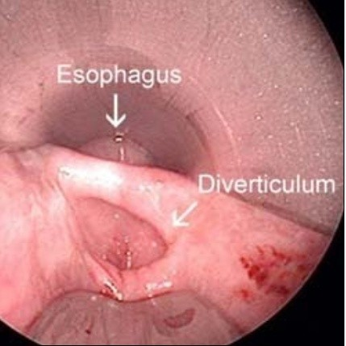
2. Diverticulum resulting from raised intrapharyngo
-oesophageal pressure:
♦
Rare
The laimer-Hackerman area Elderly people
Weakness of the musculature Always asymptomatic
No treatment required
Vary in size depending on the peristaltic wave Some discount their existence altogether
♦
♦
♦
♦
♦
♦
♦

Slide 30
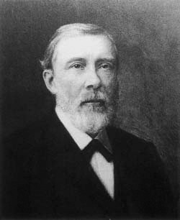
3. Posterior pharyngeal pulsion diverticulum: (Zenker’s diverticulum)
♦
Most common Many names:
-Pharyngo-oesophageal pouch or diverticulum
-Retropharyngeal pouch or diverticulum
-Posterior pharyngeal pouch or diverticulum
-Zenker’s diverticulum
-Cricopharyngeal achalasia
-Hypopharyngeal diverticulum
♦
Friedrich Albert von Zenker, Professor of Pathology at Erlangen University (1825– 1898), German pathologist whose name is associated with Zenker's diverticulum

Slide 31
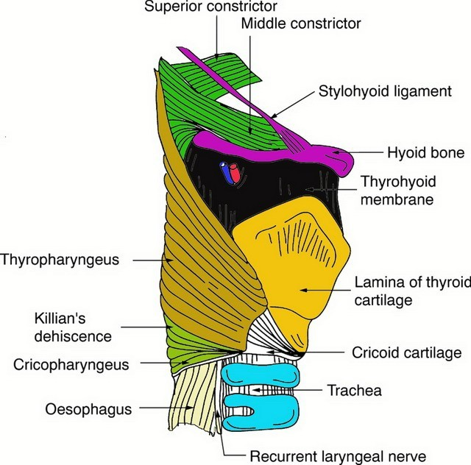
♦
Acquired, pulsion diverticulum between the thyropharyngeus and the cricopharyngeus muscle in an area of weakness called Killian’s dehiscence /triangle/hiatus
♦
Described by Killian in 1907

Slide 32
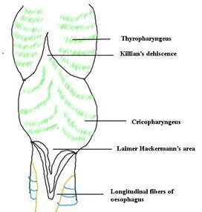
Found almost exclusively in humans
♦
♦
Hypothesized to be secondary to the large size & relatively caudal location of the larynx◊oblique orientation of the pharyngeal constrictor muscles
regions of weakness
Some animals- pig, camel, monkey & elephant
Theoretically- diverticulum herniates to the side of least resistance
ZD more prone to herniate to the left:
Left carotid artery located more laterally◊less adherent to the adjacent prevertebral fascia
Cervical oesophagus slight convexity to the left
♦
♦
♦
¬
¬

Slide 33
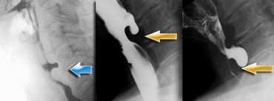
Incidence:
♦
Difficult to quantify the incidence in general population
Incidence of presentation to ENT specialist- 0.47 cases per 100,000 per year
In 1999, Incidence in Oxford region UK- 1/100,000
Men affected 2-3 times more often than women
Usually above 50 yrs, 7th-8th decade of life Affects caucasians
Extremely rare in Asian and African
♦
♦
♦
♦
♦
⁄

Slide 34
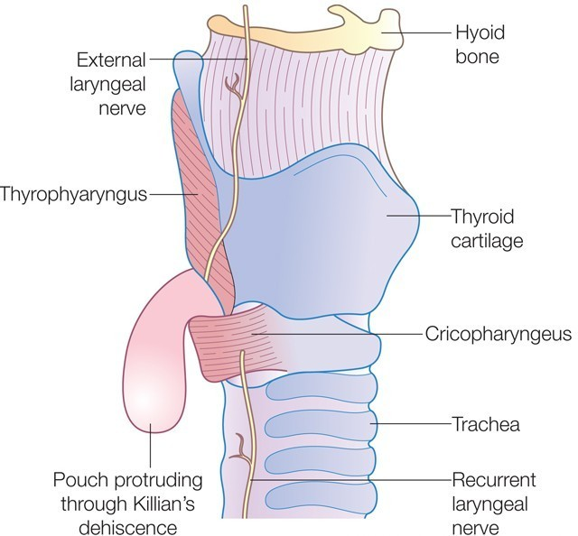
First case described by Abraham Ludlow,
♦
surgeon from Bristol in 1764
♦
Ineffectual swallowing attempts leading to pharyngeal distension
(Sir Charles Bell, 1817)
Early classifications of oesophageal diverticula by Zenker called this type ‘pulsion diverticula’
Zenker and Von Ziemssen (1878) reviewed 22 cases between 1764-1876◊ symptoms & possible pathogenesis
Spasmodic contraction of the circular fibers at the upper end of the oesophagus (Killian, 1907
♦
♦
♦
)

Slide 35
Aetiology:
θ
Unknown
Conflicting evidence based on anatomical, radiographic, manometric and electromyographic studies
♦
♦
Many theories:
Spasm of the cricopharyngeus muscle (Negus, 1950)
Lack of inhibitory stimuli to the cricopharyngeus (Dohlman and Mattsson, 1959)
The second swallow(due to pharyngeal laxity) (Wilson, 1962)
Neuromuscular incoordination and congenital weakness(Korkis, 1958)

Slide 36
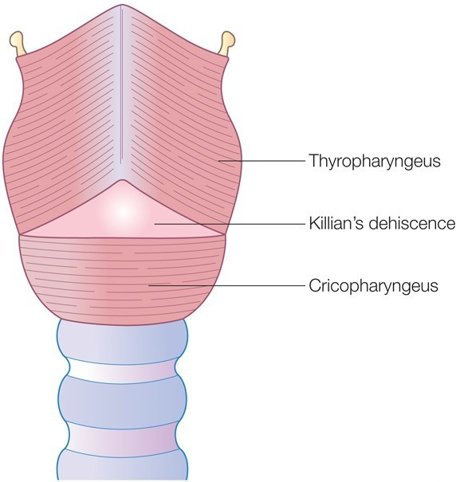
1. Spasm of the cricopharyngeus muscle:
♦
Human evolution to an erect position with larynx & cricopharyngeus moving lower down the neck, causing other constrictors to lie obliquely◊Killian’s dehiscence
(Negus, 1950)
♦
Persistent, tonic spasm of cricopharyngeus (inflammation, stenosis, or neurological deficit)◊ high pressure◊herniation of mucosa through Killian’s dehiscence
(Sutherland, 1962 and Belsey, 1996)

Slide 37
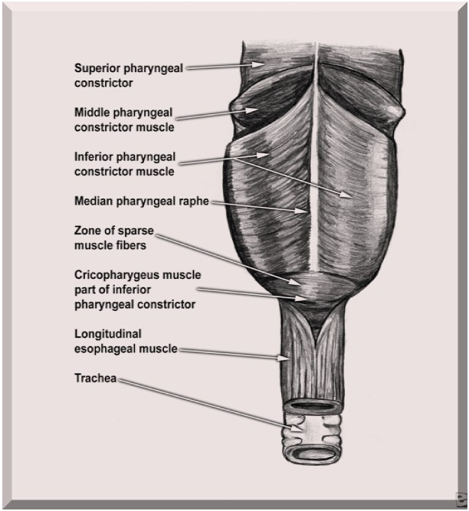
3. The second swallow (due to pharyngeal laxity):
♦
Due to pharyngeal muscular laxity◊weak pharyngeal stripping(peristaltic) wave ◊unable to clear the whole bolus before the cricopharyngeal sphincter contracted◊residue left in the pharynx
Second swallow needed to clear the residue◊against a closed sphincter◊high pressure ◊ mucosal bulging,
If long standing◊ diverticulum
(Wilson, 1962)
♦

Slide 38
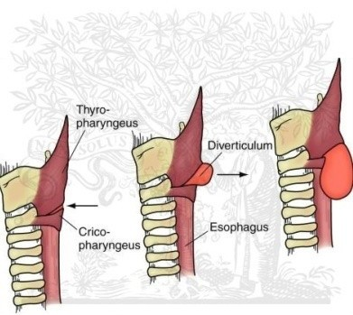
2. Lack of inhibitory stimuli to the cricopharyngeus:
♦
During deglutition- the larynx elevated pulling the cricopharyngeus upwards rather than stretching the muscle which normally trigger off a reflex arc resulting sphincter relaxation◊readiness for bolus
♦
The cricopharyngeal sphincter failed to relax◊increased intrapharyngeal pressure ◊mucosal bulging posteriorly
♦
Prevertebral fascia weakening with age

Slide 39
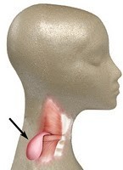
4. Neuromuscular incoordination and congenital weakness:
♦
Neurological disorder in presence of congenital weakness◊ diverticulum
(Korkis, 1958)
♦
If diverticula were acquired, they should occur more frequently in women as dysphagia is more common in women
♦
But diverticula are more common in men
♦
Gastro-oesophageal reflux may lead to cricopharyngeus spasm or incoordination
( Resouly, 1994)

Slide 40
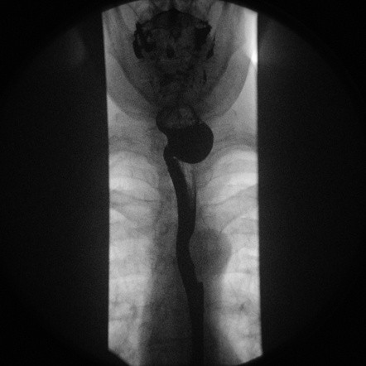
Risk factors:
♦
Older age
♦
Male gender
♦
Hiatal hernia
♦
Gastro-oesophageal reflux(GORD)

Slide 41
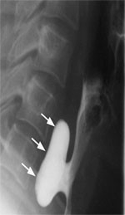
Pulmonary complications: Aspiration◊
θ
Recurrent respiratory infections, pneumonia, bronchiectasis & lung abscess
θ
Hoarseness:
-Laryngitis(aspiration or gastric reflux)
-Compression of recurrent laryngeal nerve
-Carcinoma in the diverticulum◊vocal cord paralysis
θ
Belching, choking, coughing

Slide 42
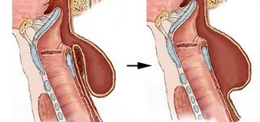
Symptoms:
♦
Symptoms of variable severity not necessarily related
to the size of the pouch
Longstanding and slowly progressive symptoms Dysphagia- most common symptom, virtually in all pt initially for solids, then semisolid and finally liquid Regurgitation of undigested food- 80% patients Noisy deglutition (borborygmi)
Hoarseness
Foul taste and halitosis Weight loss & malnutrition
Blood in regurgitated food contents- carcinoma Pain – carcinoma
Patients fail to respond to medication for another condition (tablets lodging in the sac)
♦
♦
s
θ
θ
θ
θ
θ
θ
♦
θ

Slide 43
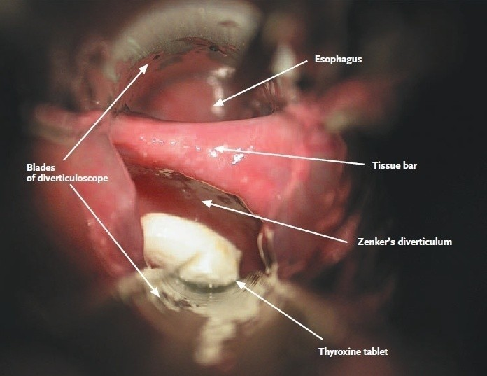

Slide 44
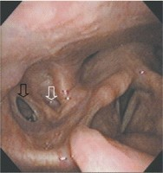
Signs:
θ
Usually without any specific findings, Minimal physical findings
Emaciation or dehydration
Soft, compressible swelling usually in the left side in anterior triangle
Laryingitis or Pooling of saliva in hypopharynx in I/L examination
Boyce’s sign (swelling in the neck that gurgles on palpation)
Spasm of coughing on palpation(spillage of contents into larynx)
Blood in regurgitated contents-carcinoma
θ
θ
♦
♦
♦
♦

Slide 45
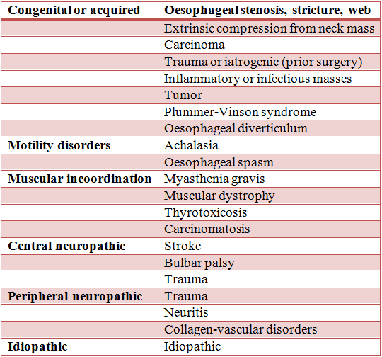
Differential diagnosis of dysphagia:

Slide 46
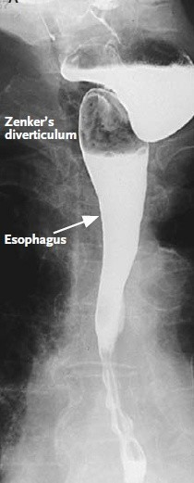
Investigations:
♦
History and examination: virtually pathognomic
Confirm the diagnosis with radiological evidence
♦
Barium swallow
Contrast videofluoroscopy
Plain radiography
Ultrasonography
Oesophagoscopy

Slide 47
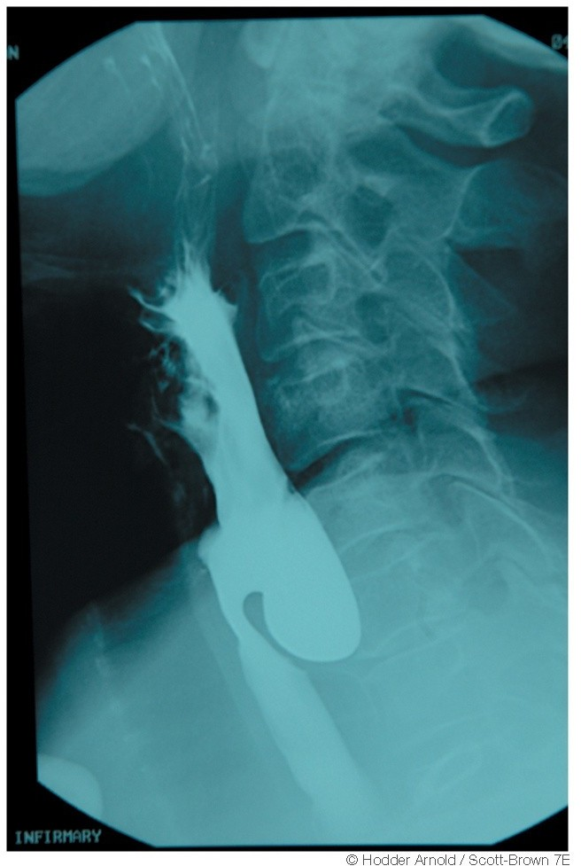
Barium swallow:
♦
Internal contour examined
Irregular or filling defect within diverticulum: solid food remnants or carcinoma
Constant filling defect in lower two-third of sac-carcinoma
Filling defect in the neck of pouch- food and air bubbles
¬
¬
¬
♦
Long term radiographic follow up failed to show transient diverticulum ◊ into full blown diverticulum

Slide 48
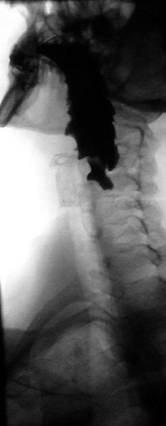
^{θ} Contrast video-fluoroscopy:
¬
Constant monitoring of the swallowing
(single shot barium swallow may miss small pouch)
Able to see pouch from different angles
Size, location, and character of the mucosal lining
Function of the pharyngeal muscles Presence or absence of gastric reflux
Contrast study should include lower oesophagus & stomach – lower oesophageal carcinoma & hiatal hernia can coexist with pharyngeal pouch
¬
¬
¬
¬
♦

Slide 49
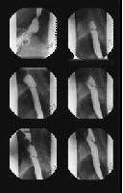
Images obtained during barium swallow videofluoroscopy demonstrating an intermediate-sized Zenker diverticulum

Slide 50
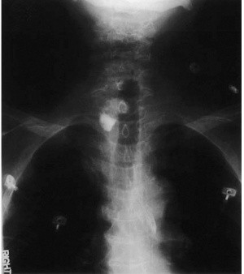
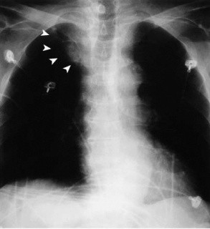
Plain radiograph of neck
♦
Triangular lucency in the prevertebral tissues with apex at the level of cricoid(due to air in the upper part of pouch),base has meniscus(due to fluid in the fundus)
Chest x-ray of a 75-year-old patient with a 6-cm Zenker's diverticulum. A, Before barium swallow. Note the hazy soft tissue mass in the right upper lung field (arrowheads) representing the Zenker's diverticulum. B, After barium swallow in the same patient. Air-fluid level can be seen within the Zenker's diverticulum.

Slide 51
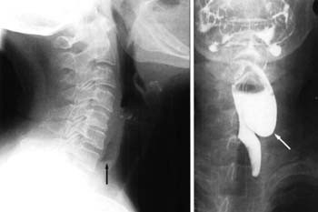

Slide 52
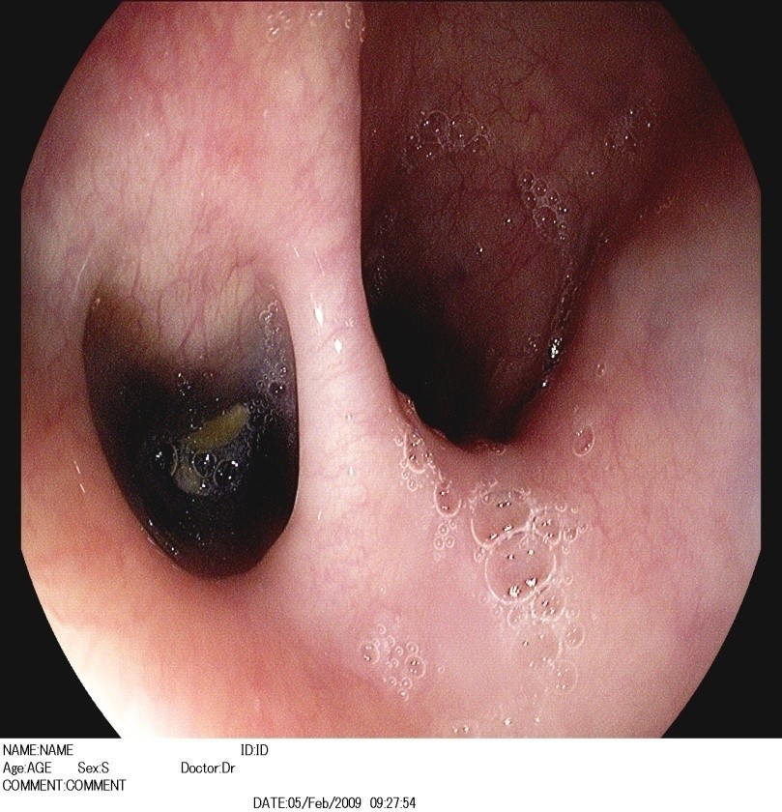
Rigid or flexible oesophagoscopy:
♦
-to assess the nature of the mucosa of the diverticulum
-to exclude the presence of SCC or carcinoma in situ
Care must be taken with rigid esophagoscopy to avoid perforating the Zenker diverticulum
Esophageal or hypopharyngeal manometry: does not add to the clinical workup
Ultrasonography:
♦
♦

Slide 53
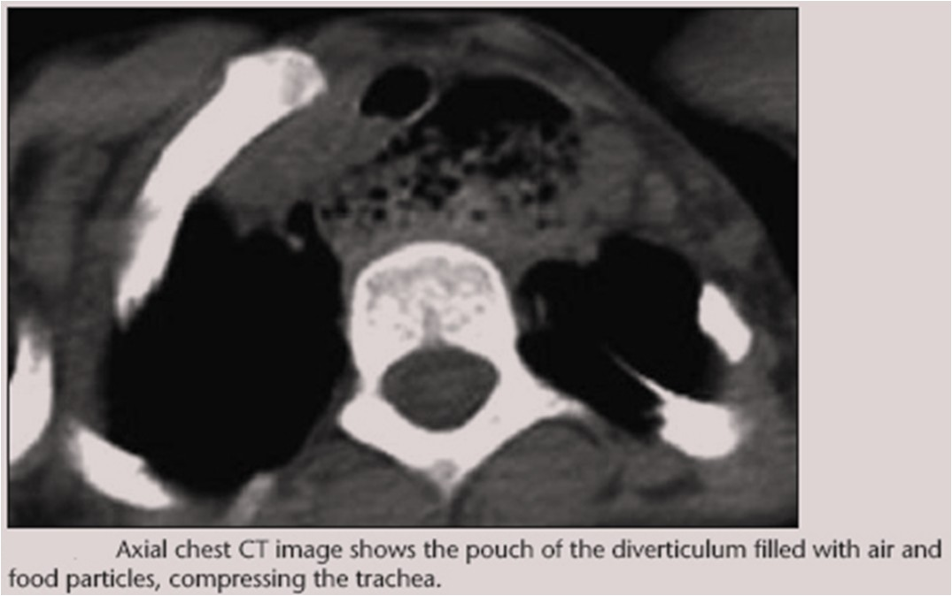
θ CT scan:

Slide 54
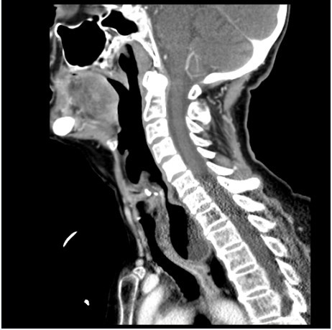

Slide 55
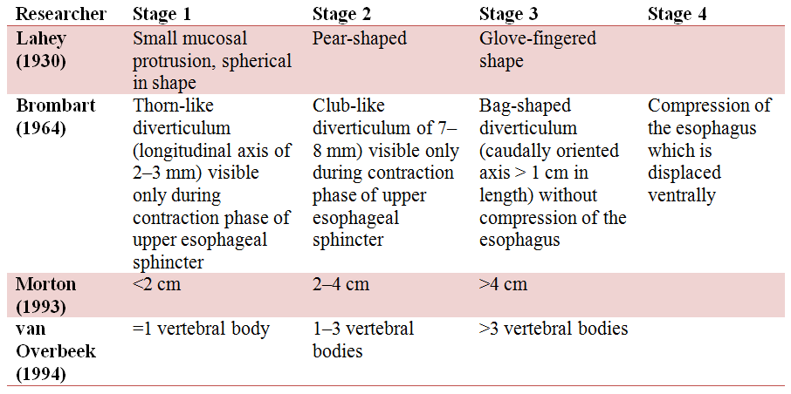
There are classifications based on contrast radiography, vertebral body measurements, and simple radiologic appearance, but categories are becoming increasingly complex and incorporate elements from several of the classic classification schemes. Clinical utility is not particularly high
There are classifications based on contrast radiography, vertebral body measurements, and simple radiologic appearance, but categories are becoming increasingly complex and incorporate elements from several of the classic classification schemes. Clinical utility is not particularly high

Slide 56
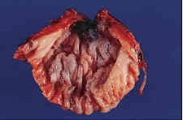
Pathology:
♦
Lined with stratified squamous epithelium
♦
No muscular layer exists
♦
Fibrosis surrounding the diverticulum is common
The fibrotic tissue limit the spread of any extravasated material from the diverticulum during endoscopic procedures ◊ reduce likelihood of local abscess

Slide 57
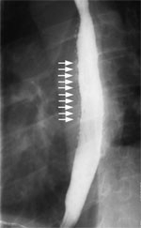
Complications of Zenker’s Diverticulum:
Oesophageal obstruction
Aspirarion pneumonia, bronchiectasis, lung abscess Recurrent infection
Compression of trachea
Ulceration
Squamous cell carcinoma: 0.4%
Chronic inflammation of lining of diverticulum◊Ca
(Sood and Newbegin, 2000)
Diverticulo-tracheal fistula
Additional risk factor in the overall health of the elderly patient.
deterioration of pulmonary function
cachexia/dehydration/malnutrition secondary to “fear of eating”

Slide 58

Treatment:
Conservative treatment:
- Asymptomatic patients: No treatment but follow up
-If general condition is poor and medically unfit or with minimal symptoms: No treatment
Pharyngeal pouch surgery:
Symptomatic patients: surgery is the mainstay of treatment
Endoscopic surgery:
External approach surgery:

Slide 59

Algorithm to approach a patient with pharyngeal pouch

Slide 60

Surgical treatment methods:
External:
Cricopharyngeal myotomy alone
Diverticulectomy (Excision)
Diverticulopexy(Suspension)
Inversion
^{θ} Endoscopic:
Dilatation
Diathermy/Electrocoagulation (Dohlman’s operation)
Laser :Co2, KTP
Stapling(Endoscopic Staple Diverticulostomy)

Slide 61


External approaches:
1.Diverticulectomy:
♦
In 1886, Wheeler reported the first successful excision of pharyngeal pouch
Oesophagoscopy- openings identified ribbon gauze soaked with BIPP or proflavin packed, NG tube inserted
Transverse incision at the upper border of the cricoid, extending laterally to the SCM muscle(usu. left side)
Retract the SCM muscle and carotid sheath contents laterally, thyroid glands & cartilage retracted medially
Anterior belly of Omohyoid, Middle thyroid veins identified and divided
♦
♦
♦
♦

Slide 62


The recurrent laryngeal nerve identified,
⁄
Inferior thyroid artery divided
^{θ} Diverticulum fundus grapsed with babcock forceps & the sac neck dissected free of oesophagus
⁄
CP sphincter & upper circular fibers of oesophagus divided posteriorly
Connell suturing Drain
⁄
⁄
♦
Especially useful:
-Carcinoma in pouch: diverticulectomy + post- operative radiotherapy
-Large perforation if happens during attempted endoscopic stapling

Slide 63

2. Cricopharyngeal Myotomy:
♦
Richardson in 1899 perfomed first cricopharyngeal myotomy
Can be performed alone for small diverticulum (<2cm) or in combination to other procedure
♦
♦
Other surgical procedure combined with it◊decreased recurrence
♦
Creating a tunnel betn circular muscle fibers & submucosa with curved artery forceps◊dividing muscle betn opened forceps
♦
3-4 cm length divided, as posteriorly as possible to avoid damage to recurrent laryngeal nerve

Slide 64

3. Diveritculopexy:
♦
Schmid in 1912 described the method of diverticulopexy
♦
For high risk surgical candidates, CP myotomy and diverticulopexy is preferred
Diverticulopexy technique: After a cricopharyngeal myotomy is performed and diverticulum freed, the sac is tacked with 2-0 silk sutures superiorly to the prevertebral fascia

Slide 65

4. Inversion:
♦
First described by Girard (1896)
Bevan (1917) modified by placing series of purse string suture along the length of sac to obliterate it
♦
♦
Carried out in same way as for excision but After mobilisationn of pouch & CP myotomy, the pouch is invaginated into the oesophagus & its neck oversewn with interrupted catgut sutures instead of being excised

Slide 66

Endoscopic treatment methods
♦
In 1917 Mosher first described endoscopic approach but abandoned due to complications
In 1960,Dohlman and Mattsson popularised the procedure(cautery)
In 1984, Van Overbeek introduced use of operating microscope & CO2 LASER(15-20 W power)
Bent and Kuhn in 1992, used potassium titanyl phosphate
♦
♦
♦
laser(KTP)
In 1993, Collard et al introduced endoscopic stapling technique
Dohlman Portrait: Gosta Dohlman, Professor of Oto-rhino-laryngology at Lund University who introduced endoscopic diathermic diverticulostomy
♦

Slide 67

Endoscopic treatment methods:
1.Dilatation:
♦
Lahey in 1946 recommended cricopharyngeal dilatation
Early treatment method for dilating
Cricopharyngeal sphincter- using bouginage or hydrostatic bag
Temporary relief from symptoms Risk of perforation
Rarely used nowadays except to dilate post-operative stenosis
♦
♦
♦
♦

Slide 68

2.Endoscopic diathermy (Dohlman’s operation):
♦
First described by Mosher in 1917 using scissors◊abandoned due to complications
Dohlman and Mattsson modified and popularized in 1960
Short operation lasting 30 mins
Can be performed under LA, if GA contraindicated (useful in elderly & GA unfit pts)
Doesn’t remove the pouch
Relieves the symptoms & restores swallowing - dividing the
♦
♦
♦
♦
♦
cricopharyngeus & widening the mouth of the diverticulum
Endoscopic electrocautery technique

Slide 69


3.Endoscopic laser technique:

Slide 70


4. Endoscopic staple diverticulostomy(ESD):
♦
Modified laryngoscope (Weerda bivalved
laryngoscope) ◊Visualization of the diverticulum ◊expose common wall betn oesophageal & diverticular lumen
♦
Magnified view of field-rigid 0 or 30 degree telescope with video camera
♦
2-0 silk retraction sutures through lateral edges of common wall
♦
Upper blade (long beak) into oesophagus & lower blade (short beak) into neck of pouch

Slide 71


Suspension apparatus connected
♦
♦
Common wall(cricopharyngeal bar) divided using stapler◊internal cricopharyngeal myotomy
♦
Stapler simultaneously cuts & staples the divided mucosal edges of common wall
♦
Single lumen created without removal of pouch

Slide 72






Slide 73







Slide 74

Endoscopic staple diverticulostomy is
♦
superior to external as well as other, endoscopic approaches
(Chang et al, 2003 )
♦
Endoscopic techniques-performed faster, short in patient stay,shorter anaesthetic time (important in elderly & medically infirm), recover more quickly
♦
Simultaneously divide & “suture” with staples◊reduced risk of perforation
No thermal damage to recurrent laryngeal nerve
♦

Slide 75
Not only for ZD, but for all other hypopharyngeal and pharyngeal diverticula
♦
♦
ESD can be performed in pts with recurrence of diverticulum after external or endoscopic approaches
♦
Endoscopic and external approaches are equally effective treatments
(Overbeek 1994, Liang et al,1995, and Bonafede 1997)
♦
The endoscopic stapling technique appears to have an improved efficacy and safety when compared with the CO2 laser technique
(Miller et al,2006)

Slide 76


Limitations of endoscopic techniques:
♦
Exposure of the diverticulum may be difficult or impossible – kyphosis, large cervical osteophytes or small oropharyngeal opening
♦
In smaller pouches(<2cm) insufficient cricopharyngeal myotomy performed
♦
Pouch can be inspected throughly & biopsy taken, but complete specimen for pathological exam not obtained
♦
Malignancy –endoscopic method contraindicated

Slide 77

Advantages/disadvantages of Endoscopic vs External surgery

Slide 78

Current management in pharyngeal pouch surgery by UK Otorhinolaryngologists (Siddiq M and Sood S, 2004)
Procedures performed by consultants

Slide 79


Audit:
Treatment of choice

Slide 80

Complications of pharyngeal pouch surgery:
Immediate:
Haemorrhage: Slippage of ligature
Pneumothorax: Mobilisation of large pouch with adhesions
Surgical emphysema: Mucosal tear
Early:
Secondary haemorrhage: Usually due to infection
Hoarseness: Risk of damage to RLN in external approach(3-5%)
Wound infection or abscess: Spillage of contents during surgery or through suture line(1.5-5%)
Fistula: Secondary to infection(1-8%)
Mediastinitis: Leakage
Aerocele: Sup.mediastinum
♦
♦

Slide 81

Late:
1. Persistent hoarseness: Division of recurrent laryngeal nerve
2. Stricture: Excising too much mucosa
3. Recurrence:
-Symptomatic relief after surgery (external or endoscopic approach)-90% in short term
-All methods have recurrence
-If cricopharyngeal myotomy not done- higher recurrence
-Higher for endoscopic diathermy(6-7%) than diverticulectomy(0.5-4%)
-Recurrences can easily be treated endoscopically than externally
-If patient has recurrent symptoms after endoscopic procedure, contrast studies are rarely helpful
(Jaramilo et al, 2001)

Slide 82
Future and Controversies:
♦
A complete understanding of the aetiology of pharyngeal pouch formation is not available
Further studies focused on the function of the CP muscle are likely to be fruitful
The final role for endoscopic procedures (with the laser or stapler) awaits further analysis and longer-term follow-up studies.
Flexible endoscopic cricopharyngeal myotomy
(Recipi et al, 2010 )
Harmonic scalpel in the treatment of Zenker's diverticulum
(Fama et al, 2009)
♦
♦
♦
♦

Slide 83

Pokhara, Nepal

