Slide 1
PHYSIOLOGY OF HEARING

Slide 2
PHYSICAL PROPERTIES OF SOUND
Sound has 2 basic properties : INTENSITY & FREQUENCY.
INTENSITY is the subjective correlate of loudness. INTENSITY is defined as power transmitted by sound waves through a unit area.
FREQUENCY is the subjective correlate of pitch.
PRESSURE & INTENSITY OF SOUND WAVES
Peak pressure of sound wave (P)
P=R V(R is the impedence of the medium)(V is the peak velocity of air)
Impedence is the resistance offered by medium for sound transmission.

Slide 3
INTENSITY
INTENSITY = PEAK PRESSURE * PEAK VELOCITY/2
If the intensity of the sound wave is constant, the peak velocity and peak pressure are also constant. This relationship doesnot depend on the frequency of sound wave.
DECIBEL
Sound pressure levels are usually measured in decibels. A difference in 1dB is the minimum perceptible change in volume of sound.

Slide 4
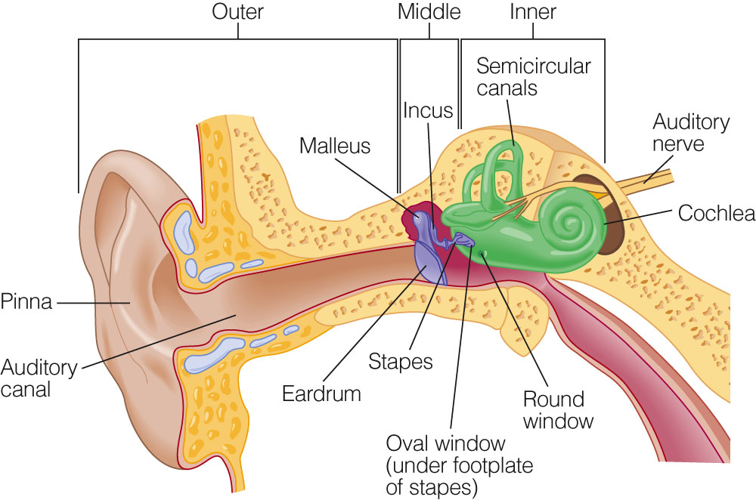
ROLE OF EXTERNAL EAR IN SOUND TRANSMISSION
THE EXTERNAL EAR COMPONENTS ARE
PINNA
CONCHA
EXTERNAL AUDITOTY CANAL
1)INCREASES THE PRESSURE AT THE EAR DRUM LEVEL IN A FEQUENCY SENSITIVE WAY BY ACTING AS A RESONATOR
2)INCREASES PRESSURE IN A WAY THAT DEPENDS ON THE DIRECTION OF THE SOUND SOURCE, HELPS IN LOCALISATION OF SOUND
3)THE PINNA CONCHA SYSTEM ACTS LIKE A TRUMPET,CATCHING SOUND OVER A LARGE AREA & CONCENTRATING IT IN SMALLER AREA .THIS INCREASES THE TOTAL ENERGY AVAILABLE TO THE EARDRUM.

Slide 5
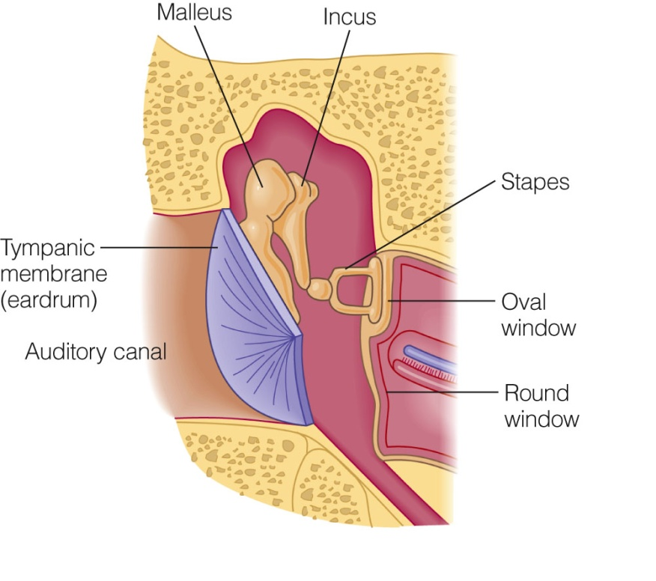
ROLE OF EXTERNAL EAR IN SOUND LOCALISATION
If a tube blocked at one end and open at the other is placed in a sound field,the pressure will be high at the closed end and low at the open end.The tube also adds resonance to the incident sound making the sound frequencies of 3 kHz stronger.THIS PHENOMENON is seen in HUMAN EXTERNAL EAR. This particular resonance is known as “QUARTER WAVE RESONANCE”. This phenomenon adds to the clarity of hearing to spoken sounds.
The external ear by dampening low frequency sounds serves to block the endogenous noise produced by the body(Air inside the lungs, blood flowing inside the blood vessels etc)
Another important resonance present in external is termed as BROAD RESONANCE. This adds about 10dB for sound frequencies aroung 5 kHz.

Slide 6
Role of ear drum in sound conduction
The eardrum conducts sound from external ear to middle ear. Ear drum moved like a stiff plate upto frequencies of 2 kHz. The inferior edge of the drum is flaccid and moves the most. At frequencies above 6 kHz the vibrating pattern becomes more complex. This reduces the efficiency of sound transfer mechanism.
The handle of malleus is attached to the centre of the ear drum.This allows sound vibrations on any portion of the ear drum to be transmitted to the ossicles.

Slide 7
ROLE OF MIDDLE EAR IN SOUND CONDUCTION
The middle ear acts as an acoustic transformer,facilitating impedance matching between the external and internal ear structures.
Middle ear will convert low pressure,high displacement vibrations into high pressure,low displacement vibrations suitable for driving cochlear fluids.
It also protects the cochlea from the deleterious effects of environmental agents.
The middle ear apparatus couples sound preferentially to only one window of the cochlea,thus producing a differential pressure between round and oval window, that causes movement of cochlea fluid. This movement is perceived by the hair cells of the cochlea.
The middle ear transformer mechanism ensures that upto50% of the incident sound energy is transmitted to cochlea.

Slide 8
FREQUENCY RESOLUTION EFFECT OF MIDDLE EAR CAVITY
1)Low frequency transmission in the middle ear is affected by the elastic stiffness of various components of middle ear cavity.
2)The elastic stiffness is contributed by various ligaments holding the ossicles in place.One important ligament is annular ligament. This ligament fixes the circumference of the foot plate of the stapes in the oval window. This ligament has been found to cause stiffness of the system .

Slide 9
3)Presence of air in the middle ear cavity also adds to the stiffness component. When the ear drum moves in response to sound waves,air inside the middle ear cavity is compressed, thereby reducing the movement of ear drum. This in effect reduces the conduction of low frequency sounds.
4)Mass effect is important in limiting ossicular movements in high frequencies. The mass effect increases during edematous condition of middle ear cavity,which depresses conduction of high freq sound.

Slide 10
Role of middle ear muscles in sound transmission of middle ear
1) Tensor tympani muscle inserts on top of handle of malleus. When it contracts,it pulls the malleus medially and anteriorly. This is nearly at right angles to the normal direction of vibration of ossicles.Increases stiffness of middle ear cavity.
2) Stapedius muscle inserts to the posterior aspect of stapes. Contraction of stapedius rocks the stapes to the ovalwindow,reducing its pumping action in response to sound.
Contraction of these muscles reduces the conduction of low frequency sound.It also decreases the pts hearing sensitivity to his/her speech.
Contraction of stapedius muscles occurs reflectively to loud noises.Protects inner ear from deleterious effects of loud noises.

Slide 11
PHYSIOLOGY OF BONE CONDUCTION
Sound conduction via bone is one imp way in which one hears his/her voice.It also maintains some level of residual hearing in pts with conductive hearing loss.
Cochlea is embedded in a bony cavity in temporal bone. Vibrations of entire skull can cause fluid vibration within the cochlea itself. Vibration of skull could vibrate csf. Cochlear fluids are in continuity with csf via cochlear aqueduct. Bone vibrations may also be transmitted by the air inside the external canal which in turn can cause vibrations of ear drum.

Slide 12
MECHANISM OF HEARING
Any vibrating object causes waves of compression &
rarefaction & is capable of producing sound.
Sound signal is collected by the pinna , passes through the external auditory canal & strikes tympanic membrane.
Vibrations of tympanic membrane are transmitted through a chain of ossicles coupled to TM.
Movements of stapes footplate cause pressure changes in Labyrinthine fluids, which moves the basilar membrane—This stimulates the hair cells of ORGAN OF CORTI.

Slide 13
HAIR CELLS of ORGAN OF CORTI acts as transducers and convert the mechanical energy into electrical impulses which travel along the auditory nerve.The mechanism of hearing can be broadly divided into
1) MECHANICAL CONDUCTION OF SOUND(conductive apparatus)
2)TRANSDUCTION OF MECHANICAL ENERGY TO ELECTRICAL IMPULSES(sensory system of cochlea)(INNER EAR)
3)CONDUCTION OF ELECTRICAL IMPULSES TO THE BRAIN(neural pathway)

Slide 14
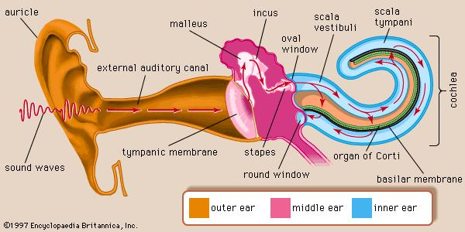

Slide 15
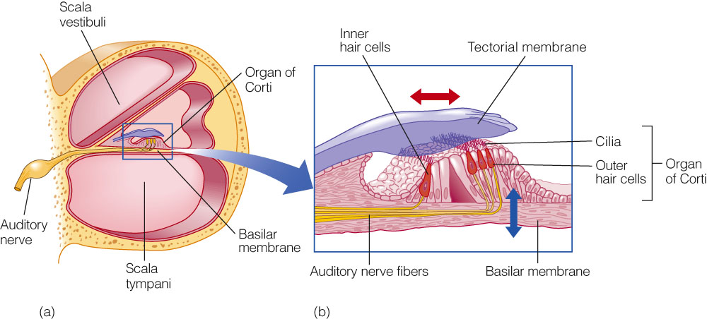

Slide 16
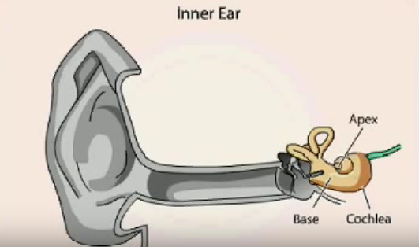

Slide 17
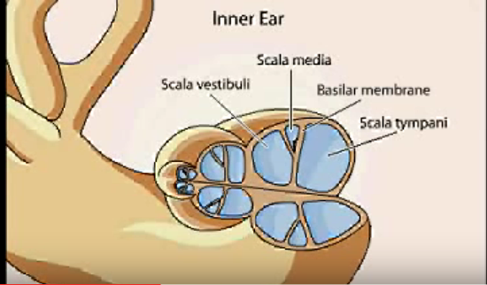

Slide 18
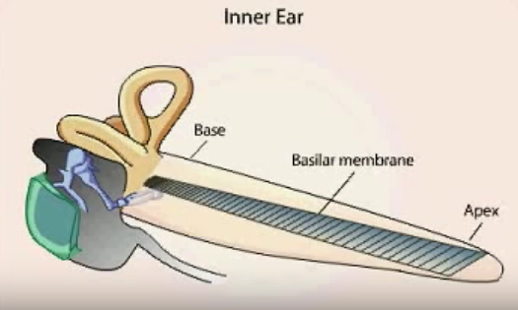

Slide 19
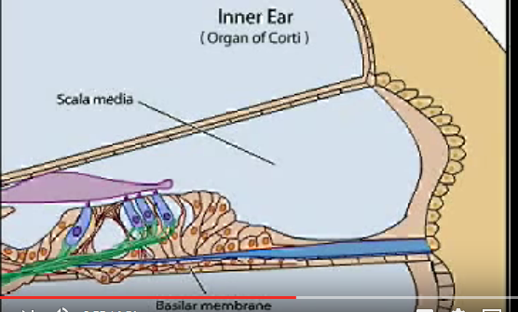

Slide 20
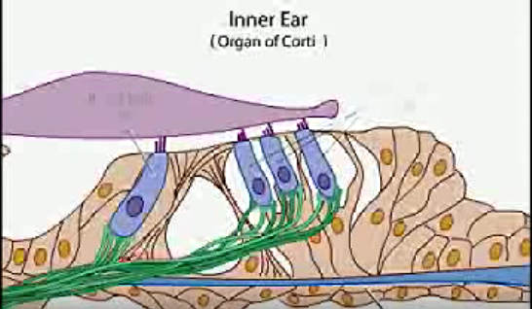

Slide 21
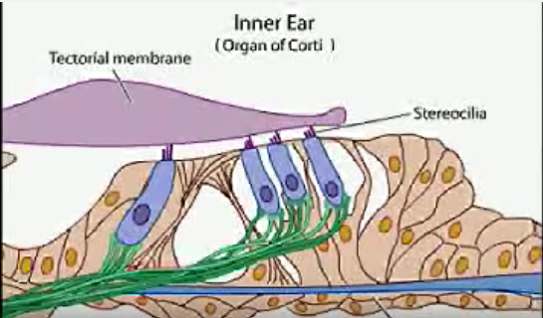

Slide 22
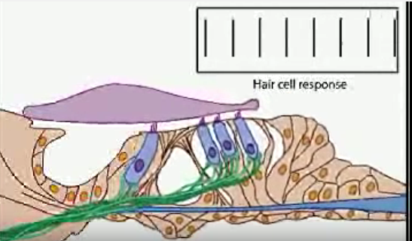

Slide 23
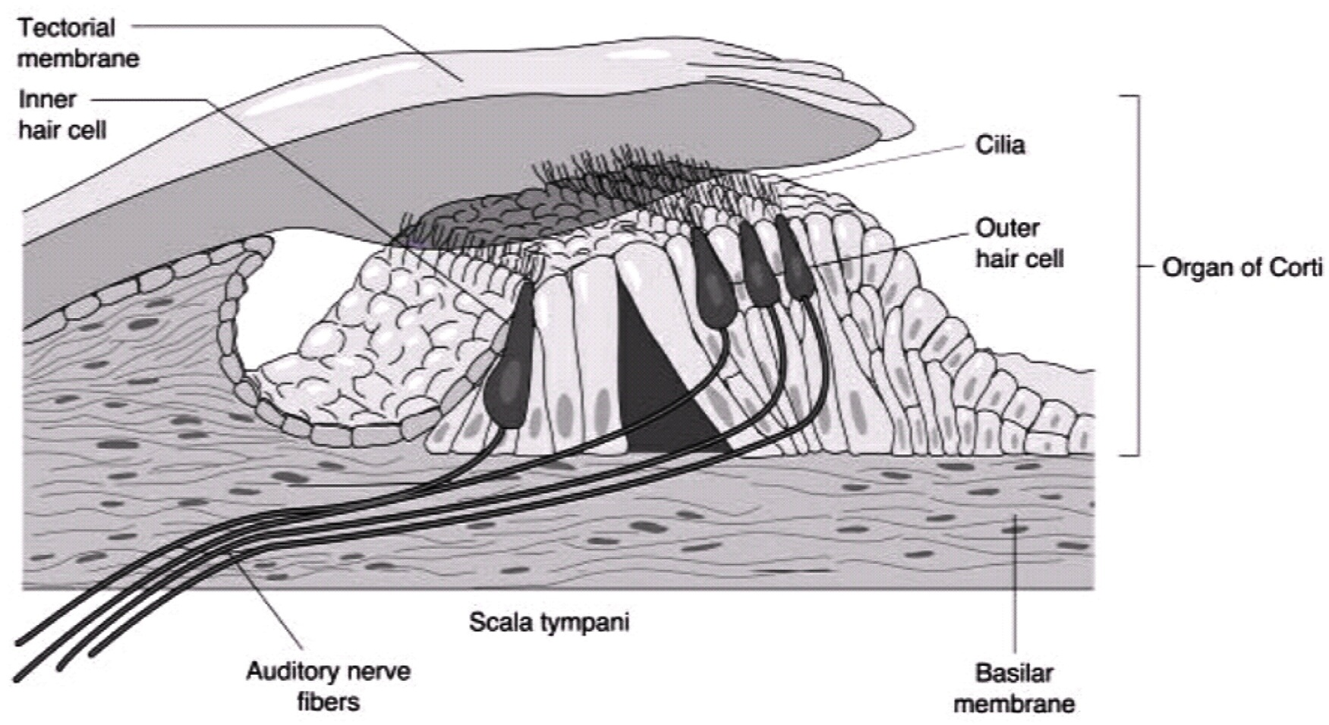
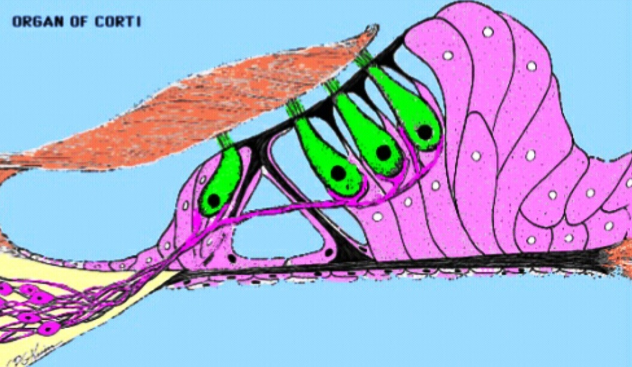
ORGAN OF CORTI
The end organ of hearing
Contains stereocillia & receptor cells
3 rows of OHC, 1 row IHC
Tectorial membrane & Basilar membranes
Cochlear fluids

Slide 24
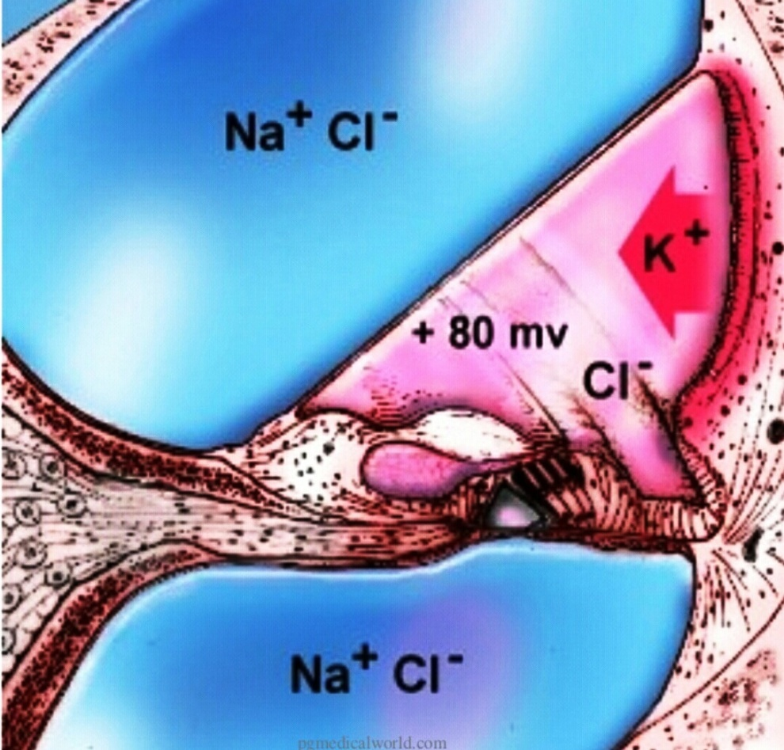
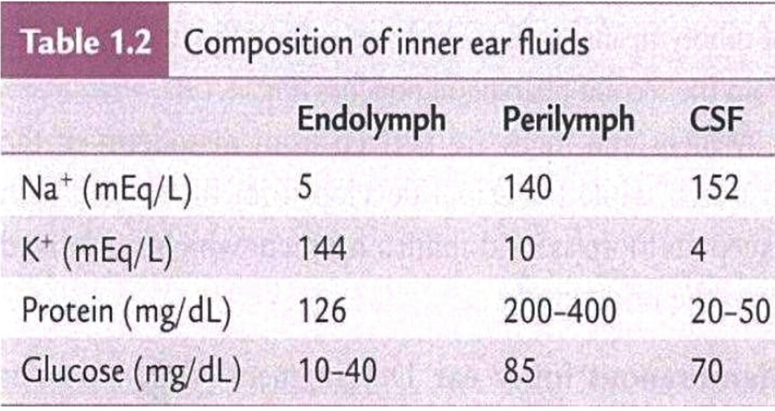
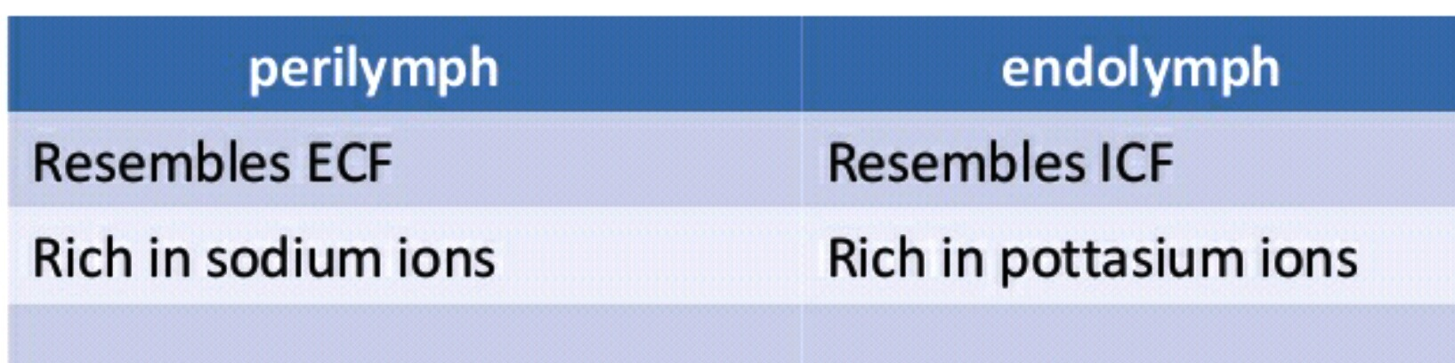
INNER EAR FLUIDS
Perilymph – between Bony and Membranous Cochlea , from plasma & csf
Endolymph – fills the entire Membranous labyrinth ,produced by stria vascularis.

Slide 25
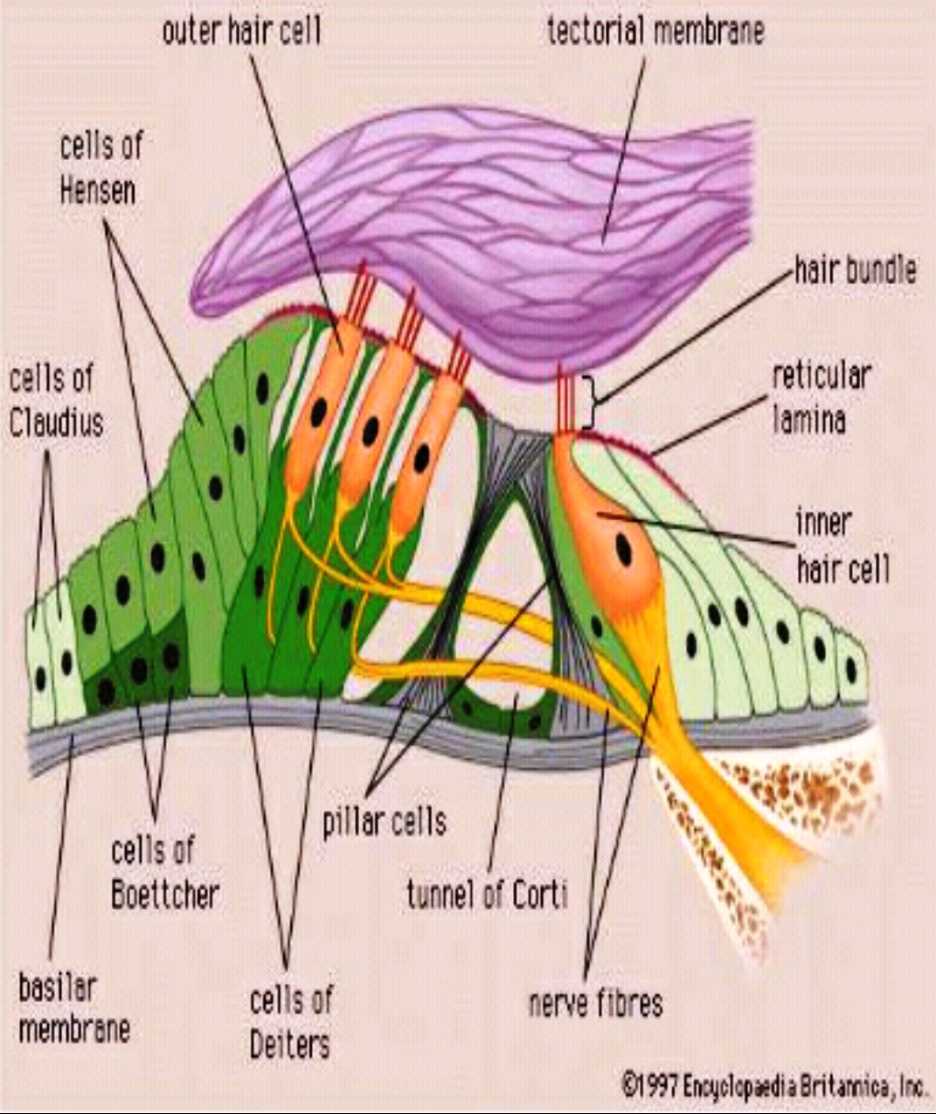
Afferent fibres ( that go to the brain )
innervate the Inner hair cells
Efferent fibres innervate the Outer hair cells
Inner hair cells are sensory cells responsible for 95%
Information to the brain
Outer hair cells are motor cells that amplify the movements of the Basilar membrane in response to a stimulus
Some of this energy is transmitted to the middle ear which can be recorded as otoaccoustic emission

Slide 26
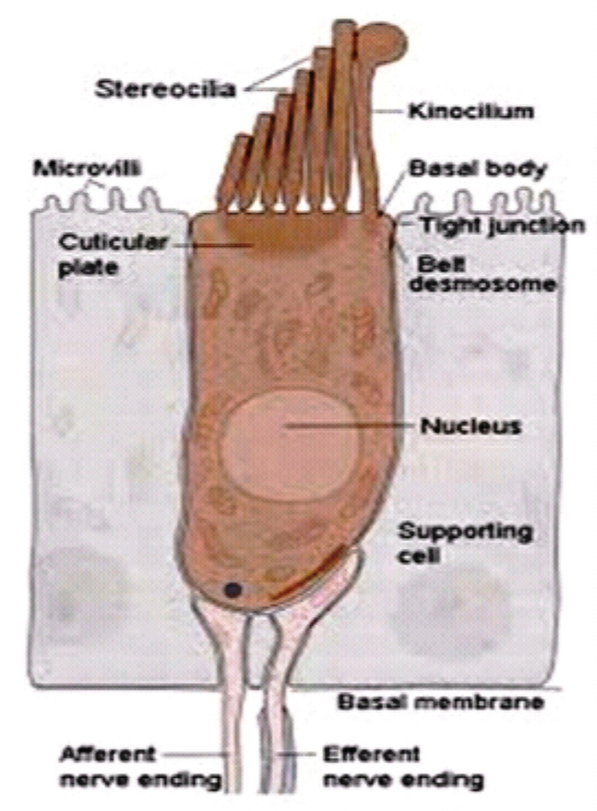
Each hair cell has 50 to 100 small Stereocillia and a single larger cillium called a Kinocillium, which only exists in a rudimentary form in the hair cells of the cochlea .
The Stereocillia are arranged by length , with the longest stereocillia located close to the kinocillium and are connected by tip links.

Slide 27
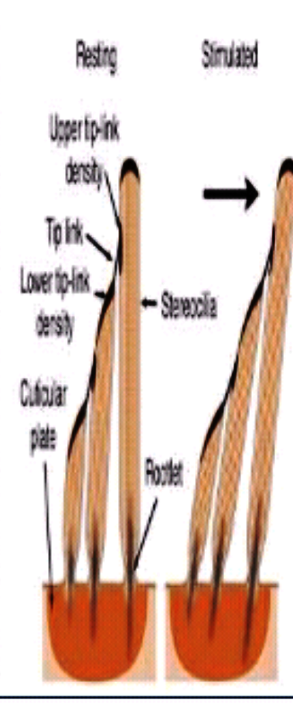
Movement of the stereocillia hair bundle towards the Kinocillium causes depolarization ( excitatory ) sensory response whereas movement away from the kinocillium causes hyperpolarization ( inhibitory ) sensory response.

Slide 28
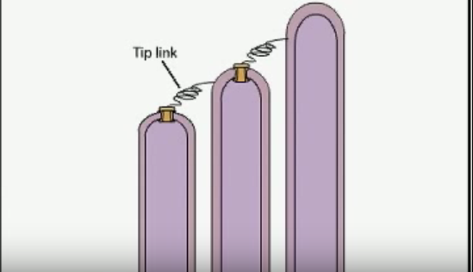

Slide 29
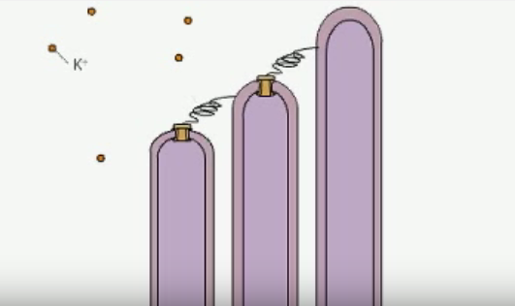
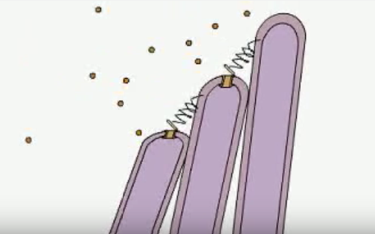

Slide 30
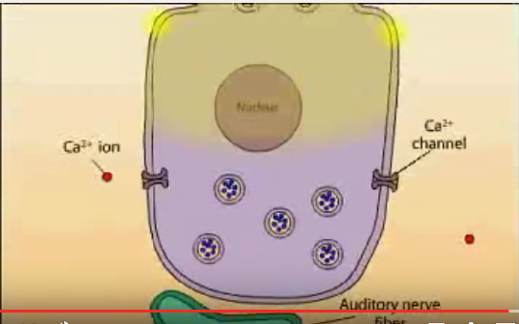

Slide 31
TRANSDUCTION OF HAIR CELLS
There are fine links running upwards from the tips of shorter stereocilia on the hair cell,which join the adjacent taller stereocilia. When stereocilia are deflected in the direction of the tallest stereocilia,the links are placed under tension.This opens ion channel in the cell membrane.
This causes K influx & depolarisation of inner hair cells & opening of voltage gated calcium channels .
In response to this stimulus, neurotransmitter(glutamate) is released in the synapses at the base of inner hair cells.
This gives rise to ACTION POTENTIAL in the Auditory nerve fibers.

Slide 32
Stria vascularis contain a high concentration of Na K ATPase, adenyl cyclase and carbonic anhydrase.These enzymes are a/s with active pumping of ions and transport of fluid into endolymph.Endolymph has high K content.The K ions of endolymph flow into sensory hair cells through the mechanotransduction channels and then into perilymph via basolateral K channels in hair cells.There are 3 types of K channels in hair cells
1) KCNQ1
2) KCNE1
3) KCNQ4
Genetic mutations involving these channels can lead to defects in K recycling causing sensorineural hearing loss. Abnormalities in gap junctions could also cause defective recycling of K ions causing SN hearing loss.Three types of proteins are involved in these gap junctions-connexin 26,connexin 30,connexin 31.
Mutations in the gene for connexin 26 account for half of all cases of autosomal non syndromic prelingual hearing impairment.

Slide 33
1)MECHANICAL CONDUCTION OF SOUND
Air conducted sounds has to travel to cochlear fluids.
Nature has compensated for the loss of sound energy by interposing the middle ear which converts sound of greater amplitude but lesser force to that of lesser amplitude but greater force.
This fuction of middle ear is called impedance matching mechanism or transformer action.
It is accomplished by 1) lever action of ossicles 2) hydraulic action of tympanic membrane 3)curved membrane effect.

Slide 34
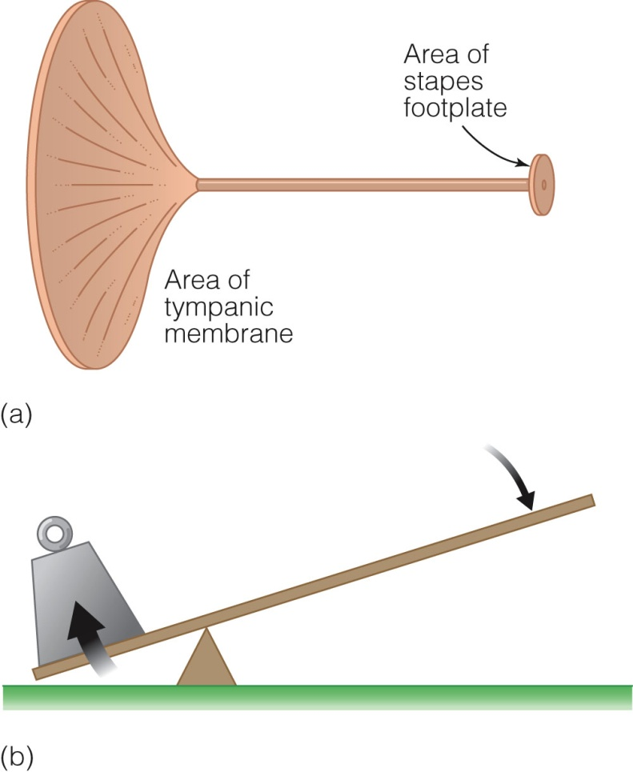
1) lever action of the ossicles
handle of malleus is 1.3 times longer than the long process of incus providing a mechanical advantage of 1.3.
2) Hydraulic action of tympanic membrane
the area of TM is much larger than the areaof stapes footplate,avge ratio between the two being 21:1.
As effective vibratory area of TM is only 2/3rd ,the effective areal ratio is reduced to 14:1 and this is the mechanical advantage provided by TM.
THE PRODUCT OF AREAL RATIO & LEVER ACTION IS
18: 1

Slide 36
3) Curved membrane effect
movements of TM are more at periphery than at the centre where handle of malleus is attached. This produces some leverage.

Slide 37
Phase difference between oval & round window
Sound waves striking the TM do not reach the oval and round windows simultaneously. There is a preferential pathway to the oval window because of the ossicular chain. Thus when oval window is receiving wave of compression,the round window is at phase of rarefraction.
If the sounds were to strike both the windows simultanously, they would cancel each other with no movement of perilymph & no hearing.This acoustic seperation is achieved by presence of intact TM & a cushion of air in the middle ear around the round window.

Slide 38
Natural resonance of external & middle ear
Inherant anatomic ,physiologic properties of ext & middle ear allow certain frequencies of sound to pass more easily to inner ear due to natural resonances.
Natural resonance of EAC is 3000 hz.
Middle ear is 800 hz
Ossicular chain is 500-2000 hz
So greatest sensitivity of sound transmission is between 500-3000 hz.

Slide 39
2) Transduction of mechanical energy to electrical impulses
Movement of stapes footplate is transmitted to cochlear fluids which moves basilar membrane & set up shearing force between tectorial membrane and hair cells. The distortion of hair cells give rise to cochlear microphonics which trigger nerve impulse.
Higher frequencies are represented on basal turn of cochlea , lower ones towards the apex.

Slide 40
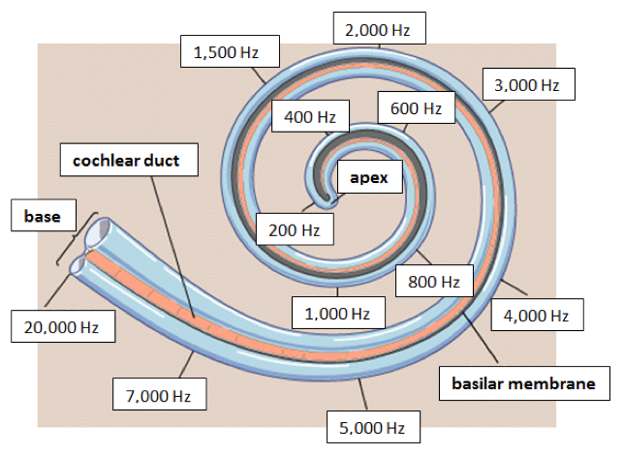

Slide 41
3) Neural pathways
Hair cells get innervation from the bipolar cells of spiral ganglion. Central axons of these cells collect to form cochlear nerve which goes to ventral & dorsal cochlear nuclei.
From cochlear nuclei , it travels to
Superior olivary nucleus- lateral lemniscus- inferior colliculus – medial geniculate body – auditory cortex of temporal lobe. ( O L I M A )

Slide 42
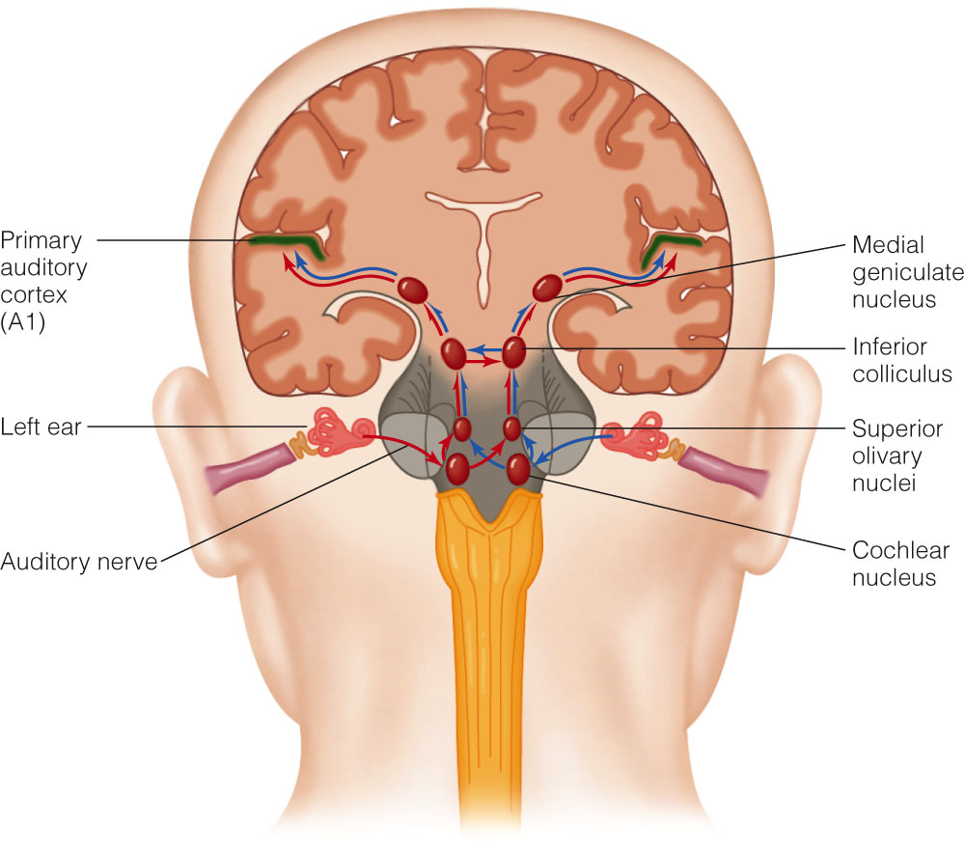
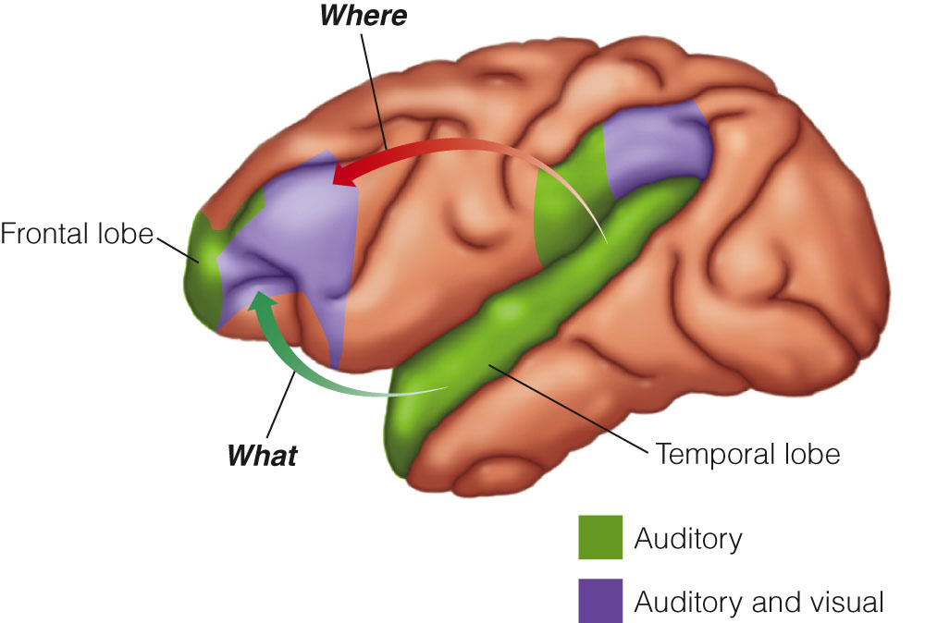

Slide 43
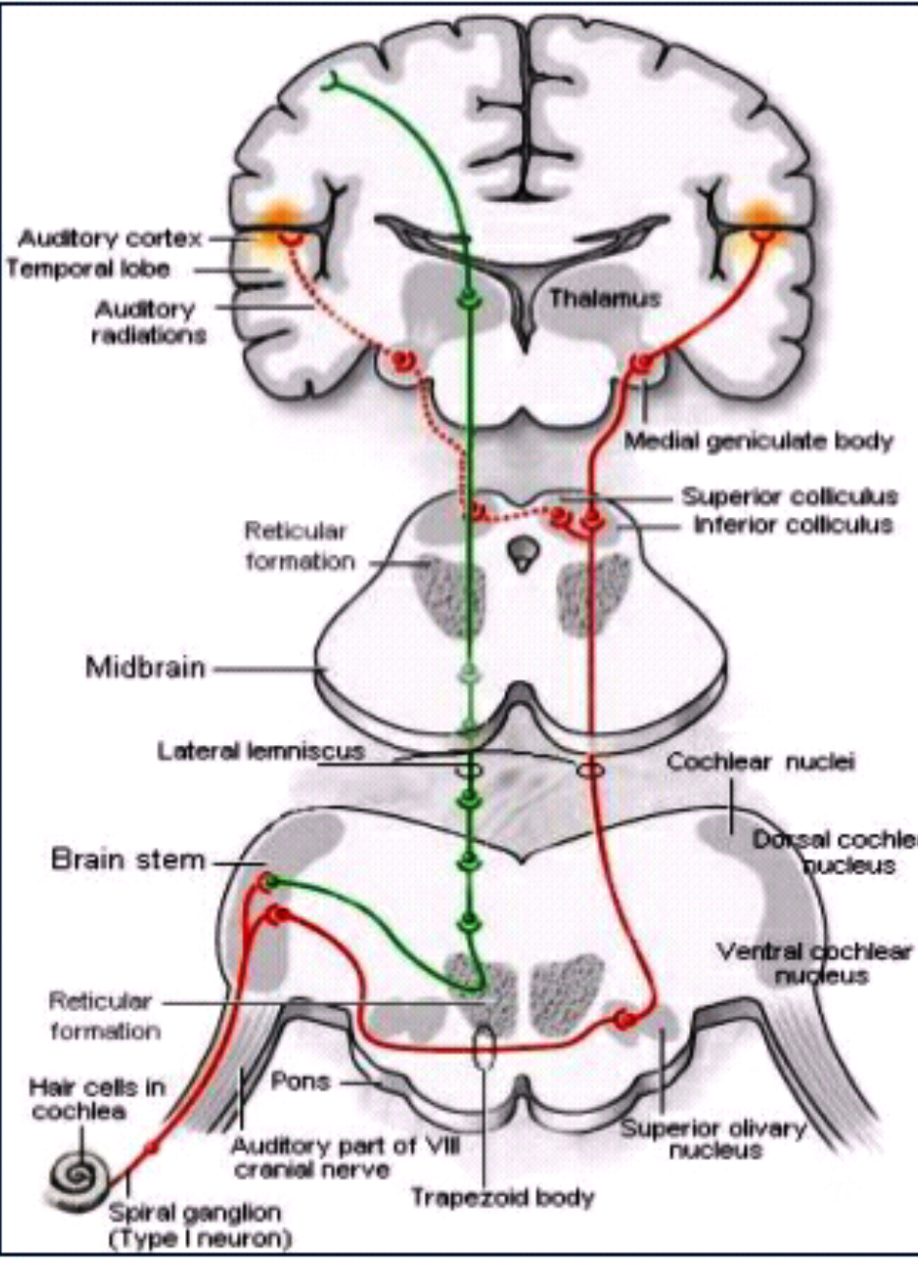
CENTRAL AUDITORY PATHWAY
Cochlear Nerve ( cochlea)
Cochlear Nucleus (Brain stem)
Auditory Nerve
Red Green
Ventral Dorsal
Cochlear Nucleus Nucleus

Slide 44
Ventral Dorsal
Nucleus Nucleus
Superior Thalamus &
Colliculus & Cortex
Inferior Colliculus Minute differences in
through Lateral lemniscus timing & loudness in
Then to theMedial Geniculate each ear is localised
body by Dorsal cochlear
Nucleus
Auditory cortex
Temporal lobe)
Efferents are derived from the Superior colliculus and make direct connection with Outer hair cells..

Slide 45
ELECTRICAL POTENTIALS OF COCHLEA & CN 8
FROM COCHLEA
1) ENDOCOCHLEAR POTENTIAL - direct current potential recorded from scala media. Generated by stria vasularis by Na K ATPase pump. Provides energy for cochlear transduction. Even present at rest, do not require stimulus.
2) COCHLEAR MICROPHONIC – when basilar membrane moves in response to sound stimulus, electrical resistance at tips of hair cells changes- allowing flow of K+ through hair cells & produces voltage fluctuation called cochlear microphonics.
3) SUMMATING POTENTIAL – DC potential produced by hair cells. May be –ve or + ve. It is superimposed on CN 8 Action potential.
FROM CN 8 FIBRES
4) COMPOND ACTION POTENTIAL - all or none response of auditory nerve fibres.

Slide 46
Theories of hearing
1) PLACE THEORY (HELMHOLTZ)
Also known as resonance theory. Helmholtz proposed that basilar membrane was constructed of different segments, that resonated in response to different frequencies.
Pitch reception of sound depends upon a separate vibration point on basilar membrane for each frequency.

Slide 47
2) TELEPHONE THEORY
According to this theory, the discrimination of pitch depends upon the rate of firing of individual nerve fibres & frequency is analysed by central nervous system.
Here the sounds of all frequencies are transmitted as in telephone cable & frequency analysis is performed at higher level(brain)

Slide 48
3) VOLLEY THEORY OF WEVER
Combination of both place and telephone theories.
According to this theory, higher frequencies are perceived by place mechanism , lower frequencies by telephone mechanism.

Slide 49
4) TRAVELLING WAVE THEORY (VON BEKESY)
This work of Von Bekesy was awarded nobel prize.
Sound waves starting at the oval window produce vibrations which travel along the basilar membrane.
As the wave moves along the membrane, its amplitude increases until it reaches a maximum and then falls off sharply until the wave dies out.
That point at which the wave reaches the greatest amplitude is the point at which frequency of sound is detected by ear. Higher frequencies are represented at the base of the cochlea, lower frequencies at apex.

Slide 50
THANK YOU

