Slide 1
Styloid apparatus

Slide 2
Learnig outcomes
Define styloid apparatus
List the components of styloid apparatus
Knowledge of realatios of other surrounding structures with this
anatomical landmark

Slide 3
The styloid process
The styloid process is a deeply placed spike-like bone that projects downward and forward from a site on the skull just lateral to the jugular foramen.
The styloid process is 2 to 3 cm in length and ends deep to the back edge of the mandibular ramus at its midpoint.

Slide 4
3 muscles & 2 ligaments
Styloglossus muscle
Stylohoid muscle
Stylophryngeus muscle.
Stylohoid ligament
Stylomandibular ligament

Slide 5
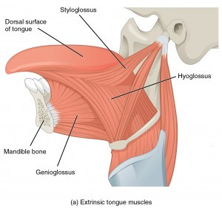

Slide 6
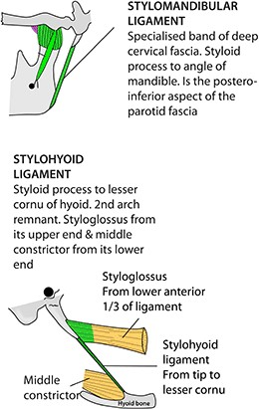

Slide 7
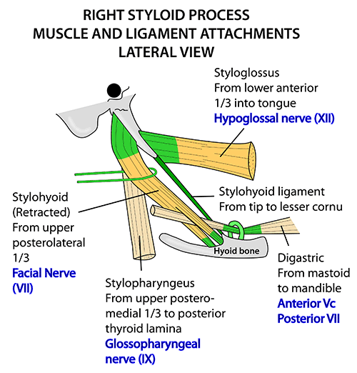

Slide 8
Styloglossus muscle
Arises from tip of styloid process, runs downwards & forwards to insert into whole length of side of tongue
( intermingling with vertical fibres of hyuoglossus
N.S. CNXII, hypoglossal nerve

Slide 9
Stylohoid muscle
Arises from middle of styloid process & is inserted into hyoid bone at junction of body & greater horn.
It is closely related to posterior belly of digastric.
NS CNVII, facial nerve

Slide 10
Stylopharyngeus muscle
Longest of three muscles; it arises from medial side of base of styloid process & descends to insert on to posterior border of lamina of thyroid cartilage.
NS: CN. IX , glossopharyngeal nerve.

Slide 11
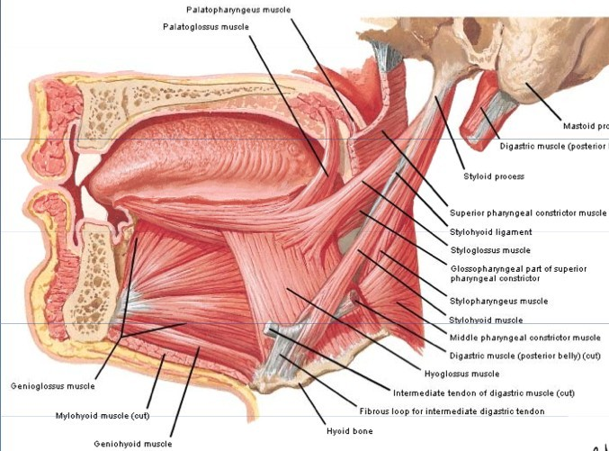

Slide 12
ACTIONS
Styloglossus muscle: It draws tongue backwards(retract tongue)
Stylohoid muscle:raises hyoid bone upwards
Stylophryngeus muscle: lifts larynx during swallowing & phonation

Slide 13
The styloid process, stylohyoid ligament, lesser cornu, and superior half of the body of the hyoid bone are all skeletal derivatives of the 2nd branchial arch.
The greater cornu and inferior half of the hyoid body are derivatives of the 3rd branchial arch.

Slide 14
Ligaments
Attached to styloid prcess
Stylohoid ligament: from tip of styloid process to whole length of hyoid bone.
The periosteum of the styloid process is continued beyond that structure, maintaining its forward and downward course, to reach the periosteum of the lesser horn of the hyoid bone. This connective tissue band linking the tip of the styloid process to the hyoid bone is called the stylohyoid ligament It may partially ossify.
Stylomandibular ligament: from styloid process to posterior border of ramus of mandible above its angle.

Slide 15
Other structures related to styloid process
The parotid gland:
covers it superficially.
The facial nerve:
crosses lateral surface of its root.
The external carotid artery:
lies superficial to it.
The internal carotid artery:

