Slide 1
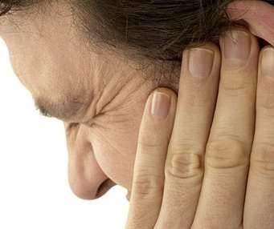
Tinnitus

Slide 2

Definition
Tinnitus is the description of a noise inside a person’s head in the absence of auditory stimulation.
Tinnitus is not a disease, but a condition that can result from a wide range of underlying causes.

Slide 3


Types of tinnitus

Slide 4

Causes
Ear problems
Neurological disorders
Psychiatric disorders
Metabolic disorders
Miscellaneous

Slide 5
Category | Conditions Associated
Ear Problems | Conductive : otitis externa, acoustic shock, noise induced, cerumen impaction, middle ear effusion, superior canal dehiscence Sensorineural : Noise induced, presbycusis, Ménière's disease, acoustic neuroma, mercury or lead poisoning, Ototoxic medications
Neurological Conditions | Arnold–Chiari malformation, multiple sclerosis, head injury ( skull fracture, closed head injury, whiplash injury, temporomandibular joint dysfunction, giant cell arteritis )
Metabolic disorders | Thyroid disease, Hyperlipidemia, vitamin B₁₂ deficiency, iron deficiency anemia
Psychiatric disorders | Depression, Anxiety
Miscellaneous | Fibromyalgia, vasculitis, hypertonia, thoracic outlet syndrome, Lyme disease, migraine, glomus tumor, anthrax vaccines, Some psychedelic drugs, benzodiazepine withdrawal, nasal congestion, intracranial hyper or hypotension

Slide 6
Evaluation
Diagnosis
Severity
Auditory Evoked Responses

Slide 7
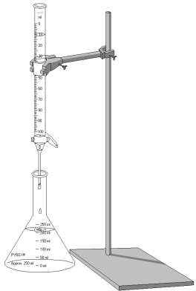
Diagnosis
Subjective vs Objective ??
Severity
Validated self report questionnaires
AERs

Slide 8

Management
Modes
Psychotherapy and Reassurance
Relaxation and biofeedback techniques
Sedation and pharmacotherapy
Masking manouvers and devices

Slide 9
Psychotherapy and reassurance
First line therapy for patients with subjective form.
Psychological counselling may help.
Biofeedback techniques
Biofeedback is a relaxation technique that teaches people to control certain autonomic body functions, such as pulse, muscle tension, and skin temperature. The goal of biofeedback is to help people manage stress in their lives not by reducing
the stress but by changing the body’s reaction to it.

Slide 10

Pharmacotherapy
Acute tinnitus
Systemic Delivery
Corticosteroids
Rheological therapy
Nootropics
Lidocaine
Local Therapy
Topical Corticosteroids
Chronic tinnitus
Antidepressants
Anticonvulsants
Glutamate receptor antagonists (Caroverine)

Slide 11

Others
Misoprostol
Betahistine
Nimlodipine
Furosemide
Pramipexole
Zinc
Vitamin tablets
Antihistamines
Antioxidants ( Ginkgo biloba )
Botulinum toxin and so on…….

Slide 12
Other modalities of treatment
HBO therapy
Sound therapy devices
Tinnitus retraining therapy
Maskers
Noise Generators
Hearing Aids
Tinnitus instruments
Cognitive Behavior therapy
Music Therapy

Slide 13
Recent Advances
Acoustic Coordinated Reset Neuromodulation
Magnetic and Electrical Brain stimulation

Slide 14
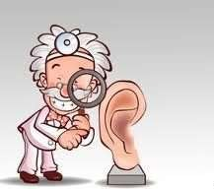
Thank You

