Slide 1
TUMOURS OF EXTERNAL EAR
Notes:
- S.DINESH PONRAJ
’47’BATCH

Slide 3
CLASSIFICATION OF EXTERNAL EAR TUMOURS
TUMOURS OF AURICLE
Benign tumours
Malignant tumours
TUMOURS OF EXTERNAL AUDITORY CANAL
Benign tumours
Malignant tumours

Slide 4
BENIGN TUMOURS OF AURICLE
Pre Auricular Cyst
Sebaceous Cyst
Dermoid Cyst
Papilloma
Keloid
Keratoacanthoma
Nuerofibroma

Slide 5
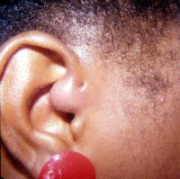
PRE AURICULAR CYST
Faulty union of Hillocks of 1st and 2nd branchial arches
Presentation-often as an infected cyst

Slide 6
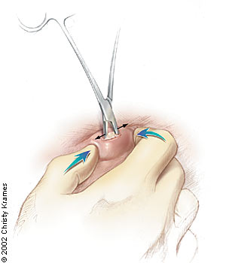
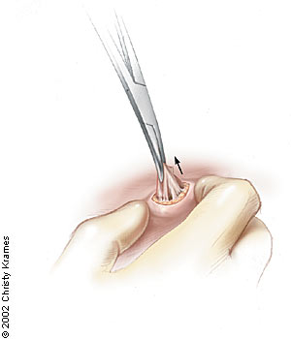
Management-surgical excision if unsightly swelling

Slide 7
SEBACEOUS CYST
Site-post auricular sulcus,behind the lobule
Benign lesion
Management-
non-infected : removal,patients choice
infected :antibiotics+surgery

Slide 8
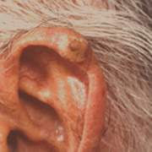
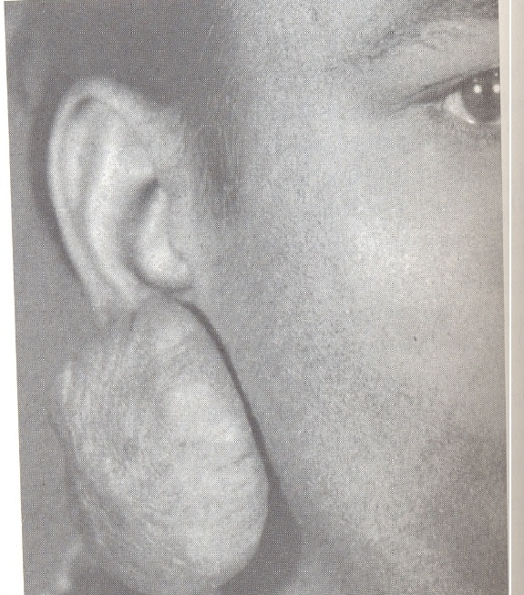
KELOID
Pedunculated tumour
Causes-
trauma-ear piercing instruments
surgical incision

Slide 9
MANAGEMENT
surgical removal
corticosteroids
cryosurgery
interferon medicines
laser surgery
radiation therapy
silicone gel dressings

Slide 10
HEMANGIOMA
Congenital tumours seen in childhood
Types
cavernous hemangioma
capillary hemangioma
self regressive and disappears by 5 years of age

Slide 11
MALIGNANT TUMOURS OF AURICLE
SQUAMOUS CELL CARCINOMA
BASAL CELL CARCINOMA
MALIGNANT MELANOMA

Slide 12
Principles of managing
Investigations-Biopsy
Surgical Removal
Sometimes Radiation following Surgery

Slide 13
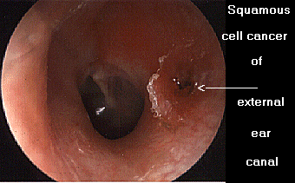
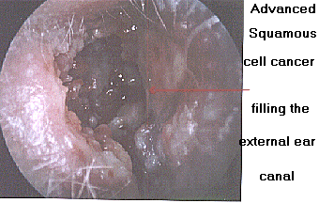
SQUAMOUS CELL CARCINOMA
Site-Helix
Presented as-painless nodule,with raised edges everted edges
Metastasis-Regional Lymph nodes

Slide 14
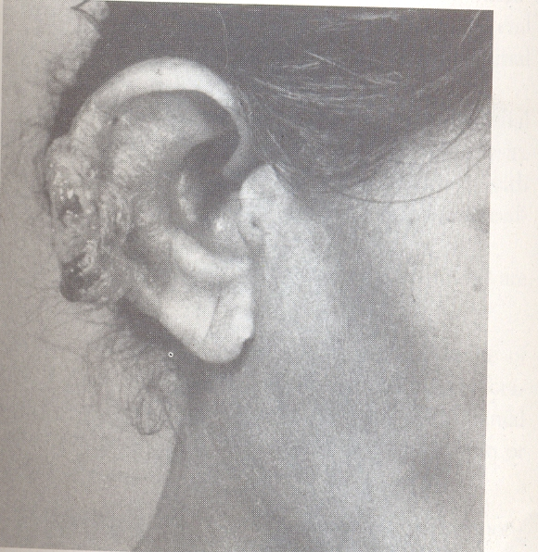
SQUAMOUS CELL TUMOUR

Slide 15
Management
Investigation-Biopsy picture shall show keratin pearl appearance
Surgical treatment
Non deep seated-skin of ear canal removed
Deep seated-underlying bone drilled
If near the ear drum-along with skin,bone,ear drum removed
Radiation Therapy

Slide 16
BASAL CELL CARCINOMA
Site-Helix and Tragus
Presented as-Nodule with a central crust
Metastasis- Lymph node involvement Uncommon

Slide 17
MANAGEMENT
Investigations-Biopsy
picture shows downward proliferation of cells
Surgical Treatment
wide local excision
insuffecient excision?- recuurence
split skin graft

Slide 18
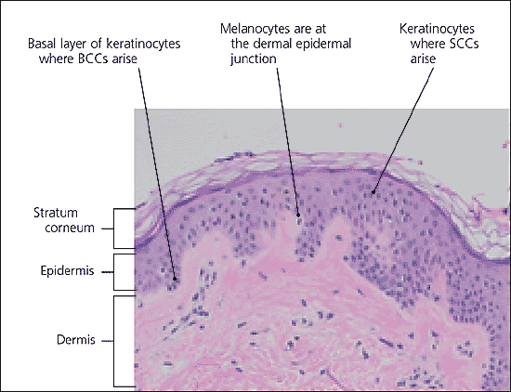

Slide 19
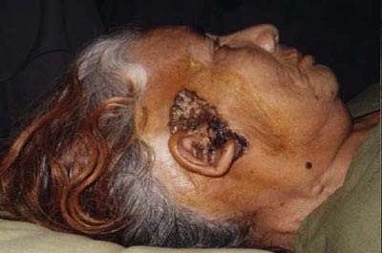

Slide 20
MALIGNANT MELANOMA
Fastest growing tumour
Site-confirmed to auricle
Presented as-locally infiltrative
Metastasis-Pre-auricular,post-auricular
and post cervical sections

Slide 21
MANAGEMENT
Investigations-Biopsy
-tissue of more than 1mm obtained
-horizontal sections made for study
-sentinentel lymph node biopsy
Surgical treatment
Superficial melanoma less than1cm
-Wedge resection
Superficial melanoma more than 1cm
-parotidectomy,pinna resection

Slide 22
TUMOURS OF EXTERNAL AUDITORY CANAL
BENIGN TUMOURS
Osteoma
Ceruminoma
Sebaceous adenoma
MALIGNANT TUMOURS
Squamous cell Carcinoma
Basal cell Carcinoma
Ceruminoma
Malignant Melanoma

Slide 23
OSTEOMA
Arises from cancellous bone
Presented as-Single smooth,bony hard,
pedunculated mass.
Treatment – surgical removal by fracturing
its pedicle or removal with
a drill.

Slide 24
CERUMINOMA
Tumour of modified sweat glands(apocrine glands)
Presented as-Smooth,firm,skin covering
polypoid swelling in the outer
part of the meatus.
Treatment-Wide surgical excision with
regular follow up

Slide 25
EXOSTOSES
Arises from the compact bone
Presented as-Multiple,Bilateral,smooth,
sessile,bony swelling in the
deeper part of the meatus.
Treatment-Small mass : asymptomatic
Large mass : high speed drill
removal
During surgeries avoid use of gouge and hammer
as exostoses may extend deeply and lie close to Facial Nerve

Slide 26
SQUAMOUS CELL CARCINOMA
Most often seen in long standing ear discharge
Arises from the meatus
Metastasis-preauricular,postauricular,
infraauricular lymph nodes.
Treatment-en bloc wide surgical excision
-followed by radiation

Slide 27
CERUMINOMA
MALIGNANT TUMOUR TWICE COMMON THAH THE BENIGN ONES.
Presented as-polypoidal swelling,attatched
to posterior wall
RATIO OF MALIGNANT TO BENIGN
2:1

Slide 28
MALIGNANT MELANOMA
RARE TUMOUR TO OCCUR

Slide 29
PINNA RECONSTRUCTION
Pinna Reconstruction a unique area of plastic surgery of cosmetic importance
Reconstruction is a combination of Science and art.
-those without loss of tissues
-those with discrete loss of tissues

Slide 30
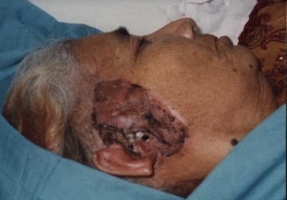
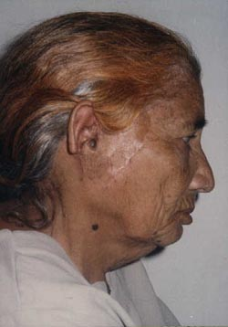

Slide 31

THANK YOU

