Slide 1
Tonsils and Adenoids

Slide 2
Definition
Palatine tonsils are dense compact bodies of lymphoid tissue located in the lateral wall of the oropharynx, bounded by the palatoglossus muscle anteriorly and the palatopharyngeus and superior constrictor muscles

Slide 3
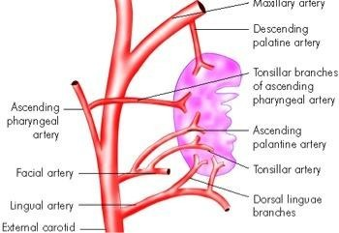
Arterial supply of tonsils

Slide 4
Venous drainage
– Para tonsillar vein → pharyngeal
venous plexus → internal jugular vein
Lymphatic drainage
  Jugulo- digastric lymph node of Woods
Nerve supply
  Glossopharyngeal nerve and lesser palatine nerve

Slide 5
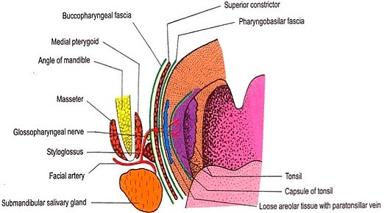
Relations of tonsillar bed

Slide 6
Relations of tonsillar bed (Inside out)
Tonsillar capsule
Peritonsillar space with paratonsillar vein
Pharyngobasilar fascia , Superior
constrictor fascia
4.Styloid
muscle, Bucco-pharyngeal
process,
muscles,
glossopharyngeal nerve

Slide 7
Differences between tonsils and lymph node
Tonsils | Lymph Nodes
Subepithelial | Connective Tissue
Partly encapsulated | Fully encapsulated
Efferent only | Afferent + Efferent
Crypts present | Absent
No cortex or medulla | Present
Growth curve present | Absent

Slide 8
Differences between adenoids and Tonsils
Adenoids | Tonsils
Ciliated columnar epithelium | Non-keratinizing squamous epithelium
No capsule | Partly encapsulated
Has furrows | Has crypts
Peak growth : 6 yrs | 8 yrs
Growth stops at 12 yrs | 15 yrs
Disappears at 20 yrs | Partial regression at 18 yrs

Slide 9
Acute tonsillitis
Classification
Superficial / catarrhal: as generalized pharyngitis
•
a part of
Follicular: Crypts filled with pus, visible as yellow-white dots
Membranous: Multiple follicles join to form a yellow-white membrane
Parenchymatous: Infection of lymphoid
•
•
•

Slide 10
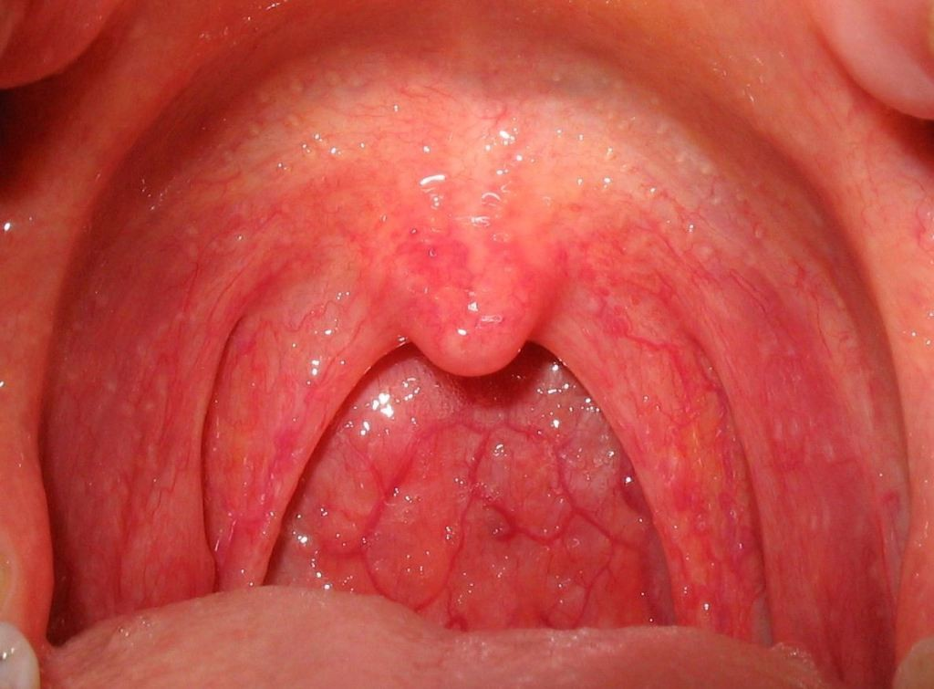
Superficial Tonsillitis

Slide 11
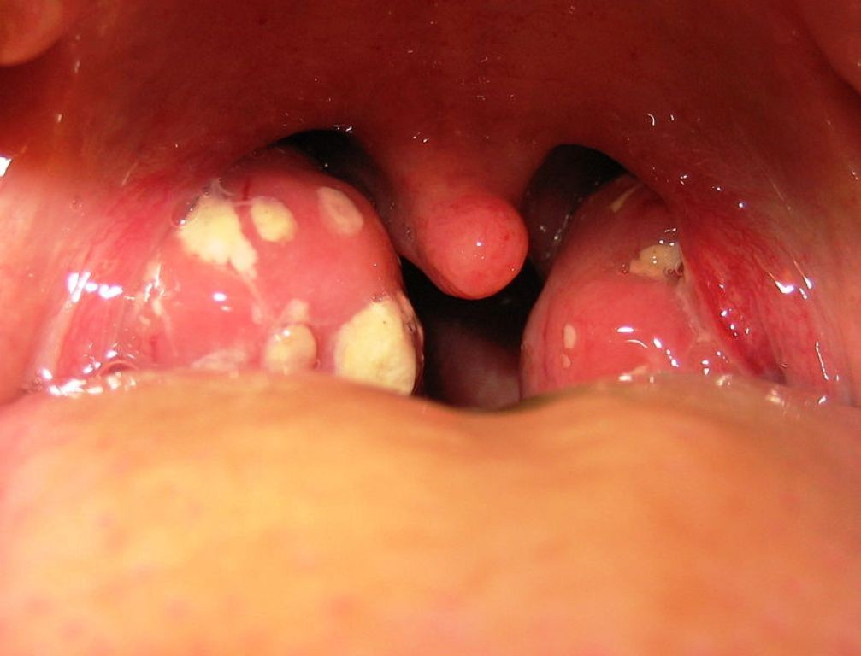
Follicular Tonsillitis

Slide 12
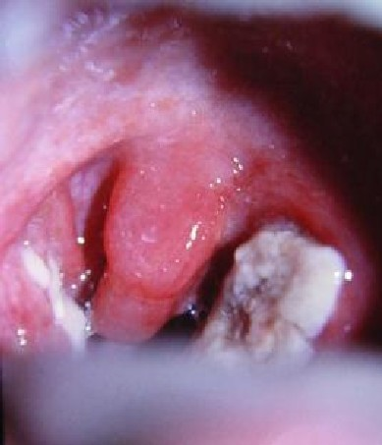
Membranous Tonsillitis

Slide 13
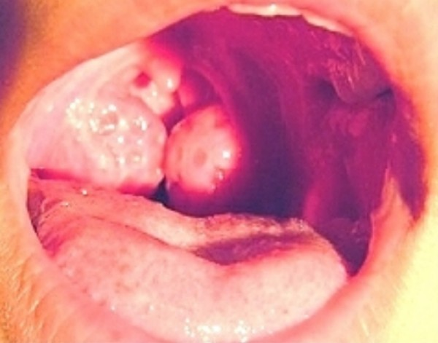
Parenchymatous tonsillitis

Slide 14
Types of chronic tonsillitis
Follicular: crypts filled with pus, visible as yellow-white dots
Parenchymatous: infection of lymphoid parenchyma → tonsil enlargement
Fibrotic: small tonsil with hidden pus inside, expressed by pressure on anterior tonsillar pillar (tonsillar squeeze)

Slide 15
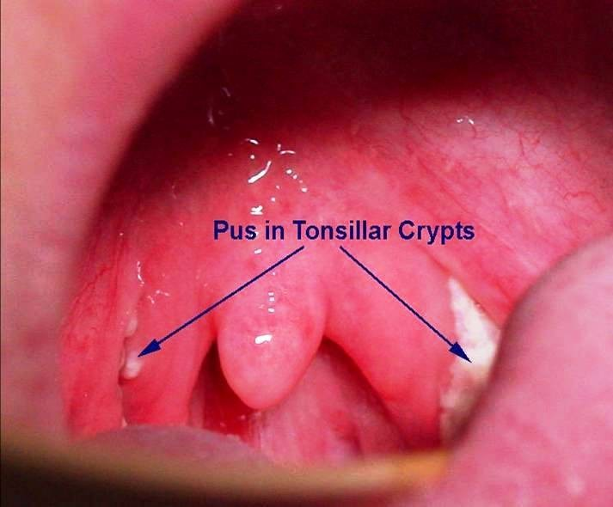
tonsillitis
Fibrotic

Slide 16
Signs of tonsillitis
Congested tonsil and tonsillar pillars
Enlarged tonsil (except chronic fibrotic type)
Tonsil squeezed by tongue depressor pressing on anterior tonsillar pillar → pus comes out in chronic fibrotic tonsillitis
(Irwin Moore sign)

Slide 17
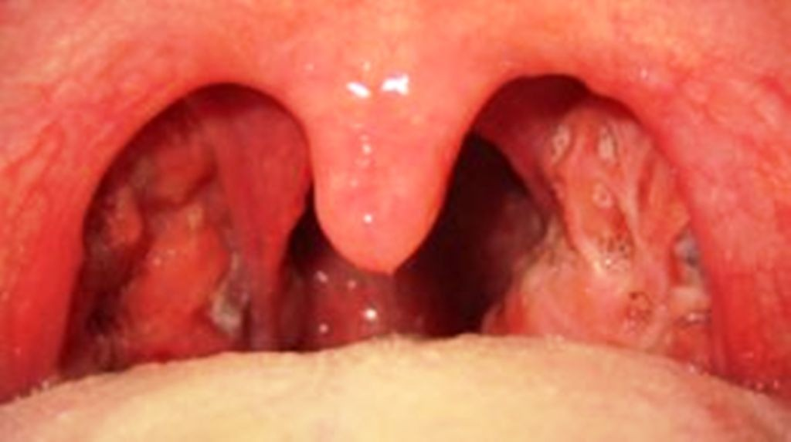
Grade 1 enlargement

Slide 18
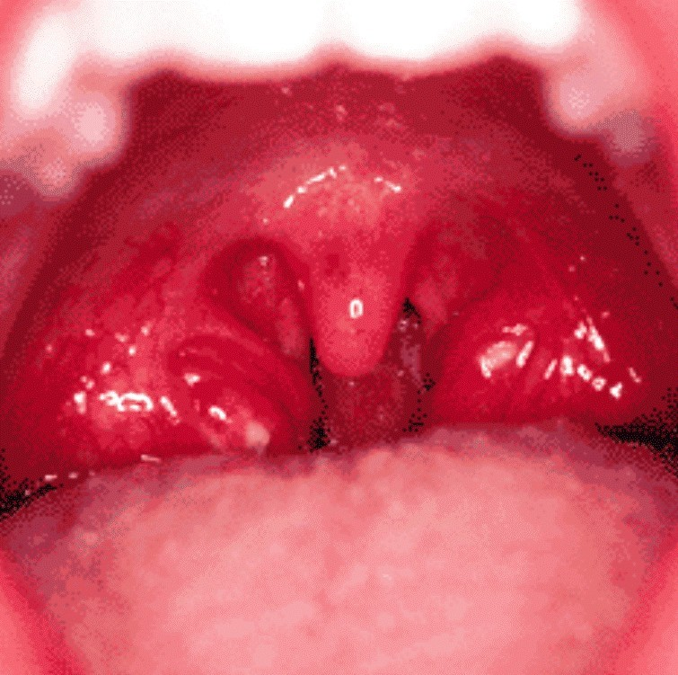
Grade 2 enlargement

Slide 19
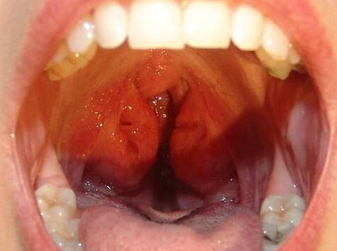
Grade 3 enlargement

Slide 20
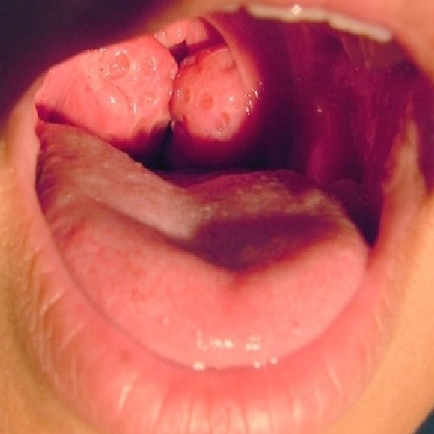
Grade 4 enlargement

Slide 21
Complications of acute tonsillitis
Local / locoregional
  Recurrent tonsillitis
  Intra- tonsillar abscess
Systemic
  Rheumatic fever
  Subacute
Peritonsillar (Quinsy)
Parapharyngeal abscess
Retropharyngeal abscess
Otitis media
bacterial endocarditis (SABE)
Glomerulonephri tis
Septicemia
abscess
– Suppurative cervical

Slide 22
Differential diagnosis of white patch on the tonsil
Membranous tonsillitis
Faucial diphtheria
Infectious mononucleosis (Mono spot test)
Candidiasis (throat swab → Candida albicans)
Vincent's angina (fusiform bacilli, spirochete)

Slide 23
Treatment of tonsillitis
Bed rest
Adequate hydration
Systemic antibiotics:
Antihistamines and decongestants
Analgesics
Antiseptic gargle
Treatment of focus of infection

Slide 24
Differenc es between | Membranous Tonsillitis | Diphtheria
Age | > 5 yr | 2- 5 yr
Onset | Acute | Insidious
General Symptoms | More | Less
Odynopha gia | More | Less
Temperatu re | High | Low
Tachycard ia | Proportionate | Disproportion ate
Tonsils | Enlarged, | Normal

Slide 25
Treatment of faucial diphtheria
Isolation and bed rest
I.V. benzyl penicillin 600 mg q6h
Diphtheritic anti - toxin infusion in saline
– 20,000 – 40, 000 U : ≤ 48 hrs duration, tonsillar
– 40,000 – 80, 000 U : nasopharynx / larynx
– 80,000 – 120, 000 U : ≥ 48 hrs, neck edema

Slide 26
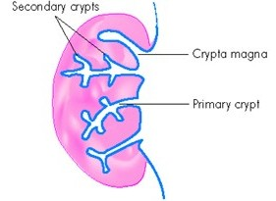
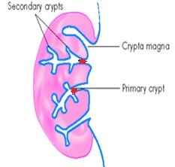
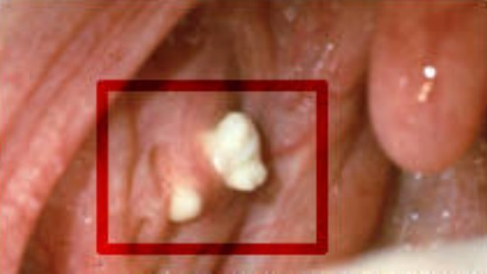
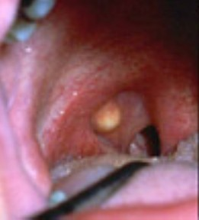
Tonsillolith and Tonsillar cyst
Recurrent tonsillitis / retention of debris
Blockage of tonsillar crypts
pus and debris
calcify
yellow colored
inclusion
tonsillar
Tonsillo
cyst
lith
cyst

Slide 27
Tonsillolith and Tonsillar cyst contd…...
Clinical features
  Halitosis, bitter taste in mouth
  White outgrowths from tonsillar crypts or yellow cyst in supra-tonsillar cleft
Treatment
  Asymptomatic → drainage of cyst or manual expression of tonsillolith
  Severe symptoms → tonsillectomy

Slide 28
Keratosis pharyngis
Benign , self limiting condition
Etiology
deficiency
O/E:
– Yellowish, horn-like outgrowths from mucosa of tonsil that cannot be wiped off
Histopathology :
: Smoking, alcohol, vitamin A

Slide 29
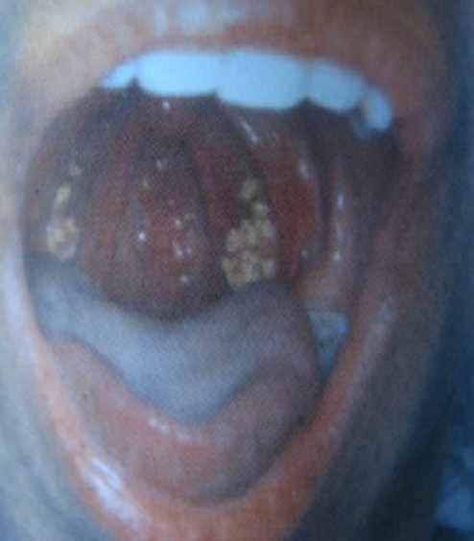
Keratosis pharyngis
Treatment:
  Reassurance
  Tonsillectomy in severe cases

Slide 30
D/D of Unilateral tonsillar enlargement
Extra-tonsillar causes
– Parapharyngeal
Tonsillar causes
  Tonsillar malignancy
  Peritonsillar abscess
Intra-tonsillar abscess
Tonsillolith
Tonsillar cyst
Tonsillar artery aneurysm
Vincent's angina
abscess
Parapharyngeal tumors
Tumors of deep parotid lobe
Internal carotid art.

Slide 31
Adenoids
Symptomatic, hypertrophic
nasopharyngeal (Luschka's) tonsils
Adenoids lead to
  Nasal obstruction ◊ Mouth breathing
  Eustachian tube block ◊ OME
Features like adenoids are also seen in
  Dental mal-occlusion
  B/L nasal block ( Nasal polyps, choanal atresia)

Slide 32
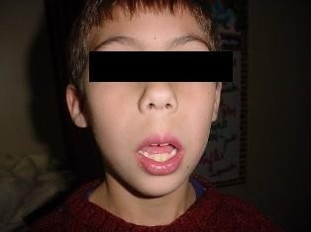
Adenoid facies

Slide 33
Features of nasal obstruction
  B/L nose block & nasal discharge
  Rhinolalia clausa (flat toneless voice)
  Difficulty in feeding
  Snoring
  Pulmonary hypertension
  Pinched nostrils (due to disuse atrophy)

Slide 34
Features of mouth breathing
– Open mouth, dribbling of saliva
High-arched palate action of tongue)
Crowding of teeth, protruding central incisor
Hitched upper lip (hare lip)
Under shot mandible
Chronic pharyngitis (by breathing impure air)
(d/t moulding

Slide 35
Features of Eustachian tube block
  Earache
  Conductive deafness (due to O.M.E.)
  Dull, expressionless look
  Inattentive child
Other Features
  Pectus excavatum
  Nocturnal enuresis

Slide 36
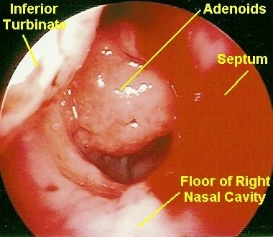
Nasopharyngoscopy

Slide 37
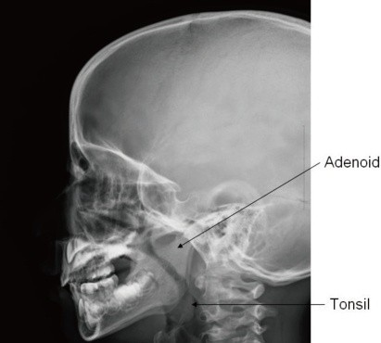
Plain X-ray soft tissue nasopharynx lateral view

Slide 38
Management
Diagnosis
  Nasopharyngoscopy → rigid / flexible
  Plain X–ray soft tissue nasopharynx lateral view with head extended → adenoid mass
Treatment
  Mild symptoms → antihistamine +

