Slide 1
MIDDLE EAR TUMOURS

Slide 2
BENIGN TUMOURS
GLOMUS TUMOUR
BENIGN, SLOW GROWING AND VASCULAR TUMOURS
ARISING FROM ‘GLOMUS BODIES’
JUGULAR BULB, HYPOTYMPANUM, PROMONTORY AND ALONG THE TYMPANIC PLEXUS.
TWO TYPES : 1. GLOMUS JUGULARE
2. GLOMUS TYMPANICUM

Slide 3
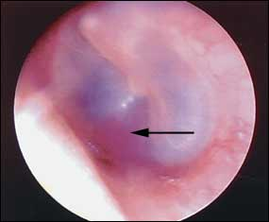
INVESTIGATIONS
OTOSCOPY
INTACT TYMPANIC MEMBRANE – PINKISH MASS IS SEEN
BROWN’S SIGN
POLYP

Slide 4
DIAGNOSIS
HISTORY & PHYSICAL EXAMINATION
PLAIN X – RAYS ( JUGULAR FORAMEN VIEW )
CT SCAN – HEAD – PHELPS’ SIGN
MRI
MAGENETIC RESONANCE ANGIOGRAPHY & VENOGRAPHY

Slide 5
BRAIN PERFORATION STUDIES
ADEQUENCY OF CONTRALATERAL ICA
CIRCLE OF WILLIS ASSESMENT
BIOPSY – “NOT DONE”

Slide 6
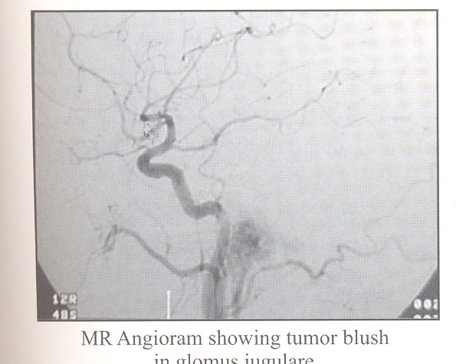

Slide 7
DIFFERENTIAL DIAGNOSIS
INFLAMATORY AURAL POLYP
HAEMANGIOMA
HIGH DOME OF IJV
CP ANGLE
NASOPHARYNGEAL TUMOUR EXTENDING INTO MIDDLE EAR

Slide 8
OLDRING AND FISCH CLASSIFICATION OF GLOMUS TUMOURS
TYPE A – LOCALIZED TO MIDDLE EAR CLEFT ( GLOMUS TYMPANICUM )
TYPE B - TYMPANO – MASTOID TUMOURS WITH NO DESTRUCTION OF BONE IN INFRALABYRINTHINE COMPARTMENT
TYPE C – TUMOURS INVADING INFRALABYRINTHINE REGION
TYPE D - INTRACRANIAL EXTENTION

Slide 9
TREATMENT
1.SURGERY
TYPE A - TRANS MEATAL APPROACH AND EXCISION
TYPE B - EXTENDED FACIAL RECESS APPROACH
TYPE C - FISCH INFRATEMPORAL FOSSA APPROACH ( LATERAL APPROACH )
TYPE D - SKULL BASE APPROACH AND POSTERIOR FOSSA CRANIOTOMY

Slide 10
COMPLICATIONS OF SURGERY
PERSISTANT LEAKAGE OF CSF FROM EAR
PALSY OF ONE OF CRANIAL NERVE.

Slide 11
2.RADIOTHERAPY
DOESN’T CURE THE TUMOUR
REDUCE ITS VASCULARITY
ARRESTS ITS GROWTH
TREAT OF CHOICE FOR INOPERABLE, RESIDUAL & RECURRENCES OF TUMOUR AFTER SURGERY.

Slide 12
3.EMBOLISATION
REDUCE VASCULAITY OF TUMOUR BEFORE SURGERY
SOLE TREAT IN INOPERABLE PTS WHO RECEIVED RADIOTHERAPY.
COMPLICATIONS
SWELLING OF TUMOUR
RELEASE OF CATECHOLAMINE

Slide 13
ADENOMA:-
BENIGN GLANDULAR TUMOUR
DIAGNOSIS:-
CT SCAN – SOFT TISSUE MIDDLE EAR & MASTOID MASS WITHOUT ASSOCIATED BONY DESTRUCTION.
RARELY DIAGNOSED PREOPERATIVELY
HISTOPATHOLOGY – ACINAR, SOLID, TRABACULAR & CARCINOID LIKE FEATURES
TREATMENT
COMPLETE SURGICAL EXCISION

Slide 14
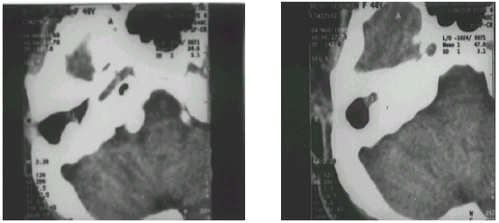

Slide 15
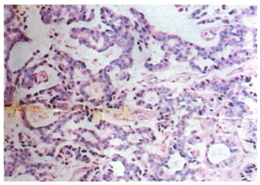

Slide 16
HEMENGIOMA
BENIGN VASCULAR TUMOUR
DIAGNOSIS
HIGH RESOLUCTION CT SCAN
MRI – ALL TUMOUR OF INTERNAL AUDITORY CANAL & SOME TUMOUR NEAR THE GENICULATE
HISTOPATHOLOGY EXAMINATION

Slide 17
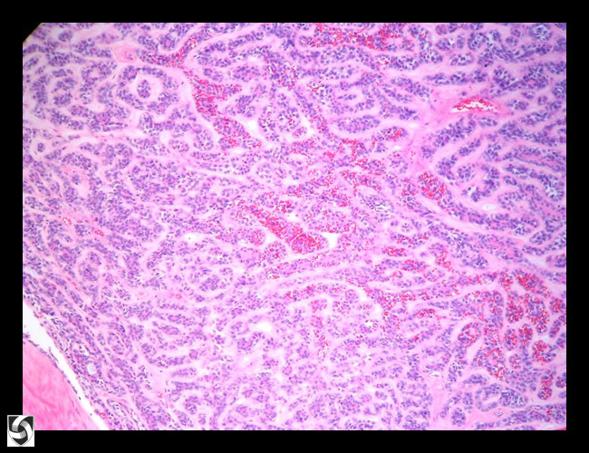

Slide 18
TREATMENT
SURGICAL EXCISION
APPROACH – MIDDLE FOSSA
TRANSMASTOID
TRANSLABYRINTHINE
INTRATEMPORAL FACIAL GRAFTING

Slide 19
OSTEOMA
VERY RARE BENIGN TUMOUR
DIAGNOSIS
CT SCAN – CONFIRMATORY
TREATMENT
ASYMPTOMATIC OSTEOMA – MANAGED WITHOUT REMOVAL.
TYMPANOMASTOIDECTOMY

Slide 20
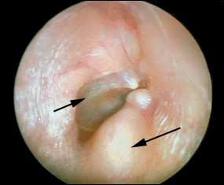

Slide 21
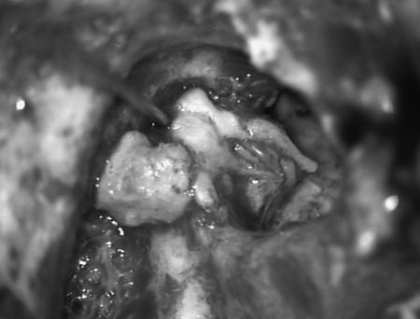

Slide 22
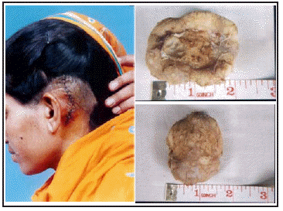

Slide 23
MALIGNANT TUMOUR
SQUAMOUS CELL CARCINOMA
COMMENEST OF ALL MALIGNANT MIDDLE EAR TUMOURS
CHRONIC IRRITATION – CAUSATIVE FACTOR
ORIGIN : PRIMARILY FROM MIDDLE EAR OR EXTENSION OF CARCINOMA OF THE DEEP MEATUS.
DESTROYS OSSICLES, FACIAL CANAL, INTERNAL EAR, JUGULAR BULB, DEEP BONY MEATUS AND MASTOID.

Slide 24
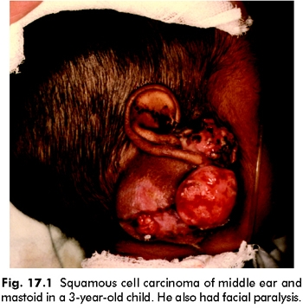

Slide 25
DIAGNOSIS
BIOPSY – ONLY DEFINITIVE DIAGNOSIS
CLINICAL & RADIOLOGICAL EXAMINATION
CT SCAN
ANGIOGRAPHY
TREATMENT
SURGICAL TREATMENT
RADICAL MASTOIDECTONY
SUBTOTAL (OF ) TOTAL PETROSECTOMY

Slide 26
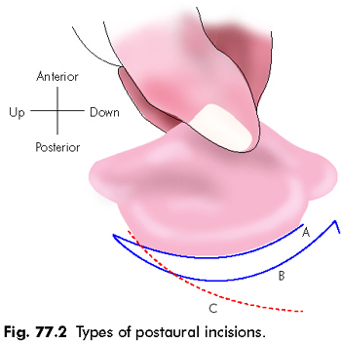
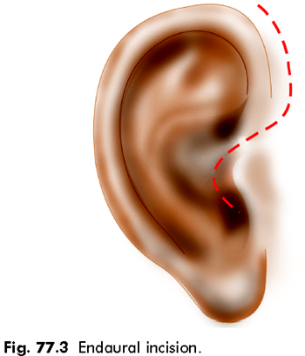

Slide 27
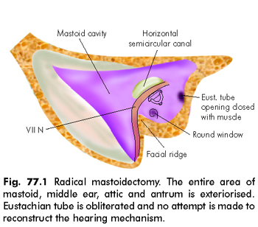

Slide 28
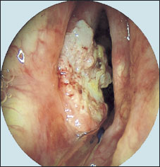

Slide 29
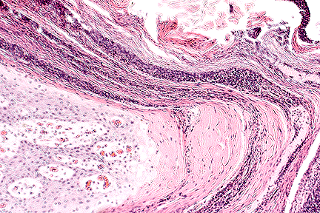

Slide 30
RADIOTHERAPY
PALLIATIVE TREATMENT
INVOLVEMENT OF IX AND XII CRANIAL NERVE
SPREAD INTO CRANIAL CAVITY OR NASOPHARYNX.

Slide 31
SARCOMA – RHABDOMYOSARCOMA
RARE MALIGNANT TUMOUR
MOSTLY AFFECT CHILDRENS
DIAGNOSIS
ONLY ON BIOPSY
PROGNOSIS –POOR.
TREATMENT
COMBINATION OF RADIOTHERAPY AND CHEMOTHERAPY
SURGERY – DONE ONLY IN SELECTED LOCALISED LESIONS.

Slide 32
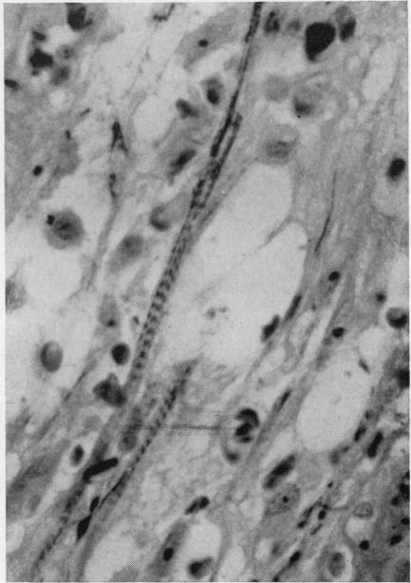

Slide 33
ADENOCARCINOMA
VERY RARE MALGNANT TUMOURS
MICROSCOPY – RESEMBLES ADENOMA
TREATMENT
SURGERY – RADICAL SURGERY

