Slide 1





Slide 2


JUVENILE NASOPHARYNGEAL ANGIOFIBROMA
It is a benign tumor of nasopharynx
Exact etiology is not known
It is a rare tumor
Seen in adolescent males in 2nd decade of life (most commonly at age of 14 years with range 7-19 years)
Its growth is thought to be testosterone dependent

Slide 3

PATHOGENESIS
Ringertz (1938): inequalities in growth of skull bones
result in hypertrophy of underlying periosteum in response to hormonal influence
Ewing (1941): arises from embrygenic fibro-cartilage between basi-occiput and basi-sphenoid
Burner (1942): suggested origin from conjoined pharyngo-basilar and bucco-pharyngeal fascia
Osborn (1973): either from hamartomas or fetal erectile tissue→ hormonal influence
Girgis (1973): undifferentiated epithelial cells→ linked to paraganglianomas

Slide 4

Origin of tumor: still now it is a matter of debate→ it is believed to arise from the posterior part of nasal cavity close to the superior margin of sphenopalatine foramen
Pathology: Gross→ firm, lobulated, pink to white.
It has no capsule
Microscopy→ composed of vascular spaces of varying sizes and shape. It contains fibrous stroma, thin walled sinusoids, lined by flattened epithelium absent muscular coat

Slide 5

 Extension of the tumor- it is benign and locally invasive
Nasal cavity: causes obstruction, epistaxis, nasal discharge
Paranasal sinuses
Pterygo-maxillary fissure, infratemporal fossa
May involve orbit including inferior and superior orbital fissures
Cranial cavity: middle fossa commonly involved through erosion of foramen lacerum. Tumor lies lateral to carotid artery, cavernous sinus
It may extend to sphenoid sinus into sella tursica where it lies medial to carotid artery
May extend to anterior cranial fossa through ethmoidal roof or cribriform plate

Slide 6

CLINICAL FEATURES
Age/sex: 14-19 year/male
Most commonly patient presents with recurrent epistaxis or profuse epistaxis
Progressive nasal obstruction
Conductive hearing loss: SOM
Mass in nasopharynx on examination which is sessile, smooth, lobulated, pink or whitish, firm (should not be palpated)
Broadening of nasal bridge, proptosis, cheek swelling, infra-temporal involvement, II to VI nerves involvement

Slide 7

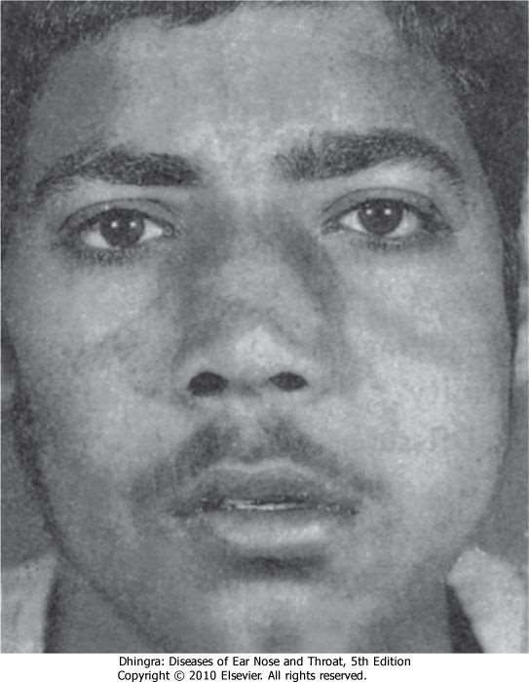

Slide 8

INVESTIGATIONS
X-ray: soft tissue lateral view of nasopharynx, paranasal sinuses, skull base
CT/MRI: anterior bowing of posterior wall of maxillary sinus, erosion of sphenoid sinus and greater wing of sphenoid, extension into pterygopalatine and infra-temporal fossa
Angiography (digital subtraction angiography) of carotid artery
Biopsy is no longer justifiable

Slide 9

DIAGNOSIS
It is mostly based on clinical picture.
Biopsy of the tumour is attended with profuse bleeding and is therefore, avoided. If it is essential to differentiate it from other tumours, biopsy can be done under general anaesthesia with all arrangements to control bleeding and transfuse blood.

Slide 10

DIFFERENTIAL DIAGNOSIS
(diagnosis is rarely doubtful)
Antro - choanal polyps
Large adenoid
Chondromas

Slide 11

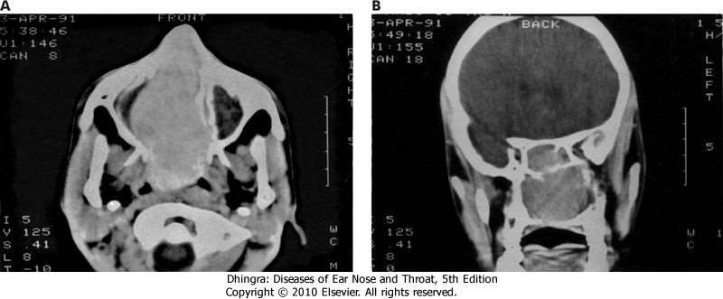

Slide 12

TREATMENT
only surgical
Various surgical approaches depending on origin and extension
Trans-palatal
Trans-palatal + sublabial approach (Sardana's approach)
Extended lateral rhinotomy
Via facial incision
Via degloving approach
Extended Denker's approach
Intracranial-extracranial
Infratemporal fossa
Endoscopic
Transmaxillary (Le Fort I approach)
Maxillary swing approach

Slide 13
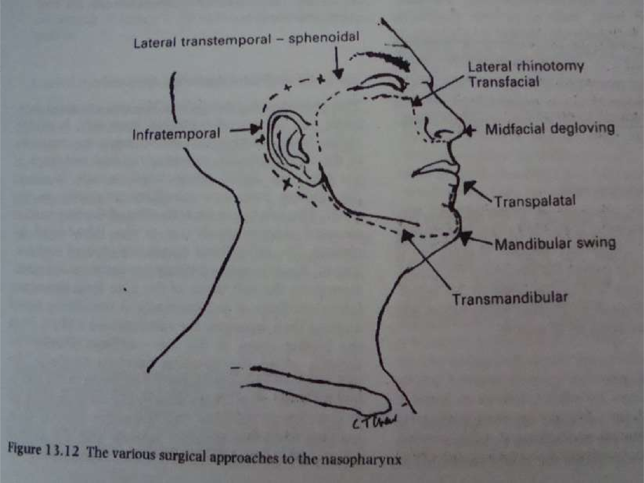


Slide 14

Hormonal Therapy can be given to reduce Vascularity of tumor pre-operatively
Stilbesterol 2.5mg TID for 3 weeks prior to surgery
Embolization of feeding vessels is done prior to surgery to reduce bleeding
Radiotherapy : used as a primary mode of treatment
dose of 3000 to 3500 cGy in 15-18 fractions is delivered in 3-3.5 weeks
Tumour regresses slowly in about a year, sometimes even up to 3 years
Also used for intracranial extension of disease when tumour derives its blood supply from the internal carotid system

Slide 15

Chemotherapy
For Recurrent and residual lesions
doxorubicin, vincristine and dacarbazine in combination.

Slide 16

OTHER BENIGN TUMORS OF NASOPHARYNX
Teratomas: seen at birth
Pleomorphic adenoma
Chordoma
Hamartoma (malformed normal tissue) →
haemangioma
Choristoma: mass of normal tissue in abnormal site
paraganglianomas

Slide 17


Slide 18

NASOPHARYNGEAL CARCINOMA
Incidence- common in china particularly in southern states and Taiwan. It is uncommon in India and constitutes 0.5% of all cancers
Incidence if nasopharyngeal cancer in china is 30- 50/100000 population
Sex: male: female = 2-3 : 1
Age: in Chinese risk starts by 15-19 yrs of age. Average age group is 25-64 years

Slide 19

Aetiology
Genetic: Chinese have higher genetic susceptibility (even in migrants)
Environmental: air pollution, smoking, nitrosamines from dry salted fish, smoke from burning incense and wood
Occupation: wood workers, foresters, welders, coal workers, metal workers are commonly effected
Viral: epstein-barr virus- Ig A is the serological marker. It is elevated months or years prior to the clinical onset
Epithelial tumor cells have intimate relation with T- lymphocytes which are CD-8 positive

Slide 20

NASOPHARYNGEAL CARCINOMA-NATURAL HISTORY
Inception
Genetic, environmental, viral factors
silent period
Systemic spread
Focal invasion
Blood stained mucus, ET
blockage
Parapha ryngeal, skull
Primary lymph node
base
Locoregional spread
station
retropharyngeal

Slide 21

HISTOPATHOLOGY
Squamous Cell Carcinoma
Well differentiated
Moderately differentiated
Poorly differentiated
Non-keratinizing carcinoma: transitional cell carcinoma
Undifferentiated carcinoma
Lymphoepithelioma
Anaplastic carcinoma
Spindle cell carcinoma
Clear cell carcinoma

Slide 22

Gross appearance:
1. Proliferative
When a polypoid tumour fills the nasopharynx, it causes obstructive nasal symptoms
2. Ulcerative
Epistaxis is the common symptom
3. Infiltrative
Growths infiltrate submucosally.
Commonest site: lateral wall, fossa of Rosenmuller

Slide 23

W.H.O CLASSIFICATION
Epithelial tumors: benign, malignant
Soft tissue: benign, malignant
Malignant lymphomas
Tumors of bone and cartilage
Miscellaneous tumors: benign and malignant
Secondary tumors
Tumor like lesions

Slide 24

WHO classification based on histopathology
 | Present WHO terminology | Former terminology
Type I (25%) | Squamous cell carcinoma | Squamous cell carcinoma
Type II (12%) | Non-keratinising carcinoma | Transitional cell carcinoma
 | - Without lymphoid stroma | Intermediate cell carcinoma
 | - With lymphoid stroma | Lymphoepithelial carcinoma (Regaud)
Type III (63%) | Undifferentiated carcinoma | Anaplastic carcinoma
 | - Without lymphoid stroma | Clear cell carcinoma
 | - With lymphoid stroma | Lymphoepithelial carcinoma (Schminke)
 |  | Spindle cell carcinoma

Slide 25

CLINICAL FEATURES
 Age: 50-70 years (in India) 35-64 years (in Chinese)
 Sex: M : F:: 2-3 : 1
Symptoms :
Nasal: obstruction, discharge, denasal speech, epistaxis
Otological: eustachian tube obstruction, conductive deafness, tinnitus, dizziness, otalgia

Slide 26

CLINICAL FEATURES
Ophthalmo-neurological:
VI nerve involvement results in squint and diplopia
III, IV, V nerve involvement results in ophthalmoplegia
facial nerve involvement results in absent corneal reflex, horner’s syndrome
Neck: painless lymph node most commonly jugulo- digastric, spinal accessory (posterior triange node)
Distant metastasis: thoraco lumbar spine, liver, lungs

Slide 27

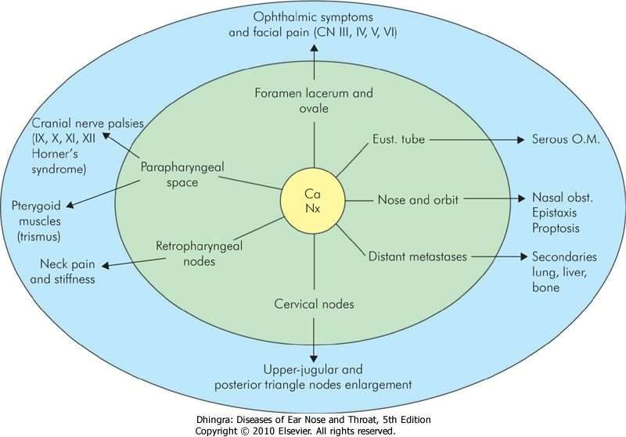

Slide 28

Presenting symptoms and signs of nasopharyngeal cancer in order of frequency are:
Cervical lymphadenopathy (most common) (60-90%)
Hearing loss
Nasal obstruction
Epistaxis
Cranial nerve palsies. CN VI paralysis is the most
common of these
Headache
Earache
Neck pain
Weight loss.

Slide 29

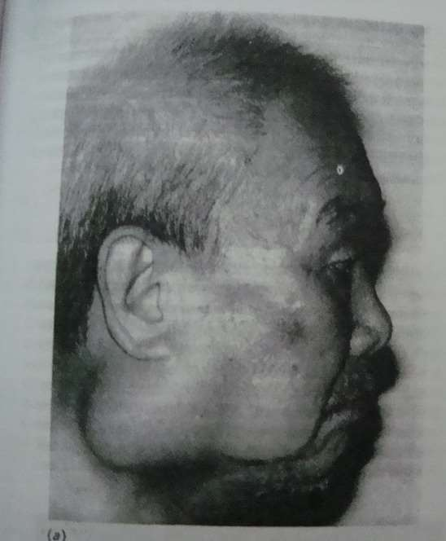

Slide 30

DIAGNOSIS
Posterior rhinoscopy
Fibro-optic endoscopy
Rigid endoscope
Examination under general anaesthesia
Biopsy
X-ray skull
CT- scan

Slide 31



TNM classification of nasopharyngeal carcinoma (AJC 2002)
Primary tumour
T₁ | Tumour confined to the nasopharynx
T₂ | Tumour extends to soft tissues of oropharynx and/or nasal fossa
 | ^{T}2a | without parapharyngeal extension
 | ^{T}2b | with parapharyngeal extension
T₃ | Tumour invades bony structures and/or paranasal sinuses
T₄ | Tumour with intracranial extension and/or involvement of cranial nerves, infratemporal fossa, hypopharynx or orbit or masticator space

Slide 32



Regional lymph nodes
The distribution and the prognostic impact of regional lymph node spread from nasopharynx cancer, particularly of the undifferentiated type, is different from that of other head and neck mucosal cancers and justifies use of a different N classification scheme
N_{X} Regional lymph nodes cannot be assessed
N₀ No regional lymph node metastasis
N
Unilateral metastasis in lymph node(s), 6 cm or less in greatest dimension, above the supraclavicular fossa
1
Bilateral metastasis in lymph nodes, 6 cm or less in greatest dimension,
above the supraclavicular fossa.
N
2
N₃
Metastasis in a lymph node(s)
^{N}3a
Greater than 6 cm in dimension
^{N}3b
In the supraclavicular fossa
Distant metastasis
M_{X} Distant metastasis cannot be assessed
M₀ No distant metastasis
M₁ Distant metastasis

Slide 33



Stage grouping
0 | Tis | N₀ | M₀
I | T₁ | N₀ | M₀
IIA | ^{T}2a | N₀ | M₀
IIB | T₁ | N₁ | M₀
 | T₂ | N₁ | M₀
 | ^{T}2a | N₁ | M₀
 | ^{T}2b | N₀, N₁ | M₀
III | T₁ | N₂ | M₀
 | ^{T}2a, ^{T}2b | N₂ | M₀
 | T₃ | N₀, N₁, N₂ | M₀
IVA | T₄ | N₀, N₁, N₂ | M₀
IVB | Any T | N₃ | M₀
IVC | Any T | Any N | M₁

Slide 34

TREATMENT
Radiotherapy: treatment of choice, megavoltage radiation of 6000-7000 rads
Brachytherapy:
Rapid fall of radiation at short distance
Higher dose
Spares neighboring structures
Trans nasal intra cavity brachytherapy using iridium 192

Slide 35

TREATMENT
Surgery: plays minor role. It is limited to radical neck dissection for radio resistant nodes and post reduction salvage surgery for recurrent tumors
Approaches:
Trans nasal-maxillary
Lateral rhinotomy
Leforte-I osteotomy
Extended subtotal maxillectomy
Transpalatal
Mid facial degloving
Maxillary swing
Mandibular swing
Infra temporal fossa approach
Trans pharyngeal, trans temporal, trans cervical

Slide 36

CHEMOTHERAPY
Stages III and IV → cure rate is doubled when chemotherapy is combined with radiotherapy.
Chemotherapy can be given concomitantly or postradiotherapy.
Cisplatin or cisplatin with 5-FU have been used
Also been found useful to control metastases from lymphoepithelioma and undifferentiated carcinoma of nasopharynx.
Goal of chemoradiotherapy →To improve local control of tumour and treat distant metastases

Slide 37

RESULTS
Depends on histological type, stage, age, sex, presence of nodes
905 recurrence in 2-3 years
Survival rate: 40-50% (5 years)
Better outcome in patients below 40 years of age

Slide 38

OTHER MALIGNANT TUMOURS OF NASOPHARYNX
They are rare and include:
Lymphomas. Non-Hodgkin's type is more common than Hodgkin's. Almost all are B-cell type.
Rhabdomyosarcoma. Commonly seen in Children.
Embryonal rhabdomyosarcoma presents as a polypoid mass in the nasopharynx.
Plasmacytoma. It may be solitary or part of generalised multiple myelomatosis.
Chordoma (from remnant of notochord).
Adenoid cystic carcinoma (from minor salivary glands).
Melanoma (rare).

