Slide 1
ANATOMY OF PHARYNX

Slide 2
OBJECTIVES
STRUCTURE OF PHARYNX
PHARYNGEAL WALL
NASOPHARYNX
OROPHARYNX
LARYNGOPHARYNX
PHARYNGEAL MUSCLES
PHARYNGEAL SPACES
BLOOD SUPPLY
NERVE SUPPLY

Slide 3
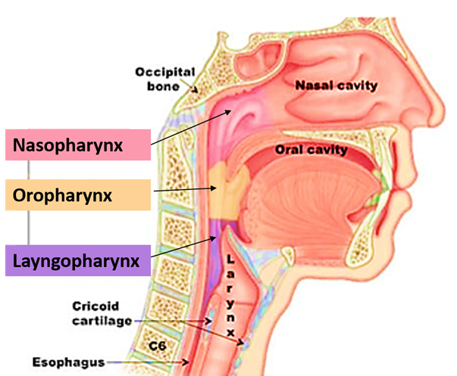
PHARYNX
LENGTH :
LOCATION
EXTENSION
BOUNDARIES
DIVISION

Slide 4
PHARYNGEAL WALL
CONSISTS OF 4 LAYERS
1.MUCOUS MEMBRANE
2.PHARYNGEAL APONEUROSIS
3.MUSCULAR COAT
4.BUCCOPHARYNGEAL FASCIA

Slide 5
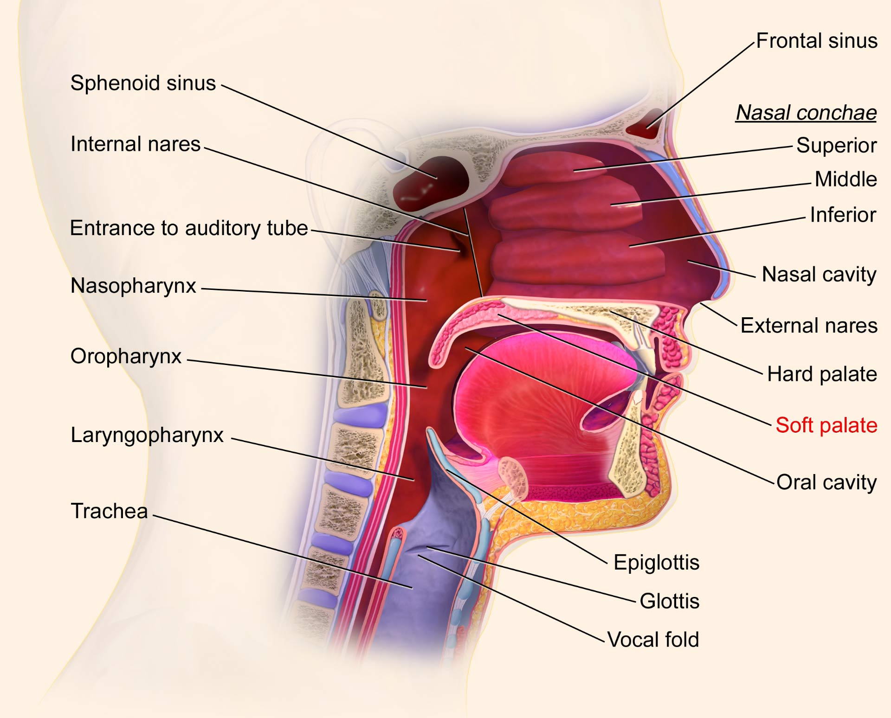
NASOPHARYNX
LOCATION
EXTENSION
EPITHELIUM
COMMUNICATIONS

Slide 6
BOUNDARIES
ROOF AND POSTERIOR WALL
ROOF - BASISPHENOID,BASIOCCIPUT
POSTERIOR -ARCH OF ATLAS VERTEBRA
STRUCTURES:
1.NASOPHARYNGEAL TONSIL (ADENOIDS )
2.NASOPHARYNGEAL BURSA (TORNWALDT”S DISEASE)
3.RATHKE”S POUCH
FLOOR :
SOFT PALATE
ANTERIOR:
COMMUNICATES WITH NASAL CAVITY THROUGH POSTERIOR NASAL APERTURE
LATERAL WALL
1. PHARYNGEAL OPENING (OR) ET TUBE
2.TORUS TUBARIUS
3.TUBAL TONSIL
4.FOSSA OF ROSSENMULLER
5.SALPHINGOPHARYNGEAL FOLD

Slide 7
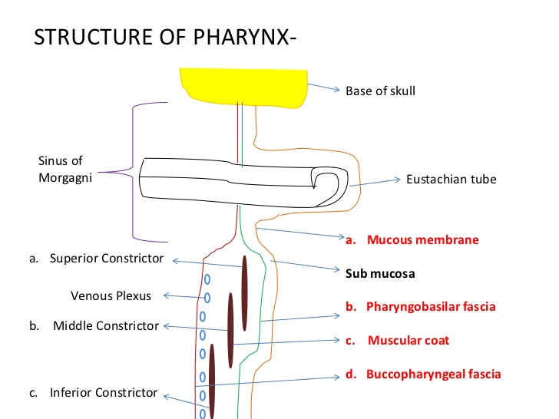
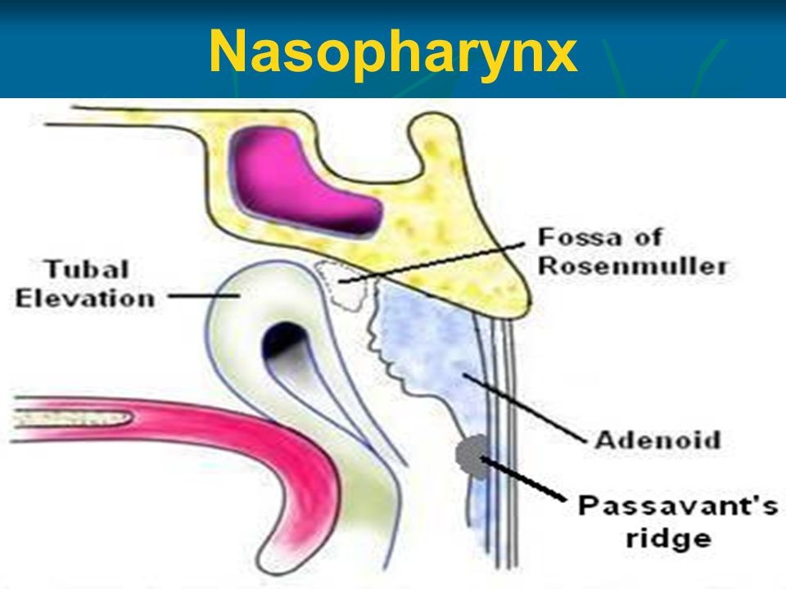
SINUS OF MORGAGNI
PASSAVANT”S RIDGE

Slide 8
FUNCTIONS OF NASOPHARYNX
AIRWAY
MIDDLE EAR VENTILATION
RESONANCE
DRAINAGE

Slide 9
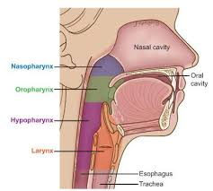
OROPHARYNX
LOCATION
EXTENSION
COMMUNICATION

Slide 10
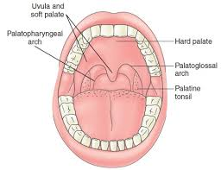
BOUNDARIES
POSTERIOR WALL:2nd AND 3rd CERVICAL VERTEBRA
ANTERIOR WALL: OROPHAYNGEAL ISTHMUS
STRUCTURE
1.BASE OF TONGUE
2.LINGUAL TONSIL
3.VALLECULAE
LATERAL WALL: ANTERIOR PILLAR
POSTERIOR PILLAR
PALATINE TONSIL
SUPERIOR: SOFT PALATE
NASOPHARYNGEAL ISTHMUS
INFERIOR: POSTERIOR ONE THIRD OF TONGUE

Slide 11
FUNCTIONS
PASSAGE FOR AIR AND FOOD
DEGLUTITION
VOCAL RESONANCE
TASTE SENSATION
LOCAL DEFENCE AND IMMUNITY
LYMPHATIC DRAINAGE
JUGULODIGASTRIC LYMPH NODE
RETROPHARYNGEAL NODE
PARAPHARYNGEAL NODE
POSTERIOR CERVICAL GROUP

Slide 12
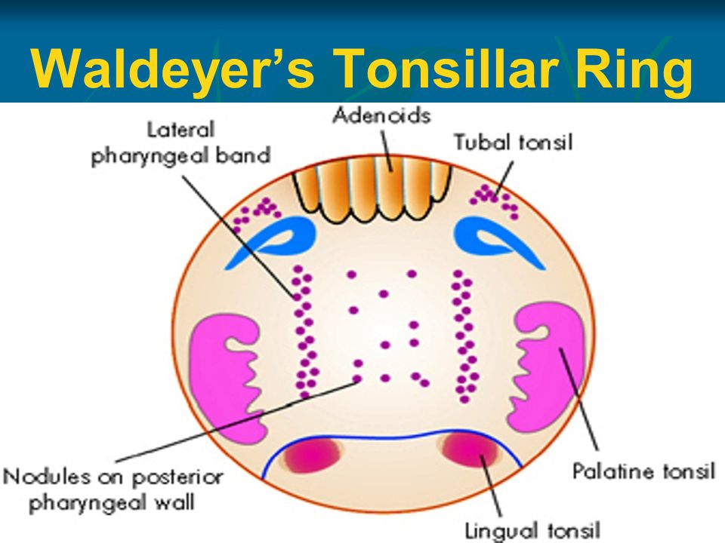
WALDEYER'S RING
MUCOSA ASSOCIATED LYMPHOID TISSUE IN SUBEPITHEILAL LAYER OF PHARYNX IS AGGREGATED AT THE AERODIGESTIVE TRACT.

Slide 13
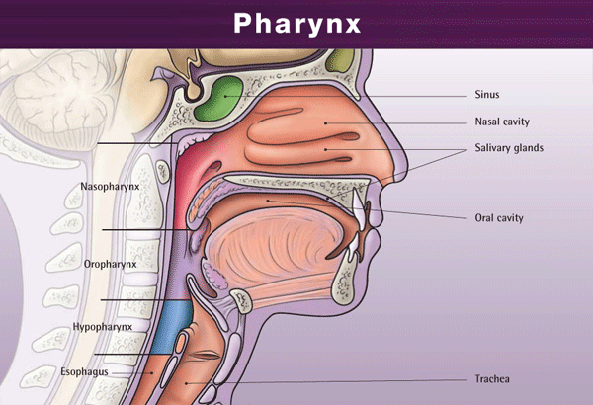
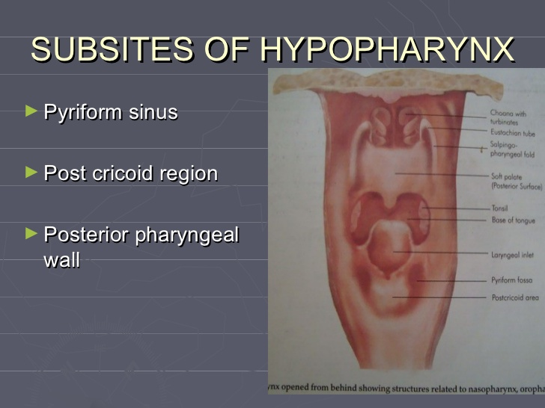
Hypopharynx
LOCATION
EXTENSION
COMMUICATION
DIVISION
PYRIFORM SINUS
POST CRICOID REGION
POST.PHARYNGEAL WALL
FUNCTIONS

Slide 14
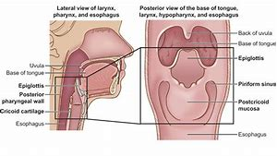
PYRIFORM SINUS:
LOCATION
EXTENSION
BOUNDARIES
LATERAL : THYROHYOID MEMBRANE
THYROID CARTILAGE
MEDIAL : ARYEPIGLOTTIC FOLD
POST.SURFACE OF ARYTENOID AND CRICOID
SUPERIOR : PHARYNGOEPIGLOTTIC FOLD
INFERIOR : INTO ESOPHAGUS
POSTCRICOID REGION :
ANTERIOR WALL OF PHARYNX
POSTERIOR PHARYNGEAL WALL:
FROM HYOID BONE TO LOWER BORDER OF CRICOID CARTILAGE

Slide 15
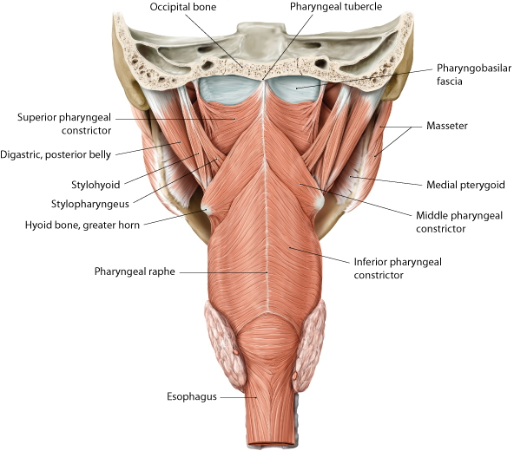
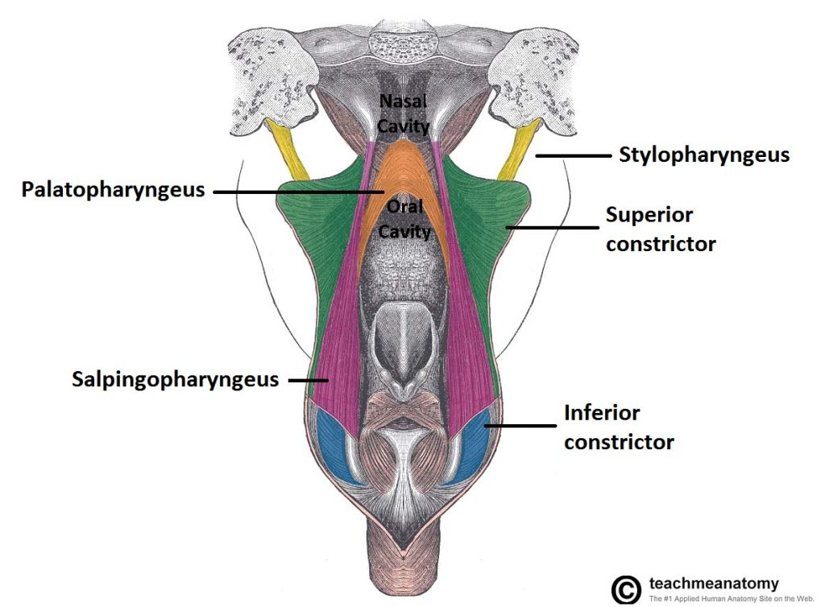
MUSCLES OF PHARYNX
TWO MUSCULAR LAYERS
OUTER CIRCULAR LAYER
1.SUPERIR CONSTRICTOR
2.MIDDLE CONSTRICTOR
3.INFERIOR CONSTRICTOR
INNER LOGITUDINAL
1.STYLOPHARYNGEUS
2.SALPHINGOPHARYNGEUS
3.PALATOPHARYNGEUS

Slide 16
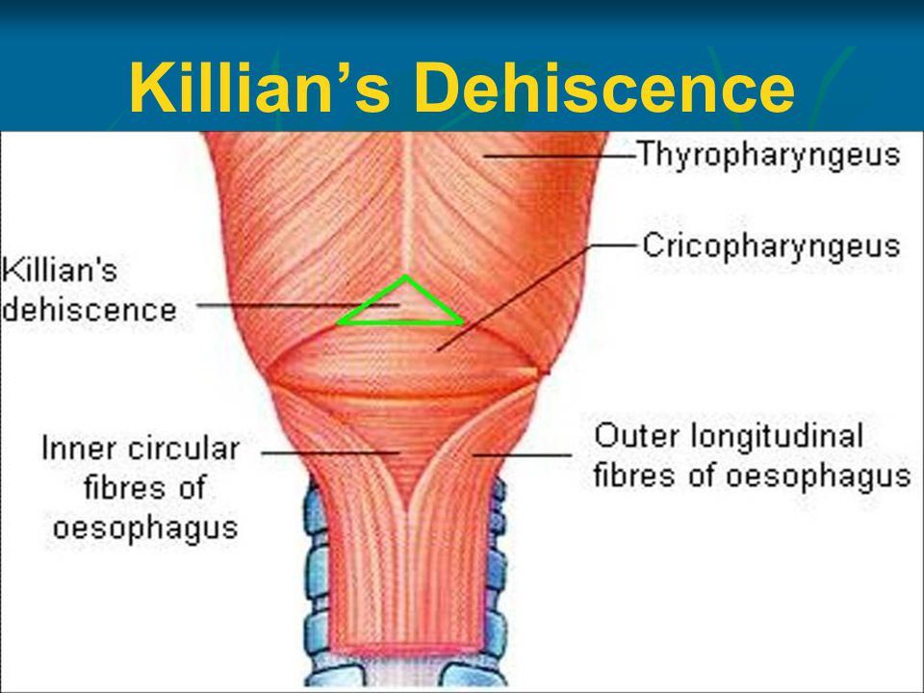
KILLIAN'S DEHISCENCE
POTENTIAL GAP BETWEEN THE THYROPHARYNGEUS MUSCLE(OBLIGUE) AND CRICOPHARYNGEUS MUSCLE(TRANSVERSE)

Slide 17
PHARYNGEAL SPACES
RETROPHARYNGEAL SPACE
BEHIND PHARYNX
EXTENDS FROM BASE OF SKULL TO BIFURCATION OF TRACHEA
PARAPHARYNGEAL SPACE
ON SIDE OF PHARYNX
CONTAINS
CAROTID VESSELS
JUGULAR VEIN
LAST 4 CRANIAL NERVES
SYMATHETIC CHAINS

Slide 18
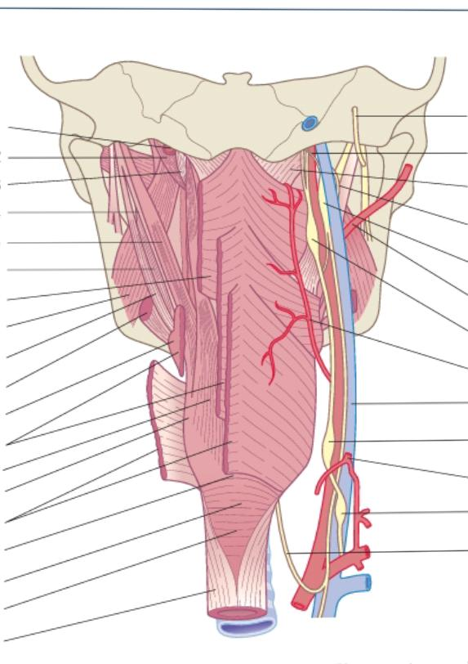
BLOOD supply of pharynx
ASCENDING PHARYNGEAL ARTERY
ASCENDING PALATINE ARTERY
TONSILLAR BRANCHES OF FACIAL ARTERY
BRANCHES OF MAXILLARY AND LINGUAL ARTERY

Slide 19
NERVE supply of Pharynx
MOTOR SUPPLY :
ALL MUSCLES SUPPLIED BY PHARYNGEAL PLEXUS EXCEPT STYLOPHARYNGEUS (GLOSSOPHARYNGEAL NERVE)
SENSORY SUPPLY :
NASOPHARYNX - PHARYNGEAL BRANCH OF MAXILLARY NERVE
OROPHARYNX - GLOSSOPHARYNGEAL AND LESSER PALATINE NERVE
LARYNGOPHARYNX -INTERNAL LARYNGEAL BRANCH OF VAGUS NERVE

Slide 20
THANK YOU

