Slide 1
ASSESSMENT OF VESTIBULAR FUNCTIONS

Slide 2
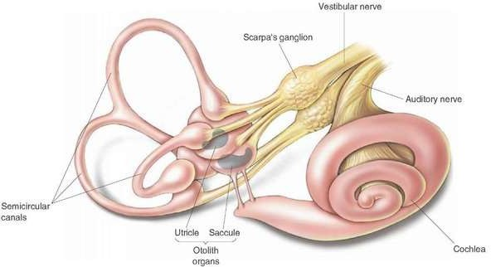
VESTIBULAR SYSTEM
PERIPHERAL : MEMBRANOUS LABYRINTH (SEMICIRCULAR DUCTS, UTRICLE &
SACCULE) AND VESTIBULAR NERVE
CENTRAL : NUCLEI AND FIBRE TRACTS IN

Slide 3
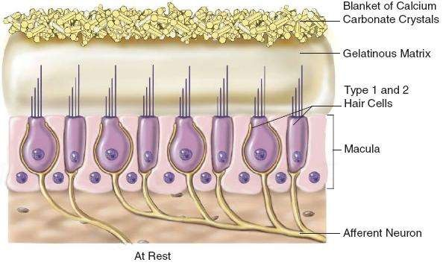
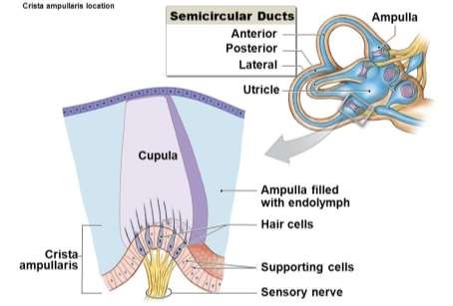
It has two peripheral receptors of vestibular system
CRISTAE : Located in the ampullated ends of three semicircular ducts.
the flow of endolymph displaces cupula of cristae which respond to angular acceleration
MACULAE : located in otolith organs.
The linear , gravitational & head tilt movements cause displacement of otolithic membrane and thus stimulate the hair cells which lie in different planes

Slide 4
VESTIBULAR SYSTEM FUNCTION
Provides information concerning gravity, rotation and acceleration
Serves as a reference for the somato-sensory & visual systems
Contributes to integration of arousal, conscious awareness of the body via connections with vestibular cortex, thalamus and reticular formation
Allows for:
gaze & postural stability
sense of orientation
detection of linear and angular acceleration

Slide 5
DISORDERS OF VESTIBULAR SYSTEM
Cause vertigo and are divided into:
Perpheral (85% of all cases of vertigo) : involve vestibular end organs and vestibular nerve.
Ex: meniere’s disease, benign paroxysmal positional vertigo, labyrinthitis, acoustic neuroma etc
Central: CNS after the entrance of vestibular nerve and vestibulo-ocular, vestibulo-spinal and other CNS pathways
Ex: vertebro-basilar insufficiency, basilar migraine, cerebellar disease, multiple sclerosis, tumors of brain stem etc

Slide 6
ASSESSMENT OF VESTIBULAR FUNCTION
CLINICAL TESTS LABORATORY TESTS
SPONTANEOUS NYSTAGMUS
FISTULA TEST
ROMBERG TEST
GAIT
PAST POINTING AND FALLING
HALLPIKE MANOEUVRE
TEST OF CEREBELLAR DYSFUNCTION
CALORIC TESTS
ELECTRONYSTAGM OGRAPHY
OPTOKINETIC TEST
ROTATION TEST
GALVANIC TEST
POSTUROGRAPHY

Slide 7
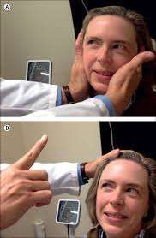
SPONTANEOUS NYSTAGMUS
Nystagmus is defined as involuntary, rhythmical, oscillatory movement of eyes.
To elicit nystagmus
The examiner should keep a finger 30cms from the patients eye in central position
Move it to right or left, up or down but not moving more than 30˚from center(to avoid gaze nystagmus)
Presence of spontaneous

Slide 8
Degree of nystagmus
1st degree : it is weak nystagmus and is present when patient looks in the direction of fast component.
2nd degree : it is stronger than the first degree nydtagmus and is present when patient looks straight ahead
3rd degree : it is stronger than the second degree nystagmus and id present even when patient looks in the direction of the slow component.

Slide 9
Nystagmus of peripheral origin can be suppressed by optic fixation by looking at a fixed point, they include
Irritative lesions Ex: serous labyrinthitis Cause nystagmus to the side of lesion
paretic lesions Ex: purulant labyrinthitis, trauma
cause nystagmus to the healthy side
Nystagmus of Central origin cannot be suppressed by optic fixation, they include
Torsional nystagmus (lesion of brainstem)
Vertical down beat nystagmus (lesion of cranio cervical region)
Vertical upbeat nystagmus (lesion at the junctions of pons and medulla or pons and mid brain)
Pendular nystagmus (congenital or acquired)

Slide 10
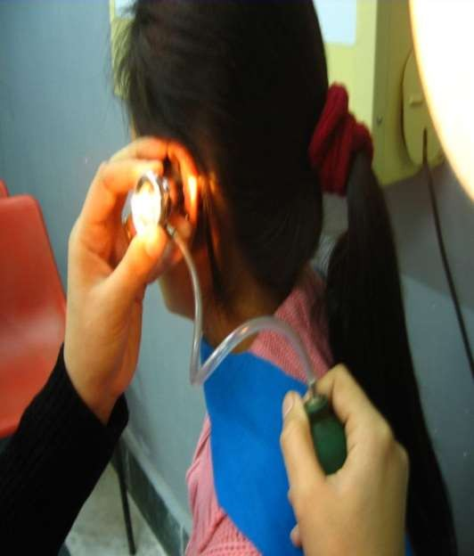
FISTULA TEST
The basis of this test is to induce nystagmus by producing pressure changes in external canal which are then transmitted to labyrinth,
stimulation of labyrinth produces nystagmus and vertigo.

Slide 11
Normally the test is negative because the pressure changes cannot be transmitted to labyrinth.
Positive when there is erosion of semicircular canals as in cholesteatoma or a surgically created window in horizontal canal
The false negative fistula test is seen when cholesteatoma covers the site of fistula and does not transmit pressure changes to labyrinth
False positive test is seen in congenital syphilis and about 25% of meniere’s disease.

Slide 12
ROMBERG TEST
The patient is asked to stand with feet together and arms by the side with eyes first open and then closed.
In peripheral vestibular lesions, the patient sways to the side of the lesion
In central vestibular disorder, patient shows instability
Sharpened romberg test : in this the patient stands with one heel in front of toes and arms folded across the chest.
Inabiity to perform sharpened romberg test indicates

Slide 13
GAIT
The patient is asked to walk along a straight line to a fixed point, first with eyes open and then closed.
In uncompensated lesion of peripheral vestibular system, the patient deviates to the affected side with eyes closed.

Slide 14
PAST POINTING AND FALLING
Past pointing Falling
same
Slow component
of nystagmus are all in the
direction
Ex : acute vestibular failure on the right side nystagmus is to the left but,
past pointing, falling and slow component is towards right.

Slide 15
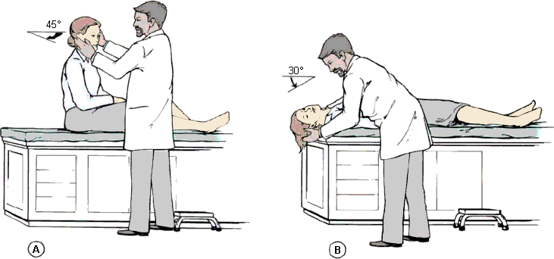
HALLPIKE MANOEUVRE (POSITIONAL TEST)

Slide 16
Positional nystagmus is elicited by Hallpike manoeuvre
Four parameters of nystagmus are observed in this position they are,
Latency | Peripheral lesion 2 – 20 s | Central lesion No latency
Duration | Less than 1 min | More than 1 min
Direction of | Direction fixed, | Direction
nystagmus | Towards the undermost ear | chainging
fatiguability | fatiguable | nonfatiguable
Accompanying | Severe vertigo | None or slight

Slide 17
TEST OF CEREBELLAR DYSFUNCTION
All cases of giddiness should be tested for cerebellar disorders, disease of cerebellar hemisphere causes:
Asynergia (Abnormal finger nose test)
Dysmetria (inability to control range of motion)
Adiadochokinesia (inability to prform rapid alternating movements)
Rebound phenomenon (inability to control movement of extremity when opposing

Slide 18
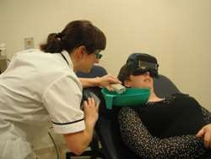
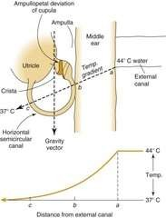
LABORATORY TESTS:
CALORIC TEST

Slide 19
MODIFIED KOBARK TEST:
The basis of the test is to induce nystagmus by thermal stimulation of the vestibular system. It includes,
The patient is seated with the head tilted 60˚ backwards to place horizontal canal in vertical position.
The ear is irrigated with ice water for 60s, first with 5ml and if there is no response 10, 20 and 40mL
Normally, nystagmus beating towards the opposite ear will be seen with 5 mL of ice water
If response is seen with increased quantities of water between 5 and 40mL, labyrinth is considered hypoactive

Slide 20
FITZGERALD-HALLPIKE TEST (BIOTHERMAL CALORIC TEST) :
The patient lies supine with head tilted 30˚ forward so that horizontal canal is vertical
Ears are irrigated for 40 s alternatively with water at 30˚C and at 44˚C and eyes are observed for appearance of nystagmus till its end point
Time taken from the start of irrigation to the end point of nystagmus is recorded and charted on calorigram
If no nystagmus is elicited from any ear, test is repeated with water at 20˚C for 4 min before labelling the labyrinth dead
A gap of 5 min should be allowed between 2 ears
Cold water induces nystagmus to opposite side and

Slide 21
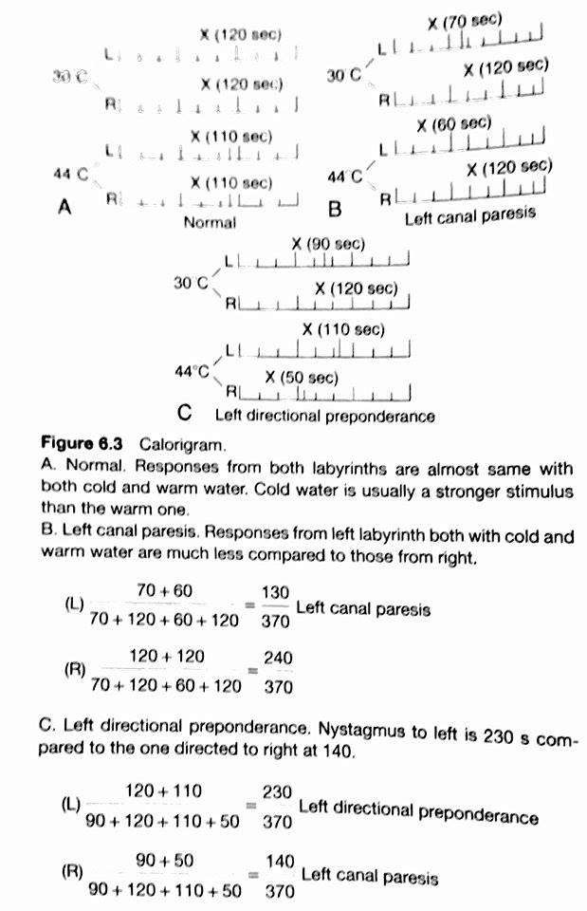
CANAL PARESIS : It indicates the response elicited from a particular canal right or left after stimulation with cold and warm water is less than that from the opposite side
DIRECTIONAL PREPONDERANCE
It considers the duration of nystagmus to right or left irrespective of whether it is elicited from right or left labyrinth.
if the nystagmus is 25-30% or more on one side than the

Slide 22
COLD-AIR CALORIC TEST:
This test is done when there is tympanic membrane perforation because irrigation with water is contraindicated in such case.
the test employs dundas grant tube, which is a coiled copper tube wrapped in cloth.
the air In the tube is cooled by pouring ethyl chloride and then blown into the ear.
It is a rough qualitative test.

Slide 23
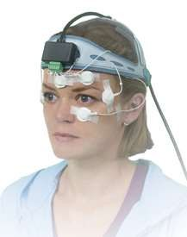
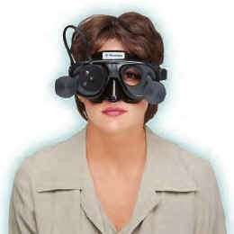
ELECTRONYSTAGMOGRAPHY
It is a method of detecting and recording nystagmus, which is spontaneous or induced by caloric, positional, rotational or optokinetic stimulus
The test depends on the presence of corneo- retinal potentials which are recorded by placing electrodes at suitable

Slide 24
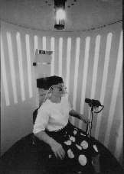
OPTOKINETIC TEST
Optokinetic nystagmus, is the eye movement elicited by the tracking of a moving field.
Patient is asked to follow a series of vertical stripes on a screen moving first from right to left and then from left to right
Normally it produces nysagmus with slow component in the direction of moving stripes and fast component in the opposite direction
Optokinetic abnormalities are seen in brainsteam and

Slide 25
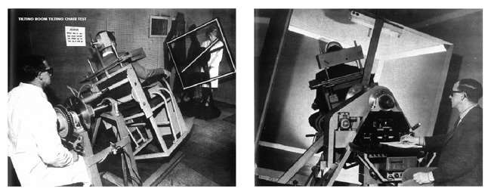
ROTATION TEST
Patient is seated in barany’s revolving chair with his head tilted 30˚forword and then rotated 10 turns in 20s, the chair is stopped abruptly and nystagmus observed.
Normally there is nystagmus for 25 to 40s .
It is useful in cases of congenital
disadvantage is both the labyrinths are stimulated
abnormalities.

Slide 26
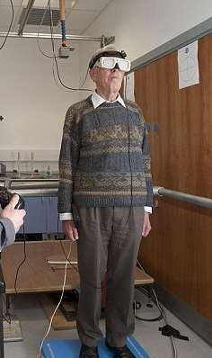
GALVANIC TEST
The patient stands with his feet together, eyes closed and arms outstretched and then a current of 1mA is passed to one e
It is the only vestibular test which helps in differentiating an end org lesion from that of vestibular lesio
Normally, person sways towards the side of anodal current.
ar
an n

Slide 27
POSTUROGRAPHY
The vestibular function is evaluated by measuring postural stability
It is based on the fact that maintenance of posture depends o three sensory inputs ie. Visual, vestibular and somatosensory.
It uses either a fixed or moving platform, visual cues can also be varied.

Slide 28
Problems Experienced with Vestibular Loss
Balance & gait deficits
Head movement-induced dizziness
Head movement-induced visual blurring
(oscillopsia)
Dressing difficulty
Driving deficits
Disability related to work, social & leisure activities

Slide 29
Vestibular Exercise Program Components
Gaze stabilization exercises to retrain VOR function
Balance retraining to retrain VSR function
Conditioning exercises to increase fitness level
Habituation or canal repositioning maneuvers as indicated

Slide 30
Vestibular Exercise Program Objectives
Complement CNS natural compensation
diminish dizziness & vertigo
enhance gaze stabilization
enhance postural stability in static & dynamic situations
Increase overall functional activities
Patient education
nature of pathology
episodic nature, prognosis
control of exacerbations

