Slide 1
ALLERGIC AND NON ALLERIC RHINITIS

Slide 2




Allergic Rhinitis
Rhinitis is defined as inflammation of the lining of the nose, characterized by one or more of the following symptoms:
  nasal congestion,
  rhinorrhoea,
  sneezing
  itching.
Allergic rhinitis involves inflammation of the mucous membranes of the nose, eyes, eustachian tubes, middle ear, sinuses, and pharynx.
Rhinitis due to IgE mediated inflammation following
exposure to allergen.
Affects 10-25% of global population .
The nose invariably is involved, and the other organs are affected in certain individuals.

Slide 3
Classification based on ARIA guidelines
Intermittent
. < 4 days per week
. or < 4 weeks
Persistent
. > 4 days per week
. and > 4 weeks
Moderate- severe
one or more of
following
. abnormal sleep
. impairment of daily activities, sport, leisure
. abnormal work and
school
. troublesome symptoms
Mild
-normal sleep
no impairment of daily activities, sport, leisure
normal work and
school
no troublesome symptoms

Slide 4

Classification | Duration
Acute(ARS) | 7 Days to ≤ 4 Weeks
Subacute | 4-12 weeks
Recurrent acute | ≥4 episodes of ARS per year
Chronic | ≥ 12 Weeks
Acute exacerbation of chronic | Sudden Worsening Of CRS With Return To Baseline After

Slide 5
Allergic Rhinitis - Causes
Seasonal/ Intermitant
Pollen from trees, grasses, and weeds
Perennial/ Persistant
House dust, mites
Mold and fungus spores Cockroaches
Animal danders Food
chemicals

Slide 6
Risk factors
Genetics and family history
The best established risk factor for allergic rhinitis is a family history of allergy, especially of allergic rhinitis.
Genes which appear to be involved in atopy include an area on the 5q chromosome.
Other possible susceptibility loci exist on chromosome 11q, chromosome 13 in the Japanese population and chromosome 12q.

Slide 7

Environment-
Lifestyle changes, increased exposure to allergen, pollution and irritants, dietary modifications leading to a reduction in Th 1-type immune response and stress.
Pollution increases symptomatic rhinitis.
Living in developed countries, pollution, climate interaction and good hygiene all seem to be risk factors.
Co-morbidities-
Conditions associated with allergic rhinitis are asthma, sinusitis, otitis media, sleep disorders, LRTI & dental occlusion.

Slide 8
PATHOPHYSIOLOGY
Allergic reaction occurs in four phases-
Sensitization
Subsequent reaction to allergen-early phase.
Late phase reaction.
Systemic activation.

Slide 9
Sensitization
In atopies, allergen molecules are inhaled and presumably not completely cleared by the mucociliary system.
They reach antigen presenting cells in the nose, the most important of which are dendritic cells / Langerhans cells.
They capture antigen, process it and present it to naive T cells in the local lymph nodes.
If no additional signal is present then a T-cell response will not ensue.
In atopic individuals, Th2 cells predominate at the sites of allergic response.

Slide 10
Sensitization
In the secondary immune response, any cell expressing surface MHC class 2 may serve as an antigen- presenting cell, including the nasal epithelium.
Activated, Th2 cells secrete cytokines, (IL-4, IL- 13 , IL- 5).
They also activate B lymphocytes in the local lymphoid tissues, encouraging them to proliferate, migrate to the nasal lining and produce IgE antibody.
Once produced, the IgE is very rapidly taken up by local cells possessing FcER 1, i.e. mainly mast cells.
Thus armed, mast cells are able specifically to respond to subsequent allergen contact.

Slide 11
Subsequent reaction to allergen: early phase
Mast cells are encouraged to degranulate once their cell-bound IgE has been cross-linked by allergen.
Secretion of histamine, leukotriene C4 & prostaglandin D2 in nasal mucus.
Histamine & cytokines are preformed while leukotriene and PGs are manufactured from membrane arachidonic acid.

Slide 12

Histamine causes
  Rhinorrhoea, sneezing, pruritis and nasal obstruction. (The response is of short duration)
  Action on sensory nerves induces itching and sneezing.
Prostaglandins induces
  Sustained nasal obstruction and is ten times more
potent than histamine.
Leukotrienes induce
  Vascular permeability and oedema in the nose
  Involved in eosinophil and neutrophil recruitment.
Cytokines are important in regulation of IgE response.

Slide 13
Late phase response
This is inflammatory in nature.
Involves the ingress of cells such as eosinophils, basophils, mast cells, T lymphocytes, neutrophils and macrophages into the local reaction site.
The main symptoms are nasal obstruction and hyper- reactivity.
Eosinophil products increase local vascular permeability and mucus secretion and cause further inflammatory cell influx
Endothelial cells, participate in the recruitment of leukocytes to the site of the allergic response by releasing chemotactic factors and modulating adhesion molecules.

Slide 14
Systemic activation
Upregulation of production and release of eosinophil and basophil precursors from the bone marrow occurs in response to allergen contact in the nose or lung.
The resultant circulating precursors are attracted to the reaction site & other parts of respiratory tract.
Ig E-INDEPENDENT RESPONSES
Certain drugs, e,g. morphine, codeine and aspirin, can act directly on the mast cell membrane causing degranulation.
House dust mite allergen is able to alter epithelial tight
junctions therefore increasing permeability.
Some allergens may produce direct response via enzymatic proteolytic activity.

Slide 15
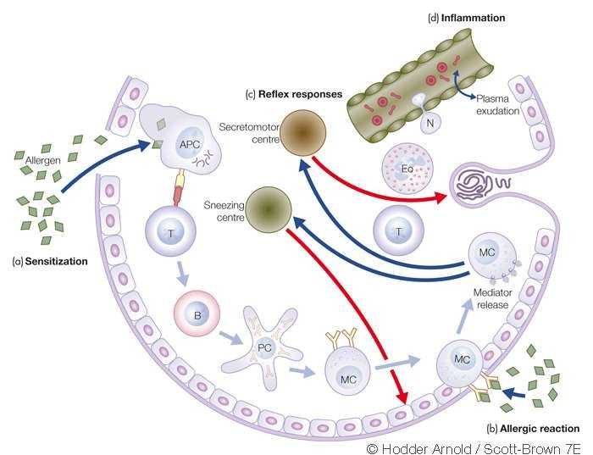
The four phases o f the allergic reaction in the nose.

Slide 16
Diagnosis of Allergic Rhinitis
Most allergic rhinitis patients can be diagnosed by a combination of
  History,
  Examination
  SPT (Skin Prick Test )
  Radioallergoabsorbent tests (RAST) for specific IgE.

Slide 17
Important elements in history include an evaluation of
  the nature, duration, and time course of symptoms;
  possible triggers for symptoms;
  response to medications;
  comorbid conditions;
  family history of allergic diseases;
  environmental exposures;
  occupational exposures;
  effects on quality of life.

Slide 18
Symptoms that can be associated with allergic rhinitis include
  sneezing,
  itching (of nose, eyes, ears, palate),
  rhinorrhea,
  postnasal drip,
  congestion,
  headache,
  earache,
  tearing, red eyes, eye swelling,
  fatigue, drowsiness, and malaise.

Slide 19
Examination
Look at the pt to assess any obvious external features, such as an ” allergic crease or allergic salute.”
Atopic dermatitis or conjunctivitis should noted.
A full ENT examination should then be carried out with particular emphasis on the nose.
Allergic nasal mucosa is usually bilaterally swollen pale or bluish in colour, oedematous and covered with watery secretions.

Slide 20
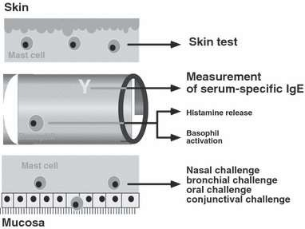
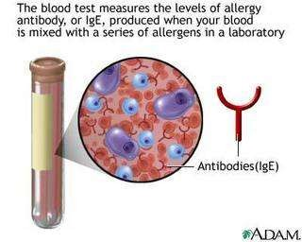
Diagnostic tests
Demonstration of IgE allergy

Slide 21
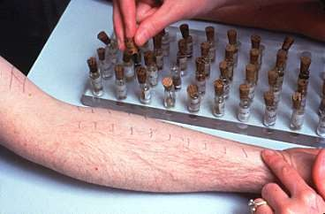
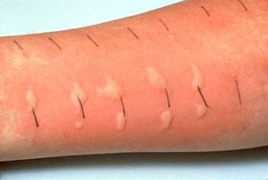
SPT(SKIN PRICK TEST)
Allergen introduced into the skin causes degranulation of IgE-sensitized mast cells with mediator release and formation of a wheal and flare.
Simple ,cheap & safe.
Low risk of systemic reactions.
Always undertaken where emergency equipments and resuscitation capable staff is available

Slide 22

Should not be performed in pts on antihistamines or with severe eczema, previous anaphylaxis or dermagraphism.
Positive results- reaction >2mm in under fives
>3mm in adults.
Positive result should be atleast 2mm greater than the negative control.
Positive SPT occurs in 20-30% of adults but only 10- 15% develop symptoms.

Slide 23

BLOOD TESTS FOR ALLERGY
Stabilized allergen is incubated with the patient's serum, any specific IgE binds to allergen and is identified by a second incubation with labelled anti-IgE.
This can be undertaken by RASTs or by fluorescent assays and enzyme-linked immunosorbent assays (ELISA).
RAST involves
  allergen bound to a solid phase, &
  incubated with the patient's serum and
  IgE molecules bind to the allergen.
  After detailed washing, radio labelled anti-IgE is added
  the radioactivity is measured.
.

Slide 24
CAP RAST is a recent improvement in which
  the allergen is coupled to a cellulose carrier
  anti-IgE is enzyme-labelled with a fluorescent substrate acting as the developing agent.
  This system has a higher sensitivity and specificity than RAST test
ELISA test
  allergen is in the fluid phase
  IgE is enzyme-labelled.
  The substrate for the enzyme is added and
  the resulted colour change is detected photometrically.

Slide 25
Immunoassay vs Skin Test for Diagnosis of Allergy
Immunoassay
Not influenced by medication
Not influenced by skin disease
Does not require expertise
Quality control possible
Expensive
Skin test
Higher sensitivity
Immediate results
Requires expertise
Cheaper

Slide 26
NASAL ALLERGEN CHALLENGE
Allergen is introduced into the nose and any reaction is measured and compared to placebo.
This is the gold standard of allergy diagnosis, but is rarely necessary.
The allergen should be applied in gradually increasing concentrations with careful monitoring.
Nasal challenge testing is time-consuming, difficult and requires extensive laboratory facilities.

Slide 27
Management of allergic rhinitis
The management of allergic rhinitis involves the following
components:
Allergen avoidance
Pharmacotherapy.
Allergen immunotherapy
Surgery is rarely needed

Slide 28
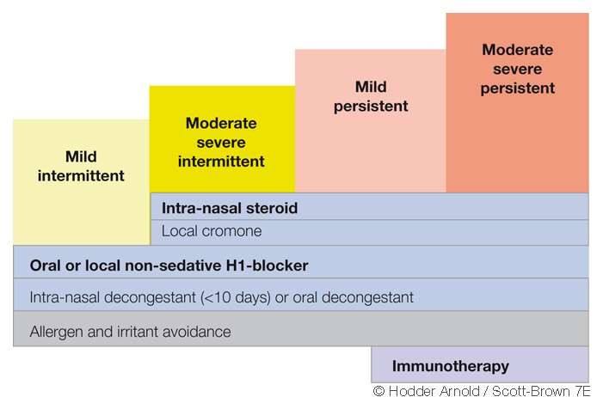
Basic treatment plan for allergic
rhinitis according to severity and duration.

Slide 29
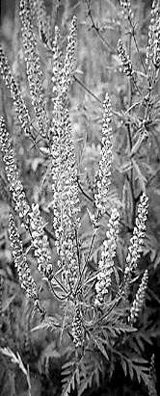


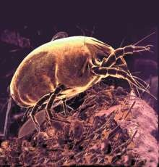
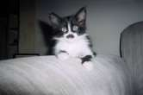
Globally important sources of allergens
House dust mites
Grass, tree and weed pollen
Pets
Cockroaches
Molds

Slide 30

Allergen Avoidance
Pets
  Remove pets from bedrooms and, even better, from the entire home
  Vacuum carpets, mattresses and upholstery regularly
  Wash pets regularly (±)
Molds
  Ensure dry indoor conditions
  Use ammonia to remove mold from bathrooms and other wet spaces
Cockroaches
  Eradicate cockroaches with appropriate gel-type, non-volatile, insecticides
  Eliminate dampness, cracks in floors, ceilings, cover food; wash surfaces, fabrics to remove allergen
Pollen
  Remain indoors with windows closed at peak pollen times
  Wear sunglasses
  Use air-conditioning, where possible
  Install car pollen filter

Slide 31
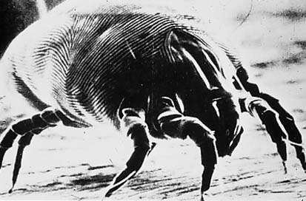
House dust mite allergen avoidance
Provide adequate ventilation to
decrease humidity
Wash bedding regularly at 60°C
Encase pillow, mattress and quilt in
allergen impermeable covers
Use vacuum cleaner with HEPA filter
Dispose of feather bedding
Remove carpets
Remove curtains, pets and stuffed toys from bedroom

Slide 32

TREATMENT
Pharmacotherapy. Sodium cromoglycate | Itching/sneezing discharge + + | blockage +/- | impaired + | smell
OralAntihistamines | +++ ++ | +/- | -
Ipratropium bromide | - +++ | - | -
Topical Decongestants | - - | +++ | -
Topical glucocorticoids | +++ +++ | ++ |  | +
Systemic corticosteroids. +++
+++
+++
++
Antileukotrienes.
-
++
+
+/-

Slide 33
Oral Antihistamines
First generation agents
Chlorpheniramine Brompheniramine Diphenydramine
Promethazine Tripolidine Hydroxyzine Azatadine
Newer agents Acrivastine Azelastine Cetirizine Desloratadine
Fexofenadine Levocetirizine Loratadine
Mizolastine

Slide 34
Newer Generation Oral Antihistamines
First line treatment for mild allergic rhinitis
Effective for
  Rhinorrhea
  Nasal pruritus
  Sneezing
Less effective for
  Nasal blockage
Possible additional anti-allergic and anti-inflammatory effect
  In-vitro effect > in-vivo effect
Minimal or no sedative effects
Once daily administration
Rapid onset and 24 hour duration of action

Slide 35
Decongestants: Alpha-2 Adrenergic Agonists
Oral Nasal
Pseudoephedrine Phenylephrine Oxymetazoline Xylometazoline

Slide 36
EFFICACY:
Oral decongestants: moderate
Nasal decongestants: high
ADVERSE EFFECTS:
Oral decongestants: insomnia, tachycardia, hyperkinesia tremor, increased blood pressure, stroke (?)
Nasal decongestants: tachyphylaxis, rebound congestion, nasal hyperresponsiveness, rhinitis medicamentosa

Slide 37
Anti-leukotriene agents
CysLT1 Receptor 5-Lipoxygenase
Antagonists Inhibitors
Montelukast
Pranlukast  Zileuton
Zafirlukast

Slide 38
Anti-Leukotriene Treatment in Allergic Rhinitis
Efficacy
Equipotent to H1 receptor antagonists but with onset of action after 2 days
Reduce nasal and systemic eosinophilia
May be used for simultaneous treatment of allergic rhinitis and asthma
Safety
Dyspepsia (approx. 2%)

Slide 39
Nasal Corticosteroids
Beclomethasone dipropionate
Budesonide
Ciclesonide
Flunisolide
Fluticasone propionate
Mometasone furoate
Triamcinolone acetonide

Slide 40
Nasal Corticosteroids
Most potent anti-inflammatory agents
Effective in treatment of all nasal symptoms including obstruction
Superior to anti-histamines and anti-leukotienes
First line pharmacotherapy for persistent allergic rhinitis

Slide 41

Nasal Corticosteroids
Overall safe to use
Adverse Effects
  Nasal irritation
  Epistaxis
  Septal perforation (extremely rare)
  HPA axis suppression
  Suppressed growth

Slide 42

IMMUNOTHERAPY
Repeated administration of an allergen extract in order to induce immunological tolerance,with a reduction in clinical symptoms & requirements for medication during subsequent natural allergen exposure.
Indicated in those pts of AR who fail to respond adequately to usual t/t with antihistamines & topical corticosteroids.
In view of the side effects associated with subcutaneous immunotherapy, alternative strategies have been considered.
The sublingual route involves application of allergen as drops or tablets under the tongue where they are retained for several minutes.

Slide 43
Mech . Of immunotherapy
Immunotherapy results in a blunting of seasonal increases in allergen-specific IgE.
Induces immune deviation from Th2- type T lymphocyte response in favour of a protective Th1-type response & also to induce a distinct population of T regulatory cells which produce the inhibitory cytokines IL-10, TGF B, both of which downregulate Th2 responses to allergens.

Slide 44
Indications for immunotherapy in AR
INCLUSION CRITERIA
IgE mediated disease(+SPT/RAST)
Inability to avoid allergen.
Inadequacy of drug treatment.
Pts who understand risks & limitations of t/t.
CONTRINDICATIONS
Coexistent asthma.
Pts taking beta-blockers.
Other medical/immunological dis.
Small children.(<5yrs)
pregnancy

Slide 45
Anti IgE - omalizumab
Could be considered in severe cases unresponsive to conventional treatment
Could be an adjunct to immunotherapy in severe cases
Nasal Surgery
Nasal surgery may be needed where there is a marked septal deviation or bony turbinate enlargement which makes topical nasal sprays usage difficult

Slide 46

Health Effects of Allergic Rhinitis
Social inconvenience
Sleep disturbances/obstruction
Learning difficulties
Impaired maxillary growth
Dental problems
Infection: nose and sinuses
Co-morbidities: conjunctivitis, asthma, rhinosinusitis, otitis media

Slide 47

To Conclude…
Allergic rhinitis is very common and causes considerable morbidity
Adequate and appropriate treatment leads to significant improvement in quality of life
Co-morbid conditions are common and warrants special attention and treatment for optimal results
Environmental manipulations is also important in the control of disease

Slide 48
NON-ALLERGIC RHINITIS

Slide 49
The term Nonallergic rhinitis' is commonly applied to a diagnosis of any nasal condition in which the symptoms are identical to those seen in Allergic rhinitis but an allergic aetiology has been excluded.
Occur more frequently in adults than in children,
More likely to be perennial than seasonal.

Slide 50
NON ALLERGIC PERENNIAL RHINITIS
TYPES:
Vasomotor rhinitis
Infection
Rhinitis associated with physical or chemical factors
Drug, food induced rhinitis 5.NARES, aspirin sensitivity
Rhinitis of pregnancy
Atrophic rhinitis

Slide 51
Vasomotor Rhinitis
Autonomic disturbance – excessive parasympathetic activity
No specific cause found
Symptoms : rhinorrhoea, sneezing, nasal obstruction

Slide 52
Neurovascular disorder
No specific antibodies
Nonspecific reflex hypersensitivity
Caused by various influences
Change of temperature or humidity
Alcohol , dust, smoke, mechanical irritation, stress, anxiety neurosis, endocrine disorders, rhinitis of pregnancy.
Drugs: (e.g., antihypertensive agents as reserpine or beta-
blockers, oral contraceptives)
Drug abuse: (imidazoline & catechol derivatives, clomethiazole, etc.)

Slide 53
Vasomotor Rhinitis Diagnosis
Typical history
Negative allergen tests
No elevated IgE in the secretion

Slide 54
Vasomotor Rhinitis Conservative Tretment
Elimination of irritant factors
Antihistamines
Nasal decongestant drops
Oral decongestant drugs
Steroids (e.g., beclomethasone)
Metabolic & endocrine systems
Sedatives
Imidazoline preparations (Potential for habituation)

Slide 55

Vasomotor Rhinitis Surgical Treatment
Turbinate surgery --Electrocautery,cryosurgery, laser
Correction of anatomical deformity
Conchotomy
Parasympathetic nasal fibers divisions (vidian neurectomy)

Slide 56
Vasomotor Rhinitis Prognosis
Uncertain
Suddenly improves
Resistant to treatment

Slide 57
Atrophic rhinitis
Predominantly in women & is charaterised by progressive atrophy of the nasal mucosa & underlying bone of the turbinates.
Leads to formation of thick crusts, which leave a constant foul smell ( ozaena) in nose.
Nasal cavities are enlarged & there is sensation of nasal congestion.
Thought to be due to infection with klebsiella ozaenae.

Slide 58
Atrophic Rhinitis clinical presentation
Greenish–yellow or brownish-black crusts
Wide nasal cavity
Atrophic mucosa & dry
Subepithelial layer fibrosis
Fetid secretion &crusts (Ozena)
Anosmia & social problem
Nasal obstruction
Mucosal changes

Slide 59

Atrophic Rhinitis
Pathogenesis
Unknown but is multifactorial
Common in orientals than in whites than in blacks
Abnormally wide nasal cavity
Mucosal atrophy& bony nasal skeleton.
Respiratory epith.→ keratinized sq. metaplasia
Destroyed mucociliary cleaning system
Bacterial proteolysis decomposed the thick & gluey secretions

Slide 60

Secondary Atrophic Rhinitis
Nasal Trauma
Extensive surgery
Occupational exposure to:- Glass, wood, asbestos, etc.

Slide 61

Atrophic Rhinitis
Diagnosis
Gluey, dry, greenish-yellow secretions & crusts
→ wide nasal cavity & very small turbinates
Foul-smelling crusts

Slide 62

Atrophic Rhinitis
Conservative Treatment
Nasal douching
Alkaline nasal lotion
Greasy ointments
Oily nasal drops, emulsions , or ointments
Steam inhalations
Osmotic Powders :Dextrose

Slide 63
Atrophic Rhinitis
Operative Treatment
Bolstering of the Nasal Mucosa
by submucous injections of paraffin . Teflon strips, powdered teflon in glycerine, plastipore, bone and cartilage Insertion submucosally.
Median Displacement of the lateral nasal wall by internal rotation of the mobilized lateral nasal wall.

Slide 64

Young’s operation
Both nostrils are closed completely just within nasal cavity by raising flaps. Opened 6month or later.
Modified Young’s operation
to avoid discomfort of bilateral nasal obstruction, nostrils are partially closed.

Slide 65

Hormonal rhinitis-a/w pregnancy.
Oestrogens cause vascular engorgement in the nose leading to nasal obstruction and/or nasal hypersecretion.
EMOTIONALLY INDUCED RHINITIS
Emotional factors such as stress and sexual arousal have been documented to affect the nose, as a result of autonomic stimulation.
Drug induced- aspirin, other nsaids,B blockers,ACE inhibitors,methyl dopa,OCPs, nasal topical decongestants induce symptoms of rhinitis when administred either topically or systemically.

Slide 66

FOOD-INDUCED RHINITIS
Certain foods and alcoholic beverages can induce nonallergic rhinitis,
Underlying mechanisms are largely unknown.
Hot and spicy foods lead to a watery rhinorrhoea termed 'gustatory rhinitis', probably as a result of the capsaicin stimulating the sensory nerves to release neuropeptides and tachykinins.
Alcoholic beverages are thought to induce symptoms as a result of vasodilation.

Slide 67
In individuals with sensitized nasal mucous membranes. Cold, dry air has been shown to lead to a condition known as skier's nose, in which rhinorrhoea features prominently.
Drug-induced rhinitis
RHINITIS DUE TO PHYSICAL AND CHEMICAL FACTORS
Several commonly employed medications, such as aspirin, other nonsteroidal anti-inflammatory drugs (NSAIDs), beta-blockers, angiotensin-converting enzyme (ACE) inhibitors, methyldopa, oral contraceptives, psychotropic agents and nasal topical decongestants may induce symptoms of rhinitis when they are administered either topically or systemically.

Slide 68

Rhinitis medicamentosa
Persistent overuse of the topical nasal vasoconstrictors also leads to nasal decongestion by a mechanism involving a rebound effect following withdrawal of these drugs, excessive use of these agents may also lead to nasal hyper-reactivity and hypertrophy of the nasal mucosa known as rhinitis medicamentosa.

Slide 69

NARES- condition where there is presence of >20% eosinophils in nasal smears of symptomatic pts with perennial sneezing attacks, profuse watery rhinorrhoea, nasal pruritis, incomplete nasal obstruction & often loss of smell.
Marked feature is lack of evidence of allergy, as indicated by negative SPT &/or absence of serum IgE antibodies to specific allergens.
Triad of nasal polyposis , intrinsic asthma, intolerance to aspirin-sampter’s triad.

Slide 70
THERAPY FOR NONALLERGIC PERENNIAL RHINITIS
Topical steroids & antihistamines are the two main drugs used.
Use of fluticasone propionate, budesonide, beclomethasone & azelastine has been approved by the FDA.
Azelastine nasal spray is effective for control of rhinorrhoea, postnasal drip, sneezing nasal congestion.

Slide 71

Ocupational Rhinits
Work related symptoms of rhinitis which usually manifest on weekdays & abate during weekends & holidays.
Risk factors for developing occupational rhinitis are:
Exposure{intensity & duration}
Atopy
Smoking.

Slide 72
Pathological effects of various chemicals & organic dusts are either due to an allergic reaction or irritation of nasal mucosa.
Nose is the portal of entry & materials impact on the mucous surface as a function of aerodynamic equivalent diameter(AED).
Approx 80% of those that have an AED of more than 9 micrometre, 50% of those with 2-9 micrometre AED & 40% of material wth less than 2 micrometre stick to the nasal wall.

Slide 73

Occupational rhinitis frequently coexists with asthma & conjuctivitis.
Prevention is the best approach .
In medical therapy only non sedating antihistamines should be used.

Slide 74
THANK YOU

