Slide 1
ANATOMY OF
EXTERNAL & MIDDLE EAR
.

Slide 2
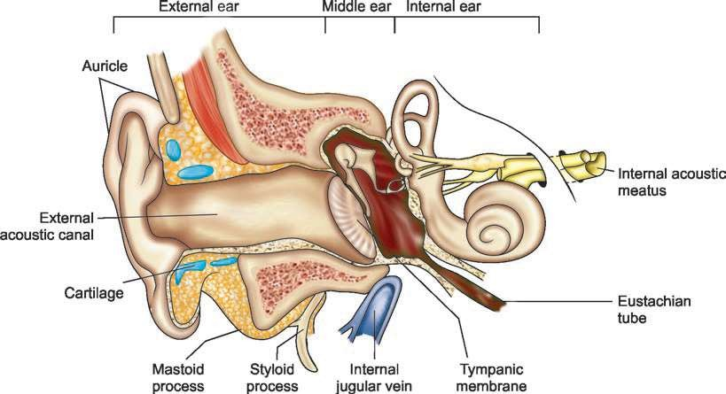
THE EAR

Slide 3
EXTERNAL EAR
Skin
Thin with no dermal palillae
Closely adherent to underlying cartilage & bony wall
The cartilagenous part of EAC has thick subcutaneous tissue which contains numerous ceruminous glands – secretes wax
Active – collumnar & Quiescent – cuboidal
Ceruminous glands and hair follicles are limited to
cartilagenous parts only

Slide 4
PINNA
Irregularly concave, faces forwards with many
eminences and depressions
Helix
Crus of helix
Auricular tubercle (Darwin’s tubercle)
Antihelix & its 2 cruras
Triangular fossa
Scaphoid fossa
Concha & Cympa concha
Tragus
Antitragus
Intertragic notch
Lobule of pinna

Slide 5
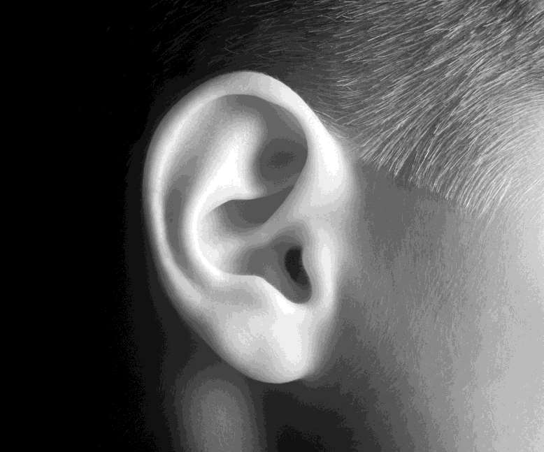

Slide 6
CARTILAGENOUS FRAMEWORK OF AURICLE
Single thin plate of elastic fibrocartilage (yellow
elastic cartilage)
It is continous with the cartilage of EAC (external auditory canal)
No cartilage in lobule and between tragus and crus of the helix
Helix and antihelix are separated by fissura anti- tragohelicinia
Medial aspect has Eminentia concha & Eminentia scaphae separated by sulcus anti-helicis transversus (corresponding to inferior crus of antihelix)
E. conchae is crossed y a oblique ridge –
Ponticulus (attachment of auricularis posterior)

Slide 7
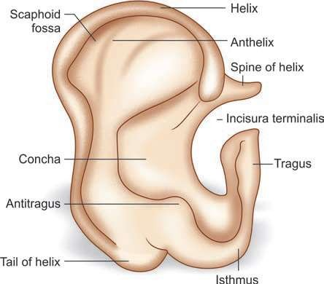
AURICULAR CARTILAGE

Slide 8
LIGAMENTS
Extrinsic - connects auricle to temporal bone
Anterior Lig - tragus & spine of helix to root of zygomatic process
Posterior Lig - post surface of concha to lat. surf of
mastoid process
Intrinsic - connects individual auricular cartilages
Strong fibrous band between tragus and helix
Another band between antihelix and tail of helix

Slide 9
MUSCLES
EXTRINSIC MUSCLES
Auricularis Anterior - smallest, thin & pale fibers
Auricularis Superior - largest, thin & fan-shaped
Auricularis Posterior - 2 or 3 fleshy fasiculi, inserts to
ponticulus
Blood supply - Post. Auricular artery
Nerve supply - Ant & Sup – Temporal br. of Facial Nr
Post. – Post auricular branch of Facial Nr.
Actions – Ant – forwards & upwards
Sup – elevates Post – backwards

Slide 10
INTRINSIC MUSCLES
Helicis Major – spine of helix to ant. border of helix
Helicis Minor – oblique fasciculus, covers crus of helix
Tragicus – short, flat, vertical band on lat aspect
Antitragicus – antitragus to tail of helix & antihelix
Transversus Auriculae – partly tendinous & partly
muscular, between eminentia conchae & em. scaphae
Obliquus auriculae – between eminentia conchae & scaphae
B/S – Post auricular & superficial temporal art
N/S – lat asp. – Temporal br of Facial Nr
med asp. – Post. Auricular br of Facial Nr
Actions – minimal change in shape of auricle

Slide 11
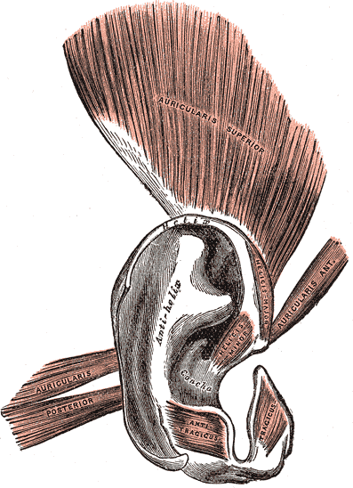
MUSCLES OF
EXT. EAR

Slide 12
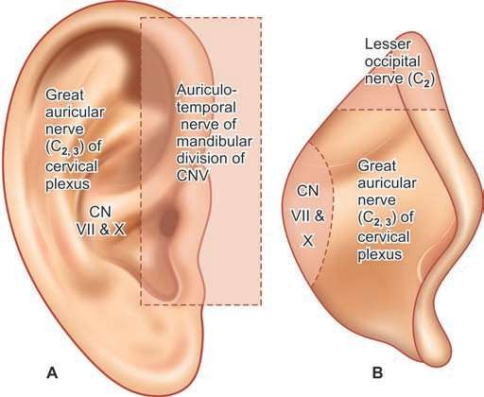
INNERVATION
OF AURICLE
Great Auricular Nr – most of medial surface & post. part of lateral surface (inclu. lobule)
Lesser Occipital Nr – upper part of medial surface
Auriculotemporal Nr – tragus, crus of helix & adjacent helix
Auricular br of Vagus (Arnold’s Nr) & Facial Nr – Concha (lat.) & Eminentia concha (med.), post. auricular skin

Slide 13
EXTERNAL AUDITORY CANAL
Dimensions: EAC measures about 24 mm
Extends from the concha to the tympanic membrane
Its anterior wall & floor are 6 mm longer than the posterior wall & roof
EAC is usually divided into 2 parts: Its outer one-third (8
mm) is cartilaginous and its inner two-third (16 mm) is bony.
Direction: EAC is ‘S’ shaped
Outer one-third is directed upwards, backwards & medially
Inner two-third is directed downwards, forwards & medially
Anatomically divided into – pars externa, pars media & pars interna

Slide 14
CARTILAGENOUS EAC
Fissures of Santorini: Transverse slits in the floor of cartilaginous EAC, provide passages for infections and neoplasms to and from the surrounding soft tissue (parotid & mastoid)
Hair follicles are present only in the outer cartilaginous canal and therefore furuncles are seen only here in Cartilagenous EAC
The skin of the cartilaginous canal is thick and contains ceruminous and pilosebaceous glands that secrete wax. The hydrophobic, slightly acidic (pH 6.0–6.5) cerumen is formed in this part of EAC.

Slide 15
BONY EAC
It is mainly formed by the tympanic portion of temporal bone but roof is formed by the squamous part of the temporal bone
In the anterosuperior region, squamous part articulates with tympanic bone (tympanosquamous suture).
Inferiorly and medially squamous part joins with the lateral superior portion of the petrous bone (petrosquamous suture).
Skin of the bony EAC is thin and continuous over the tympanic membrane & skin is devoid of subcutaneous layer, hair follicles and ceruminous glands.

Slide 16
Isthmus: Approximately 6 mm lateral to tympanic membrane, bony EAC has a narrowing called the isthmus. Foreign body impacted medial to bony isthmus of EAC are difficult to remove.
Foramen of Huschke: In children and occasionally in adults, anteroinferior bony EAC may have a deficiency that is called foramen of Huschke. It permits spread of infections to and from EAC and parotid.

Slide 17
RELATIONS OF BONY EAC
Superior: Middle cranial fossa
Inferior: Parotid gland
Posterior: Mastoid antrum and air cells and the facial nerve
Anterior: Temporomandibular joint (TMJ)
Medial: Tympanic membrane
Lateral: Cartilaginous EAC

Slide 18
NERVE SUPPLY
Auriculotemporal nerve (CN V3): It is a branch of mandibular division of trigeminal nerve and supplies antero-superior wall of EAC.
CN X (vagus nerve): Its auricular branch (Arnold’s nerve) supplies to infero-posterior wall of EAC.
CN VII (facial nerve): It innervates the skin of the mastoid and posterior of EAC.

Slide 19
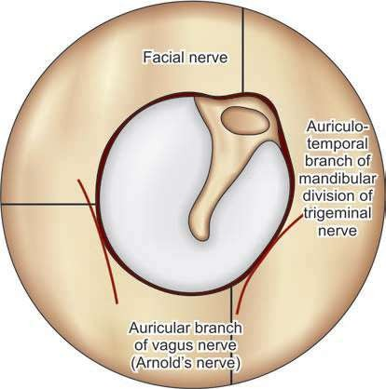

Slide 20
CLINICAL IMPORTANCE OF N/S OF EAC
Hitzelberger’s sign: The hypoesthesia of posterior meatal wall occurs due to the pressure on facial nerve (sensory fibers are affected early) in patients with acoustic neuroma.
Vasovagal reflex: While cleaning the EAC, patient may develop coughing, bradycardia, syncope and even cardiac arrest. They can occur because of Arnold’s branch of vagus nerve.
Appetite: Because of vagal innervation, instilling spirit in EAC before meal can stimulate appetite.
Ramsay Hunt syndrome: Vesicles of herpes zoster oticus occur on mastoid and posterior meatal wall which indicate that this part of external ear has facial nerve innervation.

Slide 21
TYMPANIC MEMBRANE
Dimensions: Its dimensions are: 9–10 mm height
and 8–9 mm width. It is 0.1 mm thick.
„Position: Tympanic membrane (TM) is a partition wall between the EAC and the middle ear. It is positioned obliquely. It forms angle of 55° with deep EAC. Its posterosuperior part is more lateral than its anteroinferior part.

Slide 22
Structure: Tympanic membrane consists of the following three layers
Outer epithelial layer (Cuticular Stratum): It is continuous with the EAC skin. Keratinised, stratified squamous type. 10 cells thick.
* The cells have a propensity for lateral migration
Middle fibrous layer (Fibrous Stratum): It encloses the handle of malleus and consists of three types of fibers: radial, circular and parabolic. In comparison to pars tensa, this layer is very thin in pars flaccida (consists of loose conn. tissue) and not organized into various fibers.
Inner mucosal layer (Mucous Stratum): It is continuous with the middle ear mucosa. Single layer of flat cells. Cilliated collumnar cells are absent over medial aspect of TM.

Slide 23
Parts: Tympanic membrane consists of two parts:
Pars tensa: It forms most of tympanic membrane
Annulus tympanicus: TM is thickened in the periphery and forms a fibrocartilaginous ring called the annulus tympanicus that fits in the tympanic sulcus.
Umbo: The central part of TM near the tip of malleus is tended inwards and is called the umbo.
Cone of light: A bright cone of light radiating from the tip of malleus to the periphery in the anteroinferior quadrant is usually seen during otoscopy.
Pars flaccida (Shrapnell’s membrane): It is situated above the lateral process of malleus between the notch of Rivinus and the anterior and posterior malleal folds. It is not as tense as pars tensa and may appear little pinkish.

Slide 24
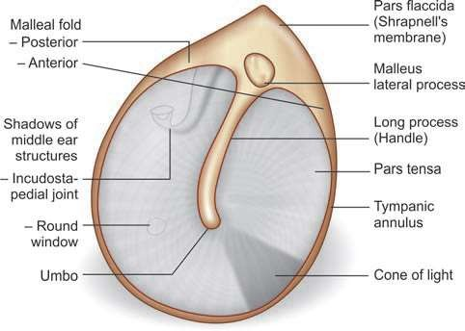

Slide 25
NERVE SUPPLY:
Auriculotemporal nerve (CN V3): It is a branch of mandibular division of trigeminal nerve and supplies anterior half of lateral surface of TM.
CN X (vagus nerve): Its auricular branch (Arnold’s nerve) supplies to posterior half of lateral surface of TM.
CN IX (glossopharyngeal nerve): Its tympanic branch (Jacobson’s nerve) supplies to medial surface of tympanic membrane.

Slide 26
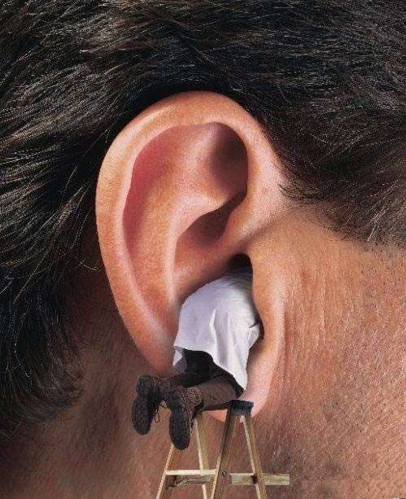
MIDDLE EAR

Slide 27
MIDDLE EAR
The middle ear cleft is lined by mucous membrane
and filled with air
Consists of the middle ear, eustachian tube, aditus ad antrum, mastoid antrum and mastoid air cells.
Middle ear is a 1 to 2 cm3 air filled cavity that houses ossicles, stapedius and tensor tympani muscles and chorda tympani nerve and tympanic plexus.

Slide 28
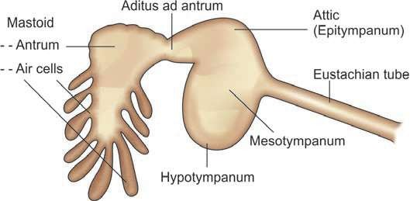
PARTS OF MIDDLE EAR CLEFT

Slide 29
RELATIONS OF MIDDLE EAR CLEFT
Roof: Tegmen plate separates it from middle cranial fossa and its contents like meninges and temporal lobe of cerebrum.
„Floor: Jugular bulb
Medial: Labyrinth & the Lateral semicircular canal
lies posterosuperior to facial nerve.
„Posterior: Sigmoid venous sinus
Anterior: Petrous part of internal carotid artery
lying in carotid canal
Posteromedial: Posteromedial to mastoid air cells is situated cerebellum in the posterior cranial fossa

Slide 30
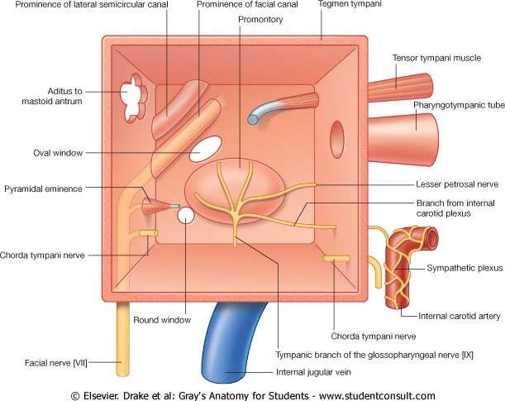

Slide 31
PARTS OF MIDDLE EAR
Mesotympanum: This is the portion of middle ear
that lies at the level of pars tensa.
Epitympanum (attic): This is the portion of middle ear that lies above the level of pars tensa and medial to Shrapnell’s membrane and the bony lateral attic wall.
Hypotympanum: This is the portion of middle ear that lies below the level of pars tensa.
Protympanum: The portion of middle ear around the eustachian tube opening is termed as protympanum. Presence of more goblet cells near the orifice of E. Tube

Slide 32
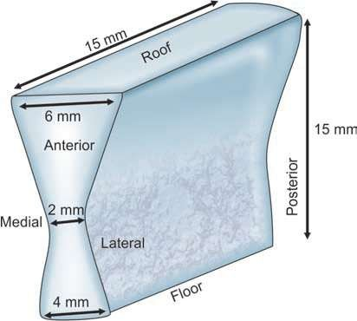
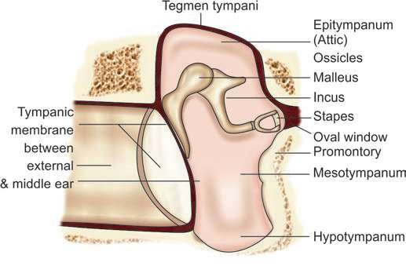
MIDDLE EAR

Slide 33
BOUNDARIES OF MIDDLE EAR
Middle ear has six boundaries: roof, floor, and medial,
lateral, anterior and posterior walls.
Roof (Tegmental wall): It is formed by tegmen tympani (a thin plate of bone), which extends posteriorly to form the roof of the aditus and antrum (tegmen antri). Tegmen tympani separates middle ear from the middle cranial fossa.
Floor (Jugular wall): The floor, a thin plate of bone,
separates tympanic cavity from the jugular bulb.
 The floor of middle ear may be congenitally dehiscent. In such cases, jugular bulb projects into the middle ear and is at greater risk of injury during surgery because it is only covered by middle ear mucosa.

Slide 34
3. Anterior (carotid wall): The anterior wall, a thin plate of bone, which separates the middle ear cavity from internal carotid artery, has following features:
Eustachian tube: It connects the middle ear with nasopharynx. It aerates and drains the middle ear. Malfunctioning of eustachian tube is common cause of ear infections especially in children.
Canal of tensor tympani muscle: It is situated in the roof of eustachian tube.
Canal for chorda tympani nerve (Canal of Huguier)
Attachment of anterior malleolar ligament.
Canal for Lesser Petrosal Nr
Canal for branch from Int. Carotid Plexus to tympanic
plexus (Caroticotympanic Nr)

Slide 35
4. Posterior (mastoid wall): It lies close to the mastoid air cells and presents following structures:
Pyramid: It is a bony projection through the summit of which appears the tendon of the stapedius muscle that is inserted to the neck of stapes.
Aditus ad antrum: It is an opening through which mastoid antrum opens into the attic. It lies above the pyramid. Its relations are following:
Medial: Bony prominence of the horizontal semicircular canal.
Lateral: Fossa incudis, to which is attached the short process of incus.
Inferior: Fallopian canal for facial nerve.
Facial nerve: The vertical mastoid part of the fallopian canal for facial nerve runs in the posterior wall just behind the pyramid.

Slide 36
 Facial (suprapyramidal) recess: This recess is a depression in the posterior wall lateral to the pyramid. Its boundaries are following:
Medial: Vertical part of CN VII.
Lateral: Chorda tympani (branch of 7th CN) and tympanic
annulus.
Superior: Fossa incudis, in which lies short process of incus.
 Sinus (infrapyramidal) tympani: This deep recess lies medial to the pyramid. It is bounded by the subiculum below and the ponticulus above.

Slide 37
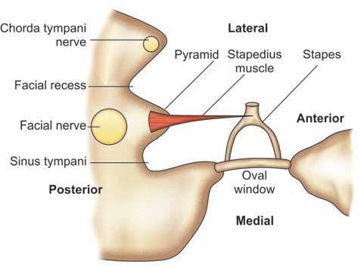
FACIAL RECESS AND SINUS TYMPANI RELATIONS WITH FACIAL NERVE AND PYRAMIDAL EMINENCE

Slide 38
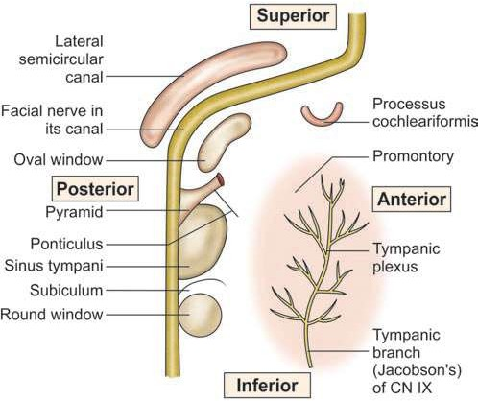

Slide 39
5. Medial (labyrinthine wall): It is formed by the lateral wall of labyrinth. It presents following structures:
Promontory: It is a bony bulge which is due to the basal coil of cochlea. Tympanic plexus present over it. Anteriorly – rel to apex of cochlea
Posteriorly – rel to sinus tympani
Oval window (fenestra vestibuli/ovalis): Kidney shaped opening. Situated above and behind promontory. The footplate of stapes is placed over this window guarded by anular ligament.
Round window (fenestra cochleae/rotunda): lies below & behind F.Ovalis. It is covered by the secondary tympanic membrane, having 3 layers : External – tymp mucosa
Intermediate – fibrous layer
Internal – cochlear lining membrane.

Slide 40
OSSICLES
 The ossicles conduct sound energy from the tympanic membrane to the oval window. There are three middle ear ossicles.
Malleus (Hammer): It consists of a head, neck, handle (manubrium), a lateral and an anterior process. It is the largest ossicle and measures 8 mm in length.
Head and Neck: They lie in the attic.
Manubrium(handle): It is embedded in the fibrous layer of the tympanic membrane.
Anterior process: bony spicule connected to petrotympanic fissure by ligamentous fibres
Lateral process: It appears as a knob-like projection on the outer surface of the tympanic membrane and provides attachments to the anterior and posterior malleal folds.

Slide 41
2. Incus (Anvil): It consists of following parts:
Body and Short process: They lie in the attic. Short pr.
Is connected to fossa incudis by lig. fibres in
epitympanic recess
Long process: It hangs vertically and medial & parallel to malleus handle and forms incudostapedial joint with the head of stapes by its lenticular process.
Stapes (Stirrup):
This smallest bone of body measures about 3.5 mm.
It consists of head, neck, anterior and posterior crura
and footplate.
The footplate is positioned in the oval window by annular ligament

Slide 42
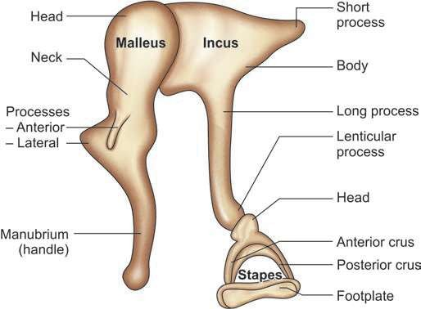

Slide 43
LIGAMENTS OF OSSICLES
Malleus
Anterior ligament of Malleus: neck of malleus to ant wall of tympanic cavity
Contains muscle fibers called as Laxator tympani/ Musculus externus mallei
Lateral ligament of Malleus: triangular band, from post
border of tympanic inscisure to head of malleus
Superior ligament of Malleus: head of malleus to roof of epitympanic recess
Incus
Posterior ligament of Incus: from end of short process to fossa incudis
Superior ligament of Incus: body to roof of epitympanic recess
Stapes
Vestibular surf & rim of stapedial base covered with hyaline cartilage, which is attached to margin of fen. vestibuli by annular ligament

Slide 44
MUSCLES OF MIDDLE EAR
Tensor tympani: It runs above the eustachian tube in a bony tunnel. Its tendon turns round the processus cochleariformis and passes laterally.
Origin: from the bony tunnel, the cart. part of E.Tube &
the adjoining part of greater wing of Sphenoid.
Insertion: Just below the neck of malleus.
N/S: It develops from the 1st branchial arch and is supplied by a branch of the nerve to medial pterygoid, a br of mandibular division of trigeminal nerve (CN V3).
B/S: sup. tympanic br of middle meningeal artery
Action : It tenses the tympanic membrane by drawing the handle of malleus medially.

Slide 45
Stapedius: On contraction it dampens the loud sounds and prevents noise trauma to the inner ear.
Origin: Conical cavity and canal within pyramid (on post. tymp wall).
Insertion: It inserts to the neck stapes.
N/S: It is developed from the 2nd branchial arch and is supplied by a branch of CN VII (nerve to stapedius of facial nerve)
B/S: branches of Posterior auricular, anterior tympanic & middle meningeal arteries
Action: damp down excessive sound vibrations.
Opposes action of tensor tympani which pushes the stapes more tightly into fenestra vestibuli

Slide 46
ACOUSTIC REFLEX
When noises are loud, there occurs reflex contraction of stapedius and tensor tympani which helps to dampen the movement of ossicular chain before vibrations reach the internal ear.
Afferent pathway: auditory component of 8th Cr Nr
Efferent Pathway: Facial Nerve – Stapedius & Mandibular Nerve – Tensor tympani

Slide 47
INTRATYMPANIC NERVES
Tympanic plexus (Nerve supply of middle ear): The tympanic nerve plexus, which lies on the promontory, supplies to the medial surface of the tympanic membrane, tympanic cavity, mastoid air cells and the bony eustachian tube. It is formed by following nerves:
Tympanic branch of glossopharyngeal (Jacobson’s
Nerve) : It carries secretomotor fibers to the parotid gland.
The pathway of secretomotor fibers to the parotid gland consists of
Inferior salivary nucleus → CN IX →
Jacobson’s tympanic branch → Tympanic plexus →
Lesser petrosal nerve → Otic ganglion →
Auriculotemporal nerve → Parotid gland.
Section of Jacobson’s nerve is carried out in cases of Frey’s syndrome.
Sympathetic fibers: Caroticotympanic nerves come from the sympathetic plexus, which is present round the internal carotid artery

Slide 48
Chorda tympani nerve: This branch of the facial nerve enters the middle ear through posterior canaliculus.
It runs on the medial surface of the tympanic
membrane.
It lies between the malleus and long process of incus, above the insertion of tensor tympani.
It carries gustatory fibers from the anterior two-third of tongue and parasympathetic secretomotor fibers to the submaxillary and sublingual salivary glands.

Slide 49
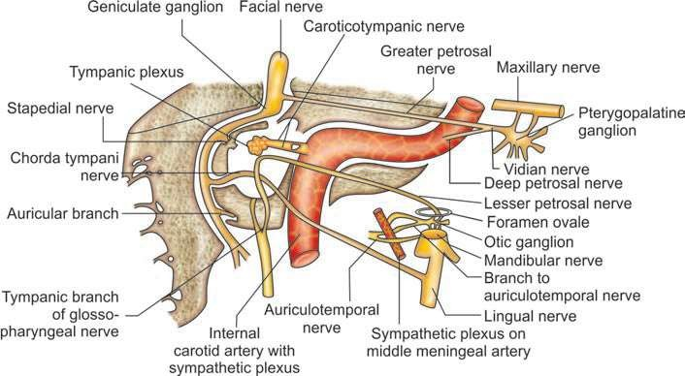
NERVES IN RELATION WITH THE MIDDLE EAR

Slide 50
MASTOID ANTRUM
 This air-containing space (9 mm height, 14 mm width and 7 mm
depth) is situated in the upper part of mastoid. Vol – 1ml
BOUNDARIES -
Roof: It is formed by the tegmen antri, which separates mastoid antrum from the middle cranial fossa.
Lateral wall: It is formed by a 15mm thick plate of squamous part of temporal bone which is marked on the lateral surface of mastoid by suprameatal (Macewen’s) triangle. It is covered by postaural skin.

Slide 51
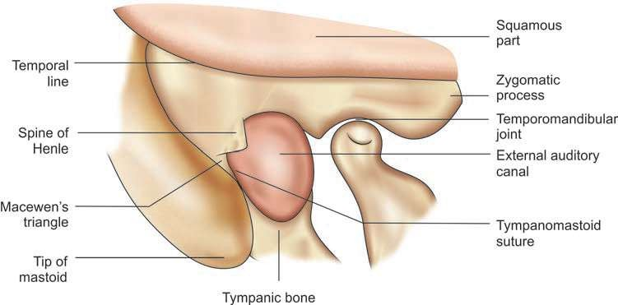
MACEWEN’S TRIANGLE

Slide 52
Medial wall: It is formed by the petrous bone and related to the
Posterior semicircular canal
Endolymphatic sac
Dura of posterior cranial fossa
Anterior: Anteriorly mastoid antrum communicates with the attic through the aditus ad antrum. Medial to lateral relations are following:
Facial nerve canal
Aditus ad antrum and facial recess lie between tympanum and mastoid antrum
Deep bony external auditory canal (EAC)

Slide 53
Posterior wall: It is formed by mastoid bone and communicates with mastoid air cells.
Sigmoid sinus curves downwards.
Floor: It is formed by mastoid bone and communicates with mastoid air cells. Other deeper relations from medial to lateral sides are
Jugular bulb medial to facial canal.
Digastric ridge which gives origin of posterior belly of digastric muscle.
Origin of sternocleidomastoid muscle.

Slide 54
TYPES OF MASTOID
The mastoid consists of “honeycomb” air cells, which lie underneath the bony cortex. Depending on its development, three types of mastoid are described: cellular, diploeic and acellular.
Cellular (Well-pneumatized): Mastoid cells are well
developed with thin intervening septa.
Diploeic: Mainly there are marrow spaces with few air cells.
Acellular (Sclerotic): There are neither cells nor
marrow spaces.

Slide 55
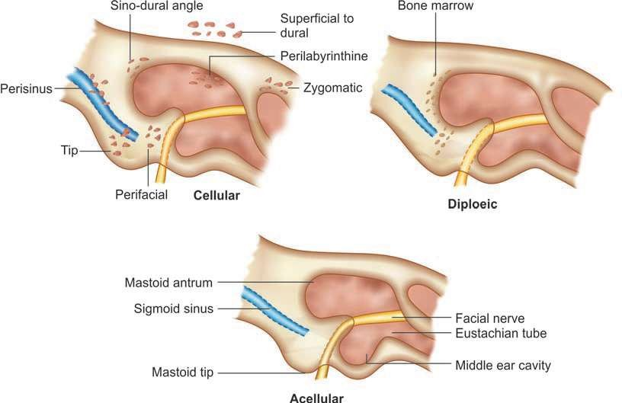
3 TYPES OF MASTOID AIR CELLS

Slide 56
MASTOID AIR CELLS
The mastoid air cells are traditionally divided into several groups, which include:
Zygomatic cells: In the root of zygoma.
Tegmen cells: In the tegmen tympani.
Perisinus cells: Present over the sinus plate.
Retrofacial cells: Present round the fallopian canal of facial nerve.
Perilabyrinthine cells: They are located above, below and behind the
labyrinth.
The cells, which are present in the arch of superior semicircular canal, may communicate with the petrous apex.

Slide 57
Peritubal cells: They are present around the eustachian tube. These and the hypotympanic cells communicate with the petrous apex.
Tip cells: These large cells lie in the tip of mastoid medial and lateral to
the digastric ridge.
Marginal cells: These cells, which lie behind the sinus plate, may extend into the occipital bone.
Squamous cells: They lie in the squamous part of temporal bone.

Slide 58
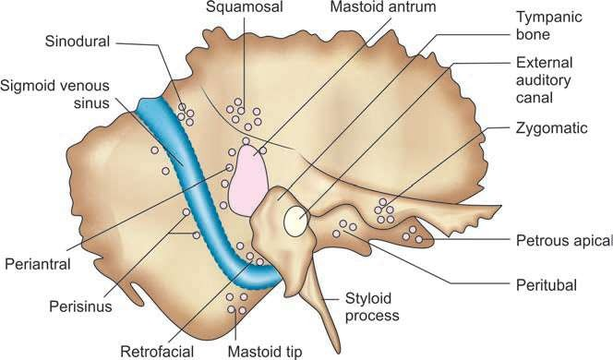
AIR CELLS OF TEMPORAL BONE

Slide 59
COMPARTMENTS & FOLDS OF MIDDLE EAR
Ossicles and their mucosal folds separate
mesotympanum from epitympanum (attic).
Compartments of Epitympanum
Prussak’s space: Its boundaries, which limit spread of infection to other compartments, are following:
Lateral: Membrana flaccida (Shrapnell’s membrane)
Medial: Neck of malleus
Floor: Lateral process of malleus
Roof: Fibers of lateral malleolar ligament arising from neck of malleus and inserting along the rim of notch of Rivinus

Slide 60
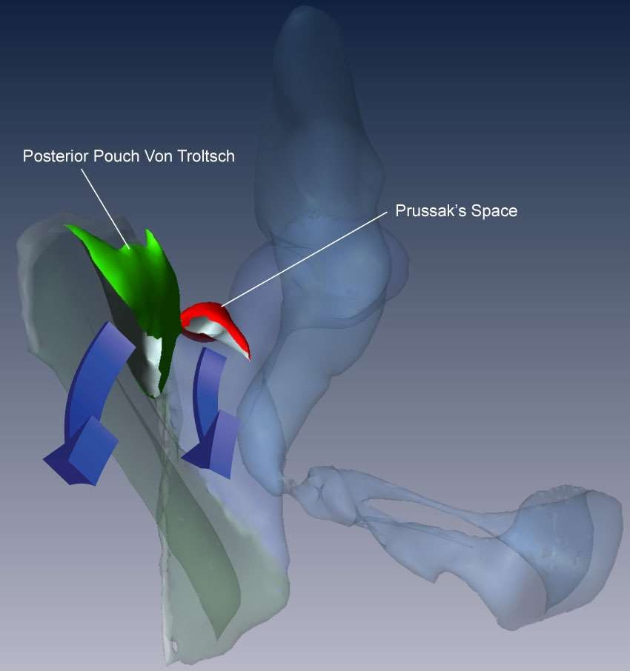
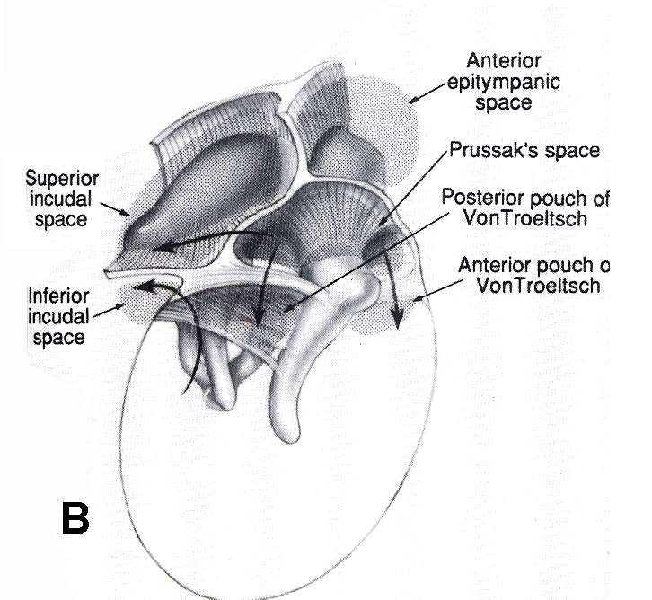

Slide 61
2. Attic compartments:
Transversely placed superior malleolar fold divides attic into two compartments – smaller anterior and larger posterior.
The space between the lateral malleolar fold and lateral incudal fold provides communication with Prussak’s space.
2 compartments
Anterior attic compartment
Posterior attic compartment: Superior incudal fold divides this space into following two divisions:
Medial space
Lateral space

Slide 62
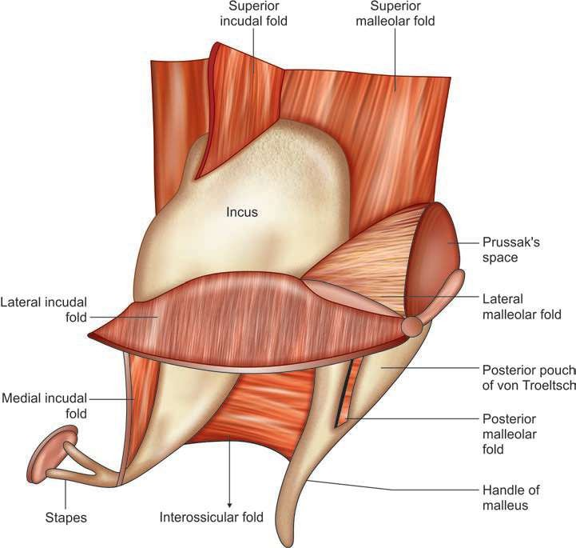
POSTEROSUPERIOR AND LATERAL VIEW OF RIGHT TYMPANIC CAVITY SHOWING COMPARTMENTS AND FOLDS OF MIDDLE EAR

Slide 63
Compartments of Mesotympanum:
In the upper part of mesotympanum there are following
three compartments.
Inferior incudal space: Its boundaries are following
Superior: Lateral incudal fold
Medial: Medial incudal fold
Lateral: Posterior malleolar fold extending from neck of malleus to posterosuperior margin of tympanic sulcus.
Anterior: Interossicular fold that lies between long process of incus and upper two-third of handle of malleus.

Slide 64
POSTEROSUPERIOR AND LATERAL VIEW OF RIGHT TYMPANIC CAVITY SHOWING COMPARTMENTS AND FOLDS OF MIDDLE EAR

Slide 65
2. Anterior pouch of von Troeltsch: It lies between the following boundaries:
Medial: Anterior malleolar fold extending from neck of
malleus to anterosuperior margin of tympanic sulcus
Lateral: Portion of the tympanic membrane anterior to handle of malleus
Posterior pouch of von Troeltsch: It is situated
between the following boundaries:
Medial: Posterior malleolar fold extending from neck of malleus to posterosuperior margin of tympanic sulcus.
Lateral: Portion of the tympanic membrane posterior to
handle of malleus.

Slide 66
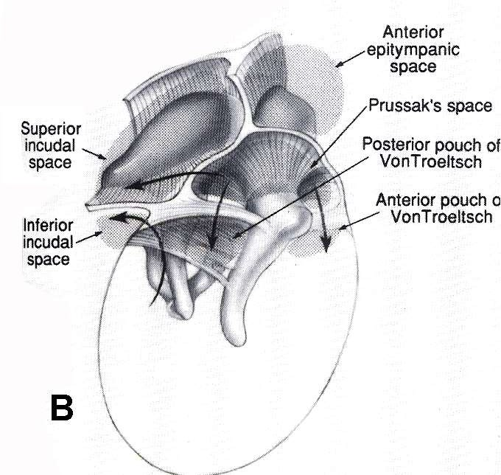
SPACES & FOLDS IN MIDDLE EAR

Slide 67
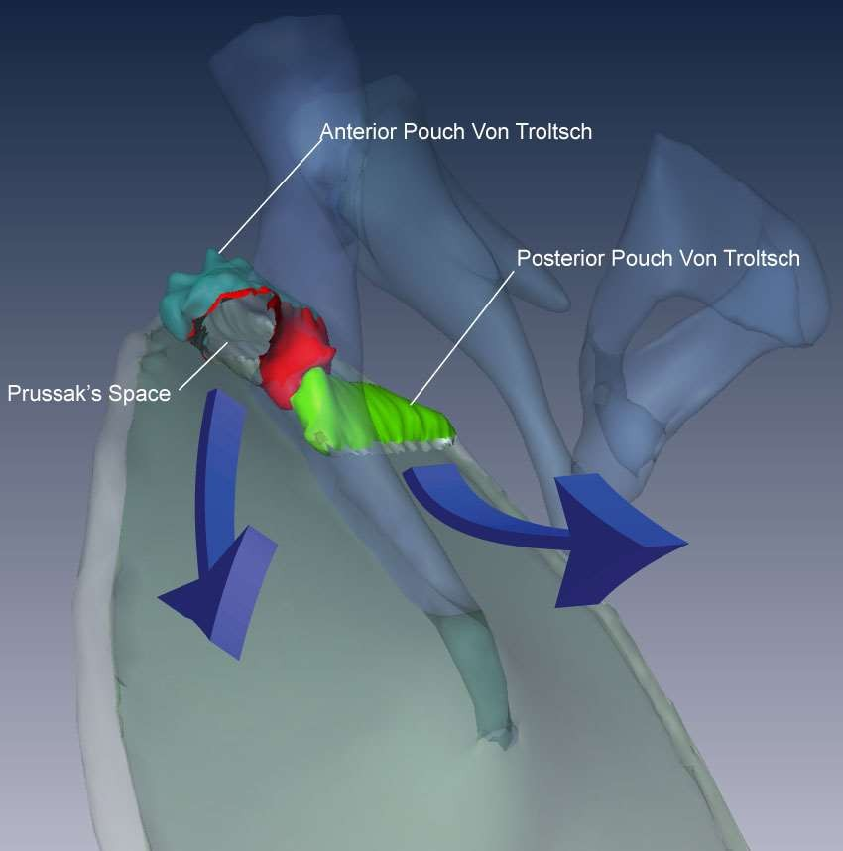

Slide 68
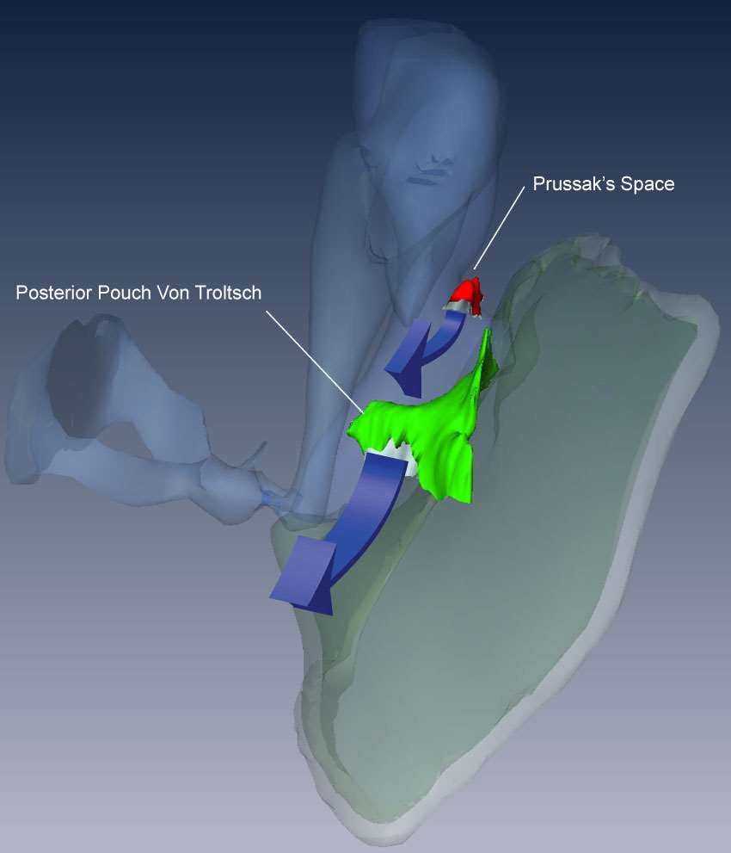

Slide 69
KORNER’S SEPTUM
Mastoid develops from the squamous and petrous
parts of temporal bone.
In some cases petrosquamosal suture persists as a bony plate called Korner’s septum, which separates superficial squamosal cells from the deep petrosal cells.
During the mastoid surgery, Korner’s septum causes difficulty in locating the antrum and the deeper cells.
If not recognized, Korner’s septum leads to incomplete removal of disease during mastoidectomy. Mastoid antrum can be entered into only after the removal of Korner’s septum

Slide 70
BLOOD SUPPLY
ARTERIAL SUPPLY
Following branches of external and internal carotid
arteries supply blood to middle ear:
External Carotid Artery
Maxillary artery
Anterior tympanic artery: Major contributor
Middle meningeal artery
Petrosal branch
Superior tympanic artery: It traverses along the canal for tensor tympanic muscle.
Artery of pterygoid canal: Branch that runs along eustachian tube.
Posterior auricular artery
Stylomastoid artery: Major contributor
Ascending pharyngeal artery
Tympanic branch
Internal Carotid Artery: petrous part
Caroticotympanic branches.

Slide 71
VENOUS DRAINAGE
Veins from the middle ear cleft drain into pterygoid venous plexus, superior petrosal sinus and sigmoid sinus.
LYMPHATIC DRAINAGE
The lymphatics of middle ear drain into retropharyngeal and parotid nodes. Eustachian tube lymphatics drain into retropharyngeal group of lymph nodes . Internal ear does not have any lymphatics

Slide 72
THANK YOU…☺

