Slide 1
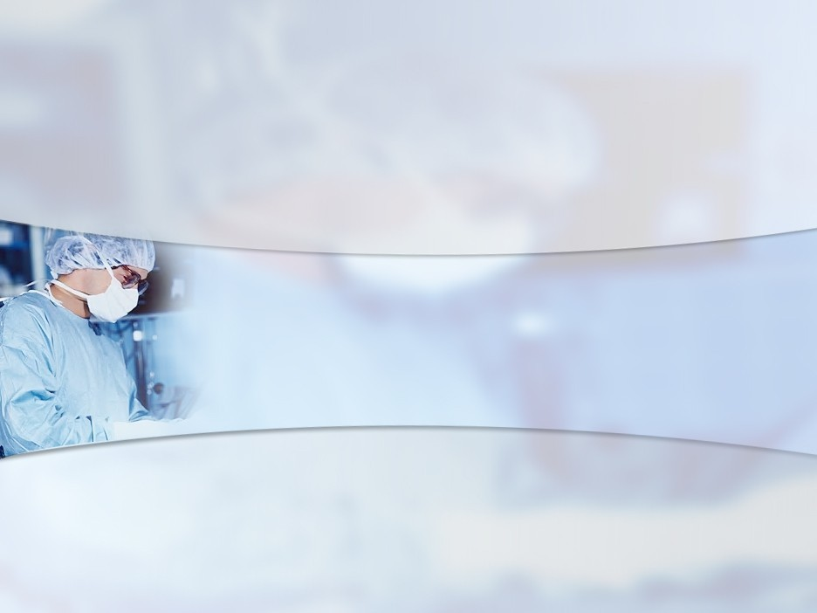
Chronic suppurative otitis media

Slide 2
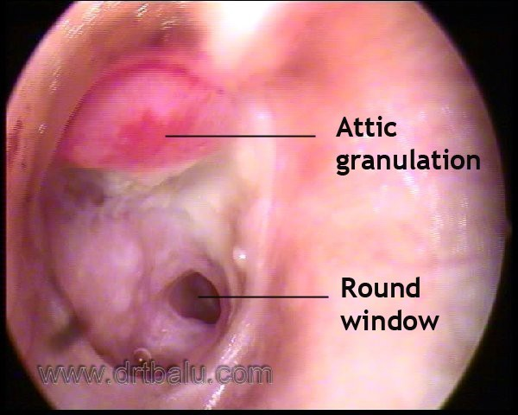
Definition
■
CSOM is defined as a chronic infection of middle ear mucosa lining the middle ear cleft
The duration of infection should be more than 3 weeks
Middle ear cleft includes eustachean tube, middle ear proper and mastoid air
■
■
cell system

Slide 3
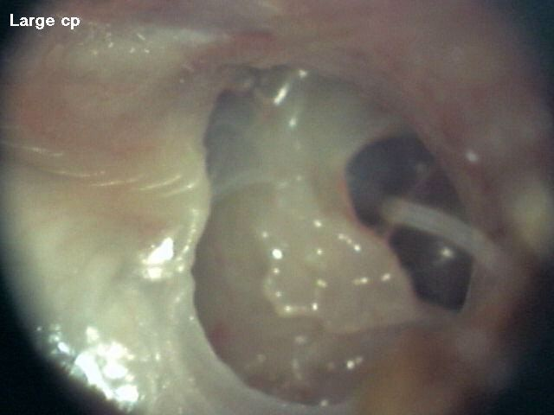
Tubotympanic disease
Also known as safe ear
It does not cause any serious complications
Infection limited to the antero inferior part of middle ear cleft
Associated with central perforation

Slide 4
Why is Tubotympanic disease safe?
There is no risk of bone erosion
Not known to cause intracranial complications
Discharge from middle ear flows freely through the perforation in the pars tensa
Usually the perforation of pars tensa is surrounded by a rim of intact drum
The annulus is intact in all these cases

Slide 5
Aetiology
Inadequately treated ASOM
ASOM causing persistent perforation (Persistent perforation syndrome)
Presence of focal sepsis in Nose / throat causing EC
Infected traumatic central perforation

Slide 6
Microbiology
Gram negative bacilli has been commonly isolated
Ps. aeruginosa, E. coli, and B. proteus
These organisms are not commonly found in the respiratory tract
These organisms are commonly found in the skin of external canal

Slide 7
Clinical features
Discharge is profuse and Mucopurulent
It is not foul smelling
Since the infected area is open at both ends discharge doesn't accumulate in the middle ear cavity
Ossicular chain is mostly uninvolved
Pts have conductive deafness – 30 – 40 dB
Pain is usually due to otitis externa

Slide 8
Stages of Tubotympanic disease
Acute stage Inactive stage Quiescent stage Healed stage
■
■
■
■

Slide 9
Acute stage
Ear is actively discharging
Middle ear mucosa hypertrophied and congested
The ear discharge is Mucopurulent
Discharge is not foul smelling

Slide 10
Inactive stage
Dry perforation of ear drum +
Perforation involves the pars tensa
Annulus is intact
Middle ear mucosa is normal and healthy

Slide 11
Quiescent stage
Perforation of ear drum present
Middle ear is dry
Middle ear mucosa may be normal / hypertrophied
Discharge stopped just a few days back

Slide 12
Healed stage
Healing of drum by thin scar
Tympanosclerotic patches may be seen
Ossicular chain invariably intact

Slide 13
Tuning fork tests
Rinne negative on the affected side
Weber lateralized to deaf ear
ABC - Not reduced

Slide 14
Pure tone audiometry
Shows conductive hearing loss
Hearing loss commonly ranges between 30 - 40 dB
If hearing loss exceeds 60 dB then ossicular chain disruption should be suspected
Associated sensorineural loss should arouse suspicion of toxic deafness
■
■
■
■

Slide 15
Conservative management
Aural toileting - in active disease
Suction clearance
Syringing of affected ear using warm saline mixed with 1.5 % acetic acid
Topical antibiotics administered after culture report becomes available
Ear drops is administered by displacement method

Slide 16
Role of systemic drugs
Antibiotics
Antihistamines
Ototoxic drugs to be avoided
Nasal decongestants ? Rhinitis medicamentosa

Slide 17
Precautions
The ear must be kept dry
Pre-existing sinus infections to be treated aggressively
Presence of focal sepsis in the throat should also be managed
■
■
■

Slide 18
Surgical management
Surgery towards eradication of focal sepsis
Surgery aimed towards eradication of middle ear disease (Mastoidectomy)
Surgery aimed at reconstruction of sound conduction mechanism (Myringoplasty and tympanoplasty)
■
■
■

Slide 19
Tympanoplasty
Tympanoplasty is defined as the surgical procedure which enables reconstruction of middle ear cavity and ossicular system. It also involves reconstruction of the perforated ear drum

Slide 20
Components of tympanoplasty
Canalplasty Meatoplasty Myringoplasty Ossiculoplasty
■
■
■
■

Slide 21
Canalplasty
This procedure is used to widen the external canal
Should be performed before grafting anterior perforations
This procedure facilitates better healing
External canal can be cleansed without any difficulty
Useful when performing second stage ossiculoplasty

Slide 22
Meatoplasty
This procedure is performed to enlarge the lateral cartilagenous portion of the external canal
This enlargement should be in proportion to the size of the bony portion of the external canal
■
■

Slide 23
Ossiculoplasty
■
Used to reconstruct the damaged ossicles of middle ear cavity
Long process of incus is found to be commonly eroded
TORP PORP
■
■
■

Slide 24
Aims of tympanoplasty
Disease eradication
Restoration of middle ear aeration
Reconstruction of sound conduction mechanism
Creation of self cleansing dry cavity

Slide 25
Preop investigations
Tubal function tests Audiometric evaluation
X-ray / CT scan of temporal bones Tests for anesthetic fitness
■
■
■
■

Slide 26
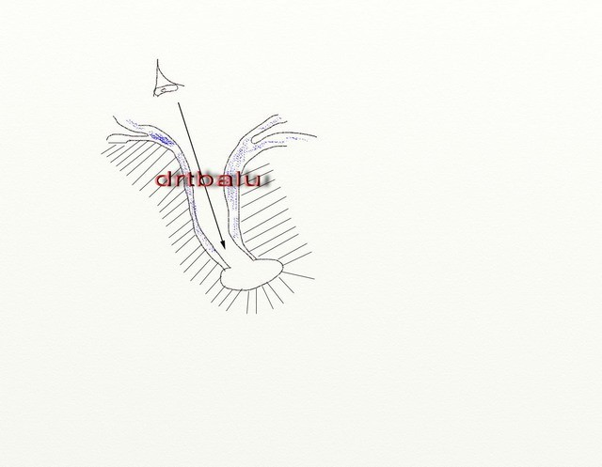
Trans canal surgical approach
■
Performed through ear speculum inserted into the ear canal
Ear canal should be wide
There should not be any bony overhang obscuring the edges of perforation
■
■

Slide 27
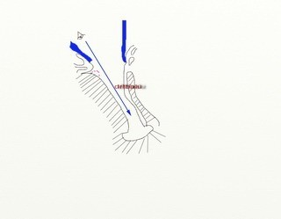
End aural approach
■
Incision is made between tragus and helix
End aural speculum is used
Posterior bony overhang can easily be drilled out
■
■
Better for anterior visualization of the ear drum

Slide 28
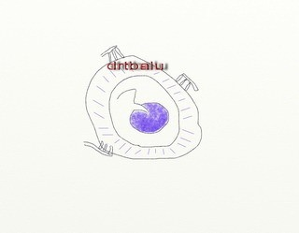
Endaural view of ear drum

Slide 29
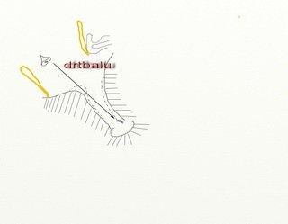
Post aural approach
■
Used in cases of narrow external canal
Used to close anterior ear drum perforations
William Wild’s post aural incision is used
■
■

Slide 30
Ideal Tympanic membrane grafts
Temporalis fascia Dura
Periosteum
■
■
■

Slide 31
Why temporalis fascia is favoured?
It has a low basal metabolic rate
Its thickness more or less resembles that of normal ear drum
It can be harvested through the same post aural incision
It is available in plenty It has a good take rate
■
■
■
■
■

Slide 32
Types of grafting techniques
Overlay technique Underlay technique Interlay technique
■
■
■

Slide 33
Underlay technique
Commonly used technique
The graft is placed under the tympanic membrane remnant and bone
To facilitate this process a tympanomeatal flap will have to be elevated
■

Slide 34
Overlay technique
The graft is placed over the bony tympanic sulcus
A bony ledge is created for this purpose if the sulcus is absent
The overlaid graft is supported by the remnant ear drum if present
❖
❖
❖

Slide 35
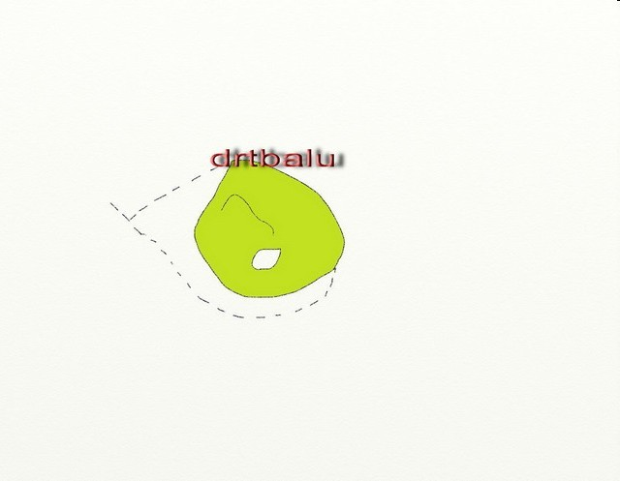
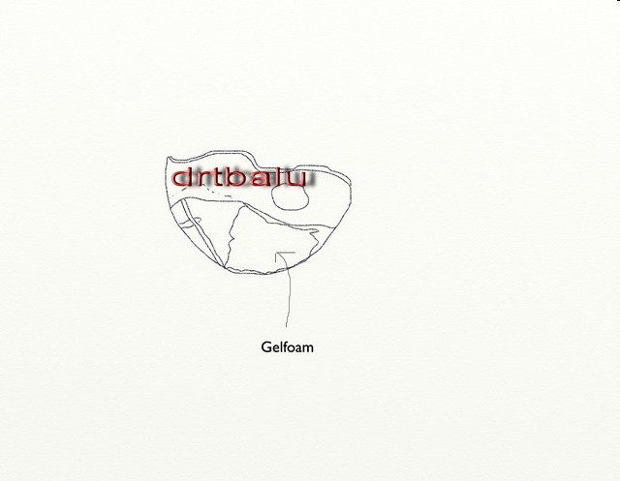
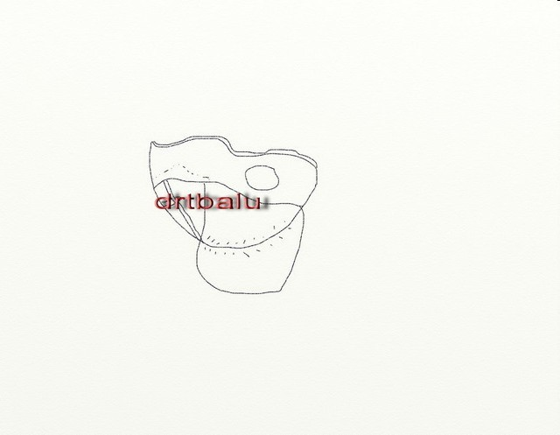
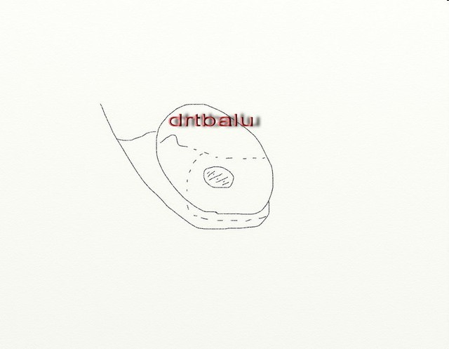
Underlay technique

