Slide 1
EUSTACHIAN TUBE disorders

Slide 2
EUSTACHIAN TUBE DISORDERS
ANATOMY
ACUTE SALPHINGITIS
CHRONIC EUSTACHIAN TUBE OBSTRUCTION
PATULOUS EUSTACHIAN TUBE OBSTRUCTION

Slide 3
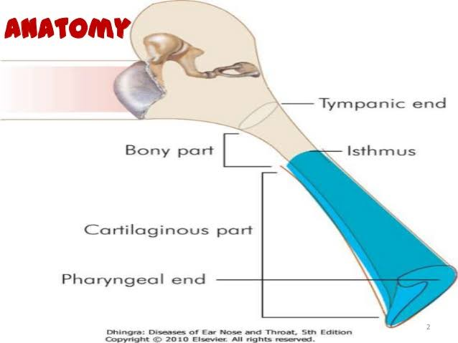
ANATOMY
Osseo Cartilageno Membranous tube
Communicates nasopharynx &middle ear
Conditions affecting the tube can alter middle ear functions
Commonly nasal & nasopharyngeal conditions direct effect on functioning of Eustachian tube

Slide 4
Acute salphingitis
Acute Eustachian tube catarrh –acute inflammation of mucosa of Eustachian tube
CAUSES
Acute sinusitis
Acute nasophayrngitis
Allergic rhinitis
Enlarged adenoids

Slide 5
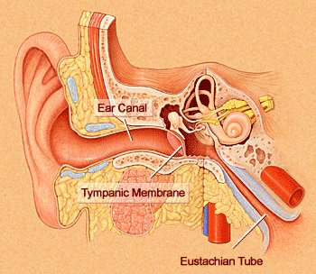
Acute salphingitis
SYMPTOMS:
Blocked sensation in ear,
Autophony (hears his own voice)
TREATMENT:
Antibiotics,
gentle blowing of nose,
anti histamine,
nasal decongestants,
steam inhalation,
adenoid removal

Slide 6
CHRONIC EUSTACHIAN TUBE OBSTRUCTION
CAUSES
Trauma
Infection
Chronic lymphoid hyperplasia
Naso pharyngeal tumour
Cleft palate

Slide 7
CHRONIC EUSTACHIAN TUBE OBSTRUCTION
SYMPTOMS:
Clicking sound on swallowing
Blocked sensation in ear,
Flucuating conductive hearing loss
Intermittent tinnitus
On examination – retracted tympanic membrane,
diminished mobility of membrane, air bubbles in middle ear,
TREATMENT:
Antibiotics,
gentle blowing of nose,
anti histamine,
nasal decongestants,
steam inhalation,
Valsalva exercise & Politzerisation
Myringotomy with grommet insertion

Slide 8
PATULOUS EUSTACHIAN TUBE DYSFUCTION
Abnormal patency of Eustachian tube lumen
CAUSES
Idiopathic
Sudden wait loss
Bariatric surgery
Multiple sclerosis

Slide 9
PATULOUS EUSTACHIAN TUBE DYSFUCTION
SYMPTOMS:
Aural fullness, Otolgia,
Autophony (hears his own voice)
URTIs
On examination – Medial & lateral excursion of tympanic membrane
while nasal breathing with opposite nostril closed
INVESTIGATION:
Tympanometry
Vestibularevoked myogenic potential
Electocochleography

Slide 10
PATULOUS EUSTACHIAN TUBE DYSFUCTION
TREATMENT:
Reassurance
To stop topical steroids and nasal decongestants
Oral fluids
Potassium iodide oral intake
Topical nasal drops
Myringotomy and grommet insertion
Cauterization of Eustachian tube orifice with trichloro acetic acid
Teflon injection
Eustachian tuboplasty.

