Slide 1
Headache and facial pain

Slide 2
Classification
International Classification of Headache Disorders (ICHD)

Slide 3
Primary headache
A headache that is not caused by another underlying disease,trauma or medical condition.
◻ Accounts for about ninety percent of all headaches.
secondary headache
◻ Caused by exogenous disorders

Slide 4
Primary headache
TENSION TYPE HEADACHE
MIGRAINE
CLUSTER HEADACHE
ATYPICAL FACIAL PAIN
TRIGEMINAL NEURALGIA
BENIGN PAROXYSMAL

Slide 5
Secondary headache
Intracerebral bleeding
Raised intracranial pressure
Infection
Inflammatory disease
Post-herpetic neuralgia
Referred pain from other structures

Slide 6
Causes Of Facial Pain
Trigeminal neuralgia
Migranous neuralgia
Post herpetic neuralgia
Temporomandibular arthritis

Slide 7
OTHER CAUSES OF FACIAL PAIN
Dental (tooth abscess) – one side, jaw, sensitive to touch
Cluster headache – one side, stuffy nose, tearing around the eye, 30 minutes to 2 hours.
Sinusitis – dull pain around the eyes and cheekbones worse bending forward
Migraine – aura, pain on one or both sides, nausea, throbbing or pounding headache
Post stroke pain – constant, moderate, or severe pain caused by damage to the brain. This means that after a stroke, your brain does not understand normal messages sent from the body in response to touch, warmth, cold, and other stimuli. Instead, the brain may register even slight sensations on your skin as painful.

Slide 8
TRIGEMINAL NEURALGIA
A disorder of the trigeminal nerve that causes episodes of sharp, stabbing pain in the cheek, lips, gums, or chin on one side of the face.
People with this pain often wince or twitch, which is where trigeminal neuralgia gets.
Commonly in middle aged or elderly people.
Female > Male

Slide 9
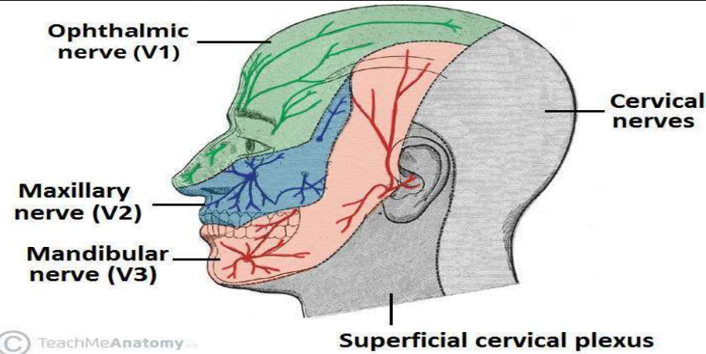
Division Of Trigeminal Nerve

Slide 10
Etiology
Degeneration.
Pressure.
Irritation of the nerve.

Slide 11
Trigger factors
Shaving
Touching your face
Eating
Drinking
Brushing teeth
Talking
Putting on makeup
Encountering a breeze
Smiling
Washing face

Slide 12
TREATMENT
Medical treatment
Carbazepine
Phenytoin sodium
Valproic acid
Surgical treatment
microvascular decompression

Slide 13
Migranous neuralgia
An exquisitely painful affliction of the mid face and upper face, particularly in and around the eye.
The name is derived from the fact that the headache occurs in temporal groups or ‘clusters’ with extended periods of remission between attacks.

Slide 14
Clinical features
May occur at any age, although it usually affects persons in the 3rd and 4th decade of life.
M > F (6:1)
They tend to run in families, transmit through genes.
The pain is described as paroxysmal ( abrupt onset) and intense, with a burning or lancinating quality and without a trigger zone.

Slide 15
Signs and symptoms
Forehead/facial sweating
Conjunctival infection
Excessive tearing
Eyelid edema
Rhinorrhea
Ptosis
Miosis
Red flushed face
Lacrimation

Slide 16
Trigger factors
Heat (hot weather, hot baths)
Exertion (physical activity)
Certain medicines
Cocaine
Bright light
Alcohol , cigarette smoking

Slide 17
Treatment
Ergotamine tartarate
Oxygen inhalation
Serotonin antagonists

Slide 18
POST-HERPETIC NEURALGIA
If the pain is caused by shingles continues and persists for more than 90 days (3 months) after the bout of shingles is over – it is known as post- herpetic neuralgia (PHN).
Post herpetic neuralgia is a painful condition that affects the nerve fibres and skin.

Slide 19
Age
Common is > 50 years
Site
trigeminal nerve is commonly affected
Complications
Paresthesia (loss of sensation

Slide 20
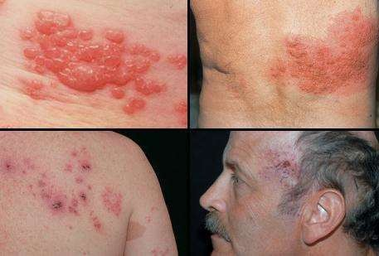
Representation

Slide 21
SYMPTOMS
Area of previous herpes zoster may show evidence of cutaneous scarring.
Sensation may be altered over the areas involved, in the form of either hypersensitivity or decreased sensation.
In rare cases, the patient might also experience muscle weakness, tremors, or paralysis if the nerves involved also control muscle movement

Slide 22
TREATMENT
Pain killer
Anticonvulsants
Lidocaine skin patches
Antidepressants

Slide 23
Temporomandibular arthritis
It is also known as COSTEN’S SYNDROME.
Pain is severe aching.
Gets intensified by chewing, movement of jaw.
Occurs at the temporomandibular joint.
Usually unilateral

Slide 24
Symptoms
Loss of dental occlusal support
Ear symptoms (pain, tinnitus)
Sinus Pain

Slide 25
Costen’s syndrome arises from the faulty articulation of the temporomandibular joint caused by:
Dental mal occlusion
Emotional stress producing masseter spasm

Slide 26
Treatment
Long term treatment may involve dental correction or stress relaxation.
Short term treatment consists of a very soft diet and simple analgesia, and may be sufficient for mild symptoms.

Slide 27
Thankyou

