Slide 1
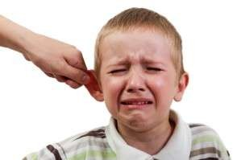
Otalgia

Slide 2
Otalgia
Is defined as pain in the ear or ear ache.

Slide 3
Types
Primary
Referred

Slide 4
Etiology of Primary Otalgia
Pinna External auditory canal
Laceration & bite
Hematoma
Otitis externa
Perichondritis
Infected pre-auricular sinus
Frostbite, sunburn
Neoplasm
Impacted wax
Foreign body
Keratosis obturans
Otitis externa
Herpes zoster oticus
Exostoses
Neoplasm

Slide 5
Middle Ear
Mastoid
Mastoiditis
Mastoid abscess
Granulomas
Bullous myringitis
Acute otitis media
Secretory otitis media
Neoplasm
Traumatic perforation
Inner ear
Hemotympanum
Acoustic trauma
Meniere’s disease
Vestibular schwannoma
Otitic barotrauma
Neoplasm

Slide 6
Cholesteatoma
It is a cyst in the middle ear or mastoid system that is lined with squamous epithelium and filled with keratin debris.
It occurs due to COM

Slide 7
Etiology of referred otalgia

Slide 8
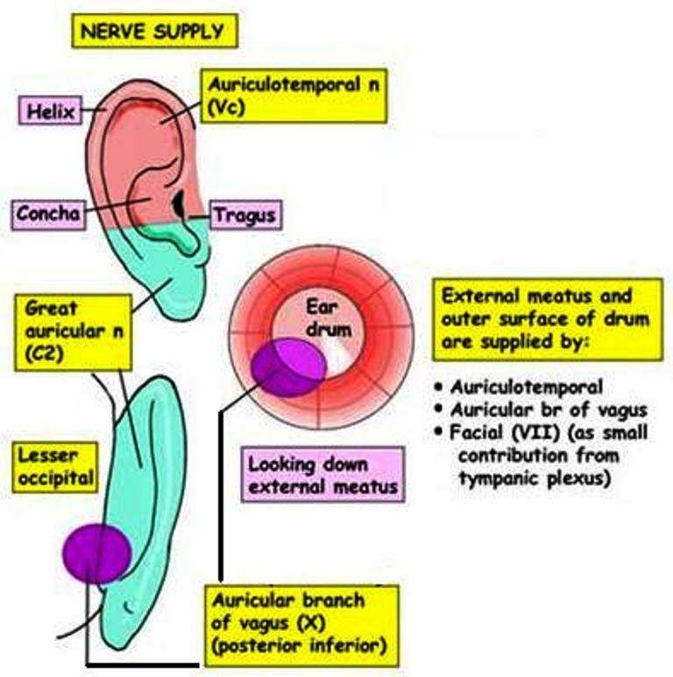

Slide 9
A. Via trigeminal nerve
Teeth: infection, impacted 3rd molar, malocclusion
Oral cavity: infection, ulcer, malignancy, Ludwig’s angina, sialadenitis, salivary calculus
Temporo-mandibular joint: arthritis, dysfunction
Nose & PNS: impacted DNS, sinusitis, neoplasm
Nasopharynx: infection, post- adenoidectomy, adenoiditis, tumor
Trigeminal neuralgia

Slide 10
B. Via glossopharyngeal nerve
Tonsil: tonsillitis, peritonsillar abscess, post- tonsillectomy, neoplasm
Oropharynx: infection, ulcer, retropharyngeal + parapharyngeal abscess, trauma, neoplasm
Eagle’s syndrome (stylalgia)
Glossopharyngeal neuralgia

Slide 11
C. Via facial nerve:
Herpes zoster oticus, vestibular schwannoma
D. Via vagus nerve:
+ hypopharynx: neoplasm, infection,
tuberculosis, trauma, foreign body
Larynx
E. Via second & third cervical nerves:
Herpes zoster, cervical spondylosis & arthritis

Slide 12
Risk factors
Insertion of unclean/sharp articles into the ear
Instillation of contaminated solutions
Swimming in polluted water
Recent Upper Respiratory Tract Infection
Eustachian tube dysfunction
Allergies

Slide 13


Pathophysiology
Trauma or infection
Inflammation
Release of inflammatory mediators & chemotaxis of leukocytes
Tissue edema, pain, heat and redness

Slide 14
Clinical manifestations
Ear ache or ear pain

Slide 15
Management
Promote healing :
Ear irrigation
Antibiotics
Alleviate pain :
Analgesics
Restore normal function and remove foreign bodies:

Slide 16
Surgical management
Myringoplasty : Closure of simple perforation of tympanic membrane.
Tympanoplasty: Surgical correction of the perforated Tympanic membrane.
Ossiculoplasty: Ossicular reconstruction
Myringotomy: An incision to the tympanic membrane through which fluid is removed.
Mastoidectomy:

Slide 17
Precautions after ear surgery
Client must lye with operated ear up for several hours after surgery.
If necessary, the client should blow the nose gently one side at a time.
The client should sneeze or cough with the mouth open for 1 week after surgery.
Participation in water sports or activities is prohibited.

Slide 18
Avoid physical activity for 1 week & exercise or sports for 3 weeks after surgery.
Avoid heavy lifting.
Change the cotton ball in the ear daily.
Keep the ear dry for 4-6 weeks.
Do not shampoo for 1 week.
Avoid airplane flights for the first week after surgery. For sensation of ear pressure , hold your nose, close your mouth and swallow to equalize pressure.
Wear noise defenders in loud environments.
Inform in case of bleeding from ear.

