Slide 1
OTOSCLEROSIS

Slide 2
OTOSCLEROSIS
INTRODUCTION
ETIOLOGY
PATHOGENESIS
CLINICAL FEATURES
INVESTIGATIONS
TREATMENT

Slide 3
INTRODUCTION
Also called as Otospongiosis
Otic capsule disease
Lamellar bone is replaced by spongy bone
If stapes is involved conductive deafness occurs due to fixation of footplate.

Slide 4
AETIOLOGY
Exact aetiology is not known
Popular theories are
Localised venous congestion of otic capsule
Osteogenis imperfecta
Paget’s disease
Genetic factor
Measles, Pregnancy
van der haave syndrome

Slide 5
PATHOLOGY
Active – Immature stage
Osteoclasts & histiocytes replaces lamellar bone
Inactive – Mature stage
Osteoblast formation

Slide 6
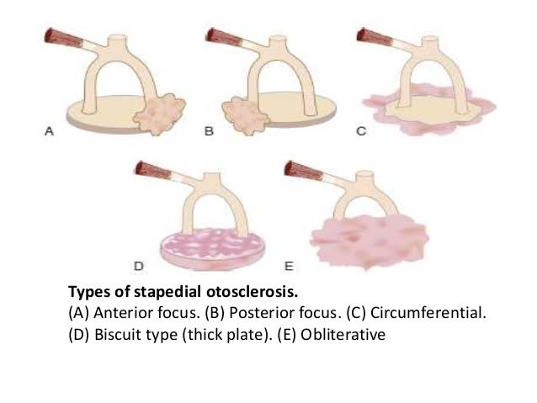
TYPES
Histological type: No clinical symptom
Stapedial type: Conductive deafness
Combined: Both conductive & sensorineural hearing loss

Slide 7
CLINICAL FEATURES
Progressive conductive deafness
Paracusis willisi (Hears better in noisy surrounding)
Tinnitus, Vertigo
Monotonous speech
On examination – Normal tympanic membrane, Schwartz sign positive (Pinkish hue on tympanic membrane) Tuning fork test (Conductive deafness) Bezold’s triad (Negative Rinne, raised lower tone limit, prolonged bone conduction)

Slide 8
INVESTIGATIONS
Pure Tone Audiometry : Conductive hearing loss
Speech audiometry : Good Speech discrimination
Impedance audiometry : Reduced complaints

Slide 9
TREATMENT
HEARING AID
SURGERY
Stapedectomy
Stapedotomy
LASER stapedectomy minus prosthesis (LASER STAMP)
Fenestration operations
Indications
Average air bone gap of 40 dB or more
Bone conduction decline & AB gap < 40 dB
Fixation of footplate

