Slide 1

PHYSIOLOGY OF EQUILIBRIUM
By Dr. Rajika Ramakrishnan

Slide 2
EQUILIBRIUM
“ The state of a body or physical system at rest or in an unaccelerated motion in which the resultant forces acting on it is zero and the sum of all torques about any axis is zero ”

Slide 3
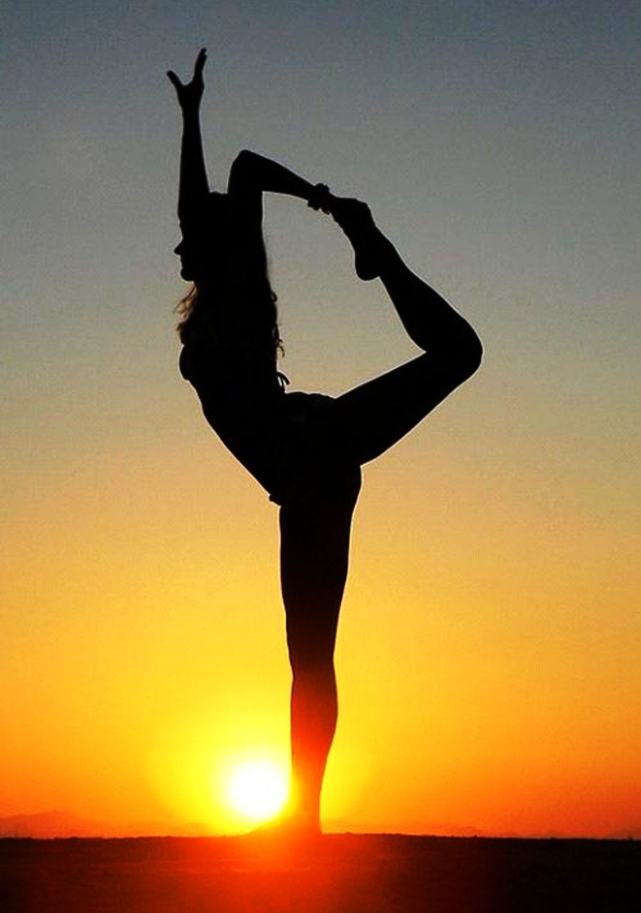
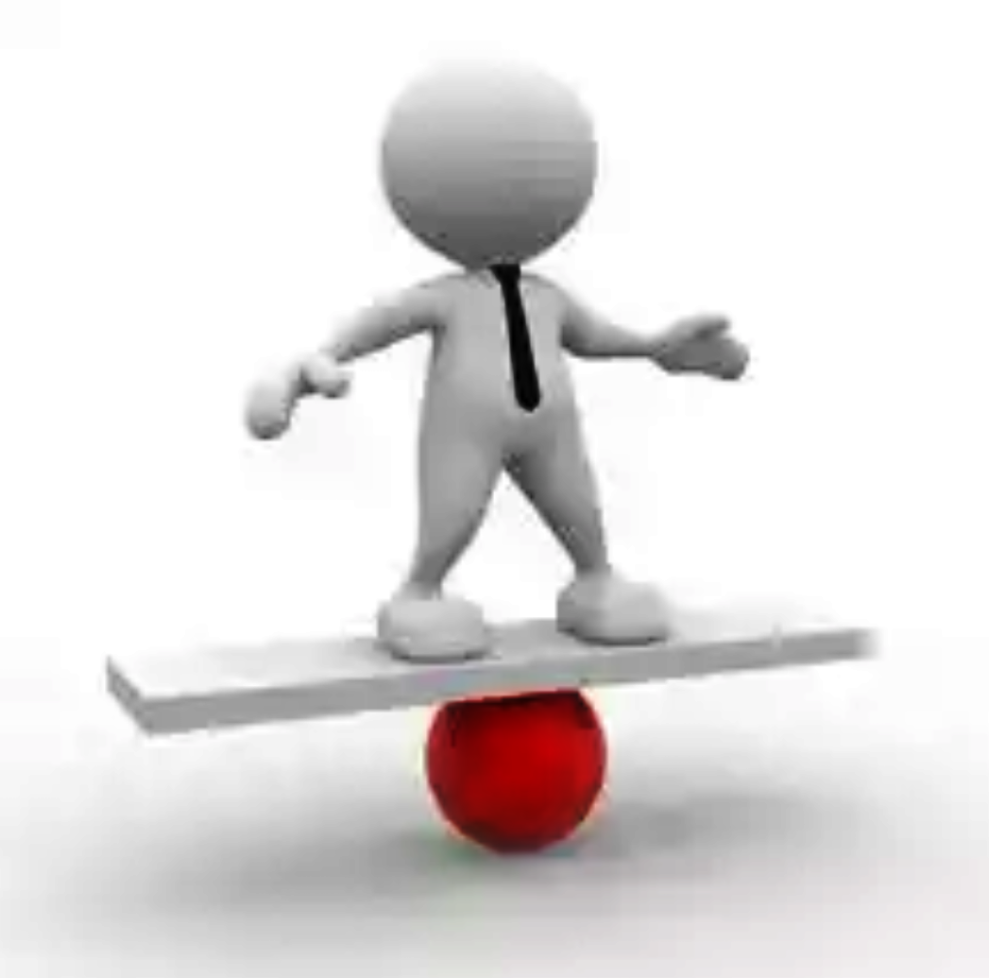
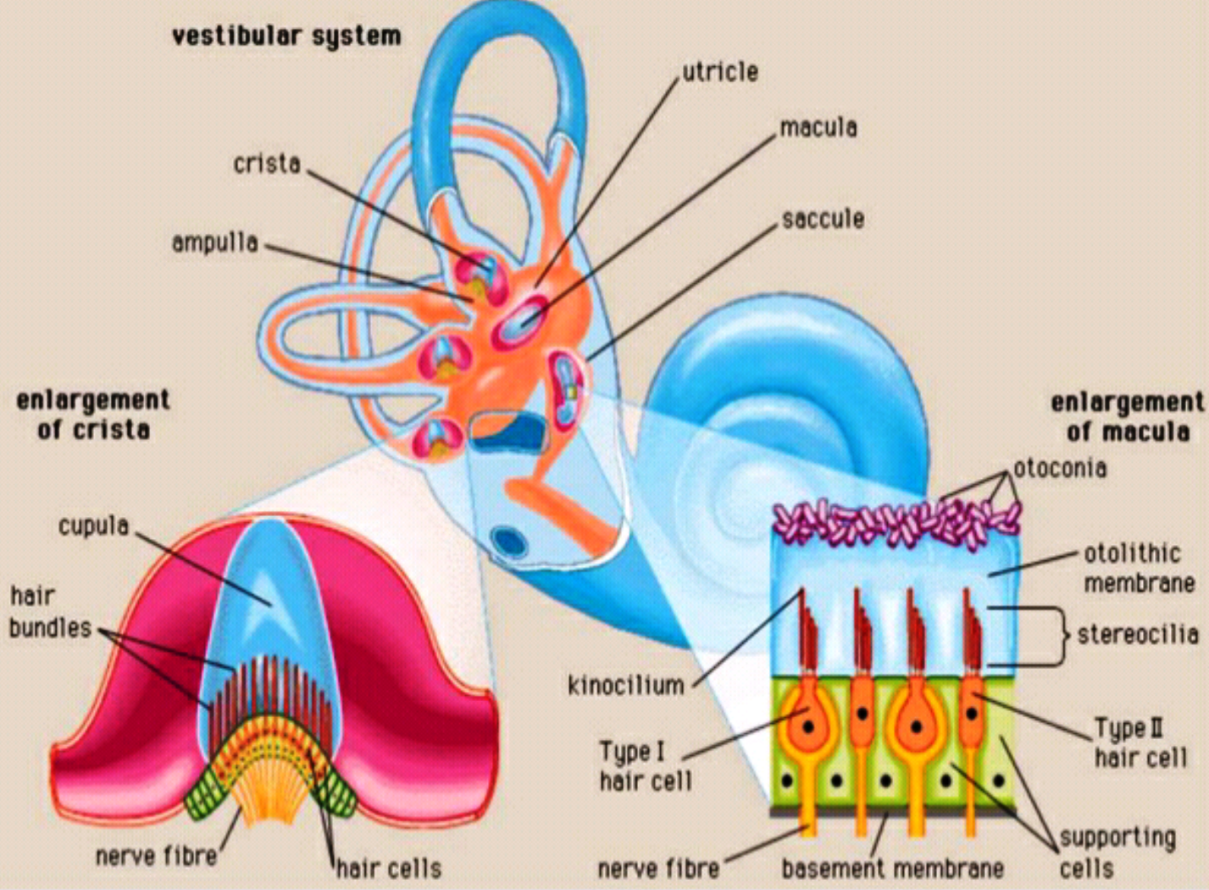
ROLE OF THE VESTIBULAR SYSTEM
The vestibular system is responsible for maintaining equilibrium, and its major functions with respect to it are :-
provide general orientation of the body with respect to gravity
adjustment of muscle activity and body position to allow for upright posture
Helps stabilize the eyes during head movements ( gaze stabilization)
Its major components are :-
Maculae in Utricle & Saccule
Cristae ampullaris in the SCCs

Slide 4
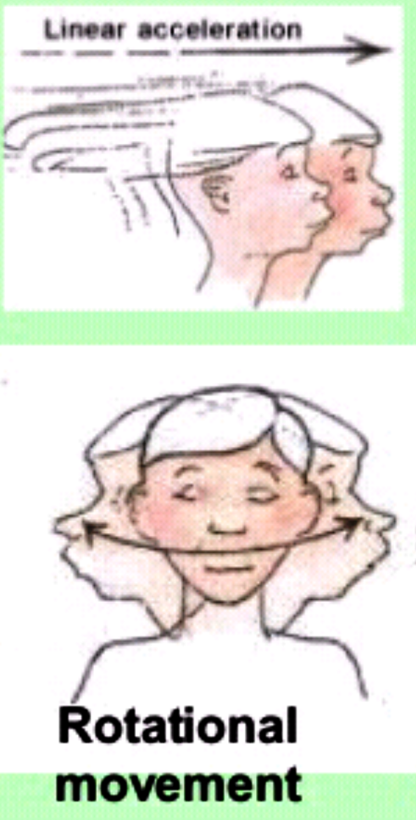
TYPES OF EQUILIBRIUM
STATIC EQUILIBRIUM -
Maintenance of position of the body( head)
relative to the force of gravity.
The receptors for static equilibrium are the Maculae present in Saccule & Utricle (Otolith organs).
DYNAMIC EQUILIBRIUM –
Maintenance of body position ( head ) in response to
rotational movements.
The hair cells present in the SCC are responsible for it.

Slide 5
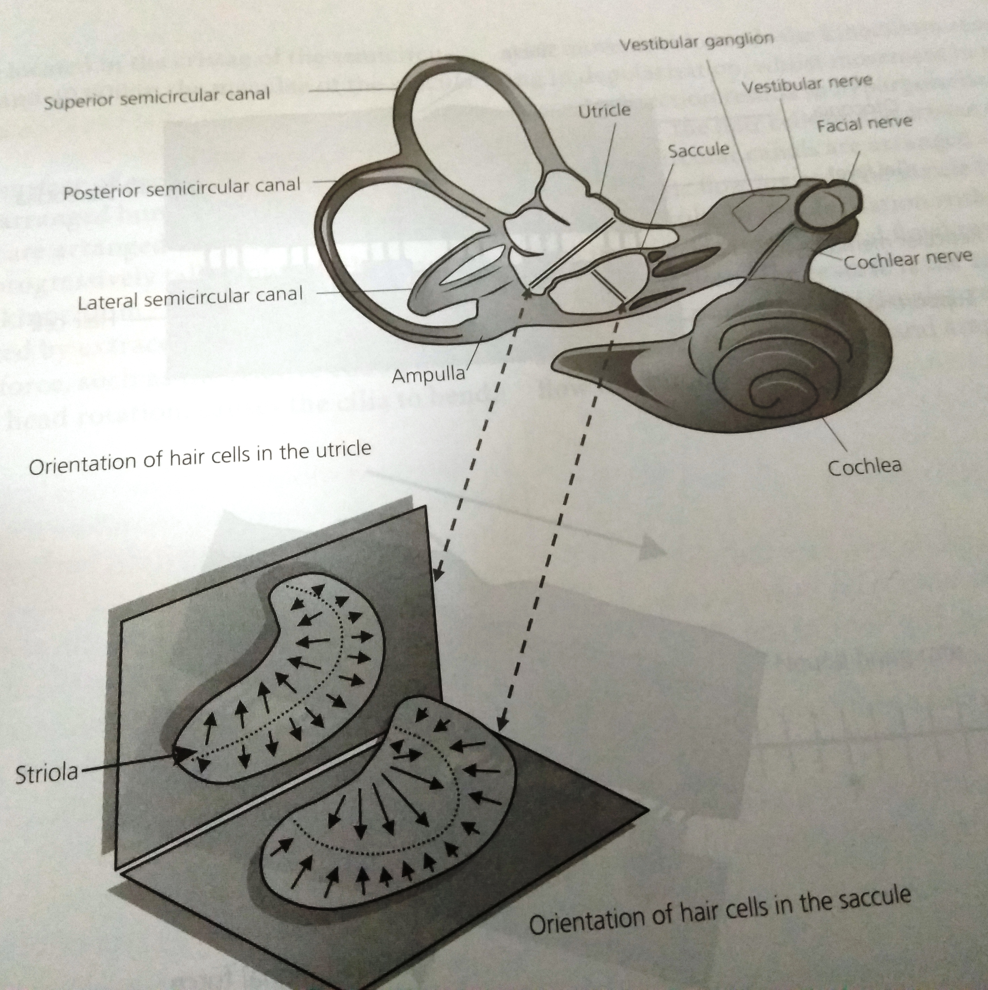
MAINTAINANCE OF STATIC EQUILIBRIUM
The Macula of the Utricle – Horizontal plane on the inferior surface of the utricle – determining the orientation of the head when the head is upright.
The Macula of the Saccule- Vertical Plane – signals head orientation when the person is lying down.

Slide 6
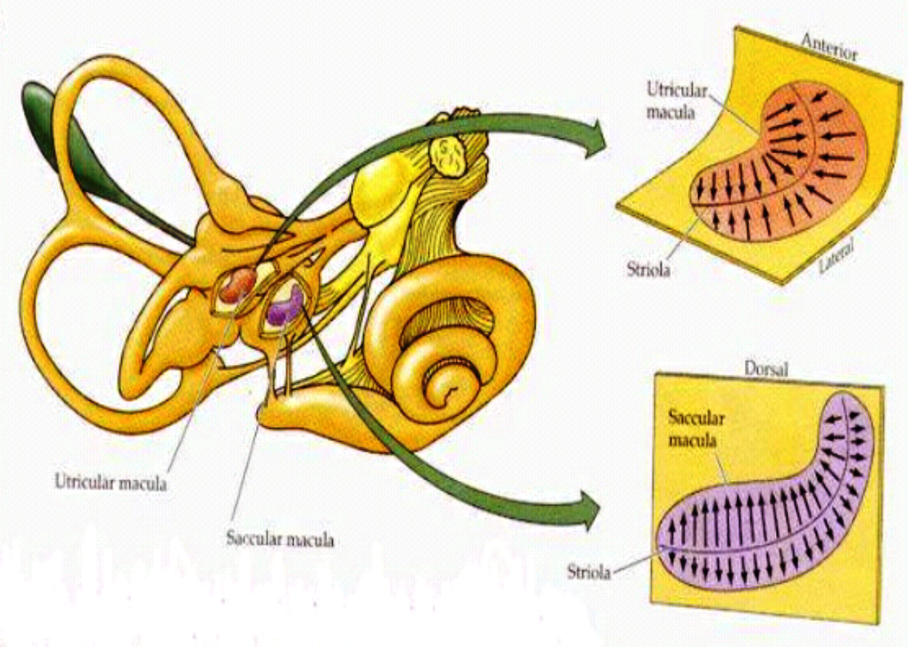
Hair cells are oriented in different directions on the maculae in the utricle and saccule, so that with different positions of the head , different hair cells become stimulated.
The “patterns” of stimulation of the different hair cells tell the brain of the position of the head with respect to the pull of gravity
Utricle responds – Horizontal acceleration
( going in a car)
Saccule responds – Vertical acceleration
(going in a lift )

Slide 7
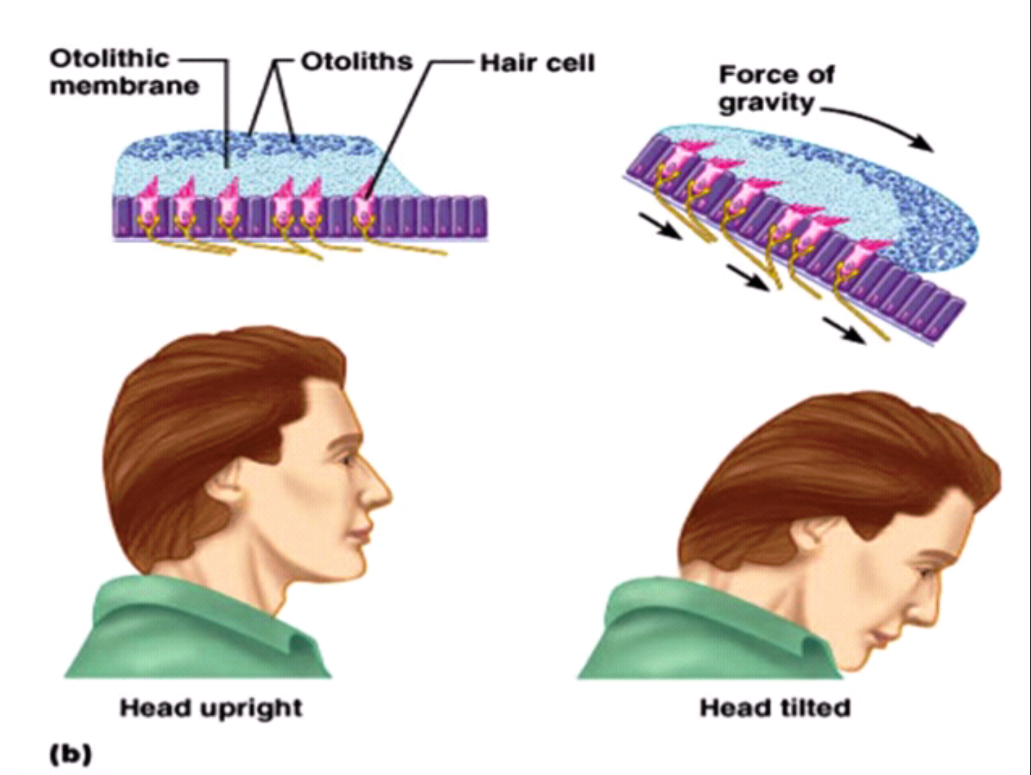
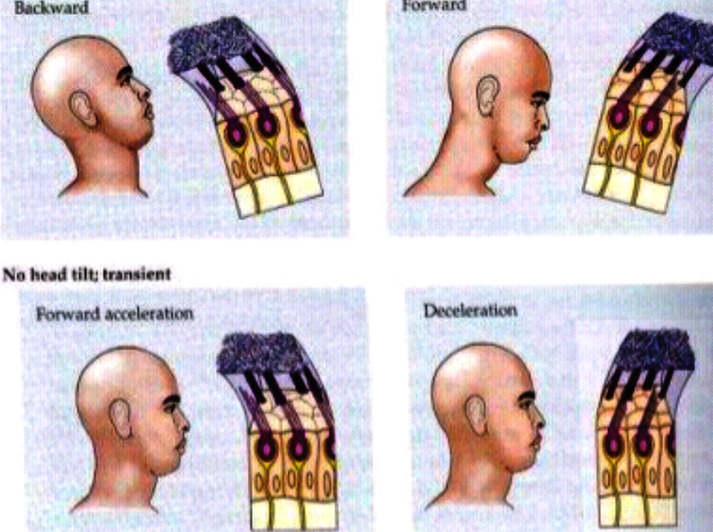
LINEAR ACCELERATION
When the body is suddenly thrust forward – when the body accelerates
The statoconia , which has greater mass inertia than the surrounding endolymph , fall forward on the hair cell cillia
And information of dysequilibrium is sent into the Nervous centers

Slide 8
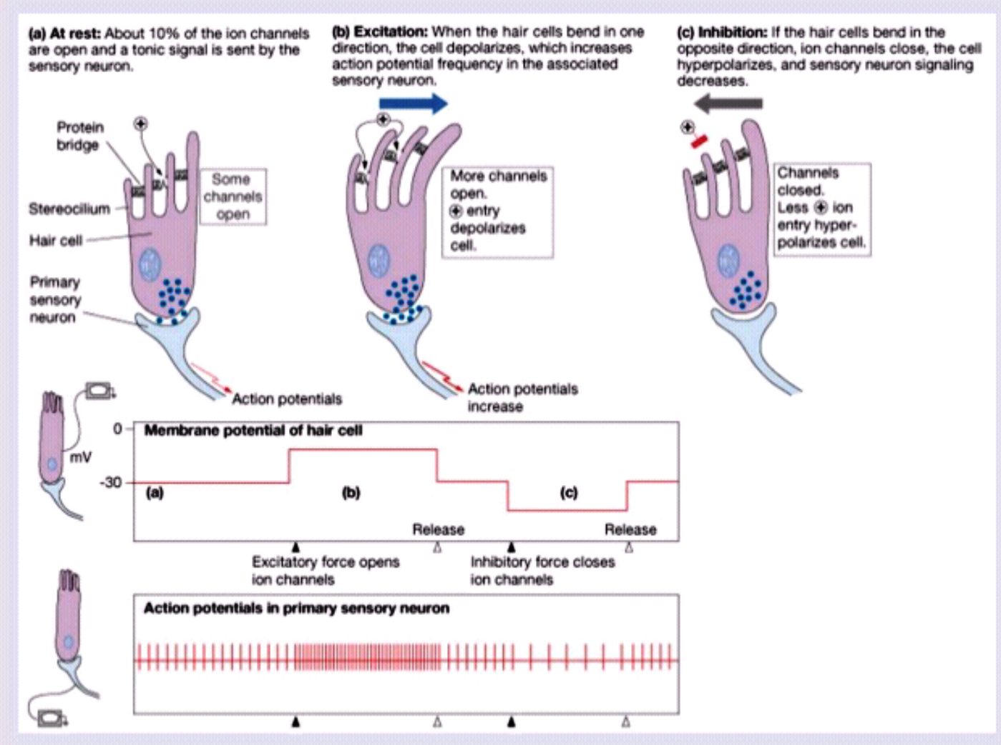
When the stereocillia bends towards the Kinocillium
Membrane receptor depolarization
Impulse traffic increases
When the Stereocillia bends away from the Kinocillium
Membrane receptor hyperpolarization
Decreases the impulse traffic
Orientation of the head & the weight of the Statoconia – bend the cillia
Appropriate signals are transmitted to the brain to control equilibrium

Slide 9
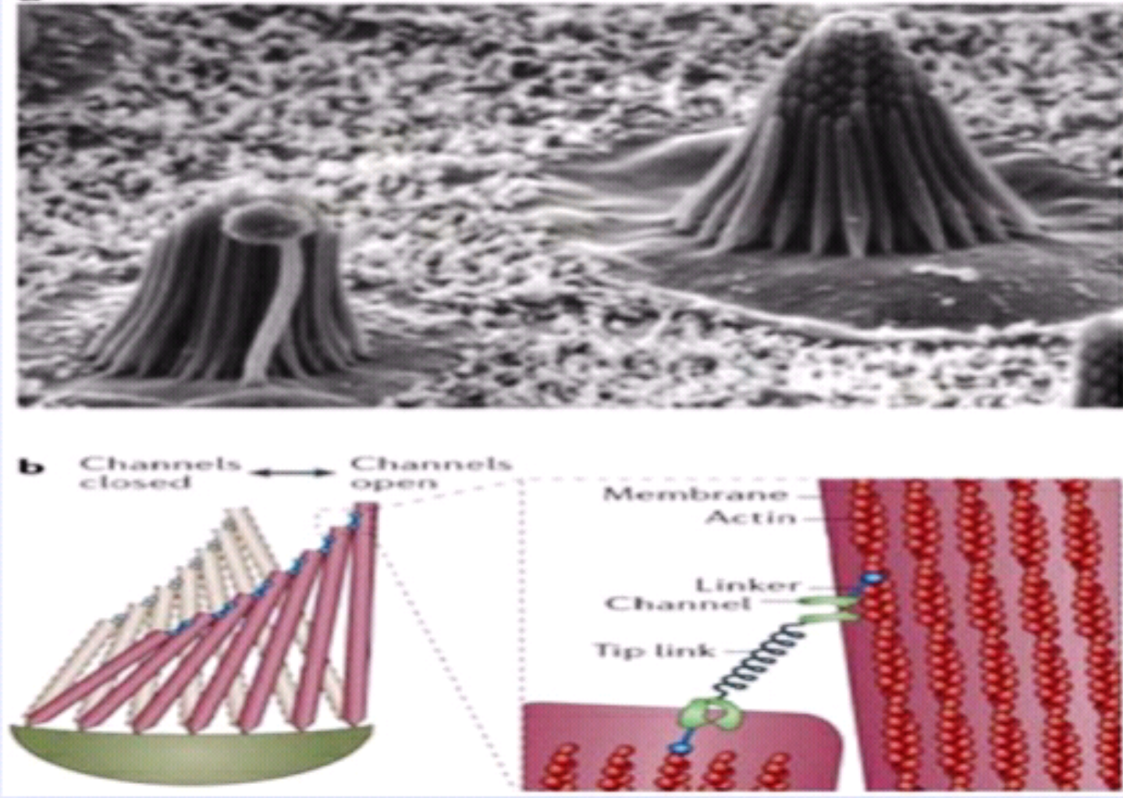
FUNCTION OF OTOLITH ORGANS
Gives information about the static position of head
Activate appropriate mechanisms to maintain equilibrium
during resting & linear movements

Slide 10
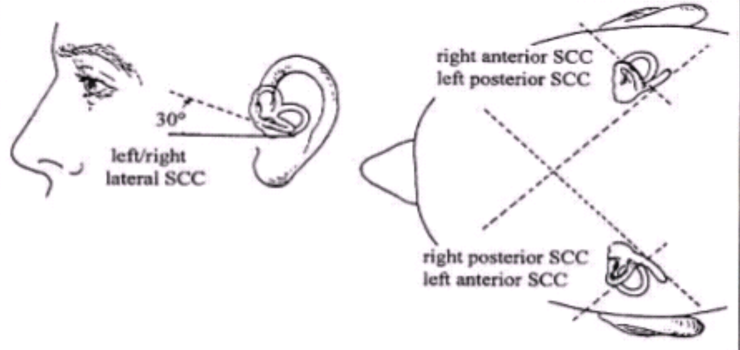
DYNAMIC EQUILIBRIUM ( Angular acceleration)
The three SCCs are oriented at right angles to one another.
Anterior & Posterior SCCs (positioned vertically) –stimulated when head rotation is in transverse axis ( “Yes” movement ) & Antero post axis ( ear touches shoulder, tilting)
Lateral SCC is positioned horizontally - stimulated when head is in vertical axis ( “No” movement )
Are functionally paired :

Slide 11
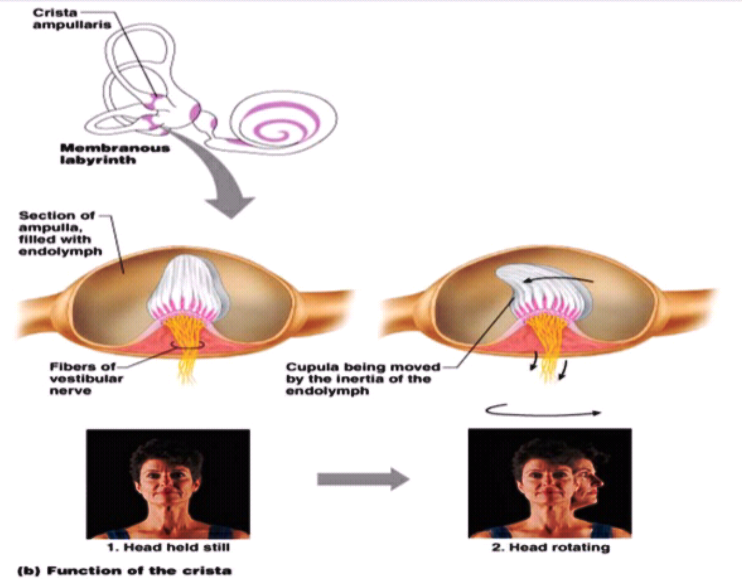
Rotational acceleration or deceleration
Of head causes the endolymph to flow over the cupula and hair cells and bend them
Results in nerve impulses being carried away by the vestibular branch of vestibulocochlear nerve

Slide 12
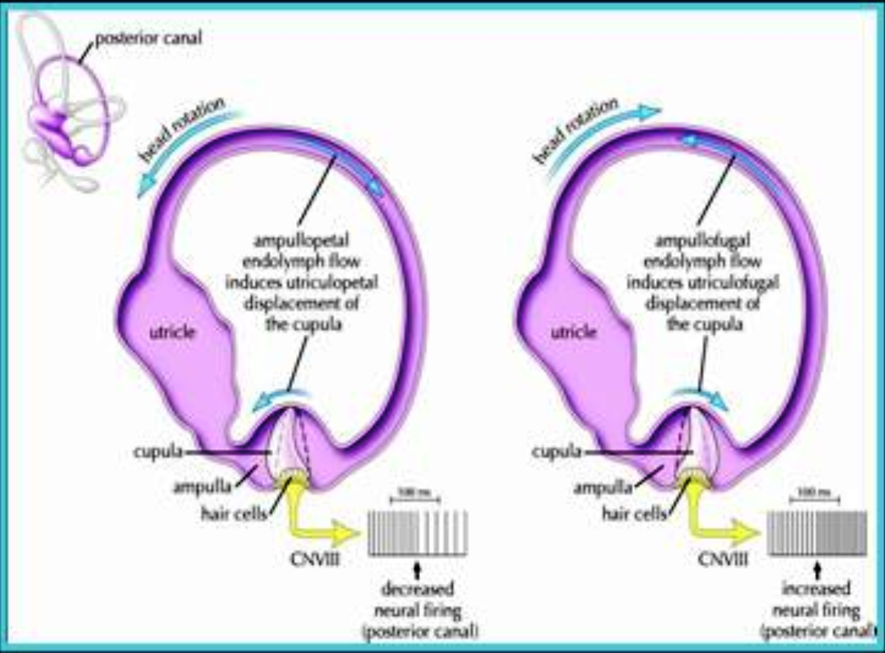
When the head is rotated to the right- stimulates haircells in the right lateral canal – inhibits haircells in the left lateral canal.
Right Canal | Left Canal
Endolymph pushed towards ampulla (Ampullopetal) | Endolmph is pushed away from the ampulla ( Ampullofugal)
Cupula moves towards ampulla | Cupula moves away from the ampulla
Stereocilia is pushed towards the Kinocillium | Stereocillia is pushed away from the Kinocillium
Depolarization | Hyperpolarization

Slide 13
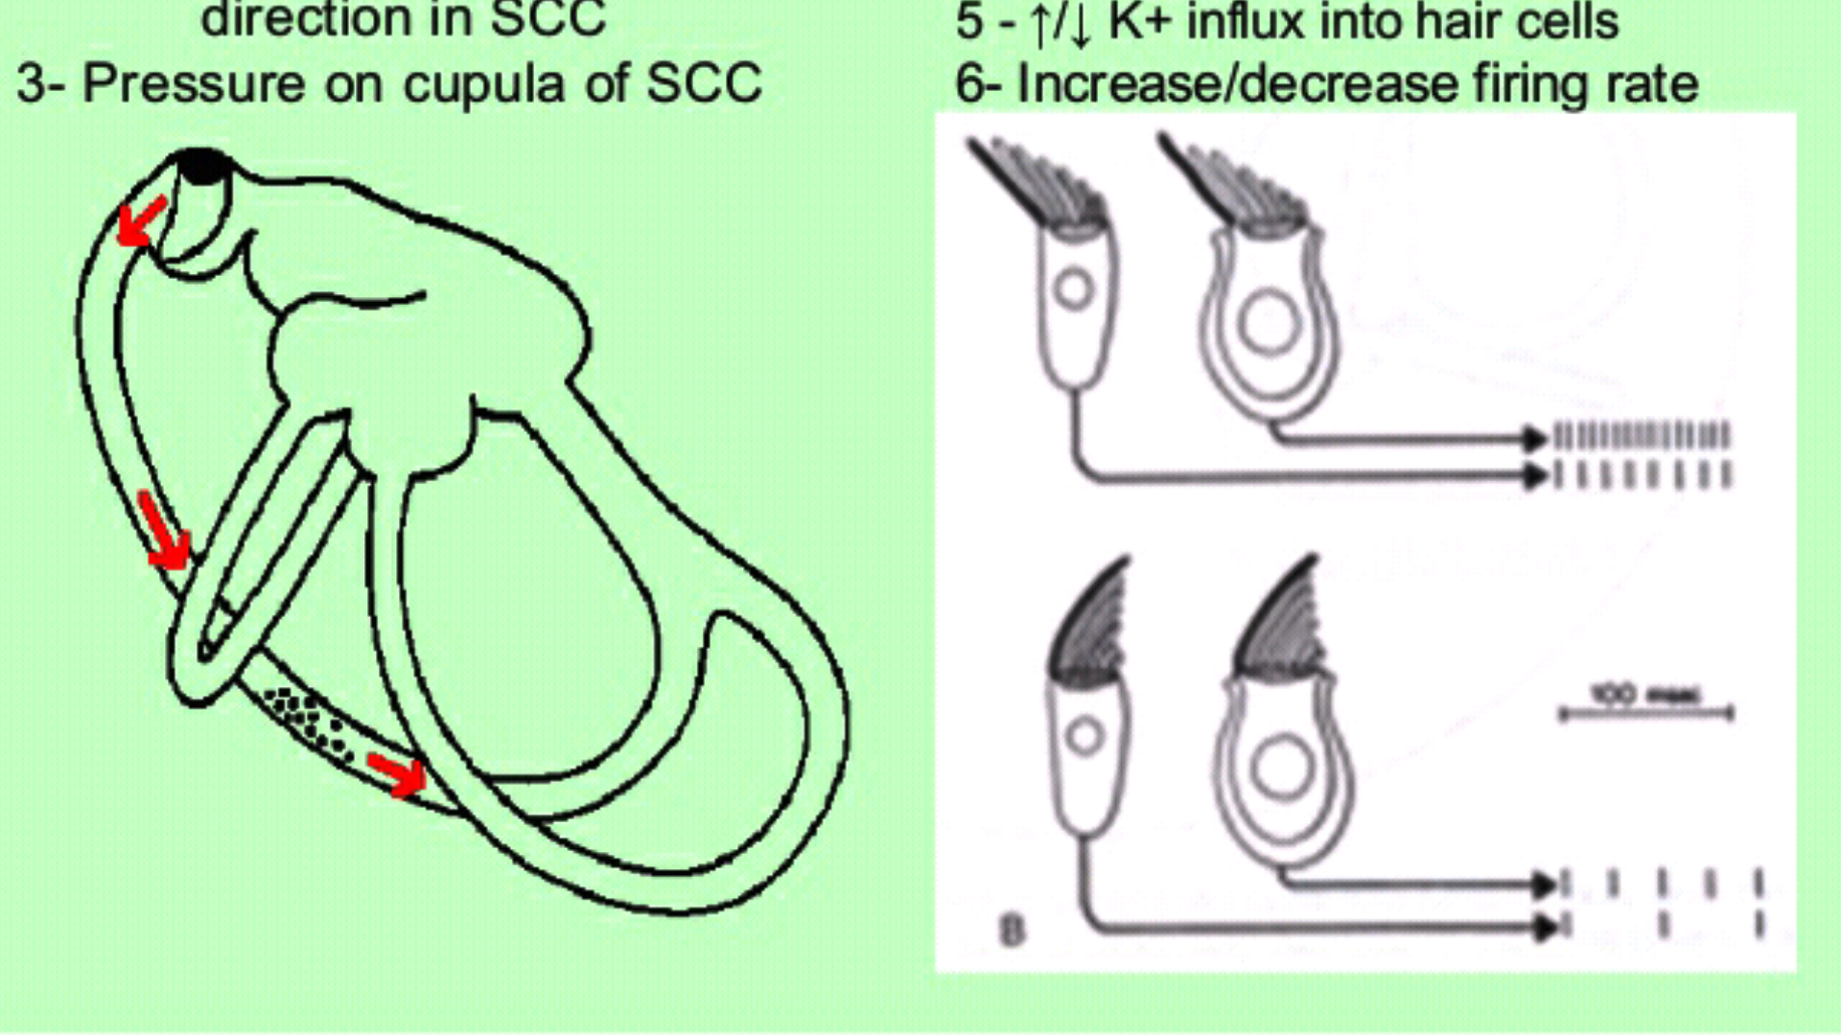
MECHANISM OF STIMULATION IN SCCs
Angular acceleration of the head
Motion of the fluid in the opposite direction in SCC
Pressure on the Cupula of SCC
Deflection of Stereocillia to / away from Kinocillium.
Increase or decrease in K+ influx into hair cells
Increase or decrease in firing rate

Slide 14
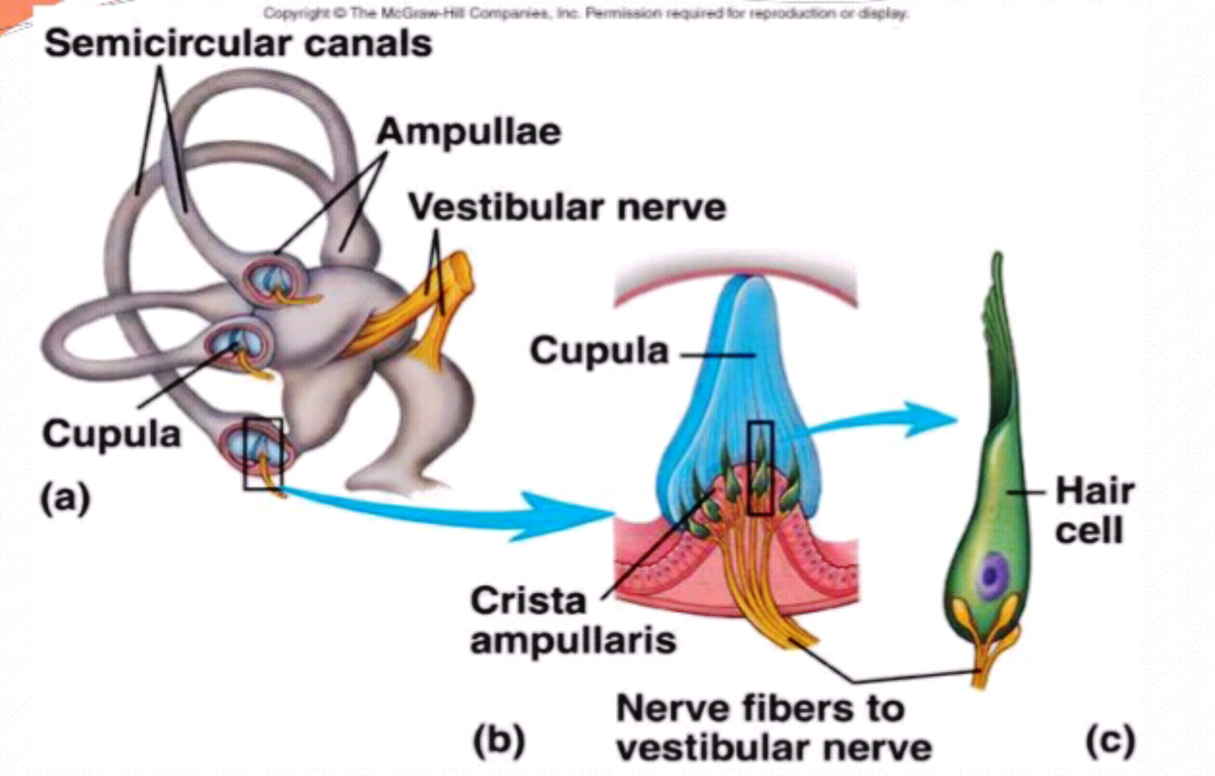
FUNCTIONS OF SEMICIRCULAR CANALS
Gives information about rotational movements of the head & activate appropriate mechanisms to maintain equilibrium
By combining input from each of the three canals , the brain can create a representation of the vector which describes the instantaneous speed of head rotation .
Helps in visual fixation during angular rotation of head through vestibulo – ocular reflex.

Slide 15
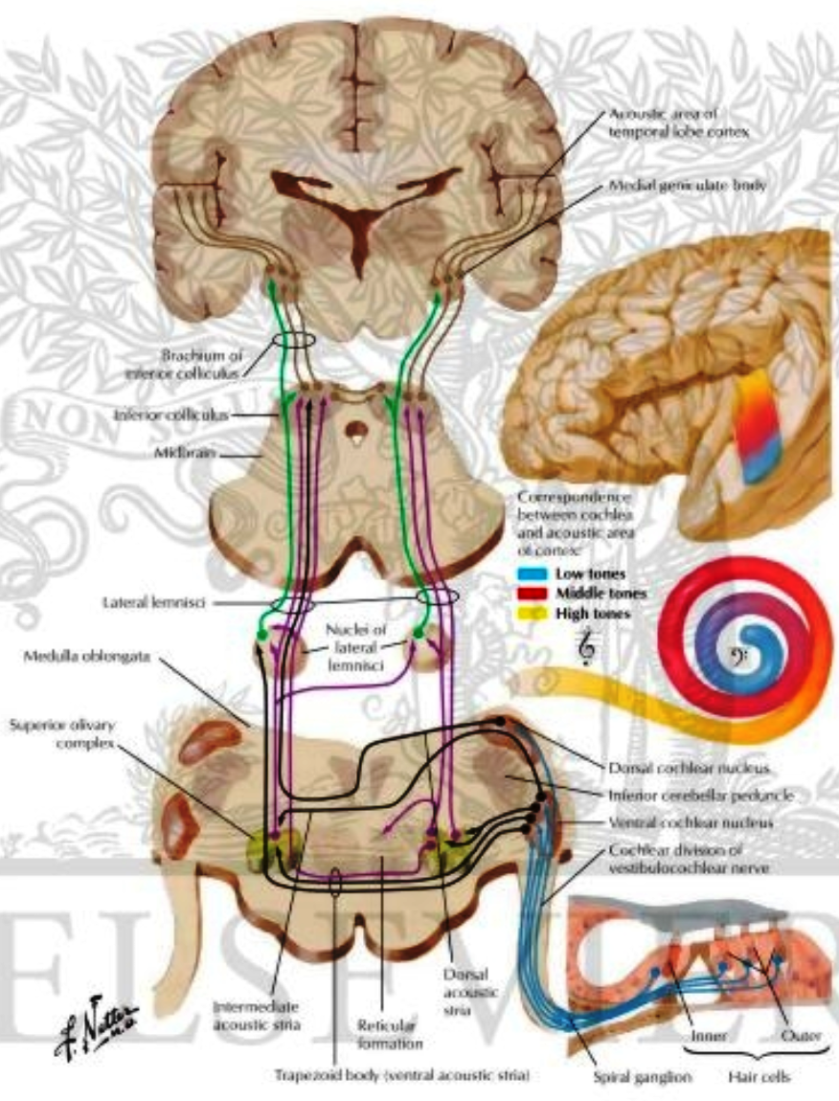
VESTIBULAR NERVE AND ITS CONNECTIONS
Vestibular or Scarpa’s Ganglion is situated in the lateral part of Internal Accoustic meatus
Fibres of Vestibular nerve end in the Vestibular Nuclei ( superior, medial, lateral and descending ) and some go directly to the cerebellum.
Afferents to the Vestibular Nuclei come from :-
- Peripheral vestibular receptors
- Cerebellum
- Reticular formation
- Spinal cord
- Contralateral Vestibular nuclei

Slide 16
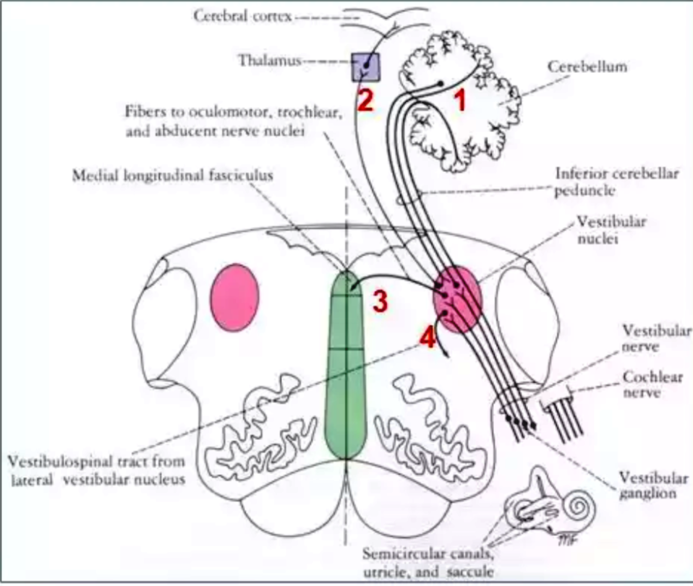
VESTIBULAR NERVE AND ITS CONNECTIONS
Efferents from the vestibular nuclei go to :-
Nuclei of CN 3, 4 , 6 through medial longitudinal fasciculus
( Vestibulo ocular reflex , Genesis of nystagmus )
Motor part of spinal cord ( Vestibulospinal)
Flocculonodular lobe of Cerebellum through inferior cerebellar peduncle
ANS ( nausea, vomitting)
Contralateral Vestibular nuclei
Cerebral cortex (from the ventral thalamus, axons are sent to synapse with neurons in the vestibular area ( Broadmann’s area 2V & 3a ) of the primary somatosensory cortex.

Slide 17
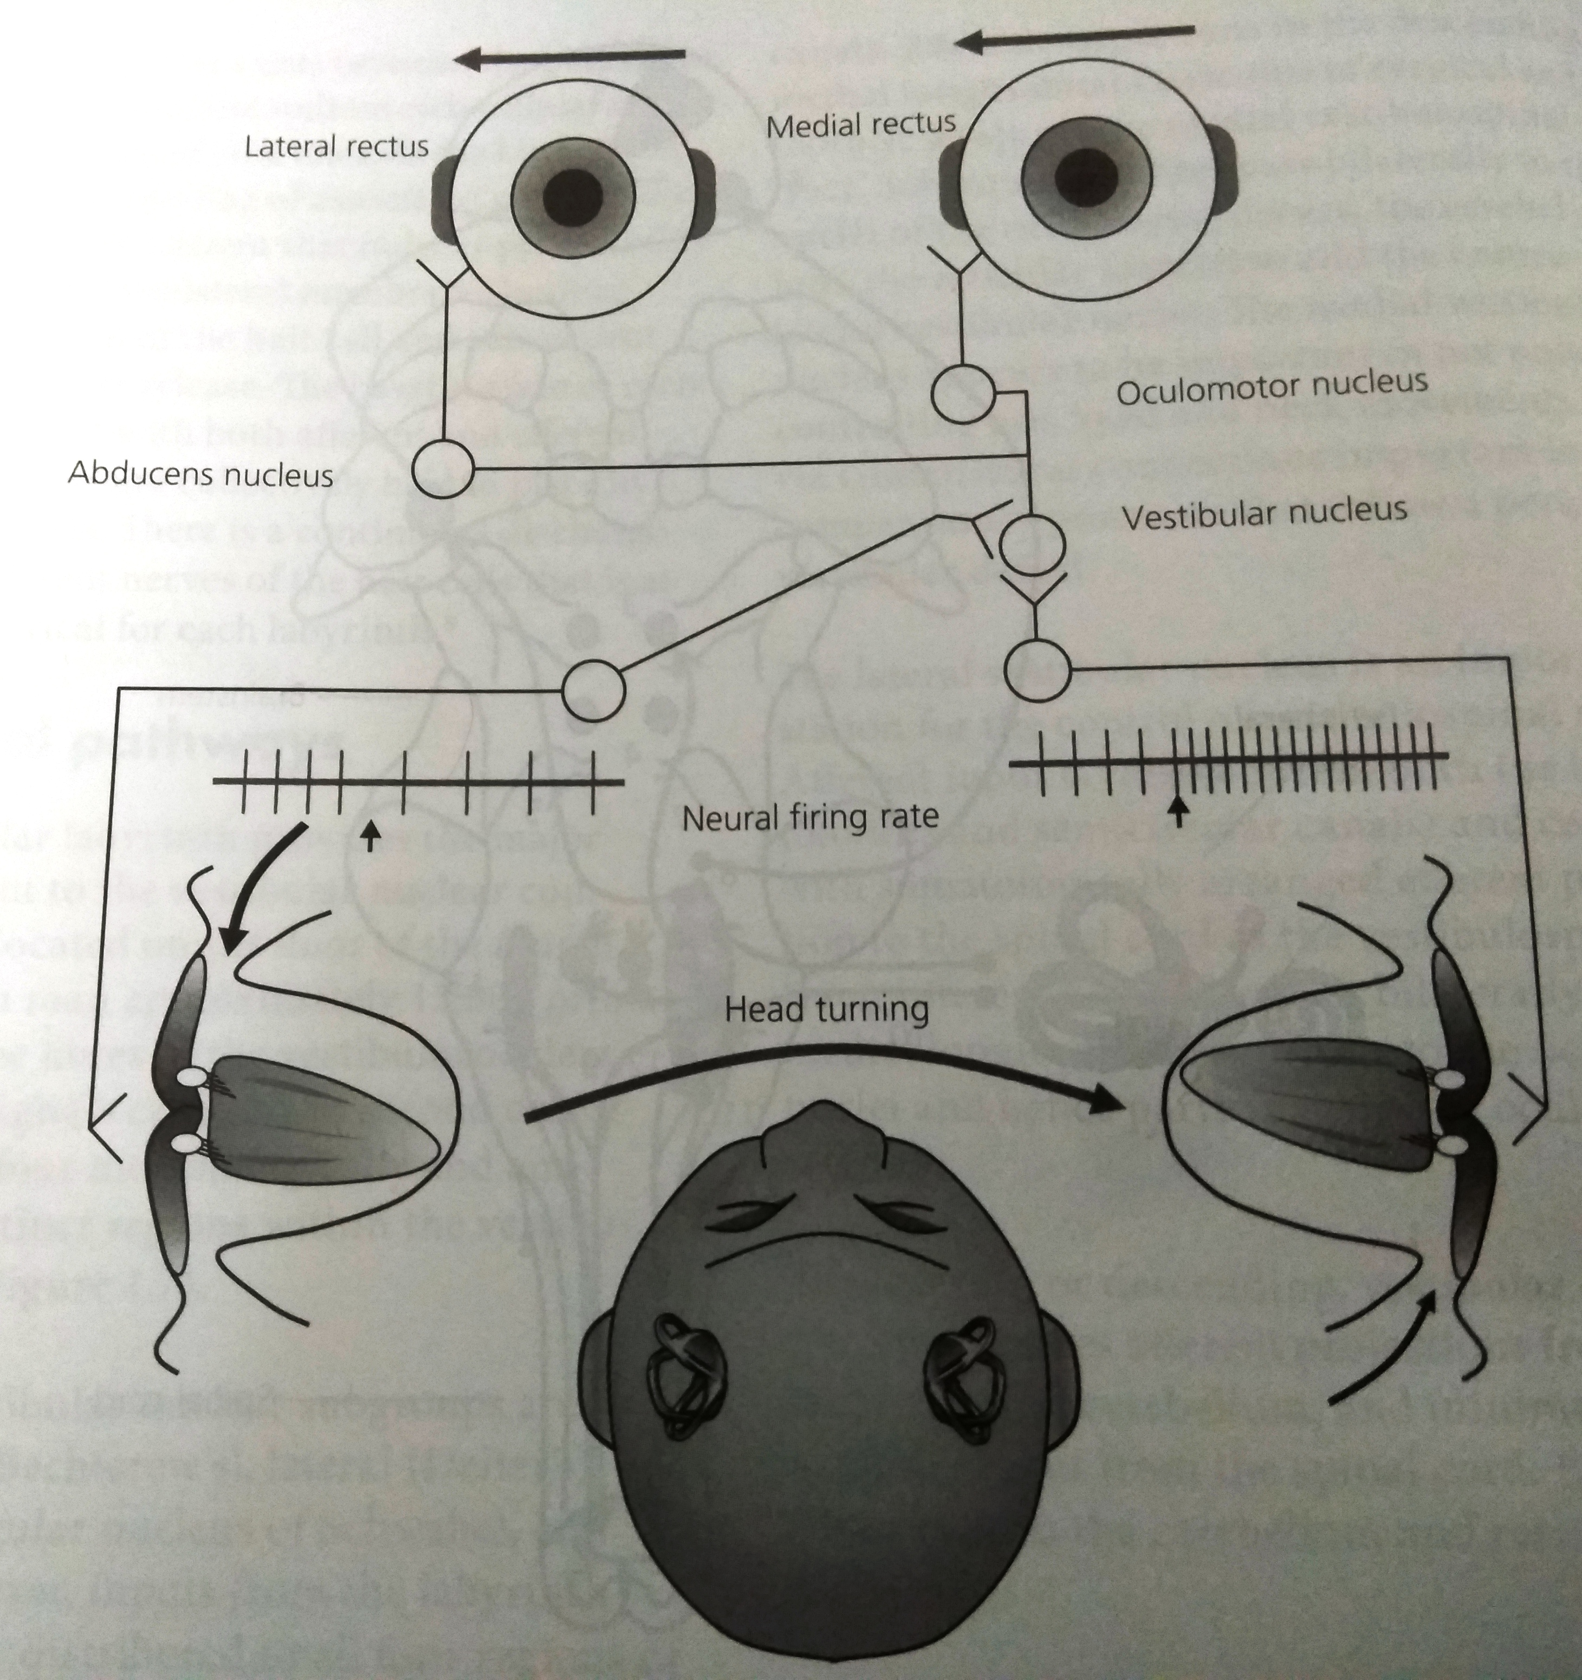
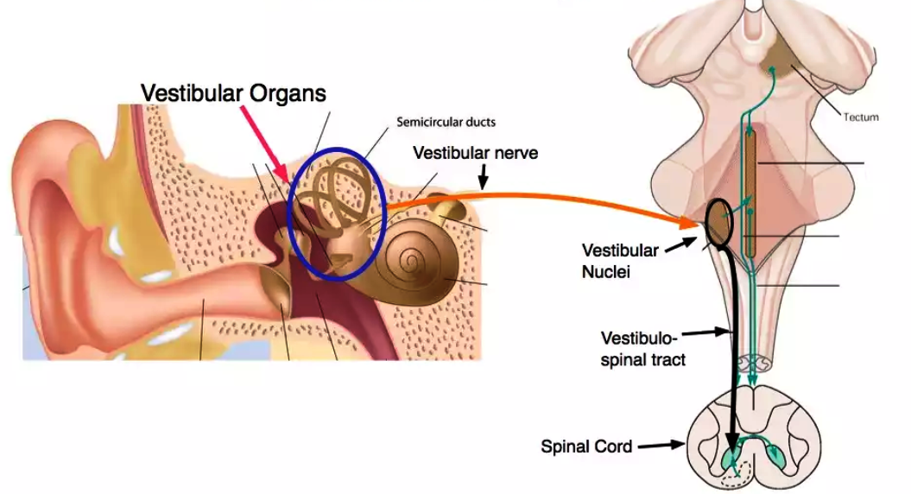
REFLEXES FROM VESTIBULAR SENSORY ORGANS
Vestibulo – ocular reflex (VOR) –
Stabilizes gaze during fast head movements
Conjugate movement of eyes in opposite direction to that of head rotation
- Also called vestibular nystagmus
Vestibulospinal reflex (VSR)
Sends information regarding gravity and linear acceleration to body muscles
- Helps maintain centre of garvity

Slide 18
VESTIBULO – OCULAR REFLEX
When a person changes his direction of movement rapidly or even leans the head sideways , forward or backward , it would be impossible to maintain a stable image on the retinas.
Eyes would be of little use in detecting an image unless they remained “ fixed “ on each object long enough to gain a clear image.
When rotation starts , the eyes move slowly in the direction opposite to the direction of rotation , maintaining visual fixation ( Vestibulo ocular reflex)

Slide 19
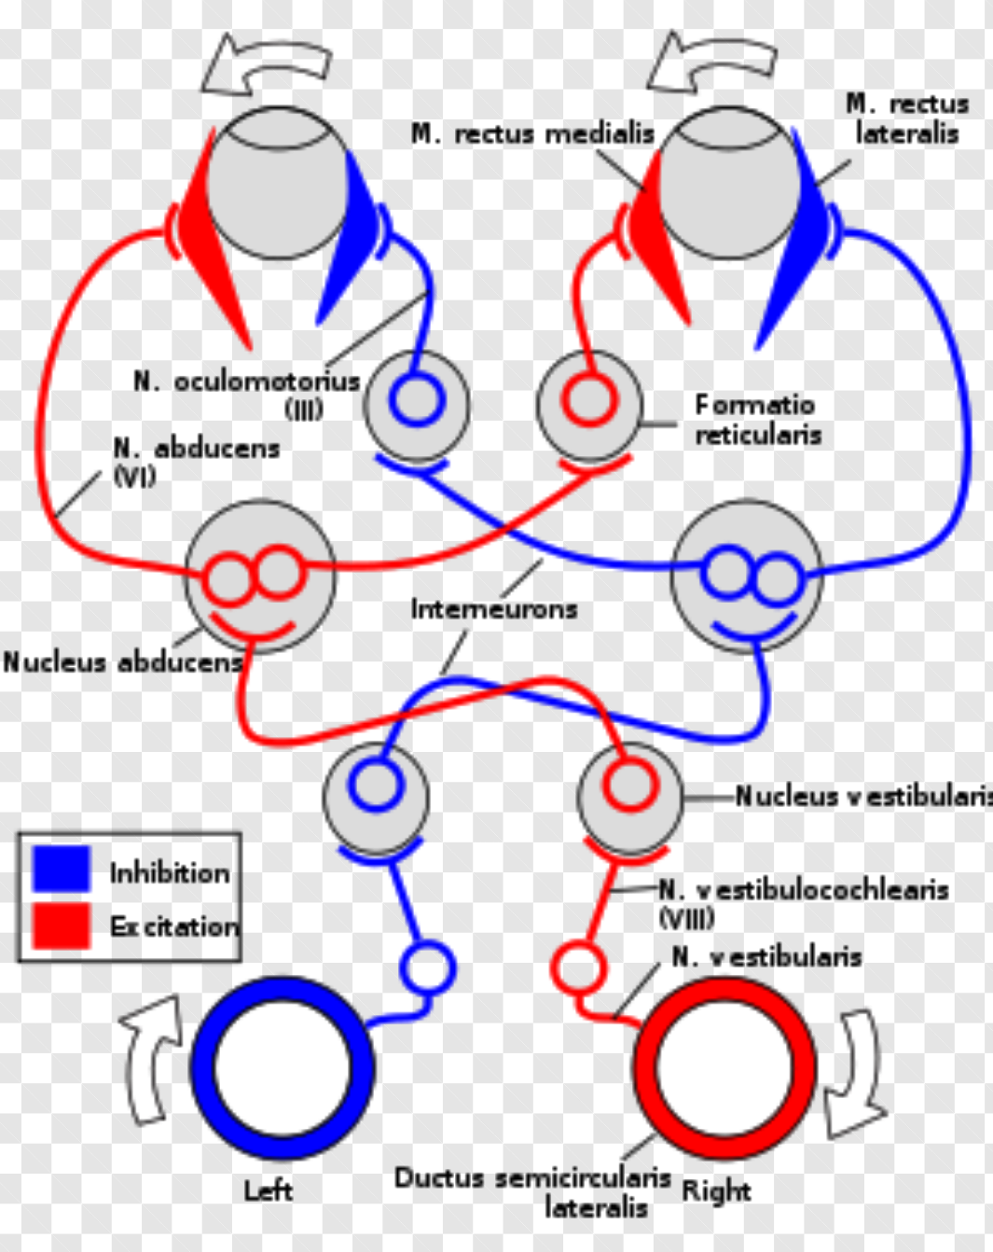
PATHWAY OF V.O.R
Vestibular nerve enters the brainstem and synapses in the vestibular nucleus
Projects to the Abducens Nucleus on the left side which stimulates the left Lateral Rectus
Simultaneously it also projects to the Oculomotor nucleus on the right side which stimulates the right Medial Rectus
Similarly the left side is wired to complementary set of muscles and since it is inhibited it will not excite its target muscles ( left Medial rectus & right Lateral rectus )

Slide 20
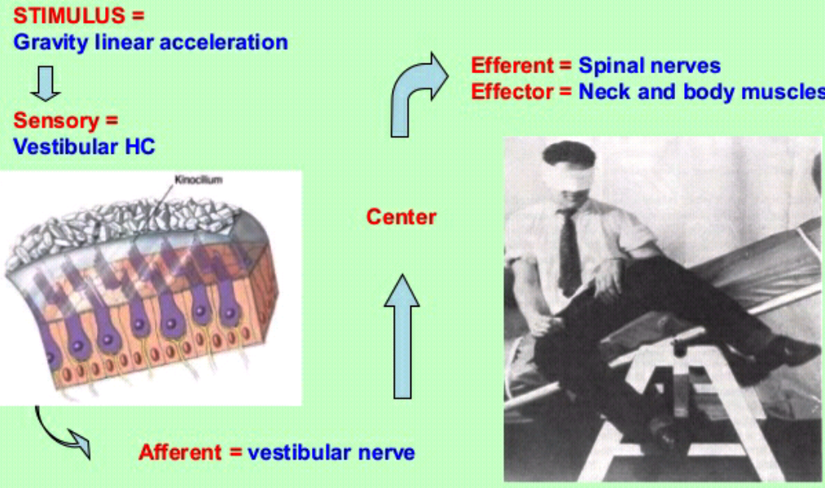
VESTIBULOSPINAL REFLEX
Effector organs – Extensor muscles of neck , trunk arms and limbs
The driving input here is mainly gravity detected by the otolith system.
These reflexes are mediated through projections of the vestibular nuclei on to the medial and lateral vestibulospinal tract.
Similar to the VOR , the same push-pull mechanism are used for controlling balance between the extensor and flexor muscles.

Slide 21
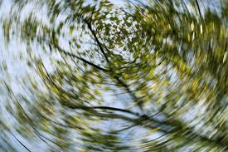
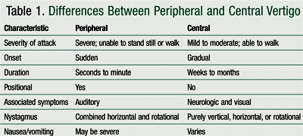
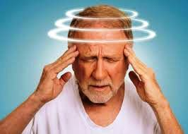
APPLIED
VERTIGO is the feeling of rotation in the absence of actual rotation and is a prominent symptom when one labyrinth is inflammed.
DIZZINESS is a feeling of unsteadiness after stoppage of rotation .
MOTION SICKNESS is a very common equilibrium disorder which is due to sensory output mismatch . The main symptoms are – nausea, dizziness , vomitting .

Slide 22
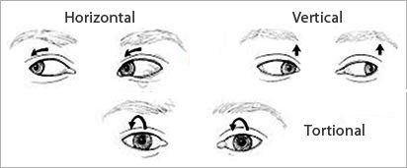
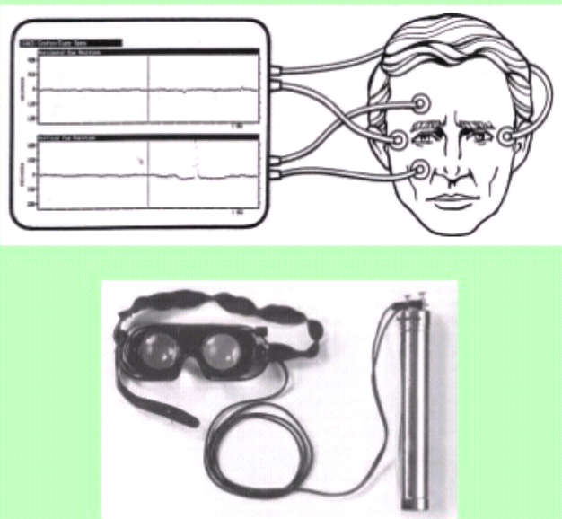
NYSTAGMUS is an involuntary movement of eyes or reflex which helps in visual fixation while the body rotates and is recorded by electronystagmography
Normally right vestibule – deviates eyes to left , vice versa and with normal tone two effects are cancelled and the eyes remain in midposition
If right vestibule is destroyed , the normal tone exerted by the left side pushes the eye to the right ,then this is corrected to the central position with a quick movement .So there is nystagmus to the left ( normal side )
If the right vestibule is hyperactive , nystagmus to the right occurs.

Slide 23
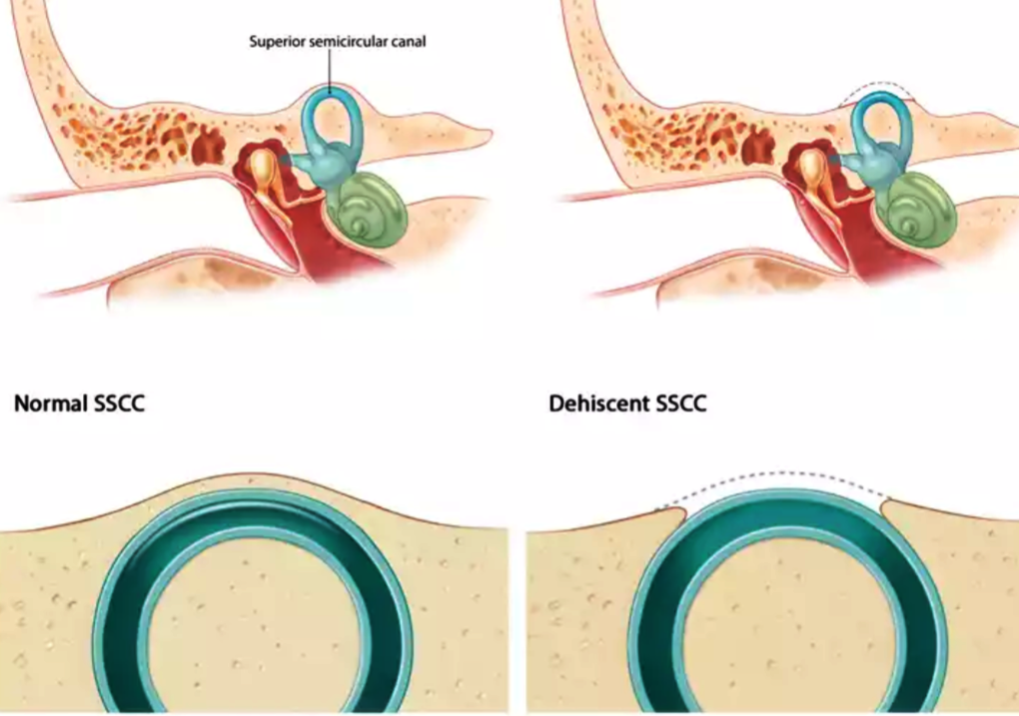
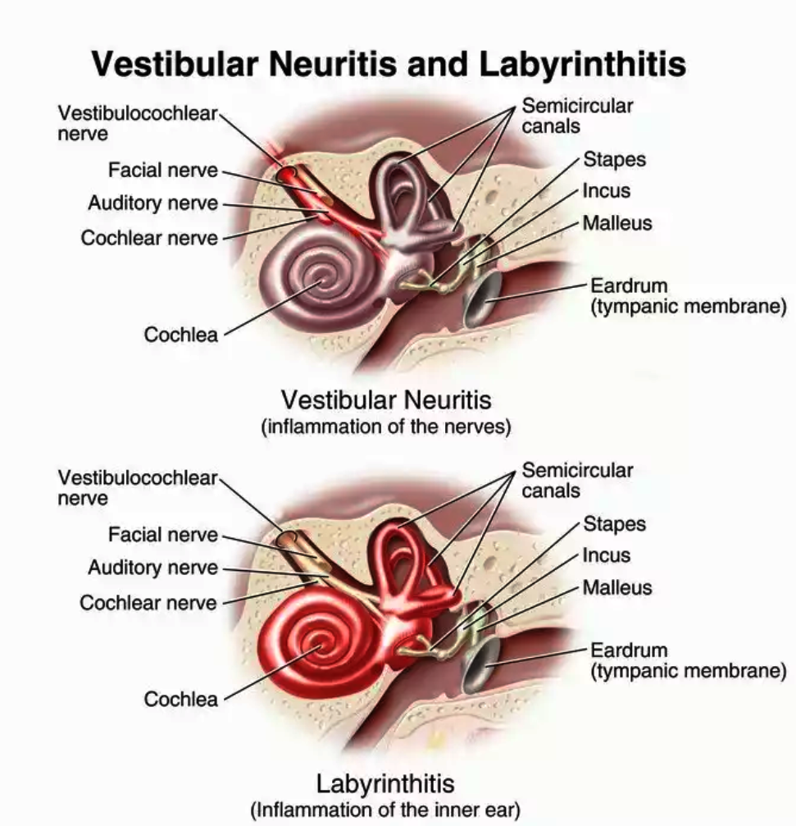
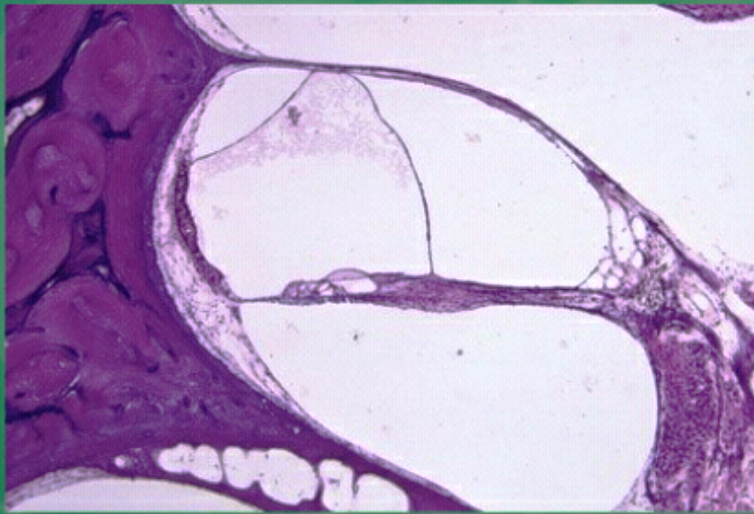
PERIPHERAL VESTIBULAR DISORDERS
Some of them are :-
BPPV
Meniere’s disease
Swelling of the endolypmphatic sac – mainly cochlear duct, saccule & utricle & SCCs is responsible for the body’s imbalance
Vestibular Neuronitis
There is diffuse lymphocytic infiltration with areas of gliosis in the vestibular nerve , number of fibres in the vestibular nerve is also diminished on the affected side and loss of sensory hair cells.
Labyrinthitis ( bacterial & viral )
Superior Semicircular canal dehiscence

Slide 24
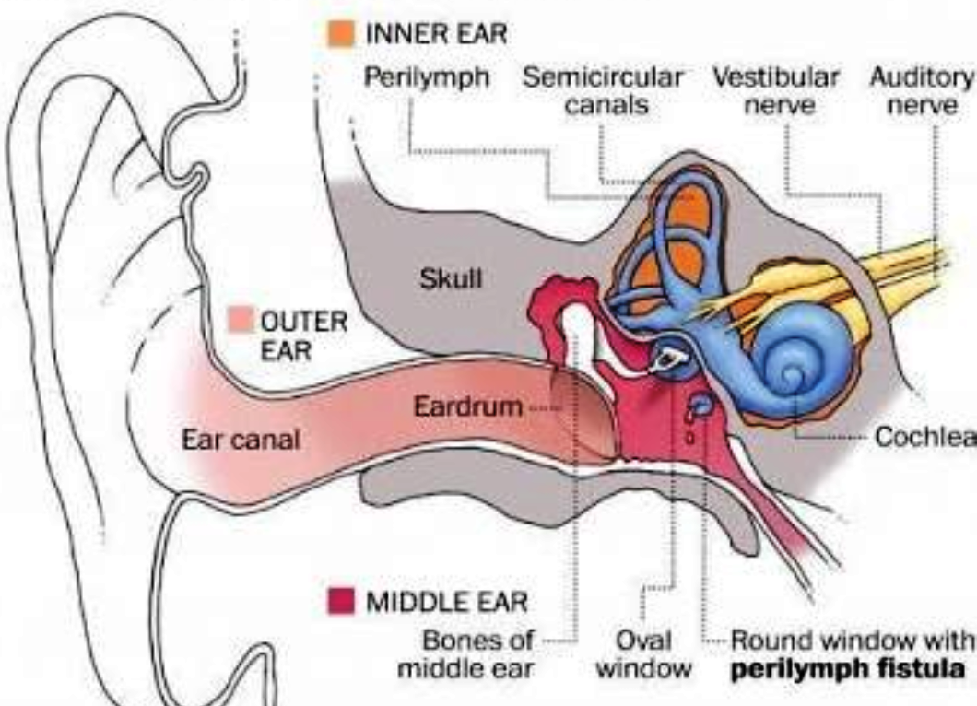
Accoustic neuroma
Perilymph fistula
Ototoxicity
Inner ear trauma
Concussion of the inner ear results in hemorrhage into the perilymphatic or endolymphatic spaces or a violent blow can also dislodge the otoconia.
Congenital – CHARGE syndrome
- absent oval window
- hypoplastic endolymphatic sac
- absent bony and membranous SCCs
and ampullae
- reduced number of Scarpa’s ganglion
cells.
- Usher’s syndrome

Slide 25
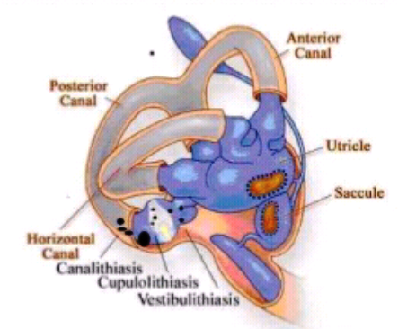
BPPV (Benign Paroxysmal Positional Vertigo )
Detached Otoconia from the macula gets dislodged and float freely in the endolymph.
The endolymph does not normally react to gravity .However the crystals do move with gravity , thereby moving the fluid when it normally would be still.
Cupula moves and the nerve endings get stimulated – sending a false message to the brain that the head is moving.
This causes a mismatch with what the other ear , eye muscles and joints are sensing thereby causing vertigo.
Posterior canal is mostly commonly affected
KEY COMPLAINT- Brief (< 1 min ) and severe , episodic rotatory vertigo related to change in head position relative to gravity.
Nystagmus will be vertical and torsional towards the effected side.

Slide 26

DIX HALLPIKE MANOUVRE

Slide 27
EPLEY’S MANOUVRE

Slide 28
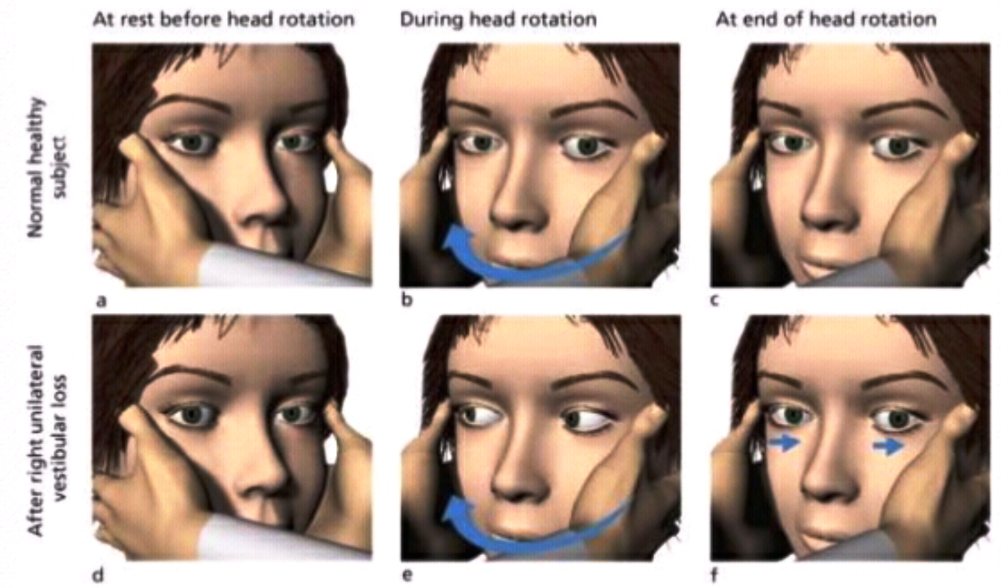
HEAD IMPULSE TEST
It detects severe unilateral loss of semicircular canal function clinically
It is more specific and sensitive than Romberg’s test
Can distinguish between vestibular neuritis and cerebellar infarction.
Head movement toward a canal will cause activation and reflex movement of eyes in the opposite direction.
Wheras head movement towards a defunct canal – failure of VOR- visual target will be lost from fixation
And thus the test is positive when the patient makes a catch up – saccade to refixate the visual target.

Slide 30
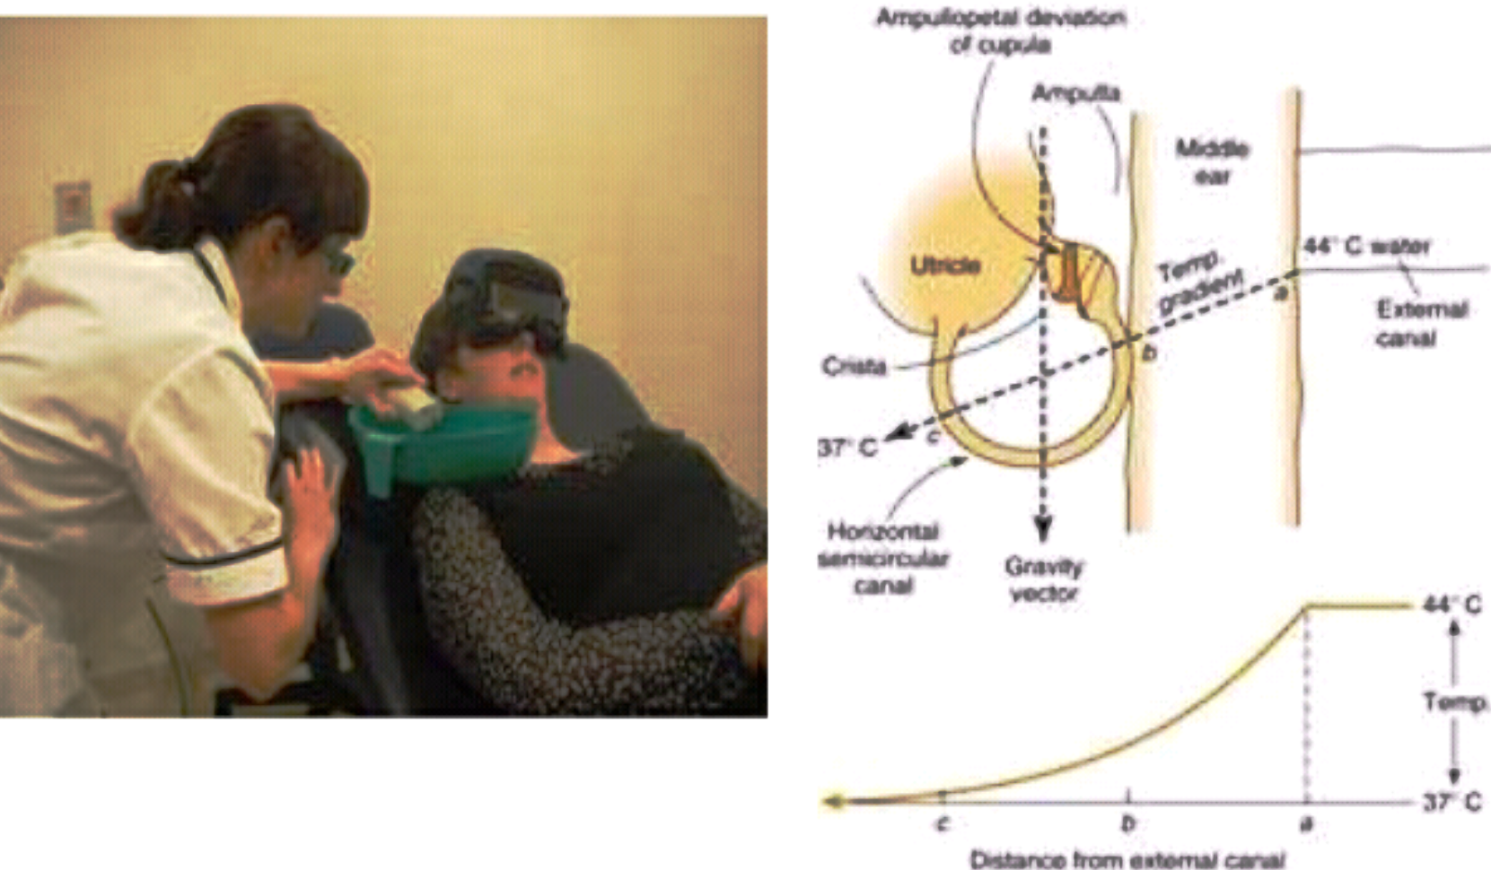
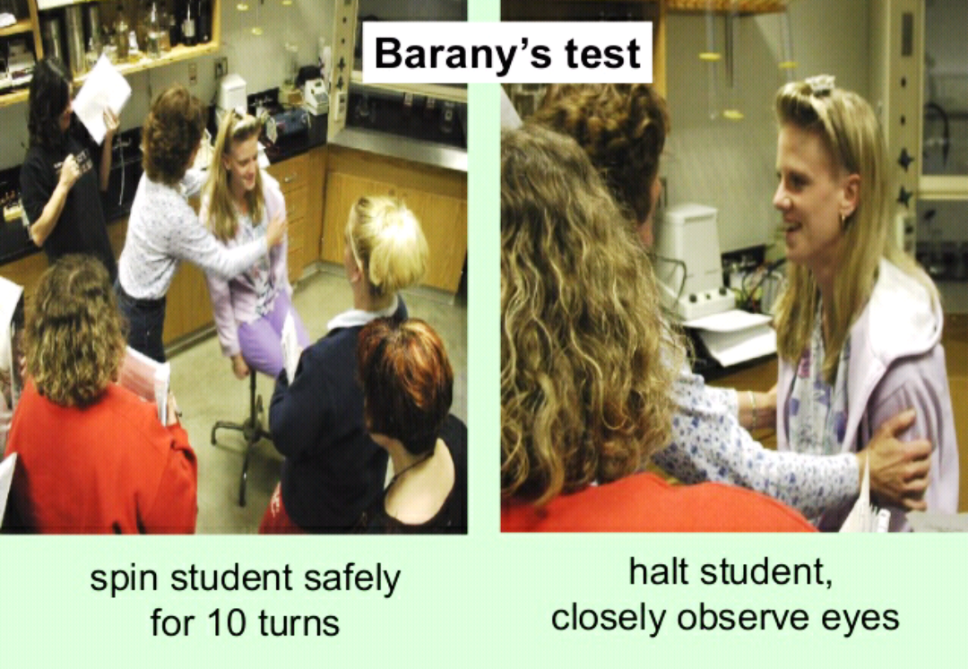
EXPERIMENTAL STIMULATION
CALORIC STIMULATION
The semicircular canals can be stimulated by instilling water that is hotter or colder than body temperature into the external auditory canal.
The temperature difference – convection currents in the endolymph – consequent motion of the cupula – causing nystagmus, vertigo, dizziness and nausea.
BARANY’S ROTATING CHAIR

Slide 32
THANK YOU

