Slide 1

TUMORS OF NOSE AND PARANASAL SINUS

Slide 2
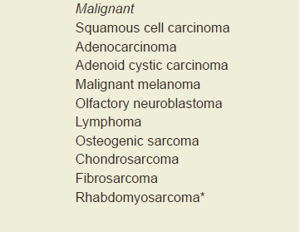
CLASSIFICATION

Slide 3
EPIDEMIOLOGY
Incidence - 0.5–1 / 1,00,000 / yr
< 1 % of all carcinomas.
Male : female = 2: 1
Whites > blacks
Mean age – 55 yrs ( 5th -6th decade )
Most common – maxillary sinus (55 % )

Slide 4
Squamous cell carcinoma
Most common sino nasal malignancy
Male > female
Vestibular- lateral wall of nasal vestibule
Septal- arises from mucocutaneous junction termed as nose pickers cancer
Lateral wall- most common site
ethmoid or maxillary sinus mass in lateral wall of nose

Slide 5
Adenocarcinoma
2nd most common malignancy
Male >female
Seen in 6th to 7th decade of life
Seen in wood worker
Usually radio resistant

Slide 6
Olfactory neuroblastoma
<5% of all sinonasal malignancy
Female> male
Peak at 20 and 50 years of age
Arise from basal cell in olfactory epithelium

Slide 7
Malignancy of PNS
Maxillary sinus most commonly involved
Followed by ethmoid and frontal sinus
Squamous cell carcinoma –most common histological type
Adenocarcinoma –common in wood workers

Slide 8
Risk factors
Inhalation of carcinogens – 40%
Hardwood dust (adenocarcinoma) – 70 times risk
Softwood dust (squamous carcinoma)
Nickel refining (250 times); chromium workers
Boot , shoe & textile workers
Isopropyl oil, volatile hydrocarbons & mustard gas
Snuff

Slide 9
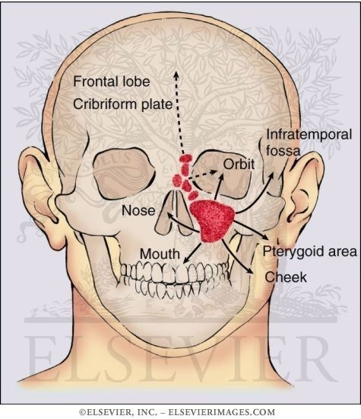
Routes of spread

Slide 10
Clinical features
Oral symptoms
Nasal symptoms
Orbital symptoms
Facial symptoms
CNS symtoms

Slide 11
ORAL SYMTOMS
Due to inferior spread to alveolus and palate
Seen in 25-40% patients
Dental pulp type pain-ant sup aleolar nerve
Loosening teeth
Dental malocclusion
Trismus
Palatal bulge/ulcerated growth

Slide 12
Nasal symptoms
Due to medial spread
Seen 45-75% patients
u/l nasal obstruction
u/l nasal discharge-blood stained

Slide 13
Orbital symptoms
Due to superior spread
Seen 25% of patients
Lid swelling,epiphora
Diplopia , proptosis, impaired vision

Slide 14
Facial symptoms
Seen in 40-70% patients
Due to extension through anterior wall
Numbness/paraesthesia of face-infra orbital nerve
Blunting of nasomaxillary fold
Widening of dorsum of nose
Ulcerative growth/fixity to skin

Slide 15
Neurological
Spread of disease through
cribriform plate….ant cranial fossa(head ache,anosmia,csf leak)
Posterior wall …pterygopalatine fossa(deep facial pain,trismus)
Orbital apex-----middle cranial fossa-EOM palsy(direct/cavernous sinus)

Slide 16
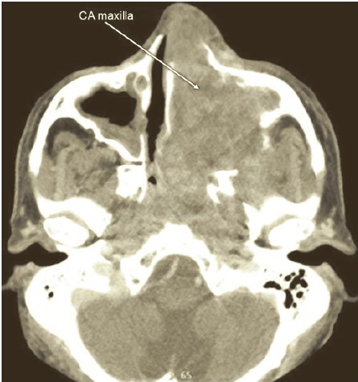
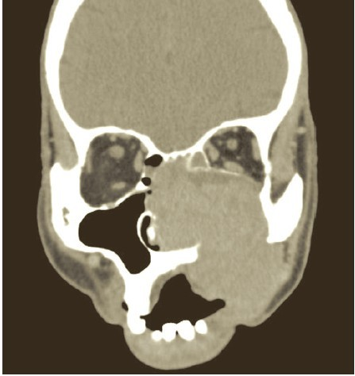
INVESTIGATIONS
DNE AND BIOPSY
CECT SCAN

Slide 17
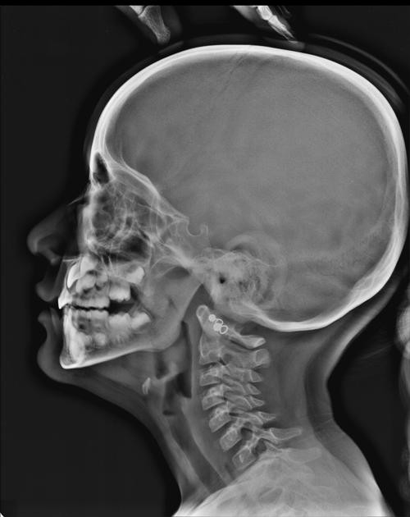
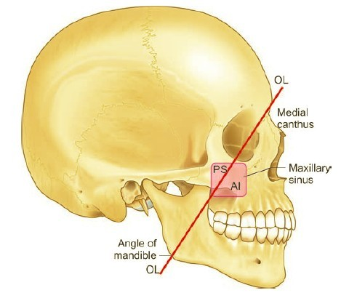
Ohngren’s line

Slide 18
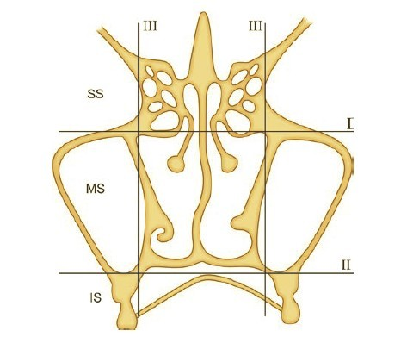
Lederman staging

Slide 19
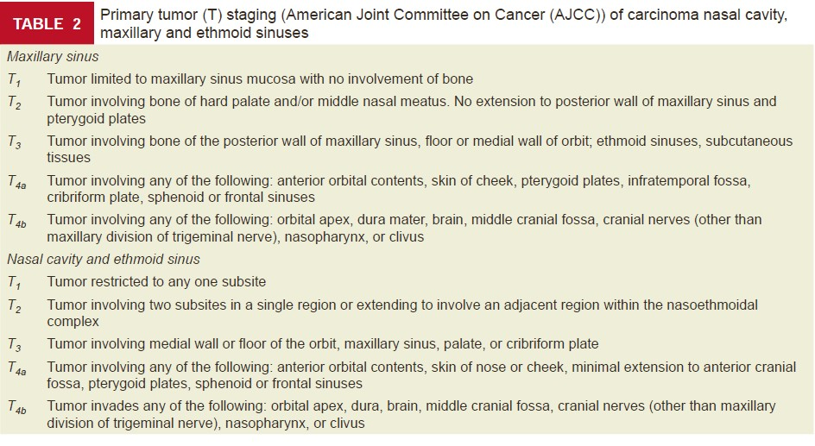

Slide 20
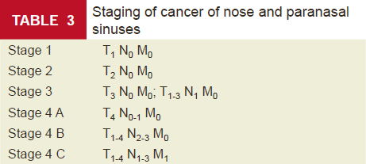

Slide 21
Treatment
Surgery-total maxillectomy
Surgery+radiotherapy
Radiotherapy …..Surgery…..Radiotherapy

Slide 22
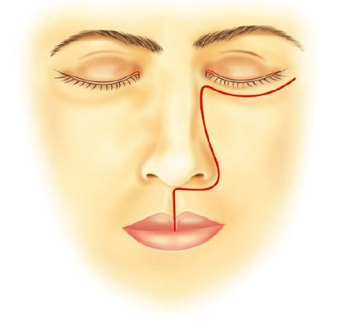
Weber Ferguson incision

Slide 23
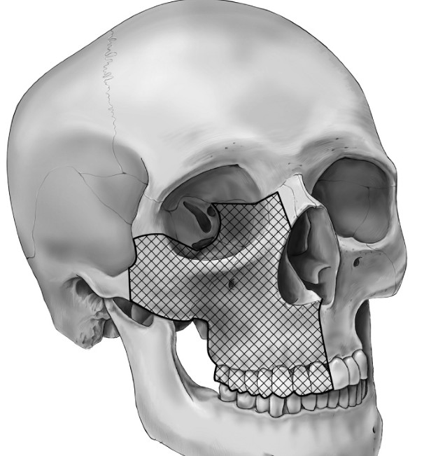
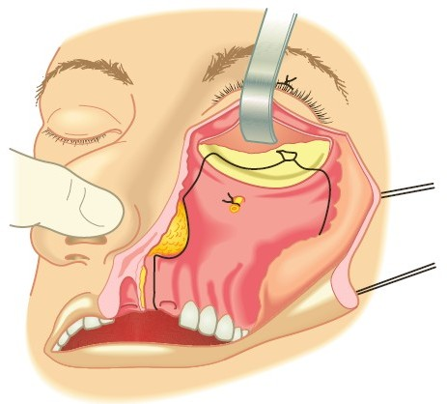
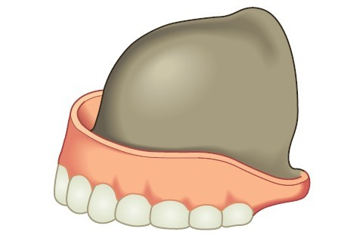

Slide 24

Thank you

