Slide 1
Voice Disorders

Slide 2
Introduction
Normal voice is difficult to interpret
Voice disorders should be classifiable
Voice disorders should be objectively quantifiable

Slide 3
Normal voice - Pre-requisites
Normal range of vocal fold mobility
Normal mobility of mucosa on deep layers
Optimal co-aptation of vocal fold edges
Optimal motor force at glottic closure
Optimal pulmonary support
Optimal timing of the glottic closure in relation to the onset of phonatory expiration
Optimal tuning of vocal fold tension

Slide 4
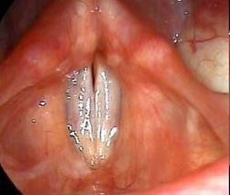
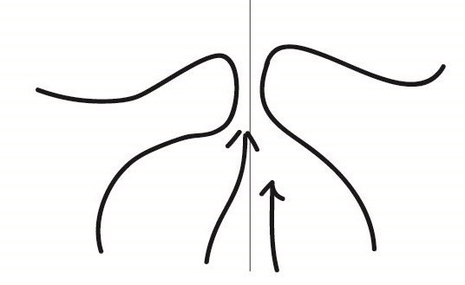
Phonatory expiration
This occurs when the person is attempting to speak
Vocal folds on both sides approximate along their entire antero-posterior dimension
This can be tested by asking the patient to say (eeee) while performing laryngoscopic examination
In non phonatory expiration vocal folds are gently abducted
•
•
•
Non phonatory expiration

Slide 5
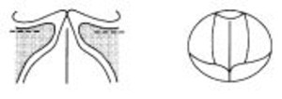
Glottal cycle
Opening phase
Closing phase
Closed phase

Slide 6
Opening phase
Vocal fold gets blown upwards by increasing subglottic pressure
Undulating wave moves on the medial margin from the lower part to upper part.

Slide 7
Closing phase
After the width of the glottis reaches the maximum, subglottic air pressure reduces and elastic recoil of vocal folds draw them towards midline. Closure occurs from below upwards
The lower lip of vocal folds close first followed by the upper

Slide 8
Closed phase
Glottis closes completely when the upper lip of both vocal folds come together.
This phase lasts till the subglottic pressure overcomes the glottic closure

Slide 9
Characteristics of voice disorder
Voice disorder
Discomfort Pain on phonation
Easy fatiguability
Not
Not
appr opri ate
for age and
sex
Unable to fullfil Liguistic/
paralingusitic functions
Not clear Not stable
a u d i b l

Slide 10
Definitions
Dysphonia - Voice impairment / difficulty in speaking
Dysarthria - Articulation difficulties due to impairment of speech muscles
Dysarthrophonia - Dysphonia + Dysarthria CNS causes like motor neuron disorders
Dysphasia - Impairment of comprehension of spoken / written language.
Hoarseness - harsh breathy voice

Slide 11
Voice disorders - diagnostic problems
Aetiology (Multifactorial)
Pts develop compensatory mechanisms in order to communicate effectively, this could mask the primary disorder
Pts may have more than one condition contributing to voice disorders

Slide 12
Voice disorders - causes
Inflammatory
Structural / neoplastic
Neuromuscular
Muscle tension imbalance

Slide 13
History
Nature & chronicity
Exacerbating / releiving factors
Life style / dietary / hydration issues
Medical conditions / trt effects
Pts voice use / voice requirements
Impact on quality of life
Pts expectations

Slide 14
Complaints
Voice quality changes - (hoarseness, roughness and breathiness)
In appropriate pitch - age and sex
Poor voice control (break in pitch)
Inability to raise voice to be heard in noisy environment
Difficulty in singing
Voice tiring

Slide 15
Complaints - contd
Throat related symptoms
Reduced ability to communicate
Difficulties in using voice at different times of the day
Emotional effects due to voice changes

Slide 16
Examination
Oral cavity
Oropharynx
Nasal cavity
Lower cranial nerves
Cervical adenopathy
Signs of increased muscle tension
Laryngeal position
Breathing pattern

Slide 17
Amplitude of vibration
It is the extent of vocal fold movement in the horizontal plane
Usually it is one half of the width of the visible part of the vocal fold
Amplitude decreases when the pitch increases
Amplitude increases with increasing loudness of phonation

Slide 18
Amplitude of vibration - Rating
0 - No observable horizontal excursions
1 - Diminished amplitude of excursion
2 - Normal amplitude of excursion
3 - Greater amplitude of excursion

Slide 19
Decreased vocal fold vibration amplitude
Vocal fold stiffness
Reduced subglottic pressure
Sulcus vocalis increases stiffness of the vocal folds
Tight glottic closure - Hyperfunctional dysphonia

Slide 20
Increased amplitude of vocal fold vibration
Reinke's odemea - There is a consious increase of subglottic pressure in these patients to move the increasingly bulky cord
Decreased laryngeal muscular tone - vocal fold paralysis (appears like flag fluttering in the wind)

Slide 21
Mucosal wave
This is a normal wavy motion of vocal fold mucosa travelling both in vertical and horizontal planes
Normally it travels across in the vertical plane of the vocal folds and then rolls laterally across atleast 50% of the width of the visible part of vocal fold
It is affected by the mucosa and the underlying muscle layers
Normally it decreases with rising pitch of phonation
It increases with increasing loudness of phonation

Slide 22
Mucosal wave - grading
0 - No observable travelling wave
1 - Restricted mucosal wave
2 - Normal mucosal wave
3 - Greater mucosal wave

Slide 23
Decreased mucosal wave - causes
Increased stiffness due to mucosal changes - Polyp, sulcus vocalis and vocal fold dysplasia
Increased muscle tension leading to tight glottic closure (Hyperfunctional dysphonia; it leaves a long closed phase)
Decreased muscle tone causes weak glottic closure pattern (Hypofunctional dysphonia with long open and short closed phase)

Slide 24
Mucosal wave absence
Stroboscopic fixation (synonym)
Malignant neoplasm
Vocal fold scarring
Recurrent laryngeal nerve paralysis

Slide 25
Increased mucosal wave
Reinke's oedema
This is due to elevated subglottic pressure

Slide 26
Symmetry
Both vocal cords are normally symmetrical
They mirror each other in timing / phase and amplitude

Slide 27
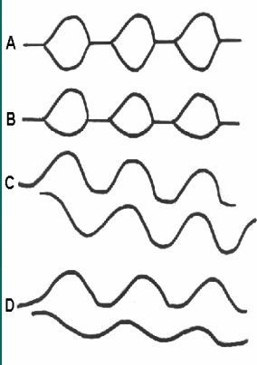
Symmetry (Contd)
•
A - displays normal amplitude and timing. Upper curve represents right cord and lower curve represents left cord movements
B - Asymmetry. The range of excursion of left cord is less than that of the right fold
C - Extreme asymmetry. Left vocal fold opens while the right vocal fold closes
D - Asymmetry both in phase and amplitude
•
•
•

Slide 28
Periodicity
This is regularity of successive glottic cycles
Aperiodicity between successive cycles could be either in amplitude or timing or in both.
To access this the strobe light setting should be set to auto so that the light flashes are executed at the same frequency as that of vocal fold vibrations
Normally laryngeal image will be static
In aperiodicity the flashes will not coincide with glottal cycle. This causes hazy shivering of laryngeal image

Slide 29
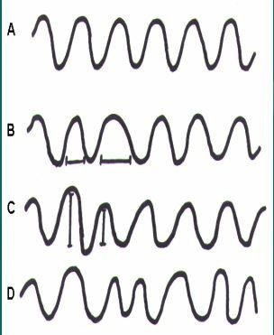
Periodicity - (Contd)
A - Normal glottic wave form
B - Aperiodicity in timing between successive cycles
C - Aperiodicity in amplitude
D - Aperiodicity in timing and amplitude

Slide 30
Aperiodicity - causes
Inadequate expiratory air during phonation
Disrupted laryngeal muscle tension
Imbalance of neuromuscular control of larynx
Disrupted mechanical properties of vocal folds

Slide 31
Glottic closure patterns
The timing of opening phase, closing phase and closed phase are more or less equal normally
Opening phase dominates with increasing pitch / decreasing loudness during phonation
Closed phase predominates with rising loudness of phonation

Slide 32
Pathological changes of glottic closure
Predominance of opening phase - decreased laryngeal muscle tension (hypofunctional dysphonia)
Predominance of closing phase - Due to increased glottal resistance / hyperfunctional dysphonia

Slide 33
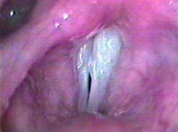
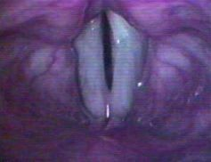
Glottic closure shape
Normal - Complete closure. Small triangular posterior chink + females
Hour glass phonatory gap - vocal nodules
Slit shape phonatory gap in hyperfunctional dysphonia

Slide 34
Glottic closure shape - (contd)
Oval shape phonatory gap - Hypofunctional dysphonia
Irregular phonatory gap - Growth vocal folds
No closure - Bilateral vocal fold paralysis

Slide 35
Non vibrating portions
Laryngeal scarring
Dysplastic patches
Mucosal fixation

Slide 36
Stroboscopy - uses
Detection of early glottic cancers
Determine changes to vocal folds not normally visible to naked eye
Pre and post treatment comparison

Slide 37
Vocal hygiene
Smoking cessation
Avoidence of dust and fumes
Reflux prophylaxis
Avoid eating late in the night
Avoidance of voice strain

Slide 38
Specific voice disorders (common)
Tension dysphonia
Laryngitis
LPR
Vocal nodules
Vocal fold cysts
Vocal fold paralysis
Arytenoid granuloma

Slide 39
Voice disorders (Less frequent)
Sulci / mucosal bridges
Spasmodic dysphonia
Papillomatosis
laryngeal trauma
Hyperkeratosis / Malignancy
Endocrine causes
Amyloid

Slide 40
Thank You !

