Slide 1
ACUTE AND CHRONIC SINUSITIS

Slide 2



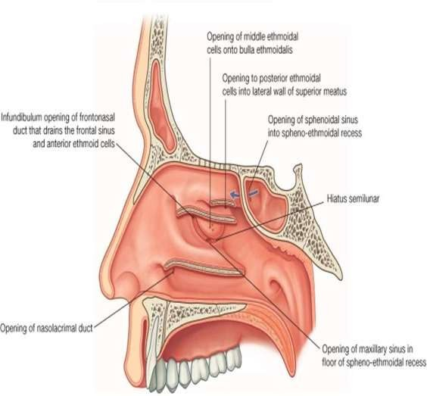
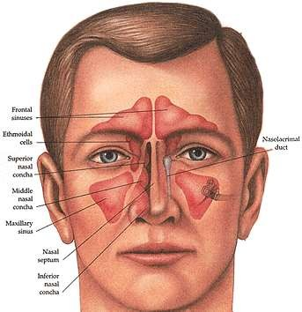

Slide 3
It is the acute inflammation of sinus mucosa.
Most commonly involved sinus is maxillary sinus(ethmoid »frontal
»sphenoid sinuses)
Multisinusitis
SINUSITIS
Pansinusitis
Open type
SINUSITIS
Closed type

Slide 4

BACTERIOLOGY:
Streptococcus pneumoniae, Haemophilus influenzae, Moraxella catarrhalis, Streptococcus pyogenes, Satphylococcus aureus, Klebsiella pneumoniae .Anaerobic infections are seen in sinusitis of dental origin.
A) EXCITING CAUSES :
Nasal infections: Viral rhinitis followed by bacterial invasion.
Swimming and diving: infected water enters sinuses through ostia.
Trauma: Compound fractures or penetrating injuries.
Dental infections.

Slide 5
B) PREDISPOSING CAUSES :
LOCAL:
Obstruction to sinus ventilation and drainage ( DNS,hypertrophic turbinates, polyp,edema of ostia, neoplasms, edema of ostia).
Stasis of secretions in nasal cavity( Cystic fibrosis ,enlarged adenoids, choanal atresia)
Previous attacks of sinusitis.
GENERAL
Environment: Cold and wet climate.
Poor general health: Exanthematous fever (measles,chickenpox),nutritional deficiencies, systemic disorders.

Slide 6
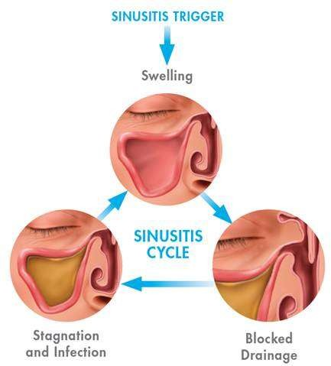

Slide 7
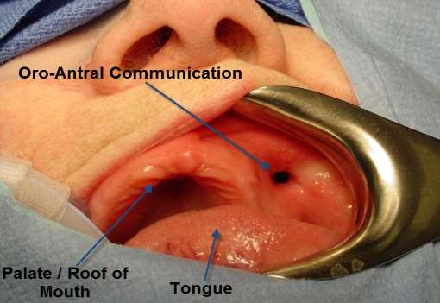
AETIOLOGY:
Dental infections(periapical dental abscess, oroantral fistula).
Viral rhinitis followed by bacterial invasion.
Diving and swimming.
Trauma (fractures and penetrating injuries).
Clinical features :
Constitutional symptoms.
Headache.
Pain.
Tenderness.
Redness and edema of cheek.
Nasal discharge.
Postnasal discharge.

Slide 8
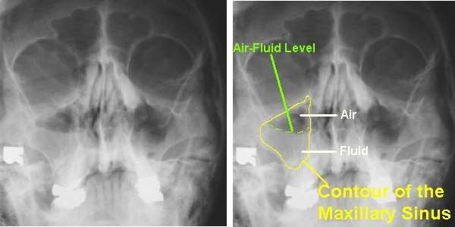
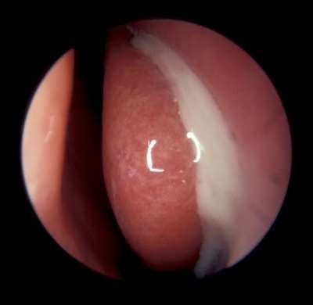
DIAGNOSIS:
Xray: WATER’S VIEW.
CT is preferred..
ANTERIOR NASAL ENDOSCOPY
PUS SEEN IN MIDDLE MEATUS

Slide 9
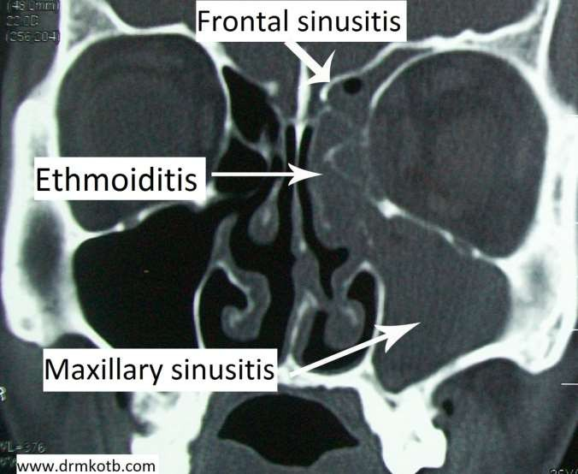
CT CORONAL SECTION

Slide 10
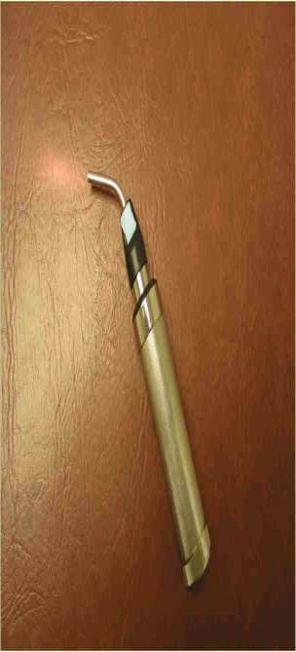
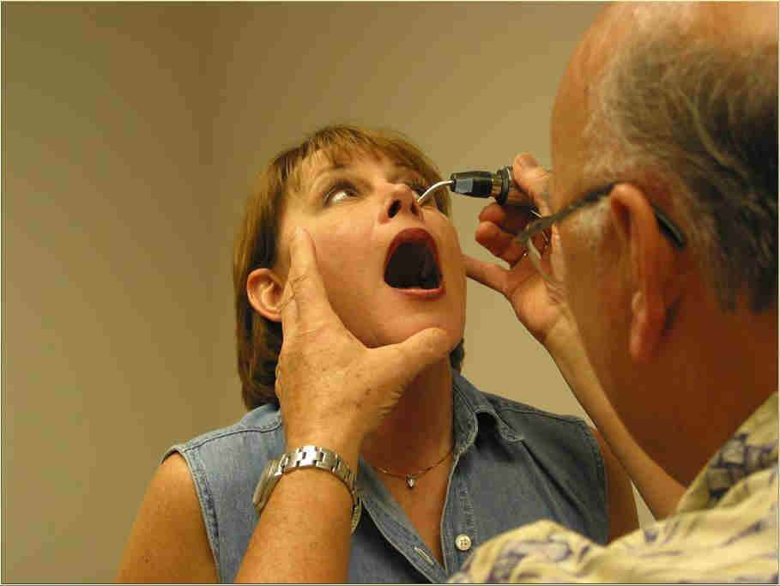
TRANSILLUMINATION TEST:
TRANSILLUMINOSCOPE
TRANSILLUMINATION OF MAXILLARY SINUS

Slide 11
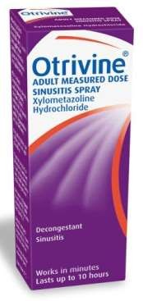
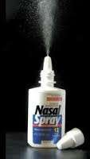
TREATMENT:
MEDICAL
Antimicrobial drugs( ampicillin/amoxicillin/erythromycin)
Nasal decongestant drops ( 0.1% oxy or xylometazoline).
Steam inhalation.
Analgesics.
Hot fomentation.
SURGICAL
Antral lavage
NASAL SPRAYS

Slide 12
AETIOLOGY:
Viral rhinitis followed by bacterial invasion.
Diving and swimming.
Trauma (fractures and penetrating injuries).
Oedema of middle meatus 2⁰ to ipsilateral maxillary sinus infection.
CLINICAL FEATURES:
Frontal headache.(OFFICE HEADACHE)
Tenderness.
Oedema of upper eyelid.
Nasal discharge.

Slide 13
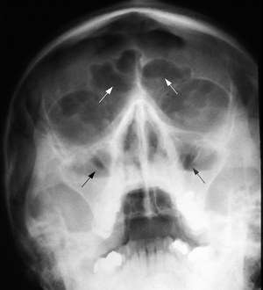
DIAGNOSIS:
Xray: WATER”S VIEW/LATERAL VIEW.
CT is preferred.
TREATMENT:
MEDICAL
Antimicrobial drugs.
Nasal decongestant drops.
Steam inhalation.
Analgesics.
Hot fomentation.

Slide 14



AETIOLOGY:
Associated with infection of other sinuses.
CLINICAL FEATURES:
Pain.
Oedema of lids.
Nasal discharge(middle or superior meatus).
Swelling of the middle turbinate.

Slide 15
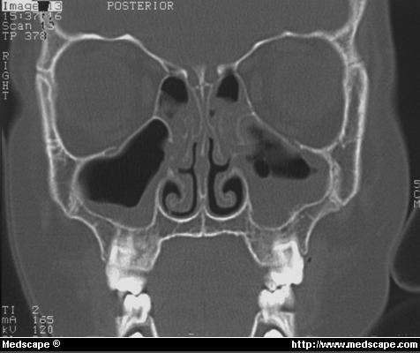
DIAGNOSIS:
Computed tomography.
TREATMENT:
Medical treatment same as for acute maxillary sinusitis.
In case of posterior orbit abscess ,drainage of ethmoid sinuses into nose through external ethmoidectomy incision may be required.

Slide 16
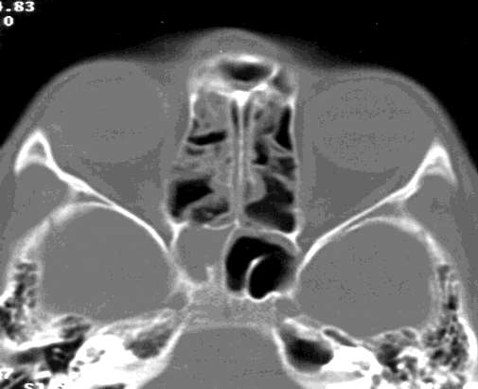
AETIOLOGY:
As a part of pansinusitis.
Associated with infection of posterior ethmoid sinuses.
CLINICAL FEATURES:
Headache.
Postnasal discharge.
DIAGNOSIS:
Xray/CT.
TREATMENT:
Medical treatment same as for acute maxillary sinusitis.

Slide 17
It is the sinus infection lasting for months or years.
Important cause is failure of acute infection to resolve.
PATHOPYSIOLOGY:
Pollution,chemicals,infections.
LOSS OF CILIA
Polypi,DNS, adenoids, tumors, allergy
IMPAIRED DRAINAGE
MUCOSAL CHANGES
ALLERGY
INFECTION
Inadequate therapy of acute sinusitis

Slide 18
PATHOLOGY:
Destruction and healing of sinus mucosa.
Hypertrophic sinusitis.
Atrophic sinusitis.
Submucosa infiltrated with lymphocytes and plasma cells.
CLINICAL FEATURES:
Similar to acute sinusitis but of lesser severity.
Purulent nasal discharge is the commonest complaint.
Foul smelling discharge( anerobic infections).
Local pain and tenderness are not marked.
Nasal stuffiness and anosmia(in some patients).

Slide 19
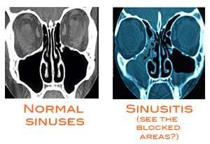
DIAGNOSIS:
Xray (mucosal thickening)
Xray with contrast.
CT
Aspiration( pus is confirmatory).
TREATMENT
Cause for obstruction of sinus drainage and ventilation to be found out.
Work up on nasal allergy may be required..
Culture and sensitivity ( selection of antibiotic).
Conservative management(antibiotics, decongestants, antihistaminics)

Slide 20
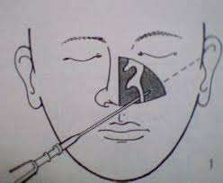
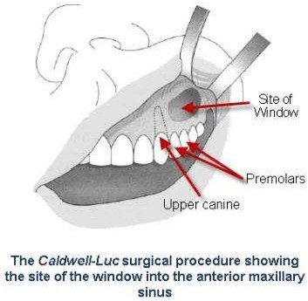
SURGICAL TREATMENT:
CHRONIC MAXILLARY SINUSITIS
Antral puncture and irrigation.
Intranasal antrostomy.
Caldwell-luc operation.
ANTRAL PUNCTURE

Slide 21
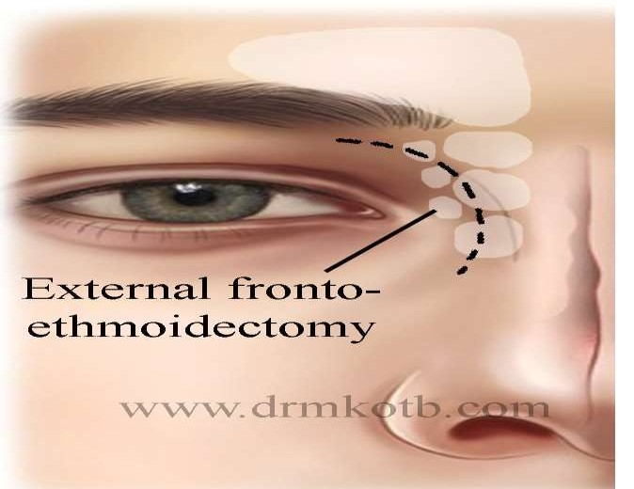
CHRONIC FRONTAL SINUSITIS
Intranasal drainage operations.
Trephination of frontal sinus.
External fronto-ethmoidectomy. ( Howarth or Lynch’s operation)
Osteoplastic flap operation.
HOWARTH’S OR LYNCH OPERATION

Slide 22
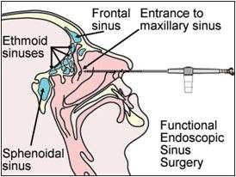
CHRONIC ETHMOID SINUSITIS
Intranasal ethmoidectomy.
External ethmoidectomy. CHRONIC SPHENOID SINUSITIS
Sphenoidotomy.
FESS HAS NOW REPLACED CONVENTIONAL SURGERIES.

Slide 23
THANK YOU

