Slide 1
Anatomy of trachea and bronchial segments

Slide 2
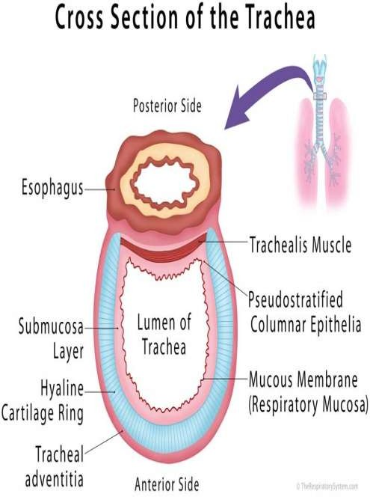
Trachea
The trachea is a cartilaginous and membranous
tube, extending from the cricoid cartilage of the larynx, on a level with C6 vertebra, to the level of the angle of Louis (T4/5) vertebra, where it divides into the two bronchi, one for each lung.

Slide 3
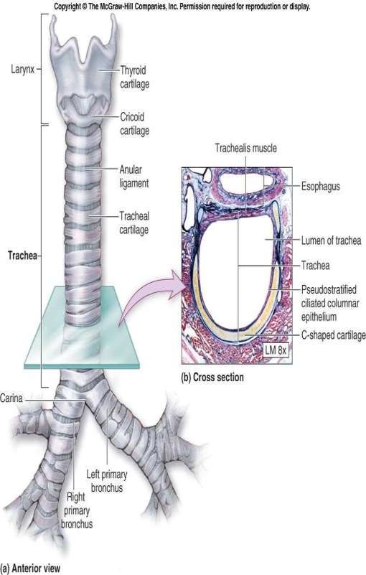
Trachea
Structure:
The trachea is a rigid fibroelastic structure. Incomplete rings of hyaline cartilage continuously maintain the patency ofthe lumen.
The trachea is lined internally with ciliated columnar epithelium.

Slide 4
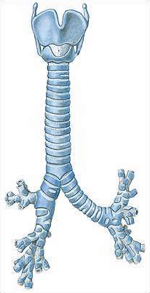
Trachea
It measures about 11 cm. In length.
Its diameter, from side to side, is from 2 to 2.5 cm.
It has 18-22 cartilaginous rings
It is greater in themale than in the female.

Slide 5
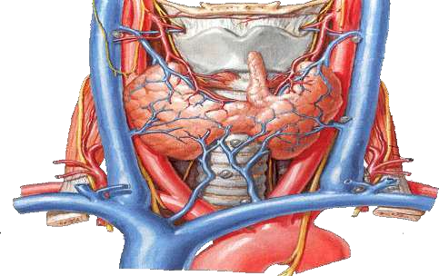
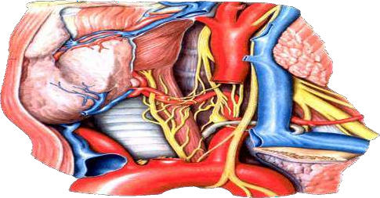
Trachea
Relations:
Anteriorly: Neck:
The isthmus of the thyroid gland (2nd, 3rd and 4th tracheal rings)
The inferior thyroid veins
The sternothyroid and sternohyoid muscles
The cervical fascia
Thorax:
The manubrium sterni
The remains of the thymus
The left innominate vein
The aortic arch
Left common carotid arteries
The deep cardiac plexus.

Slide 6
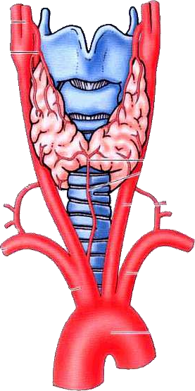
Trachea
Relations: Posteriorly : the esophagus Laterally:
Neck:
Common carotid arteries
Right and left lobes ofthe thyroid gland
Inferior thyroid arteries
The recurrent nerves

Slide 7
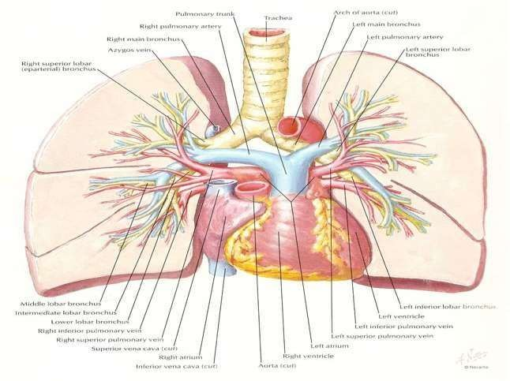
Trachea
Relations: Laterally:
Thorax: it lies in the superior mediastinum.
Right
The pleura
Right vagus,
The innominate artery
Left
Left recurrent nerve
The aortic arch
The left common carotid
Subclavian arteries

Slide 8
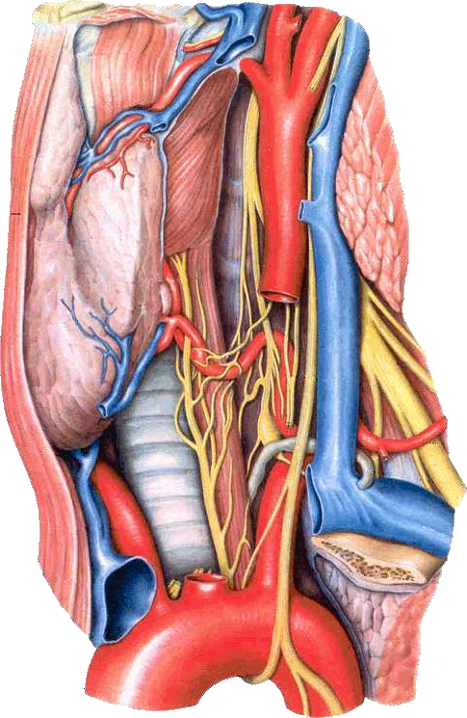
Sympathetic trunk
Inferior thyroid a.
Vagus n.
Recurrent laryngeal n.
Thoracicduct
Trachea

Slide 9
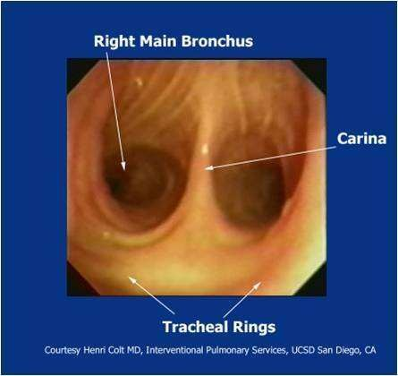
Trachea
The trachea divides into two main bronchi : the left and the right bronchi, at the level of the sternal angle at the anatomical point known as the carina.

Slide 10
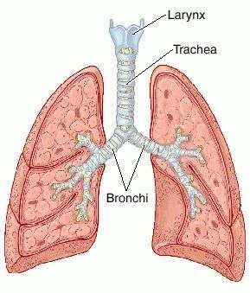
Bronchi
The right bronchus:
Wider, shorter, and more vertical in direction than the left.
It is about 2.5 cm.Long,
It enters the right lung nearly opposite the T5 vertebra.

Slide 11
Bronchi
The Left Bronchus
It is smaller in caliber but longer than the right
It is about 5 cm.long.
It enters the root of the left lung opposite the T6 vertebra.

Slide 12
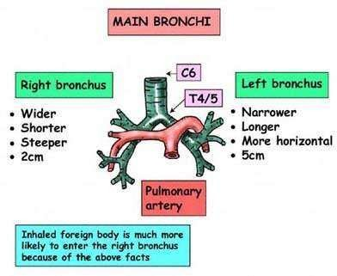

Slide 13
Wider, short er, and more vertical than the left
trachea
Right
Primary Bronchus
Left
primary bronchus

Slide 14
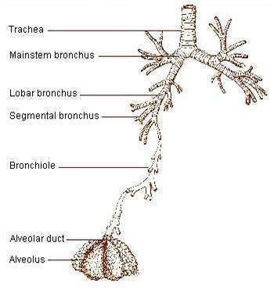
Bronchi
The primary bronchi divide to form Secondary Bronchi (lobar bronchi).
There is one secondary bronchus for each lobe of the lungs.
There are 2 lobes on the left lung.
There are 3 lobes on the right lung.

Slide 15
Bronchi
The left main bronchus enters the hilum and divides into a superior and inferior lobar bronchus.
The right main bronchus gives off the bronchus to the upper lobe prior to entering the hilum (superior lobar bronchus) and once into the hilum divides into middle and inferior lobar bronchi.

Slide 16
Bronchi
Each lobar bronchus divides within the lobe into(Tertiary Bronchi) segmental bronchi.
Each segmental bronchus enters a bronchopulmonary segment.
Each bronchopulmonary segment is pyramidal in shape with its apex directed towards the hilum.

Slide 17
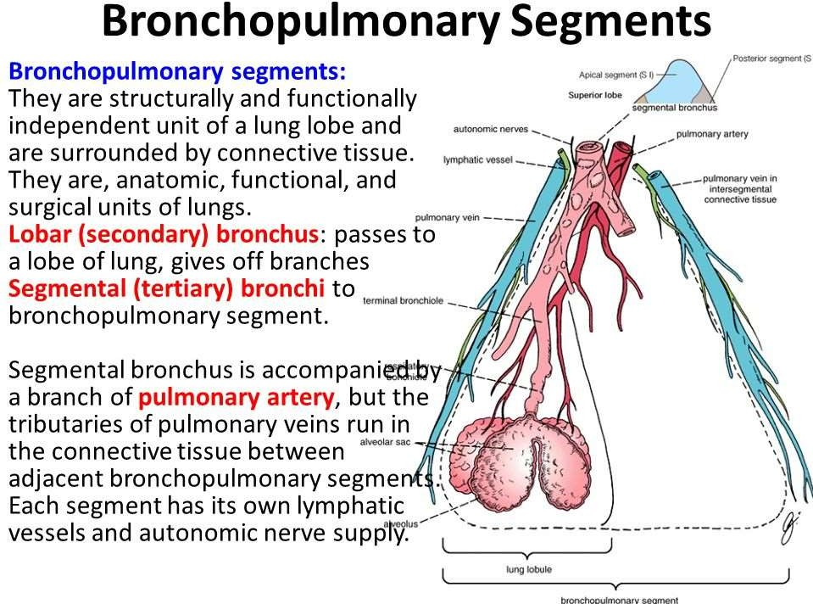

Slide 18
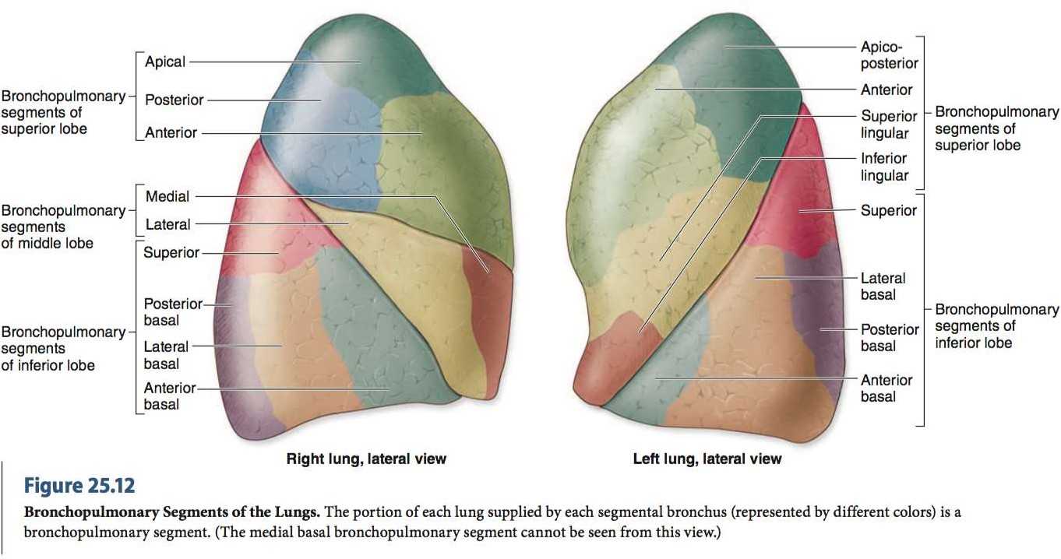

Slide 19
Trachea blood supply
the trachea receives its blood supply from branches of the inferior thyroid and bronchial arteries.

Slide 20
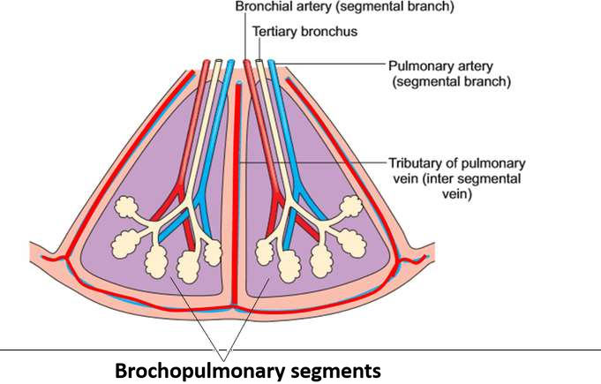
Bronchial Tree
The trachea is divided into 2 bronchi
The main bronchus divides within the lung into lobar bronchi.
The lobar bronchi divide into segmental bronchi which supply bronchopulmonary segments.
Each bronchopulmonary segment, the segmental bronchi divide into bronchioles, which further subdivide and supply the respiratory surfaces.

Slide 21
Bronchopulmonary Segment
There are ten bronchopulmonary segments in each lung
Each bronchopulmonary segment is shaped like an irregular cone with the apex at the origin of the segmental bronchus and the base projected peripherally onto the surface of the lung.

Slide 22
Bronchopulmonary Segment
Abronchopulmonary segment is the
smal est, functionally independent region of a lung and the smal est area of lung that can beisolated and removed without affecting adjacent regions.

Slide 23
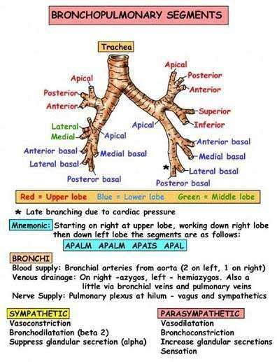

Slide 24
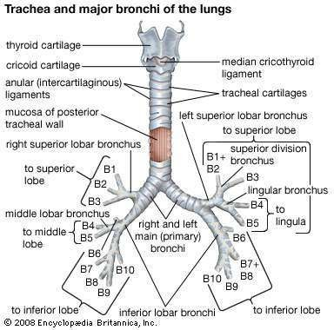

Slide 25
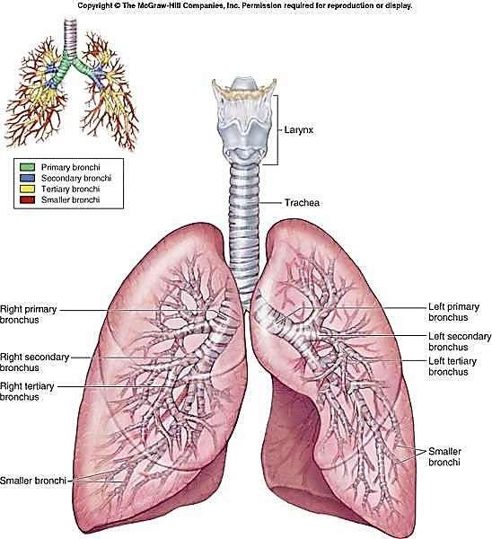

Slide 26
Thankyou ☺

