Slide 1



COMPLICATIONS OF SINUSITIS

Slide 2
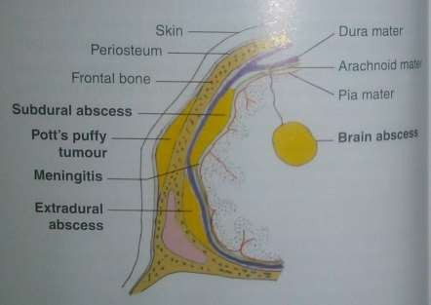

As long as infection is confined only to the sinus mucosa,it is called sinusitis. Complications are said to arise when infection spreads into or beyond the bony wall of the sinus.
Complications of sinusitis

Slide 3
TYPES :
A- Local | Mucocele/Pyocele Mucous retention cyst Osteomyelitis- frontal bone and maxila
B- Orbital | Preseptal inflammatory oedema of lids Subperiosteal abscess Orbital cellulitis Orbital abscess Superior orbital fissure syndrome Orbital apex syndrome
C- Intacranial |  | Meningitis Extradural abscess Subdural abscess Brain abscess Cavernous sinus thrombosis
D- Descending infections
E- Focal infections

Slide 4
PATHOGENESIS
Direct spread
Through wall of sinusitis
Venous spread
Through subepithelial venous plexus
Ly
mphatic spread
Perivascular lymphatics to subperiosteal plane
Perineural spread
Perineural space of olfactory nerve

Slide 5


l. LOCAL COMPLICATIONS
A. MUCOCELE OF PARANASAL SINUSES AND MUCOUS RETENTION CYSTS
This is a cystic swelling of the sinus lined by mucosa
and occurs as a result of permanent or chronic obstruction of the sinus ostium or the duct of the mucuos gland. This leads to the collection of
secretions of the gland/sinuses
resulting in retention cyst.
More commonly seen in the frontal and ethmoidal sinus.

Slide 6
Frontal sinus mucocele:
  Usually presents in the superomedial quadrant of the orbit
  Commonly occurs as a result of obstruction to the frontal ostium due to chronic disease of the frontal recess or due to postsurgical/traumatic fibrosis causing blockage.
Clinical Features:
Symptoms:
Supraorbital swelling usually above and lateral to medial canthus.
Diplopia may be present due to proptosis.
Headache is usually confined to the frontal region, mild type.
Signs :
Proptosis
Swelling is usually cystic and non-tender and egg shell cracking
may be elicited.

Slide 7
Investigations:
X-ray PNS- show cloudiness of the affected frontal sinus with loss of scalloping.
CT scan of the osteomeatal complex and PNS.
Diagnostic nasal endoscopy.
Treatment:
Endoscopic sinus surgery with frontal recess clearance and uncapping of the mucocele is the treatment of choice.
Alternatively external frontoethmo-diectomy(Lynch- Howarth operation) or osteoplastic flap operation by bicoronal incision may be done.
In case of pyocele a course of antibiotics should be
given prior to surgery.

Slide 8
B. OSTEOMYELITIS
Osteomyelitis is infection of bone marrow and should be differentiated from osteitis which is infection of compact bone. It involves either maxilla or frontal bone.
Osteomyelitis of maxilla
  More often seen in infants and children because of presence of spongy bone in the anterior wall of the maxilla.
  Clinical features: Erythema, swelling of cheek, lower lid oedema, purulent nasal discharge and fever.
  Subperiosteal abscess followed by fistulae may form in infraorbital region,alveolus, or in zygoma.
  Sequestration of bone may occur.
  Treatment: Large doses of antibiotics, drainage of any abscess and sequestra removal.

Slide 9
2. Osteomyelitis of frontal bone
More often seen in adults as frontal sinus is not developed in infants and children.
It may result from acute infection of frontal sinus either directly or through the venous spread.
Pus may form externally under the periosteum as soft doughy swelling (Pott’s puffy tumour), or internally as an extradural abscess.
Treatment: Large doses of antibiotics, drainage of abscess and trephining of frontal sinus through its floor. Sometimes, it requires removal of sequestra and necrotic bone by raising a scalp flap through a coronal incision.

Slide 10




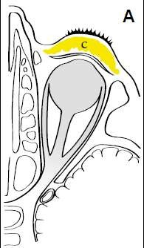
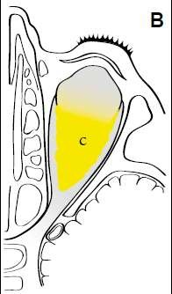
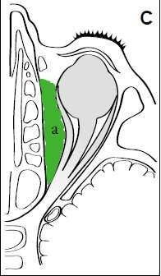
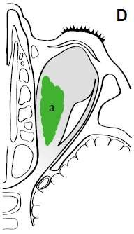
ll. ORBITAL COMPLICATIONS
Most of the orbital complications follow infection of ethmoids as they are separated from the orbit only by a thin lamina of bone- lamina papyracea.
Infection travels from these sinuses either by osteitis or as thrombophlebitic process of ethmoidal veins.
Pre-septal
cellulitis
Orbital cellulitis Subperiosteal
abscess
Orbital abscess

Slide 11
CHANDLER’S CLASSIFICATION
I. Inflammatory edema (preseptal)
Lid edema, no limitation in ocular movement or visual change.
Diffuse orbital infection and inflammation without abscess formation.
Collection of pus between medial periosteum and lamina papyracea, impaired extraocular movement.
Discrete pus collection in orbital tissues, proptosis and chemosis with ophthalmoplegia and decreased vision.
Bilateral eye findings and worsening of all other previously described findings.
II. Orbital cellulitis (postseptal)
III. Subperiosteal abscess
IV. Orbital abscess
V. Cavernous sinus thrombosis

Slide 12
1. Preseptal inflammatory oedema of lids
This is only reactionary. No erythema or tenderness.
Eyeball movements and vision are normal.
Generally, upper lid is swollen in frontal, lower lid in maxillary and
both the lids in ethmoidal sinusitis.

Slide 13
2. Subperiosteal abscess
Pus collects outside the bone under the periosteum.
A subperiosteal abscess from ethmoids forms on the medial wall of the orbit and displaces the eyeball forward, downward and laterally.
From frontal sinuses, abscess is situated just above and behind the medial canthus and displaces the eye ball downwards and laterally.
From the maxillary sinus, abscess forms in the floor of the orbit and displaces the eyeball upwards and forwards.

Slide 14
3. Orbital cellulitis
When pus breaks through the periosteum and finds its way into the orbit, it spreads between the orbital fat, extraocular muscles, vessels and nerves.
Clinical features: lid oedema, exophtalmos, chemosis of conjunctiva and restricted movements of eyeball with partial or total loss of vision.Patient may run high fever.
Orbital cellulitis is potentially dangerous because of the risk of meningitis and CST.

Slide 15
4. Orbital abscess
Intraorbital abscess usually forms along lamina papyracea or the floor of the frontal sinus.
Clinical features: same as above.
Diagnosis: CT scan or ultrasound of the orbit.
Treatment: i.v. antibiotics and drainage of the abscess and that of the sinus (ethmoidectomy or trephination of frontal sinus).

Slide 16
5. Superior orbital fissure syndrome
Infection of sphenoid sinus can rarely affect structures of superior orbital fissure.
Symptoms: Deep orbital pain, frontal headache and progressive paralysis of CN VI, III and IV, in that order.
Orbital apex syndrome
  It is superior orbital fissure syndrome with additional involvement of the optic nerve and maxillary division of the tigeminal (V₂).

Slide 17
lll. INTRACRANIAL COMPICATIONS
Frontal, ethmoid and sphenoid sinuses are closely related to anterior cranial fossa and infection from these can cause following complications:
Meningitis and encephalitis
Extradural abscess
Subdural abscess
Brai abscess
Cavernous sinus thrombosis

Slide 18
Cavernous sinus thrombosis :
Aetiology: Infection of paranasal sinuses and orbital complications from these sinus infections can
cause thrombophlebitis of the cavernous sinus.
Clinical features:
Abrupt onset with chills and rigors.
Swollen eyelids with chemosis and proptosis of eyeball.
CN III, IV and VI get involved individually and sequentially
causing total ophthalmoplegia.
Pupil becomes dilated and fixed.
Congestion of optic disc with diminution of vision.
Sensation in the distribution of V₁ is diminished.
Treatment: i.v. antibiotics and attention to the focus of infection,
drainage of infected ethmoid or sphenoid sinus.

Slide 19
DIFFERENCES BETWEEN ORBITAL CELLULITIS AND CAVERNOUS SINUS THROMBOSIS
 | ORBITAL CELLULITIS | CAVERNOU SINUS THROMBOSIS
SOURCE | Commonly ethmoid sinuses | Nose, sinuses, orbit, ear or pharynx
ONSET | Slow; starts with oedema of eyelids the inner canthus chemosis proptosis | Abrupt with high fever and chills with near signs of toxaemia Oedema of eyelids, chemosis and proptosis
CRANIAL NERVE INVOLVEMENT | Involved concurrently with complete ophthalmoplegia | Involved individually and sequentially
LATERALITY | Often involves one eye | Involves both eyes

Slide 20
lV. DESCENDING INFECTIONS
In suppurative sinusitis, discharge constantly flows into the pharynx and can cause or aggravate:
Otitis media
Pharyngitis and tonsillitis: hypertrophy of lateral lymphoid bands behind the posterior pillars (lateral pharyngitis) is indicative of chronic sinusitis.
Persistent laryngitis and tracheobronchitis
V. FOCAL INFECTIONS
Sinusitis may act as focus of infection is conditions like: Polyarthritis, tenosynovitis, fibrositis and certain skin diseases.

Slide 21
THANKYOU

