Slide 1
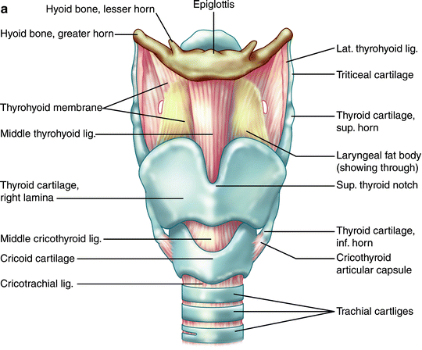
ANATOMY AND PHYSIOLOGY OF LARYNX

Slide 2
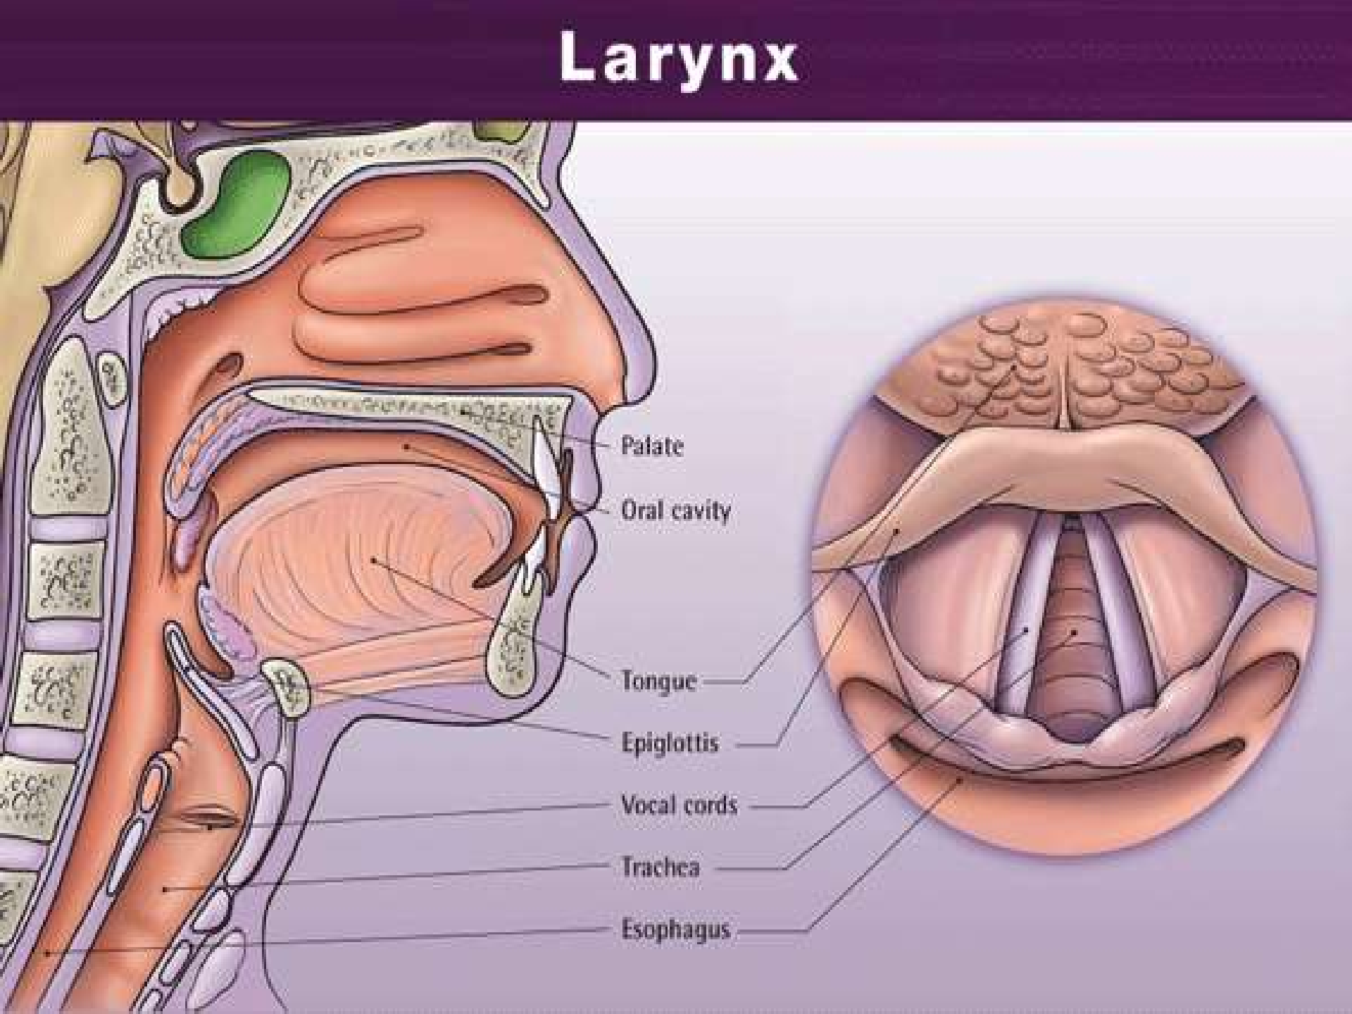
LARYNX
3

Slide 3
LARYNX
Commonly called- voice box Shape- tube shaped.
Composed- muscles, cartilages, connective tissue.
Bony part- hyoid bone. Location- 4-6 cervical vertebr Lies- midline of the neck.
a.

Slide 4
SHAPE AND SIZE
the shape of the larynx in lower side is circular and from the upper it is tringular in shape.
Its length is 4.3 cm,
transverse diameter is 4.2 cm and anterior posterior diameter 3.6 cm.
5

Slide 5
LARYNX
The larynx is composed of nine pieces of cartilage.
PAIRED
Arytenoid cartilage Corniculate cartilage Cuneiform cartilage
,
UNPAIRED:
Thyroid cartilage Cricoid cartilage
Epiglottis

Slide 6
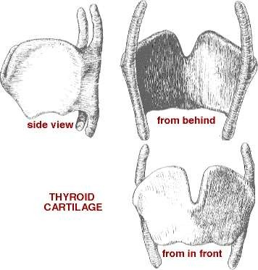
THYROID CARTILAGE
Largest cartilage.
consist of two laminae the anterior border of which are fused with each other at an angle in the middle line of the neck and form a subcutaneous projection named as
ADAM’S APPLE OR
laryngeal prominence.
7

Slide 7
LINNING OF THE LARYNX
superior of the vocal fold is
non karatinized stratified squamous epithelium, inferior to the vocal fold is pseudo stratified columnar epithelium.

Slide 8
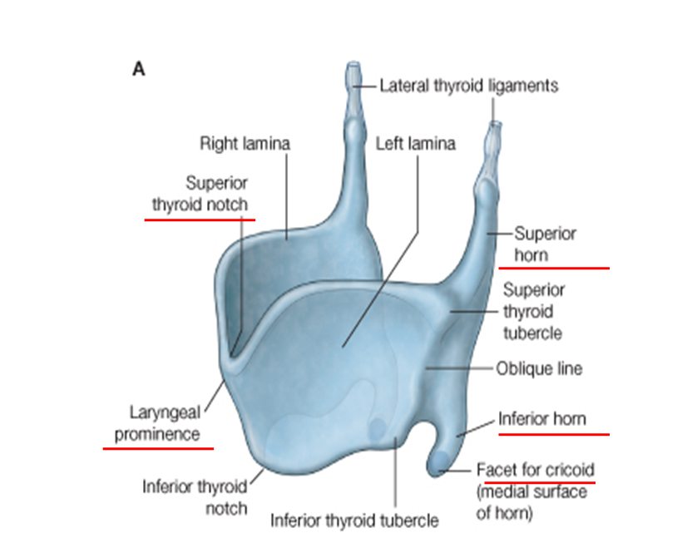
THYROID CARTILAGE
larger in males than females due to the influence of male sex
hormones on its growth during puberty.
Immediately above it is the lamina are separated by a V shape notch, the superior thyroid notch. The laminae are irregularly

Slide 9
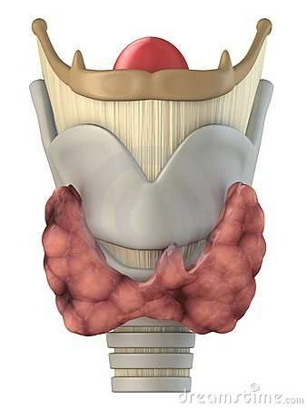
THYROID CARTILAGE
The laminae are irregularly quadrilateral in the shape and their posterior angles are prolonged into processes termed the superior and inferior cornu.
The superior cornu is long, and narrow, directed upward, backward,and medialword which gives attachmentto the lateral hypothyroid ligament.
The inferior cornu is short and thick, it is directed downward with a slight inclination forward and medialward, and present on the medial side of its tip, a small oval articular facet for articulation

Slide 10
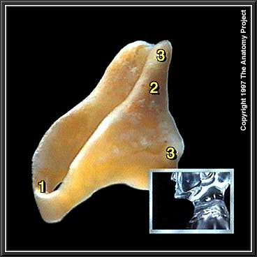
CRICOID CARTILAGE
A ring of hyaline cartilage known as SIGNET RING.
form the inferior wall of the larynx. smaller, thicker and smaller than the thyroid and forms the lower and posterior parts of the wall of the larynx.
attached to the first ring of cartilage of the trachea by the cricotracheal ligament
. the thyroid cartilage is connected to the cricoid cartilage by the cricothyroid ligament . It is the
landmark.
11

Slide 11
CRICOID CARTILAGE
It consist of two parts: a posterior quadrate lamina and anterior quadrate lamina.
The lamina (posterior portion) is deep, and broad and measure from above downward about 2 or 3 cm, on its posterior surface, in the middle line, is the vertical ridge to the lower part of which are attached to the longitudinal fibres of the oesophagus.
The arch(anterior portion) is narrow and convex, and measures vertically
from 5 to 7 mm.
12

Slide 12
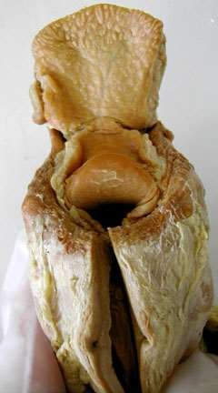
EPIGLOTTIS
It is a large leaf-shaped piece of elastic cartilage that is covered with epithelium.
stem of the epiglottis is attached to the anterior rim of the thyroid cartilage and hyoid bone .
the broad superior leaf portion of epiglottis is unattached and free to move up and down like a trap door.
The free extremity is connected by the thyroepiglottic

Slide 13
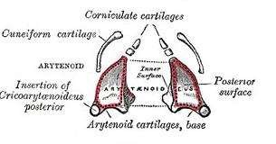
ARYTENOID CARTILAGE
Tringular pieces, hyaline cartilage located at the posterior, superior border of the cricoid cartilage at the back of the larynx.
Each is pyramidal in form and has three surface, a base and a apex.
Posterior surface in tringular, smooth and concave. Anterolateral surface is convex and rough.
Attached to the
vocal folds and intrinsic pharyngeal muscles. Supported by the arytenoid cartilage,

Slide 14
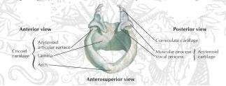
CORNICULATE CARTILAGES
Two small conical nodules
Shape-horn shaped , elastic cartilage.
Located apex of the each arytenoid cartilage. Situated in the posterior part of the aryepiglottic.
15

Slide 15
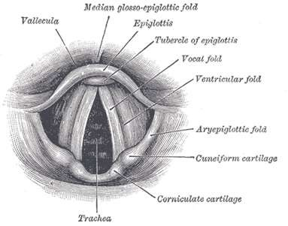
CUNEIFORM CARTILAGES
club shaped
placed one on either side , in the aryepiglottic fold
just in front of the arytenoids ligament and gives the support the vocal folds and the lateral aspects of the epiglottis.
16

Slide 16
LARYNGEAL LIGAMENTS
INTRINSIC
  Elastic membrane
  Quadrangular membrane
  Conus elasticus (cricovocal membrane)
  Median cricothyroid ligament
  Vocal Ligament
  Thyroepiglottic
EXTRINSIC
  Thyrohyoid membrane and ligaments
  Cricothyroid membrane and ligaments
  Cricotracheal ligament
  Epiglottis
ligament
17

Slide 17
EXTRINSIC LIGAMENTS
The thyroid membrane---
a broad, fibroelastic layer, attached below to the upper border of the thyroid cartilage and to the front of its superior cornu.

Slide 18
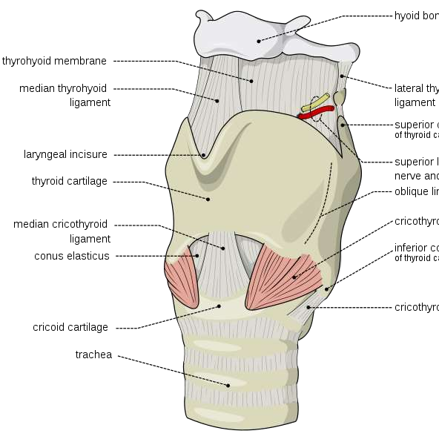
EXTRINSIC LIGAMENTS
The thyrohyoid ligament – is the round elastic cord, which forms the posterior border of the hyothyroid membrane and passes between the tip of thr superior cornu of the thyroid cartilage and the extremity of the greater cornu of the hyoid bone.

Slide 19
EXTRINSIC LIGAMENTS
Epiglottis -- is connected with the hyoid bone by an elastic hand the hyoepiglotic ligament.
Cricotracheal ligament –
Connects the cricoid cartilage with the first ring of the trachea. It resembles the fibrous membrane which connects the cartilaginous rings of the trachea to the each other.

Slide 20
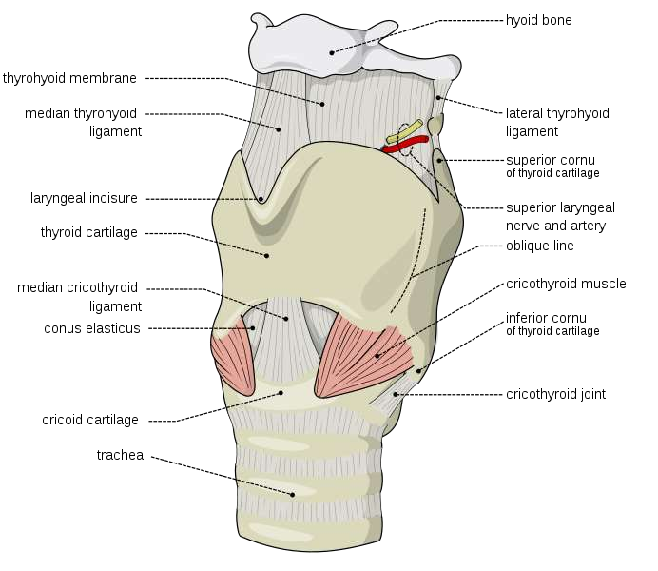
21

Slide 21
INTRINSIC LIGAMENTS
THE CORNUS ELASTICUS-- is
composed mainly of yellow elastic tissue. It connects the thyroid, cricoid, arytenoid cartilage to one another .
THYROEPIGLOTTIC LIGAMENT----
is a long, slender, elastic cordwhich connects the stem of the epiglottis with the angle of thyroid cartilage.
22

Slide 22
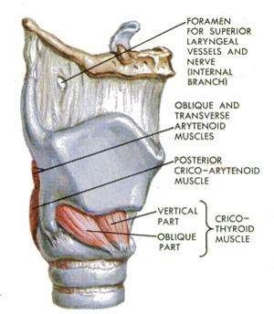
MUSCLES OF LARYNX
Extrinsic muscles
The Mylohyoid Muscle
Geniohyoid Muscle
The Stylohyoid Muscle
Cricothyroid

Slide 23
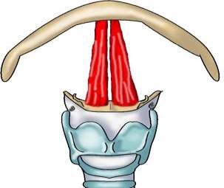
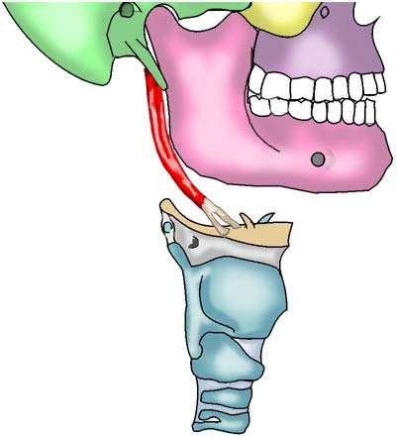
EXTRINSIC MUSCLES
The Geniohyoid Muscle
They lie superior to the mylohyoid muscle to body of the hyoid bone
The Stylohyoid Muscle
Insertion: the body of the hyoid bone

Slide 24
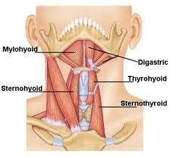
Cont…..
The thyrohyoid muscle - It arises from the oblique line on the lamina of the thyroid cartilage, and to the greater cornu of the hyoid bone.

Slide 25
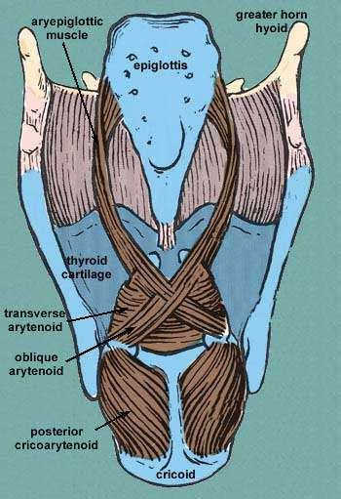
INTRINSIC MUSCLES OF LARYNX
Thyroaryatenoid
Oblique Arytaenoid
Transverse Arytaenoid
Posterior Cricoarytenoid
Lateral Cricoarytenoid

Slide 26
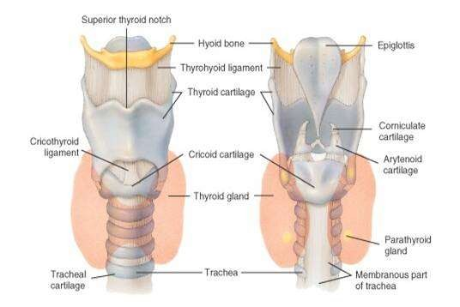
ANTERIOR AND POSTERIOR LARYNGEAL VIEW
27

Slide 27
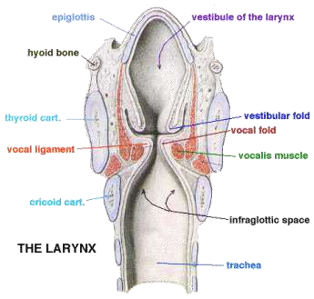
CAVITY OF THE LARYNX
Divided into 3 parts:
  Vestibule
  Ventricle
  Subglottic space
28

Slide 28
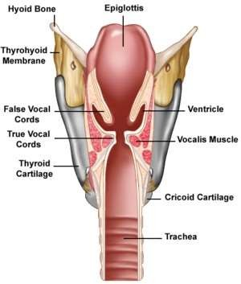
CAVITY OF THE LARYNX
False Cords (ventricular bands)
  Anteriorly: angle of the thyroid cartilage
  Posteriorly: bodies of the
  Arytenoid cartilage
True Cords:-Voice production
  Protection of lower respiratory tract
  Anteriorly,: angle of thyroid cartilage
  Posteriorly: vocal processes of the arytenoid
cartilages
  Enclose vocal ligament and a major part of the vocalis muscle
29

Slide 29
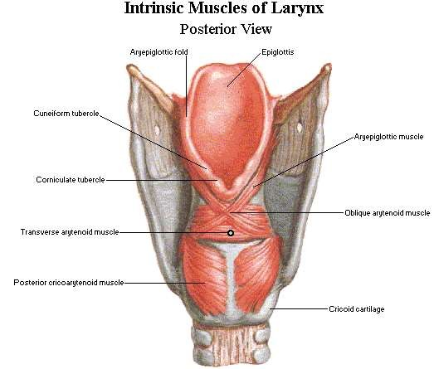
30

Slide 30
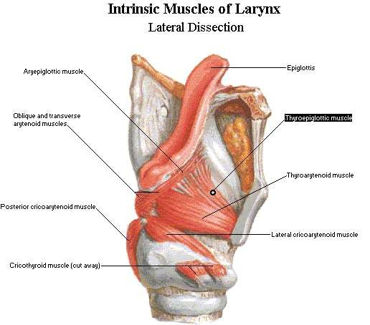
31

Slide 31
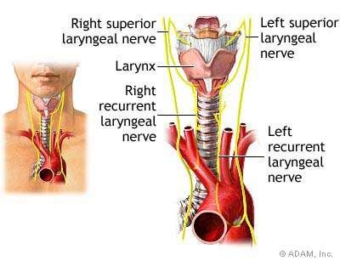
32

Slide 32
BLOOD SUPPLY
Upper Larynx
  External carotid artery
  Superior thyroid artery
  Superior laryngeal artery
Lower Larynx
  Subclavian artery
  Thyrocervical artery
  Inferior thyroid artery
  Inferior laryngeal artery
33

Slide 33
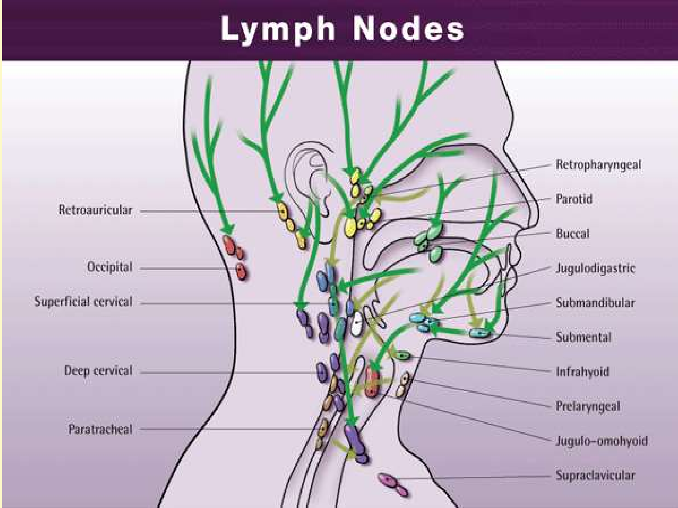
34

Slide 34
PHYSIOLOGY
35

Slide 35
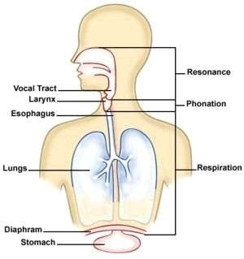
BASIC
FUNCTIONS
Protection
Respiration
Phonation
Fixation of chest
Closure of glottis
36

Slide 36
THANK YOU

