Slide 1
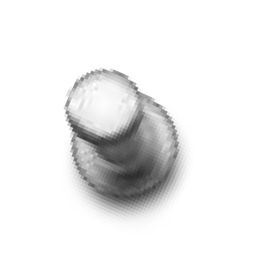
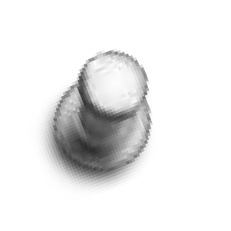



REHABILITATION OF DEAF

Slide 2

WHO-DEFINATION
Hearing impairment :refers to complete or partial loss of the ability to hear from one or both ears. The level of impairment can be mild, moderate, severe or profound;
Deafness : refers to the complete loss of ability to hear from one or both ears.

Slide 3
Classification of deafness
O Clinical
O Educational
O Sociological

Slide 4
clinical-
0 to 25 dB
purposes
: Normal for all practical
26 to 40 dB : Mild deafness
41 to 55 dB : Moderate deafness
56 to 70 dB : Moderately severe deafness
71 to 90 dB : Severe deafness
Above 90 dB: Profound deafness

Slide 5
O Educational
O Grade I- obtain benefit from education provided in ordinary school
O Grade II-requires special educational
arrangements
O Grade III- educational methods are required for deaf children without naturally acquired speech.

Slide 6
Category | dB level | % of impairment
Mild | 26 to 40dB | <40%
Moderate | 41 to 55dB | 40 to 50%
Severe | 56 to 75dB | 50-75%
Profoud | 71-90dB | 100%
Cat I
Cat II
Cat III
Cat IV

Slide 7
CLASSIFICATION OF HEARING LOSS
HEARING LOSS
ACQUIRED
CONGENITAL
ORGANIC
FUNCTIONAL
CONDUCTIVE
SENSORINEURAL
MIXED

Slide 8
CONGENITAL HEARING IMPAIRMENT
CONDUCTIVE
O Exostosis
O Microtia
O Absence of pinna
O Congenital cholesteatoma
O EAC atresia with/without ossicular fixation : Treacher Collins, Klippel Fiel, Alport’s, Goldenhar, Mohr’s
O Associated eye disorders: Cryptophtalmus, Duane’s
O Associated renal disorders:
Nephrosis, Taylor’s syn.
SENSORINEURAL
O Michael’s aplasia
O Mondini dysplasia
O Scheibe dysplasia
O Bing – Siebenmann dysplasia
O Alexander dysplasia
O Enlarged vestibular aqueduct
O Semicircular canal malformations

Slide 9
ACQUIRED CAUSES OF CONDUCTIVE HEARING LOSS
O EXTERNAL EAR : Wax, foreign body, furuncle,
benign or malignant tumour, atresia of canal
O MIDDLE EAR :
Perforation of tympanic membrane –
Fluid in middle ear-
Disruption of ossicles –
Fixation of ossicles –
Eustachian tube blockage –

Slide 10
ACQUIRED CAUSES OF SENSORINEURAL HEARING LOSS
O Infections of labyrinth – Viral, bacterial, spirochaetal
O Trauma to labyrinth or VIII nerve – Fracture
of temporal bone
O Noise induced hearing loss
O Ototoxic drugs
O Presbycusis
O Meniere’s disease O Acoustic neuroma O Sudden hearing loss O Systemic disorders

Slide 11


Rehabilitation means…
O The assessment, intervention, and management of communicative consequences of hearing loss

Slide 12
ASSESSMENT OF HEARING LOSS
O HISTORY :
Otalgia
Ear discharge
Hearing impairment – Onset, duration, progression, unilateral/bilateral
Tinnitus
Vertigo
Blocked sensation
Feeling of fullness
Neuro-otological symptoms – Fever, Headache, Facial nerve palsy, Vomiting, diplopia

Slide 13
Examination
O To assess for syndrome related to hearing loss.
O Endocrine abnormalities (diabetes,thyroid nodule)
O Pigment abnormalities
O Visual abnormalities
O Craniofacial abnormalities
O Cardiac abnormalities
O Renal anomalies

Slide 14
EXAMINATION
O Pinna , Pre-auricular and Post-auricular regions
O External auditory canal O Tympanic membrane O Middle ear
O Mastoid
O Eustachian tube
O Facial nerve

Slide 15
CLINICAL TESTS OF HEARING
O FINGER FRICTION TEST :
O WATCH TEST :
O SPEECH / VOICE TESTS :
Normal person hears conversational voice -12m, whisper -6m
Distance at which conversational and whispered voice are heard is measured

Slide 16
TUNING FORK TESTS
O RINNE’S TEST
O WEBER’S TEST
O ABSOLUTE BONE CONDUCTION TEST
O SCHWABACH’S TEST
O BING TEST
O GELLE’S TEST

Slide 17
AUDIOMETRIC TESTS
SUBJECTIVE
Pure tone audiometry
Speech audiometry
Speech reception threshold
Speech discrimination score
OBJECTIVE
Impedance audiometry
Otoacoustic Emissions
Brainstem Evoked
Response Audiometry
Electrocochleography
Auditory Steady State Response

Slide 18
PURE TONE AUDIOMERTY
O WHO classification on the basis of pure tone average of the thresholds for frequencies 500, 1000, 2000 Hz
O DEGREE OF HEARING LOSS :
0 to 25 dB : Normal for all practical purposes
26 to 40 dB : Mild deafness
41 to 55 dB : Moderate deafness
56 to 70 dB : Moderately severe deafness
71 to 90 dB : Severe deafness
Above 90 dB: Profound deafness

Slide 19
SPEECH AUDIOMETRY
O Hearing sensitivity of a subject for speech is assessed
O Main use is in the identification of neural types of hearing loss – reception and discrimination of speech is impaired more markedly than in cochlear or conductive hearing loss
O Patient’s ability to hear and understand speech is measured by two parameters :
Speech reception threshold
Speech discrimination score

Slide 20
O Normal persons and conductive hearing loss – high score of 90-100%
O Conductive deafness – graph is parallel to the normal curve , amount of displacement corresponding to amount of hearing loss
O Cochlear lesions – Curve is nearly parallel to normal curve at low intensity but at very high intensities starts descending gradually and does not reach 100% level

Slide 21
O In retrocochlear lesions – graph rises slowly as intensity is increased and after reaching a maximum, which is much below 100%, descends rapidly → Rollover Phenomenon
O PB max. : As the intensity is gradually increased, the percentage of correctly identified words increases until a maximum is reached known as PB max.
O PB max is clinically useful to set the volume of hearing aid. Maximum volume should not be set above the PB max

Slide 22
TONE DECAY TEST
O Helps in the detection of site of pathology in the sensorineural pathway
O Pathology in the auditory nerve causes an abnormally rapid deterioration in the threshold of hearing of a tone if that tone is presented continuously (as a sustained signal) to the ear
O In TDT, the rapidity of this deterioration is measured

Slide 23
INTERPRETATION OF TONE DECAY
O Normal – if decay is 0 – 5 dB
O Mild – if decay is 10 – 15 dB
O Moderate – if decay is 20 -25 dB
O Severe – if decay is 30 dB and above
O Tone decay in excess of 30 dB should arouse a suspicion of a retrocochlear lesion

Slide 24
RECRUITMENT
O Defined as : Abnormally steep growth of loudness with increasing intensity and is usually associated with a sensorineural deafness due to a cochlear pathology
O Recruitment is a normal phenomenon in high intensities of sound. Recruitment is present in all ears when sounds of high intensity are used – normal ear or with cochlear pathology
O Recruitment is not present in a case of retrocochlear pathology – accounted for by the defective transmission in a diseased auditory nerve

Slide 25
Short increment sensitive index test
O Scores between 70% to 100% - Positive SISI – Indicates a cochlear lesion
O Scores between 0% to 20% - Negative SISI – Suggests a retrocochlear pathology. But may also be seen in ears with normal hearing or with conductive deafness

Slide 26
TYMPANOMETRY
O TYPE A : Peak is near 0 pressure.
O TYPE As : Peak is at 0 but amplitude of the peak is low. Due to increased stiffness of the system
O TYPE Ad : Peak is around 0 but amplitude is abnormally high. System is more compliant than normal
O TYPE B : Flat or dome shaped curve denoting that pressure changes do not have much effect on the compliance
O TYPE C : Peak is shifted to the negative side

Slide 27
BRAINSTEM EVOKED RESPONSE AUDIOMETRY
O PRINCIPLE : Sound waves entering cochlea are transduced to electric potentials and transmitted via VIII nerve through brainstem and then to the auditory cortex
O Passage of the impulse through the auditory pathway generates an electrical activity
O These electrical responses are picked up by surface electrodes and represented graphically
O Each wave in the graph is generated by major processing centers of the auditory system

Slide 28
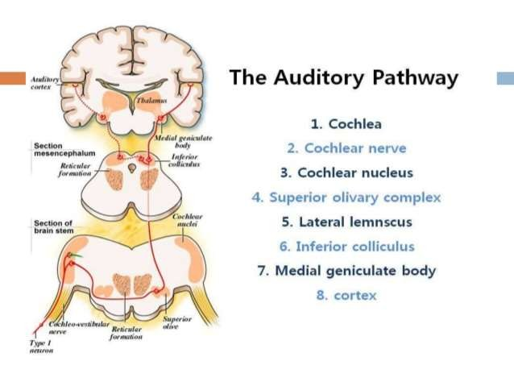
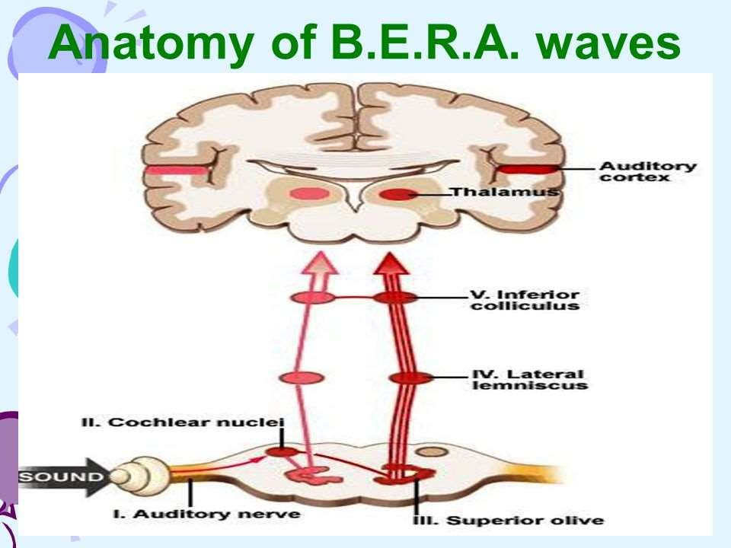

Slide 29
WAVES IN BERA
WAVE
SITE OF NEURAL GENERATOR
WAVE I
Cochlear nerve (distal end)
WAVE II
Cochlear nerve (proximal end)
WAVE III
Cochlear nucleus
WAVE IV
Superior olivary complex
WAVE V
Lateral lemniscus
WAVE VI & VII
Inferior colliculus

Slide 30
CLINICAL USES OF BERA
O Estimation of hearing threshold
O Diagnosis of lesions of VIII cranial nerve
O Identification of nature of deafness
O Screening procedure for infants

Slide 31
O To diagnose brainstem pathology. Ex: multiple sclerosis or pontine tumours
O To monitor VIII cranial nerve intraoperatively in surgery of acoustic neuromas to preserve the function of VIII nerve

Slide 32
OTOACOUSTIC EMISSIONS
O They are low intensity sounds produced by outer hair cells of a normal cochlea due to their biological activity
O Can be picked up, recorded and measured by placing a microphone – receiver in the deep external meatus
O Direction of travel of OAE : Outer hair cells → basilar membrane → Perilymph → Oval window → Ossicles → Tympanic membrane → Ear canal

Slide 33
O Two types :
Spontaneous Otoacoustic emissions
Evoked Otoacoustic emissions

Slide 34
O SPONTANEOUS OAE :
O Generated spontaneously and do not require stimulation
O Found in 50% of normal hearing subjects
O Not much diagnostic importance
O EVOKED OAE : 2 types –
Transient evoked otoacoustic emissions (TEOAE)
Distortion product otoacoustic emissions (DPOAE)

Slide 35
USES OF OTOACOUSTIC EMISSION
O Screening test of hearing in neonates
O To test hearing in unco-operative and mentally challenged individuals after sedation. Sedation does not interfere with OAE
O Distinguish cochlear from retrocochlear lesions
O Detection of early cochlear damage due to
ototoxic drugs

Slide 36
ELECTROCOCHLEOGRAPHY
O Cochlea receives sound from the middle ear and converts it into electrical energy which then passes through VIII nerve to the higher centres in brain
O Electrical activity generated by the cochlea and the VIII nerve can be measured by ELECTROCOCHLEOGRAPHY (ECochG)

Slide 37
AUDITORY STEADY STATE RESPONSE
O Auditory evoked potential test that can be used
to objectively predict frequency specific hearing threshold in all patients irrespective of
age, mental state and degree of hearing loss
O Pure tone sounds are used as the sound stimulus and the sound is modulated in the amplitude domain and in the frequency domain

Slide 38
O Hearing threshold obtained by ASSR is totally objective as it is derived by computing from set algorithms
O ASSR is possible in newborns and infants and a reasonably accurate, clinically acceptable, frequency specific audiogram can be objectively obtained

Slide 39
ASSESSING THE DEAF CHILD
O The objectives are :
O To ascertain whether the child has any deafness or not
O If deafness is present, whether unilateral or bilateral
O To document the degree of functional impairment
for each ear
O To establish a topographical localisation of the lesion
O To establish an etiological diagnosis
O To establish management protocols

Slide 40
NEONATAL HEARING SCREENING
O Performed as soon as soon as child is born
O Two types-

Slide 41
Universal Newborn hearing Screening.
O With in 48hrs of birth.
O 100% specificity
O Evoked otoacoustic emission (EOAE)
INTERPRETATION-
pass infant- needs no further testing.
Refer infant- needs diagnostic hearing evaluation . Electrochocleography ,BERA ASSR.

Slide 42
O However even if passed EOAE test
O Behavioural observation audiometry suggested at 8th, 12th , 24th, 36th months if born out of high risk pregnancy

Slide 43
HIGH RISK NEONATAL HEARING SCREENING
O Baby born out of high risk pregnancies.
O Specificity 50%
O Done in cases of-
History of in utero infections
Intake of ototoxic drugs during pregnancy
Excessive alcohol intake
Any illness that necessitated admission in neonatal intensive care unit after birth.

Slide 44
O Birth weight <1500g
O Apgar score below 4 at 1minute
O Any recognizable syndrome at birth
O Family history of marked sensory neural
hearing loss
O Presence of any craniofacial abnormalities
O Baby born out of consanguineous marriage.

Slide 45
O International joint committee on infant hearing screening recommends screening
O between 4wks to 2years in following conditions
O parental concern regarding speech language , hearing
O Delayed developmental milestones
O h/o postnatal infections like meningitis

Slide 46
O Identification of syndromes like usher’ syndrome
O h/o head trauma
O Recurrent otitis media with effusion for more
than 3months.
O Presence of neurodegenerative disorders like hunters syndrome .

Slide 47
O if child fails the EOAE test,then the child is retested 7-10 days later after cleaning the ear as EAC blocked due to meconium or vernix caseosa.
O If not passed test in first attempt but passed on second attempt i.e 7th to 10th day then manage accordingly.
O If child fails second test then there is a definite possibility that child has hearing loss.

Slide 48
O Next go for more precise and accurate evaluation of hearing i.e BERA
O If BERA shows near normal hearing then middle ear pathology suspected
O Tympanometry test done to rule out middle ear pathology.
O Medical/ surgical , hearing aids

Slide 49
O if in spite of using hearing aid for atleast 3- 4mths it appears that child is not hearing
then consider the child for COCHLEAR implant

Slide 50
O A detailed history is essential – Prenatal, perinatal or postnatal causes, family history
O A detailed physical and otologic examination
O Investigations depending on the cause
suspected
O Suspicion of hearing loss when
Child sleeps through loud noises unperturbed
Fails to startle to loud sounds
Fails to develop speech at 1 – 2 years

Slide 51
O A detailed history is essential – Prenatal, perinatal or postnatal causes, family history
O A detailed physical and otologic examination
O Investigations depending on the cause
suspected
O Suspicion of hearing loss when
Child sleeps through loud noises unperturbed
Fails to startle to loud sounds
Fails to develop speech at 1 – 2 years

Slide 52
Clinical test
O Neonates –reflexes (0 to 4mnths )
O Auropalpebral reflex
O Startle reflex
O arousal reflex

Slide 53
O (5-6months) –Distraction techniques child turns head to locate source of sound.
sound of approximately 50dB ,if speech then 25dB.
O Free field Audiometry- 2 calibrated loudspeaker in a sound- treated room and finding out whether the child is turning its head to the direction of loudspeaker.

Slide 54
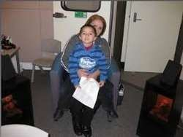
Free field audiometry

Slide 55
O COOPERATIVE TEST-(18mths-2yrs)
O PERFORMNCE TEST-(2-5yrs)
O CONDITIONING TECHNIQUE ( PLAY AUDIOMETRY)2-4yrs
O VISUAL REINFORCEMENT AUDIOMETRY.(6-24mnths)
O Objective test-

Slide 56
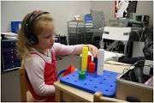
Play audiometry

Slide 57
TREATMENT

Slide 58
Methods of rehabilitation
O Parental guidance
O Hearing aid
O Speech & language therapy
O Education of deaf
O Vocational guidance

Slide 59
O CONDUCTIVE HEARING LOSS
O Medical or surgical
Removal of obstructive pathology
Stapedectomy-otosclerosis
Tympanoplasty
Hearing aids

Slide 60
O Sensorineural hearing loss
O Medical treatment
O Treating underlying cause
O Hearing aids
O Cochlear implant
O Surgical- sealing of perilymph fistula

Slide 61
MICROTIA AND ATRESIA REPAIR
O External ear reconstruction is usually delayed until child is about 6 to 7 years of age , with atresia repair (canalplasty ) following series of operations required for rib graft microtia repair.
O Waiting until child is 6 or 7allows child to attain maturity and cooperation.

Slide 62
Stapes Defect
O Stapedectomy—removal of stapes suprastructure and all or most of the stapes footplate•
O Stapedotomy—removal of stapes suprastructure and fenestration of the footplate to accommodate the prosthesis.

Slide 63
ossiculoplasty
O Malleus-Incus Defect.A prosthesis designed to
replace the malleus-incus complex is
termed prosthesis
partial ossicular reconstruction
(PORP). This prosthesis spans the distance between the stapes suprastructure and the tympanic membrane. To reduce the chance of prosthesis extrusion.

Slide 64
O Total Ossicular Defect
A prosthesis designed to replace the entire ossicular chain is termed total ossicular reconstruction prosthesis (TORP). This prosthesis spans the entire middle ear cleft between the stapes footplate and the tympanic membrane.

Slide 65
Instrumental devices
  Hearing Aids
    Conventional hearing aids
    Bone anchored hearing aids
    Implantable hearing aids
  Implants
    Cochlear implants
    Auditory brainstem implants
  Assistive devices for the deaf
Training
  Speech(lip) training
  Auditory training
  Speech conservation

Slide 66
Hearing Aids
O Deafness not cured by medicine & surgery
O People reluctant for surgery
O Contraindication for surgery

Slide 67
Hearing aid in children
O Permanent bilateral hearing loss >20dB between 1000 and 4000 hz
O Bone conduction hearing aids- indicated in canal atresia,stenotic ear canal and recurrent otorrhea.
O Children<7years –needs BTE or bone conduction hearing loss

Slide 68
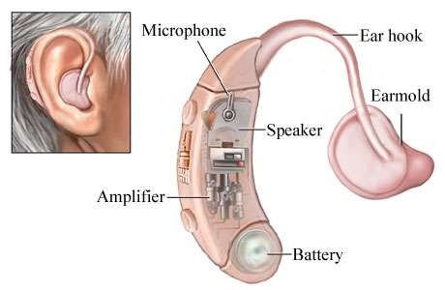

Slide 69
Device to amplify sounds ---- 3 parts
Microphone- picks up sound and converts to electrical impulses.
Amplifier- magnifies electrical impulses. Receiver-converts electrical impulses back to sound

Slide 70
Electroacoustic characteristic
O Gain –is the amount of energy added to the input signal and the amount of gain varies as a function of frequency to accommodate varying hearing loss configurations.
O Relationship of gain as the function of frequency is the frequency gain response of hearing aid.it reflects the difference b/w the intensity level of the output and input of the hearing aid .

Slide 71
Measurement of performance of hearing aid
O REAL EAR MEASUREMENT-is the
measurement of sound pressure level in a patient’s ear canal developed when a hearing aid is worn.
O Measured with the use of silicone probe tube inserted in the canal connected to the microphone outside the ear.

Slide 72
O Done to verify that the hearing aid is providing suitable amplication for a patient’s hearing loss.
O REAG-real ear aided gain- difference in decibels,as a function of frequency,between sound pressure level in the ear canal and level in the air near the patient.
O REUG-real ear unaided gain- with unoccluded ear canal.

Slide 73
O REIG-Real ear insertion gain- difference in dB as a function of frequency between REAG and REUG with same measurement point.

Slide 74
Contralateral routing of signals.
O Microphone fits in profoundly deaf ear.
O Picks sound & passes to the receiver placed in better ear.
O Useful in profound hearing loss.
O Localises sound coming from the side of deaf ear.

Slide 75
O t-CROS (transcranial contralateral routing of signal):
O This BTE style devise worn-
Solely on the deaf ear. Sound is processed in the usual manner and delivered to the bony portion of the external auditory canal through a long earmold. From that point, sound energy is delivered through bone conduction to the contralateral healthy cochlea.

Slide 76
Binaural amplification
In bilateral hearing loss
Binaural hearing aid amplification eliminates head shadow effect
Better speech discrimination and localisation.
Head shadow effect-when sound has to cross the head to reach other side of ear.6dB loss in sound intensity occurs.

Slide 77
Types of hearing aid
O Body worn types
O Behind the ear types
O Spectacles type
O In the ear type
O Canal types(ITC/CIC)

Slide 78
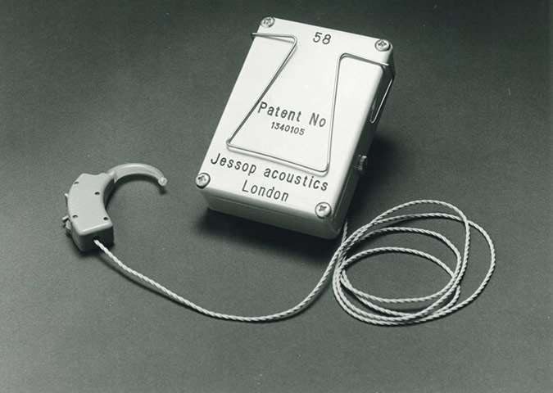

Slide 79

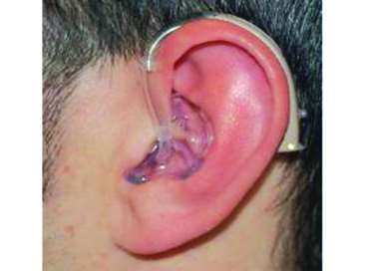

Slide 80
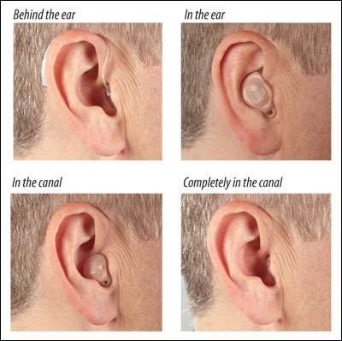

Slide 81
O BTE appropriate for all levels of hearing loss, mild to severe. Can provide the most amplification. easy to incorporate large vents, directional microphones, switches, manual volume control, larger batteries, and additional components for sophisticated signal processing and connectivity to other devices. this is the style of choice for children.
O Cosmesis is generally considered a disadvantage although newer BTE style hearing aid designs are discreet and cosmesis is generally good.

Slide 82
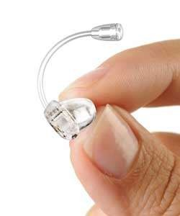
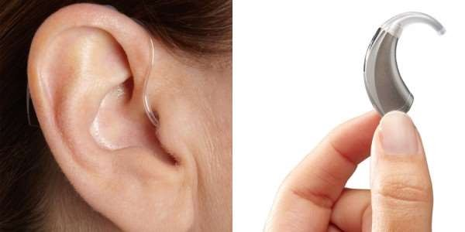
O Open fit hearing aid
O RITE(receiver in the ear)

Slide 83
O ITE- appropriate for hearing loss upto 70dB hearing loss ,easy to handle and adjust
O Cosmesis generally poor.
O ITC – smaller size ,appealing cosmesis,can accommodate vent and directional microphone, used for hearing loss upto 60dBHL.

Slide 84
O CIC excellent cosmesis, discreet hearing aid, resistant to wind noise, used for mild-to- moderate hearing loss, less than 50 to 60 dB hL
O Cannot accommodate a large vent or a directional microphone. Occlusion effect may be pronounced. Difficult to handle for patients with diminished hand dexterity.

Slide 85
Limitations of hearing aid
O Insufficient gain- maximum gain for digital ITE,ITC,CICare about 55dBto 65dB, 45 to 55dB, 35 ti 50dB respectively.
O Acoustic feedback- acoustic waves from the hearing aid speaker leaks through the air space between the hearing aid body and EAC wall back to microphone.
O Distortion of spectral shape and phase shift- too steep a change in amplifier gain across frequencies typically impart phase shifts that distort sound percepts such as pitch and timbre

Slide 86
O Nonlinear distortion- distortion produced by a speaker that generates loud sounds in air
O Occlusion effect
O Poor appearance
O Poor transduction efficiency – malfunctioning middle ear apparatus

Slide 87
Implantable hearing devices
O Middle ear implant
O Bone anchored hearing devices (BAHA)
O Cochlear implant
O Auditory brainstem implant

Slide 88
Middle ear implants
O Electromagnetic middle ear implantable hearing device
O vibrant soundbridge
O Piezoelectric middle ear implantable
hearing device
O Carina
O Esteem

Slide 89
Middle ear implant
Vibrant MED-EL Soundbridge
Indication-normal middle ear function
absence of retrocochlear or central involvement
Adult and elderly with moderate to severe hearing loss not satisfied with BTE
Semi-implantable device

Slide 90
O Indicated for patient with moderate to severe SNHL upto 70dB hearing loss.
O Implanted using transmastoid facial recess approach to the middle ear
O VORP (vibrating ossicular prosthesis) attached to long process of incus
O Internal reciever placed in bony trough in retrosigmoid bone.

Slide 91
O External component – audio processor worn behind the ear. contains microphone and transmits sound across skin by radiofrequency to internal receiver VORP
O Internal component-VORP(vibrating ossicular
prosthesis)
3 parts 1.receiver
2.floating mass transducer(FMT) 3.conductor link receiver and FMT

Slide 92
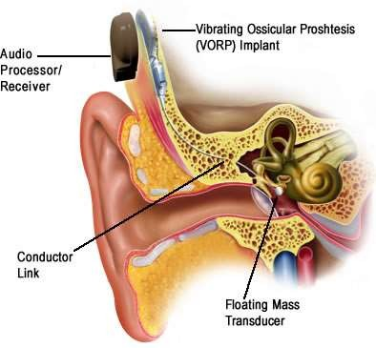

Slide 93
Advantages
O Mechanical energy is directly passed to ossicles bypassing of EAC and tympanic membrane
O Provides improved sound quality even in noisy environment.

Slide 94
O Disadvantages due to confined space between eardrum and the incus the dimension & mass of FMT are limited which restricts output
O Erosion of incus

Slide 95
O placement of VSB (vibrant sound bridge) on round window membrane directly or in combination with ossicular chain prosthesis referred to vibroplasty .

Slide 96
Piezoelectric middle ear implantable hearing devices
O Mechanism – function by connecting the ossicles to an amplifier using a piezoelectric crystal vibrator.
O Sounds picked up by microphone- converted by the signal processor to an electric signal and are sent to piezoelectric rods. Rods vibrate in response to converted auditory signals it lies in direct contact with ossicles.

Slide 97
Piezoelectric middle ear implantable hearing devices
O CARINA-a bone well is drilled for electronics and microphones posterior and superior to the atticotomy and the piezoelectric transducer tip is then placed into the hole in the incus.
O Reqires no external component apart from charger and remote control unit fully implantable device.

Slide 98
O ESTEEM – uses piezoelectric crystals to convert malleus vibrations. the result of sound waves impinging on the tympanic membrane
,into voltage encoded sound.
O Designed for moderate to severe hearing loss (35 to 85dB)

Slide 99
Osseointegrated bone conducting hearing prosthesis

Slide 100
Indication for BAHA
When air conduction hearing aid cannot be used
Canal atresia
Chronic ear discharge
Excessive discomfort
Otosclerosis and tympanosclerosis when surgery contraindicated or pt not willing for surgery
O Mixed hearing loss
O Single sided hearing loss

Slide 101
Contraindications
O Age<5 yrs
O Emotional instability, drug abuse, developmental delay
O PTA-bone conduction threshold (0.5 to 3 kHZ)
worse than 65dBHL ,SDS>60%

Slide 102
O 3component-
O Titanium fixture- surgically embedded in skull bone.process of osseointegration takes 2- 6mths
O Abutment-attached to titanium fixture.
O Sound processor-after completion of osseointegration,attached to abutment.

Slide 103
Osseointegrated bone conduction hearing prosthesis for unilateral SNHL
O Use of devices on the deafened ear can expand the sound fields for the patient and improve the patients speech understanding in noise,like contralateral routing of offside signals hearing aids.

Slide 104
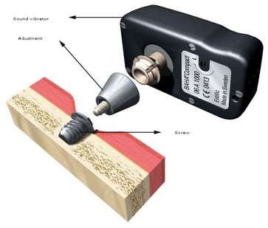
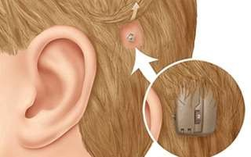

Slide 105
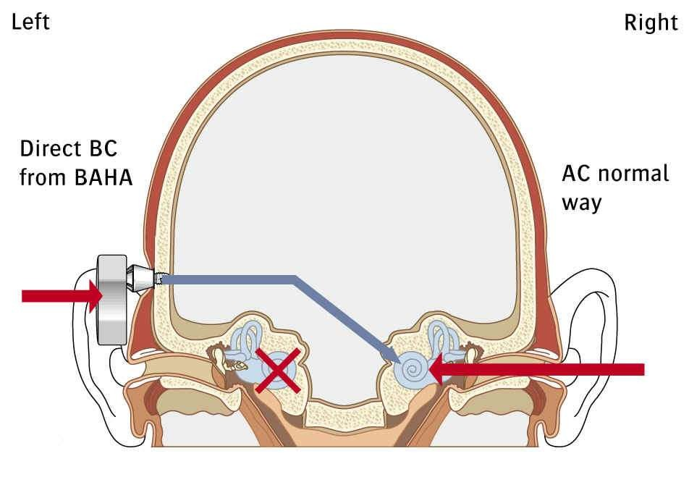

Slide 106
Cochlear implant

Slide 107
Definition
O Cochlear implants are surgically placed electrical device that receive sound and transmit the resulting electrical signals to electrodes implanted in the cochlea of the ear.
O The signals stimulate cochlea, allowing patient to hear.
O It is also known as Bionic ear.

Slide 108
Parts of cochlear implant
O External
O Microphone
O Speech processor
O Transmitter
O Internal
O Receiver and stimulator
O An array of up to 22 electrodes

Slide 109

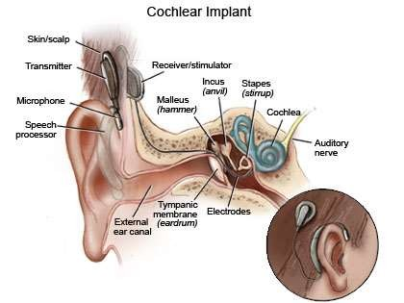

Slide 110
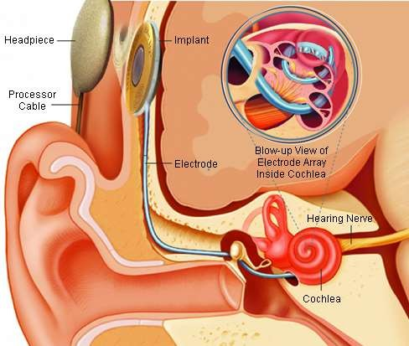

Slide 111
Selection criteria - children
O child above 12months below 7 years in pre – lingually deaf children.
At birth the cochlea is fully formed but the auditory pathway is not. Auditory pathway is
dependent on stimulation for its maturation and
this stimulation is vital to acquisition of speech and language skill as well as amount of cognitive development.
Post lingual deaf no age limit

Slide 112
O degree of deafness- profound >90dB beyond 1000HZ with poor discrimination in both ears with cochlear nerve.
O Respond to hearing aid- in those who do not benefit from a hearing aid.
O Absence of contraindications- cochlear aplasia or absent cochlear nerves are absolute contraindications to cochlear implantation.

Slide 113
Selection criteria- adult
O 18 years of age or older
O Profound, severe- profound ,bilateral sensorineural hearing loss
O Post lingual onset of profound deafness
O Little or no benefit from hearing aids
O No medical or radiological contraindications for surgery.

Slide 114
CT &MRI INFORMATION
O Inner ear morphology
O Cochlear patency
O Position o fallopian canal O Presence of cochlear nerve O Size of facial recess
O Height of jugular bulb
O Thickness of parietal bone

Slide 115
Three modes of stimulation of auditory system involving cochlear implant
O Electrical stimulation-complete electric stimulation when there is no residual hearing in both ear
O Electroacoustic stimulation-lower frequencies stimulated acoustically via hearing aid while higher frequencies electrically via cochlear implant.
O Bimodal stimulation-one ear uses implant while use a high gain hearing aid on other ear

Slide 116
Implantation of infant
O Children who undergo implantation at younger ages achieve greater progress in speech perception skill than children implanted at older ages.
O Cochlear implant in children as young as 12 months old has been approved by food and drug administration.

Slide 117
Bilateral cochlear implant
O Localisation O Head shadow O Squelch
O Summation

Slide 118
Auditory training in children with cochlear implant
O Detection
O Discrimination
O Identification
O Comprehension
O Auditory feedback loop (imitation or approximation of speech sound)

Slide 119
Auditory Brainstem implants
O Stimulates the cochlear nuclear complex in the brainstem directly by placing the implant in the lateral recess of the fourth ventricle.
O Used when CN VIII is severd in the surgery of vestibular schwannoma
O Multi electrode array is attached to a decron mesh which is placed on the brainstem.

Slide 120
O Most common indication neurofibromatosis type2 in which bilateral vestibular schwannoma present.

Slide 121
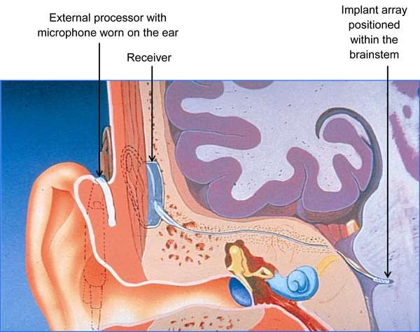

Slide 122
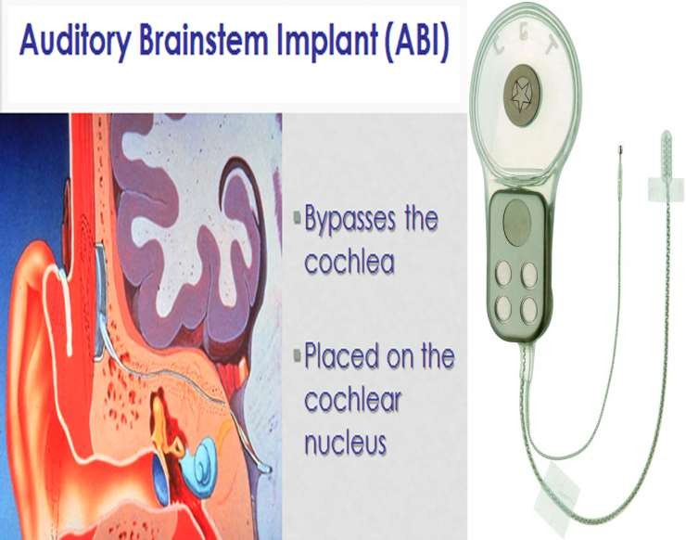

Slide 123
Communication methodology
O Oral approach- encourages to develop vocabulary and training and it is more preferred.
O Manual approach: communicate with sign language.
O Educational placement of the deaf child.

Slide 124
O usually the schools has been classified as:
Special school for deaf child where mostly sign languages are taught.
Special class in normal school, where special instruments for amplification are used in group or individual from where a specially trained teacher will teach.
Normal school-children moderate deafness
with hearing aid are selected.

Slide 125
Hearing –assistive technologies
O ALD-assistive listening devices Personal amplifiers
FM systems Television listeners
O Alerting and signal devices
O Telephone amplifiers

Slide 126
O Devices are designed to enhance an acoustic signals over background noise by the use of remote microphone.
O Hearing aid use with ALD
O Telephone amplifiers increases ability to hear on
telephone
O Television shows allows the viewer to see the spoken dialogue in printed form.
O Alerting devices such as alarm clocks, fire alarms .

Slide 127


