Slide 1
TUMOURS OF
OROPHARYNX

Slide 2
BENIGN TUMOURS
Papilloma: usually asymptomatic, surgical excision is the treatment of choice
Haemangioma: may be capillary or cavernous.
Treatment is diathermy coagulation or injection of sclerosing agents. Cryotherapy and laser coagulation is also effective
Pleomorphic adenoma: mostly seen submucosally on the hard or soft palate. It is potentially malignant and should be excised totally
Mucous cyst: usually seen in vallecula. Surgical excision is the treatment of choice in case of symptomatic cysts
Lipoma
fibroma

Slide 3
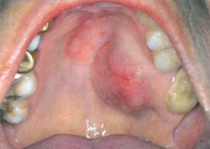
Pleomorphic adenoma

Slide 4
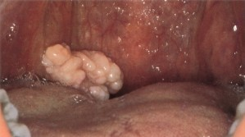
Papilloma

Slide 5
MALIGNANT TUMOURS
♣ Common sites of malignancy in oropharynx are:
¬Base of tongue
¬Tonsil and tonsillar fossa
¬Faucial palatine arch (soft palate and anterior pillar)
¬Posterior pharyngeal wall

Slide 6
MALIGNANT TUMOURS
♣ Gross appearance:
¬Superficially spreading
¬Exophytic
¬Ulcerative
¬Infiltrative

Slide 7
MALIGNANT TUMOURS
♣ Histological classification:
¬Squamous cell carcinoma: may be well/moderately/poorly differentiated
¬Lymphoepithelioma
¬Adenocarcinoma
¬Lymphomas: both hodgkin and non- hodgkin

Slide 8
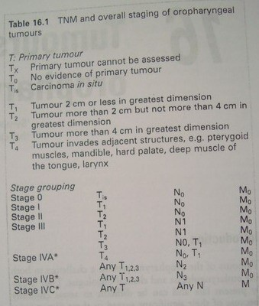
TNM CLASSIFICATION

Slide 9
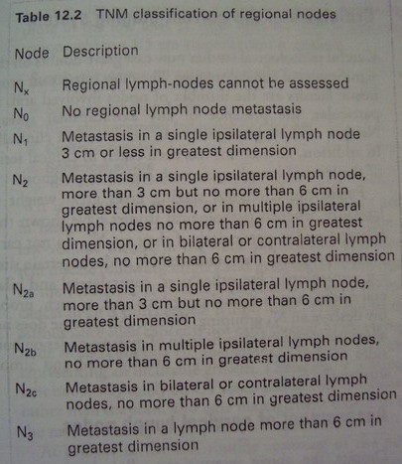

Slide 10
TREATMENT
Depends upon the site and extent of the disease, patients general condition, experience of treating surgeon and facilities available
Options of treatment are
¬Surgery alone
¬Radiation alone
¬Surgery+radiotherapy
¬Chemotherapy+surgery+radiotherapy
¬Palliative therapy

Slide 11
CARCINOMA OF BASE OF TONGUE (POSTERIOR 1/3RD OF TONGUE)
Commonly seen in our country
Patients usually presents with enlarged neck nodes
Earlier symptoms are sore throat, feeling of lump in throat, discomfort on swallowing
Late features include referred pain in ear, dysphagia, bleeding from mouth, change in quality of speech (hot potato voice)

Slide 12
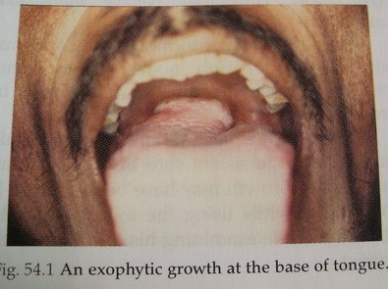

Slide 13
CARCINOMA OF BASE OF TONGUE (POSTERIOR 1/3RD OF TONGUE)
♣ Spread:
¬Local: spread to rest of tongue musculature, epiglottis, pre - epiglottic space, tonsils, faucial pillars, hypopharynx
¬Lymphatic spread: 70% of cases show cervical metastasis either unilateral or bilateral at the time of initial consultation. Jugulo-digastric nodes are first to be involved
¬Distant metastasis: bones, liver, lung may be involved

Slide 14
CARCINOMA OF BASE OF TONGUE (POSTERIOR 1/3RD OF TONGUE
♣ Diagnosis:
¬Indirect laryngoscopy
¬Palpation under anesthesia
¬CT scan
¬FNAC of neck nodes
¬Biopsy

Slide 15
CARCINOMA OF BASE OF TONGUE (POSTERIOR 1/3RD OF TONGUE
♣ Treatment:
¬Radiosensitive tumours such as Lymphoepithelioma are treated by radiotherapy to the primary and neck nodes
¬T1, T2 squamous cell carcinoma with N0, N1 neck ◊ surgical excision with block dissection with post operative radiotherapy
¬T3, T4 ◊ surgical excision with mandibular resection, neck dissection and post operative radiation
¬T4 lesions with extension to anterior tongue and vallecula ◊ extensive surgery with total glossectomy and laryngectomy in addition to the block dissection

Slide 16
CARCINOMA TONSIL AND TONSILLAR FOSSA
Squamous cell carcinomas are most common
Presents as an ulcerated lesion with necrotic base
Lymphomas present as unilateral tonsillar enlargement and mimic Quinsy

Slide 17
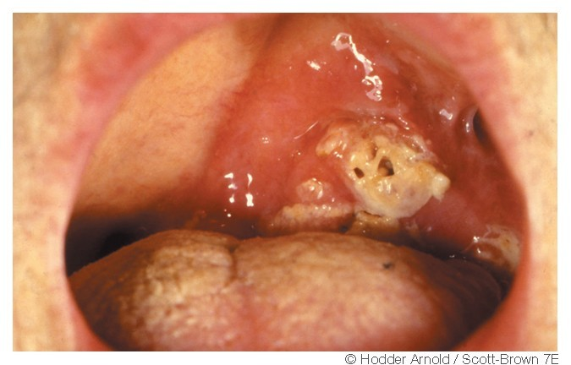
CARCINOMA TONSIL

Slide 18
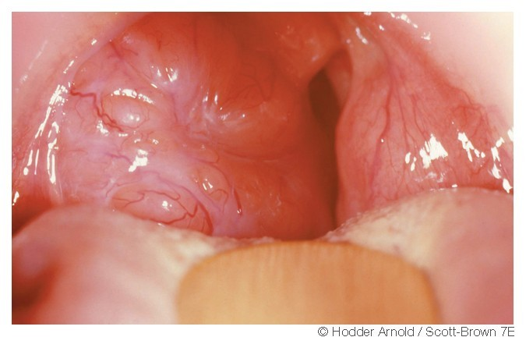
LYMPHOMA OF TONSIL

Slide 19
CARCINOMA TONSIL AND TONSILLAR FOSSA
♣ Spread:
¬Local: may spread to soft palate, pillars, base of tongue, pharyngeal wall, hypopharynx, parapharyngeal space, mandible, pterygoid muscles
¬Lymphatic: 50% patients have initial cervical node involvement at the time of presentation. jugulo-digastric nodes are first to be involved
¬Distant metastasis: seen in late cases

Slide 20
CARCINOMA TONSIL AND TONSILLAR FOSSA
Clinical features: persistent throat pain, dysphagia, ear ache, neck swelling, trismus, fetor oris
Diagnosis: palpation, biopsy
Treatment:
¬Radiotherapy
¬Surgery: excision of tonsil in early lesions.
Commando operation for larger lesions
¬Combined therapy

Slide 21
COMMANDO OPERATION
(Combined oro - mandibular resection with reconstruction)
♣ It involves wide surgical excision of primary tumor with hemimandibulectomy and radical neck dissection

Slide 22
CARCINOMA OF PALATINE ARCH
Soft palate, uvula, anterior tonsillar pillar comprise palatine arch
Most common tumour type is squamous cell carcinoma
May spread locally to contiguous structures or lymph nodes
Patient presents with persistent throat pain, local pain, ear ache
Treatment is irradiation or surgery

Slide 23
CARCINOMA OF POSTERIOR AND LATERAL PHARYNGEAL WALL
Lesions remain asymptomatic for long time
They may spread submucosally to adjoining areas such as tonsil, soft palate, tongue, nasopharynx, hypopharynx
They may also involve parapharyngeal space and anterior spinal ligaments
Bilateral nodal involvement is common
Treatment is irradiation or surgery

Slide 24
PARAPHARYNGEAL TUMOURS
Tumors of deep lobe of parotid
Neurogenic tumors: neurilemmomas
Chemodectoma: carotid body tumor, glomus vagale
Lipoma

Slide 25
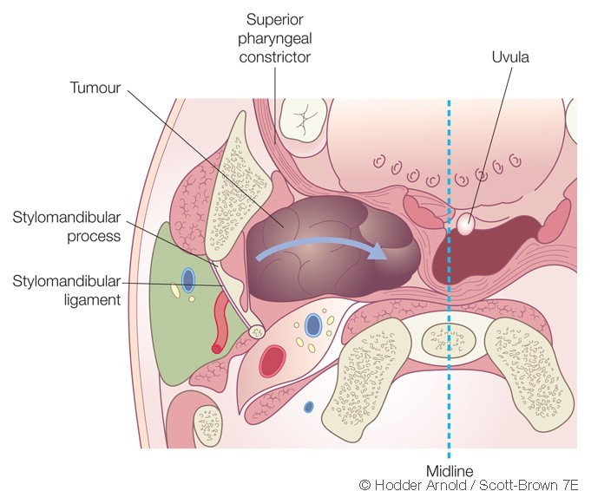
PARAPHARYNGEAL TUMOURS

Slide 26
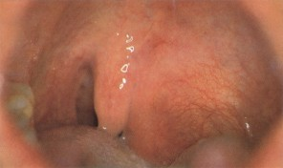
Tumors of deep lobe of parotid

