Slide 1
HISTAMINE AND ANTIHISTAMINES
Dr. Karthikeyan. G
Dept of Pharmacology
Vmkvmc

Slide 2
HISTAMINE
Biogenic amine
Present in animal and plant tissues also venoms and stinging secretions.
Synthesized by decarboxylation of the aminoacid, histidine.
Present storage granules of mast cells also found in Skin,liver,lungs,gastric mucosa,placenta.
Mediators in the inflammatory and hypersensitivity reactions.

Slide 3
MECHANISM OF ACTION
Ca2+
cAMP
cAMP
Smooth muscle contraction increase in capillary permeability
Gastric acid secretion
Histamine levels in brain,lungs,skin,gastric mucosa
HISTAMINE
H1-Receptors
H2-Receptors
H3-presynaptic autoreceptors

Slide 4
What is an antihistamine?
A drug that reduces or eliminates the effects mediated by the chemical histamine
Histamine is released by your body during an allergic reaction and acts on a specific histamine receptor
True antihistamines are only the agents that produce a therapeutic effect that is mediated by negative modulation of histamine receptors (other agents may have antihistaminergic action but are not true antihistamines)
The term antihistamine only refers to H₁ receptor antagonists (actually inverse agonists)
Antihistamines compete with histamine for binding sites at the receptors. Antihistamine cannot remove the histamine if it is already bound

Slide 5
What are allergies?
Allergies are caused by a hypersensitivity reaction of the antibody class IgE (which are located on mast cells in the tissues and basophils in the blood)
When an allergen is encountered, it binds to IgE, which excessively activates the mast cells or basophils, leading them to release massive amounts of histamines.
These histamines lead to inflammatory responses ranging from runny nose to anaphylactic shock
If both parents have allergies, you have a 70% of having them, if only one parent does, you have a 48% chance (American Academy of Asthma, Allergies and Immunology, Spring 2003).

Slide 6
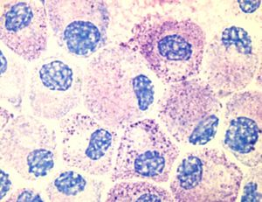
Histamine is distributed in Mast Cells in all peripheral tissues of the body and basophils, which circulate in the blood
AG:AB reaction.food products (crab,fish),bile salts,drugs like d-tc,dextran,hydralazine
When it is released, histamine causes inflammation by increasing vasodilatation, capillary permeability, causing smooth muscle contraction, mucus secretion, and parasympathetic nerve stimulation

Slide 7
Histamine has no valid clinical use
BETAHISTINE
Histamine analogue
To treat vertigo
Given oraly
Improving the blood flow in the inner ear
Nausea,vomiting,headache,pruritus
Avoid in asthma and peptic ulcer patients

Slide 8
ANTIHISTAMINE(H1 BLOCKERS)
CLASSIFICATION
First generation
Diphenhydramine
Dimenhydrinat
Promethazine
Cinnarizine
Cyclizine
Meclizine
Pheniramine
Chlorpheniramine maleate
Second generation
Cetrizine
Azelastine
Mizolastine
Loratidine
Fexofenadine

Slide 9
MECHANISM OF ACTION
H1 antihistamines antagonize the effects of histamine by competitively blocking the H1 receptors.
H1 RECEPTORS
ANTIHISTAMINES
(antagonist)
HISTAMINE
(agonist)

Slide 10
PHARMACOLOGICAL ACTIONS
CNS depression: sedation and drowsiness.
anti emetic and antiparkinsonian effects.
Anti allergic action: type 1 reactions suppressed.
Anti cholinergic actions: dryness of mouth
Blurring of vision
Constipation
Urinary retention

Slide 11
Pharmacokinetics
well absorbed orally and parenteraly
Widely distributed throughout the body
Metabolized in liver
Excreted in urine

Slide 12
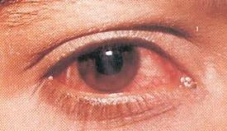
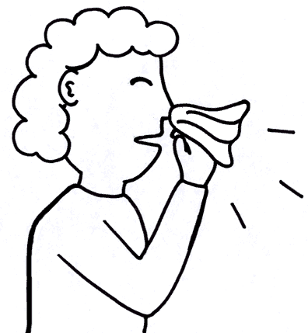
CLINICAL USES OF ANTIHISTAMINES
Allergic rhinitis (common cold)
Allergic conjunctivitis (pink eye)
Allergic dermatological conditions
Urticaria (hives)
Angioedema (swelling of the skin)
Puritus (atopic dermatitis, insect bites)
Anaphylactic reactions (severe allergies)
Nausea and vomiting (first generation H₁-antihistamines)
Sedation (first generation H₁-antihistamines)

Slide 13
USES
Insect bite
Common cold (sedative and anticholinergic).
Motion sickness (anticholinergic action and sedative,act on vestibular apparatus or cortex
Vertigo –dimenhydrinate and meclizine are effective to control vertigo in menieres disease and in othr types of vertigo.

Slide 14
USES
Antiemetic: promethazine is used to control vomiting due to cancer chemotherapy and radiation therapy.
Preanaesthetic medication (promethazine)
Cough
Parkinsonism, muscular dystonia (promethazine,diphenhydramine or orphenadrine are used to control tremors,rigidity,

Slide 15
Side effects are due to CNS depression:
Sedation
Dizziness
Tinnitus (ringing in the ear)
Blurred vision
Euphoria
Uncoordination
Anxiety
Insomnia
Tremor
Nausea/vomitting
Dry mouth/dry cough

Slide 16
SECOND GENERATION H1 ANTIHISTAMINES
They were developed in the 1980s.
No cholinergic effects
Do not cross BBB, hence cause minimal/no drowsiness
Do not imphair psychomotor performance.
Cetirizine is commonly used second generation anti histamine.

Slide 17
uses
Allergic disorders – rhinitis,dermatitis,conjunctivitis,urticarial,eczema
Vertigo: cinnarizine,promethazine,diphenhydramine (H1 blockers),hyoscine (anticholinergic),prochlorperazine.

Slide 18
Thank you

