Slide 1
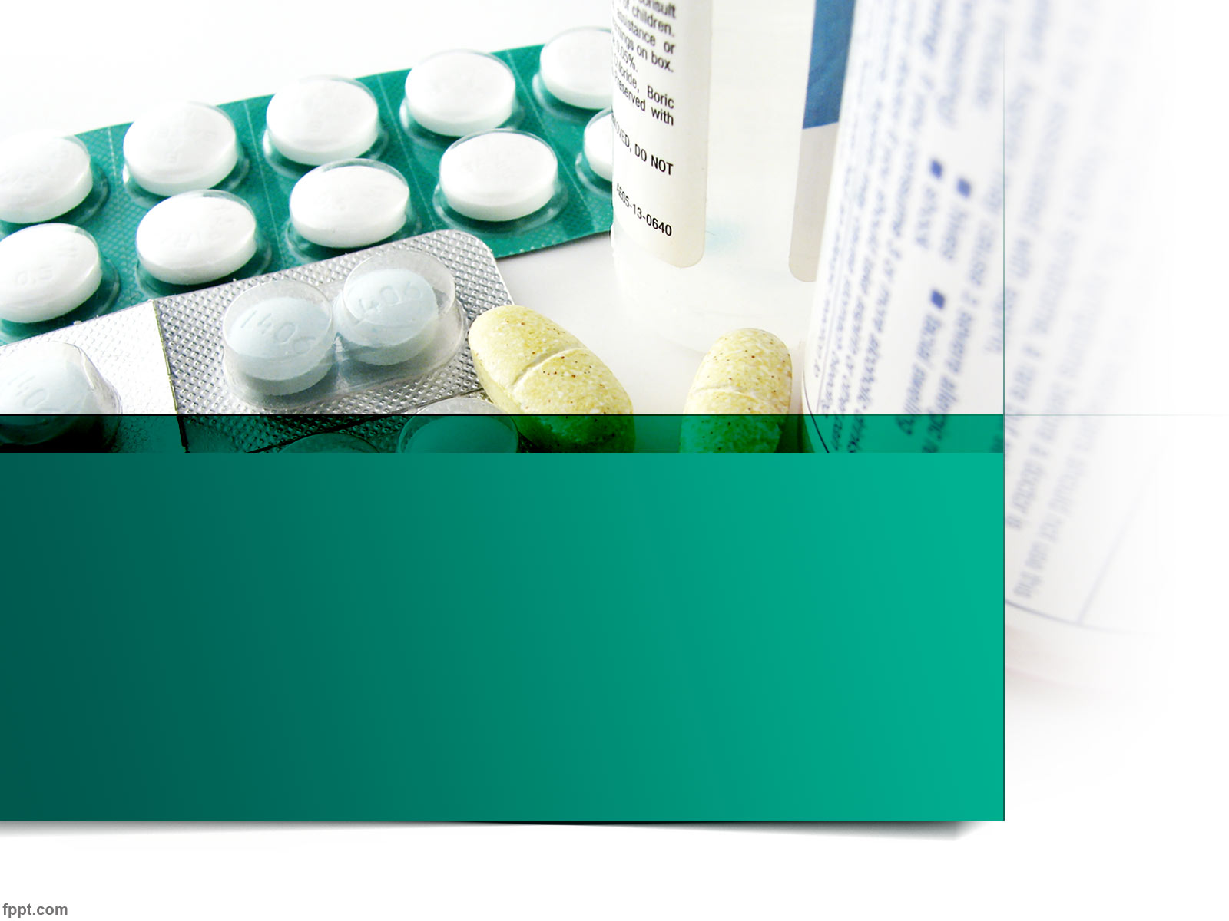
Antipsychotic Drugs Drugs for mania
Dr.Renuka Harwani
MD Pharmacology

Slide 2

Psychosis:
Thought disorder characterised by
Delusions(false belief which cannot be altered with reasoning)
Illusions(misinterpretion of sensory stimulus)
Hallucinations(false perception without true sensory stimulus)
Visual,
auditory,
olfacatory

Slide 3
Psychosis:
Two types:
Organic psychosis-
toxic cause(eg:heavy metal posioning,chronic alcoholism) or
patholologic cause(cerebral infection by rabies)
Functional psychosis-no cause
Includes schizophrenia & mood affective disorder(maina & depression)

Slide 4
Schizophrenia:
Functional psychosis characterised by Splitting of perception & interpretation from reality(split mind)
Symptoms may be positive or negative
Positive:
Delusions
Illusions
Hallucinations
Thought disorder with irrational conclusions
Aggressive behaviour
Negative:
Introvert behaviour
Poor socialisation
Emotional blunting
Lack of motivation
Lack of attention
Loss of memory

Slide 5
Pathogenesis of schizophrenia:
Unknown
Prevelance:1% worldwide
More common in men
Genetic predisposition:
First degree relative-10%,
monozygotics twins-50%,
dizygotic twins-10%
Genes:Neuergulin-1 & schizophrenia-1

Slide 6
Pathogenesis of schizophrenia:
Dopamine hypothesis:
Increased dopaminergic activity in limbic system →disorder
5-HT Hypothesis:
5HT2→LSD (5-HT agonist)→ visual hallucinations and sensory disturbance, which are similar to psychosis.
5HT has a modulator role on DA pathway
Glutamate Hypothesis:
Glutamate-NMDA receptor antagonist(phencylidine & ketamime) →pshchotic symptoms in normal person

Slide 7
Antipsychotics/Neuroleptics:
A)Typical Antipsychotics
(Antidopaminergic Drugs):
Phenothiazines
With aliphatic side chain: Chlorpromazine, trifluopromazine
Butyrophenone
Haloperidol, trifluperidol, droperidol, penfluridol
Thioxanthines
thiothixine,flupenthixol,zuclopenthixol
With piperidine side chain:thioridazine
With piperazine side chain: trifluperazine, fluphenazine

Slide 8
Atypical antipsychotics (DA &/or 5-HT antagonists)
Dibenzodizepines
clozapine
Thienobenzodiazepines
olanazepine
Benzamide
Sulpiride, amisulpiride(substituted benzamide
sertindole
quetiapine
Dibenzothiazepine
Indole derivatives
Risperidone
Benzisoxazole
Aripiprazole, ziprasidone, asenapine
others

Slide 9
Miscellaneous:
Pimozide
Loxapine
Molindone

Slide 10
Mechanism of action:
There are five important dopaminergic pathways in the brain:
The Nigro-Stiatal Pathway: Voluntary movements via extrapyramidal system
The Mesolimbic-Mesocortical-mesofrontalPathway.: Behaviour
The Tuberoinfundibular Pathway: Prolactin release
Medullary-periventricular pathway-eating behaviour
Incerto-hypothalamic pathway
Not clearly defined

Slide 11
Typical antipychotics:
Blockade of postsynaptic receptors>presynaptic receptor(mesolimbic sytem)
Synthesis & release of DA
DA metabolites in blood & urine
Feedback inhibition of DA release
Normal level of DA metabolites

Slide 12
D2 blockade in other pathways
Nigrostriatal pathway:EPS
Tuberoinfundibular pathway:increase prolactin release galactorrhoea & gynaecomastia.Other endocrinal side effects
CTZ: antiemetic effects
Also alpha adrenergic blocking & anticholinegic properties

Slide 13
Receptor binding affinities:
Chlorpromazine:D2=α1> 5-HT2=D1=M1
Thioridazine: α1>D2=5-HT2=M1>D1
Flupenthixol:D2=5HT2> α1=D1
Haloperidol:D2> α1>5HT2>D1
Sulpiride:D2>D3>D4
Pimozide:D2>5HT2>D4
Molindone:D2>5HT2A

Slide 14
Atypical antipsychotics:
Competetively block 5-HT2A & D4 receptors
Also α1,M1,H1 &D2 receptor antagonist.
Less EPS due to low affinity for D1 & D2
Receptor binding Affinities:
Clozapine:5-HT2a=D4> α1=D1=D2=H1=M1
Olanzapine:5-HT2a>D4>α1=D1=D2=H1=M1
Resperidone:5-HT2a>D4=D2= α1=H1=M1
Ziprasidone & paliperidone: 5-HT2a>D2= α1=H1

Slide 15
Pharmacokinetics:
Oral absorption is erratic & unpredictable,low bioavailability
Parenteral: consistent & reliable effect,increases bioavailabilty
High protien binding
Volume of distribution-large(20L/kg)
Metabolized in liver(CYP2D6)
Elimination t1/2-variable(18-30hrs)

Slide 16
Chlorpromazine
low efficacy
less EPS,
more sedative & hypotensive effect
more epileptogenic
potent local anaesthetic but not used (because of irritant action),
produce hypotension with reflex tachycardia,
high dose-QT prologation & suppression of T wave

Slide 17
TRIFLUPROMAZINE
More potent & more efficacious than chlorpromazine
more EPS
mainly used as antiemetic
produces acute muscle dystonia in children (parenteral administration)

Slide 18
THIORIDAZINE
Less potent
highest central anticholinergic activity
less EPS
cardiac arrhythmia & male sexual dysfunction may occur

Slide 19
TRIFLUPERAZINE & FLUPHENAZINE
High efficacy
more EPS
less sedation & hypotensive effect
less epileptogenic
Jaundice impaired glucose tolerence,Hypersensitivity reaction-less likely
Fluphenazine Decanoate- depot im injection every 2-4 wks in uncooperative patients

Slide 20
HALOPERIDOL
Few autonomic effects
less epilepticogenic
jaundice is rarely
used for acute schizophrenia
Trifluperidol more potent than haloperidol
Penfluridol- long acting
suitable for chronic schezophrenia, affective withdrawal,social maladjustment once weekly
Droperidol-short acting & highly sedative not suitable for treatment, psychiatric emergency,used for neuroleptanalgesia(combined with fentanyl) & neuroleptanaesthesia.

Slide 21
FLUPENTIXOL:
low efficacy than CPZ
less sedating
less EPS
infrequently used now
PIMOZIDE:
selective DA antagonist with little α adrenergic & cholinergic blocking activity.
Long duration of action,good for maintainence therapy
used in gilles de la tourett’s syn & in ticks
Less dystonic reactions

Slide 22
loxapine
A dibenzoxazepine,Similar to CPZ
Short acting

Slide 23
Disadvantages of typical antipsychotics:
More EPS including tardive dyskinesia
Not effective against negative sympyoms
Hyperprolactinaemia
More autononic side effects
Not effective in all cases.

Slide 24
ATYPICAL ANTIPSYCHOTICS
Competitively block 5HT-2A & D4 receptors & weak D2 blocking activity
More effective against negative symptoms than positive symptoms
EPS are minimal
Improve impaired cognitive functions
Useful for refractory cases
Effective for drug induced psychosis

Slide 25
CLOZAPINE
First atypical antipshychotics
Dibenzodiazepine
D4>D2receptors,thus less EPS
Also blocks 5HT2,histamine,muscuranic & α receptors
Reduces risk of suicidal attempts
Reserved for refractory cases of schizophrenia
Agranuloctosis-1-2% cases
Sedation,wieght gain,hyperlipidaemia,hyperglycaemia

Slide 26
Olanzapine:
Thienobenzodiazepine similar to clozapine
Blocks 5 HT2a>D2,also D3,D4,histamine & muscuranic receptor
More epileptogenic
Less EPS
Weight gain,dry mouth
Impairs glucose tolerance
Elevates serum triglycerides
Risk of stoke in elerly
Metabolized by CYP1A2 & glucuronyl transferase
T1/2:24-30 hrs
Use:schizo-affective disorder & mani

Slide 27
Quetiapine:
New short acting(t1/2-6hrs)
Mainly blocks presynaptic α1 & postsynaptic α2
Also blocks 5HT2,H1 but less D2-so less EPS
Not effective for negative symptoms
Used for acute mania
Less hyperprolactinaemia
Postural hypotension,weight gain, rise in blood sugar

Slide 28
Aripiprazole:
Partial D2 & 5HT1a agonist but 5HT2 antagonist.
Long acting(t1/2-3days)
Use:schizophrenia,mania,bipolar illness
Nausea,dyspepsia,constipation & light headedness-common
EPS,hyperprolactinaemia,hypotension-very less

Slide 29
Ziprasidone:
5-HT2a,2c,1d antagonist & 5 HT1 agonist
Anxiolytic action-5 HT1a agonist
Antidepressant action-blockade of reuptake of 5HT & NA
Less EPS/hyperproclactinaemia
Mild sedation/moderate hypotension
Lacks antimuscuranic effects
Prolongs Q-T interval
T1/2:8 hrs
Used in mania

Slide 30
Amisulpiride:
Improves negative symptoms of schizophrenia
Few EPS but hyperprolactinaemia similar to typical neuroleptics
Insomnia, anxiety, agitation
QT prolongation is noted(predisosed elderly pts)
Excreted unchanged in urine(t1/2:12) hrs

Slide 31
Zotepine:
Blocks D2,D1,5HT2,α1 adrenergic,H1 receptor & inhibits NA reuptake
Benefits both positive & negative symptoms
EPS<typical neuroleptics, but >clozapine
Epileptogenic at high doses
Weakness,headache, postural hypotension-common
Elimination t1/2=14hrs
Discontinued in U.K

Slide 32
Adverse effects:
CNS:
Drowsiness,lethargy,mental confusion(more with low potency typical antpychotics)
May produce seizures(less with high potency)
Increased appetite & weight gain(not with haloperidol)

Slide 33
CVS:
Postural hypotension,palpitation,inhibition of ejaculation(thioridazine)-α blockade,more with low potency
Q-T prolongation & cardiac arrythmia (thioriadzine,pimozide,ziprasidone)
Metabolic:
Hperglycaemia & triglyceridemia (chlorpromazine,thioridazine)
Olanazepine & clozapine may precipitate diabetes

Slide 34
Anticholinergic:
Dry mouth,blurring of vision,urinary hesistancy in elderly males(absent with high potency)
Clozapine-hypersalivation,due to central action
Endocrine:
Hyperprolactinaemia(typical neuroleptics)
Amenorrhea,infertility-infrequently on long term treatment

Slide 35
Extrapyramidal effects:
More with high potency drugs like haloperidol,pimozide etc
a)Parkinsonism: rigidity, tremor, hypokinesia, mask like facies, shuffling gait
1-4weeks of therapy
Reduce dose or add anticholinergic or change drug
b)Rabbit syndrome:
After years of therapy
respond to central anticholinergic drugs

Slide 36
Acute muscle dystonia: bizzare musle spasm, grimacing, tounge thrushing,torticollis,locked jaw
Few hrs of single dose or in 1st week of therapy
More in children <10yrs & in girls
Parenteral administration
Resolves spontaneously
i.m promethazine/ hydroxyzine clears reaction in 10-15 min

Slide 37
Akathisia: restlessness, feeling discomfort, apparent agitation
1-8 weeks of therapy
20% incidence
Dose reduction & change of drug
Benzodiazepine is 1st choice
Central anticholinergic may help
Propanolol to non responsive cases

Slide 38
Malingnant neuroleptic syndrome: marked rigidity, immobility, tremor, hyperthermia, semiconciousness, fluctuating BP & heart rate
Rare & may be fatal
Last for 5-10 days after withdrawl of drug
Drug not to be stopped promptly
Symptomatic treatment
i.v Dantrolene & bromocriptine may help

Slide 39
Tardive dyskinesia: involuntary facial & limb movements
More in elderly women
Progressive neuronal degeneration & supersensitivity of DA
10-20 % incidence
Subside months or yrs after withdrawal of therapy or life long
No treatment

Slide 40
Hypersensitivity reactions:
Cholestatic jaundice with portal infiltration:
More common with low potency phenothiazines
2-4% incidence
2-4 weeks of therapy
Resolve slowly on withdrawal of therapy
Skin rashes,urticaria,contact dermatitis, photosenstivity:cholpromazine
Agranulocytosis: clozapine
Myocarditis: few cases with clozapine

Slide 41
Drug interactions:
Potentiate CNS depressants-sedative, hypnotics,antihistaminics
Block action of levodopa
Reduce antihypertensive action of clonidine & methyldopa-due to α blockade
Enzyme inducers (barbiturates,anticonvulasnts) reduce blood levels of neuroleptics

Slide 42
Therapeutic uses:
Schizophrenia:
Functional psychosis & acute cases
Improve symptoms
Acute mania:
High dose is required.
Lithum also be added
Antipsychotic should be gradually withdrawn when lithium takes effect
Anxiety:
Having pschotic basis may be treated
Benzidiazepines are preferable

Slide 43
Antiemetics:
Typical neuroleptics-drug & disease induced vomitting at much lower doses(with jaundice-chorpromazine)
Ineffective in motion sickness
Prochlorperazine

Slide 44
Other uses:
Itractable hiccough: parenteral chlorpromazine(10-25mg) is used.
To potentiate hypnotics,analgesics,anaesthetics
Alzhiemer’s disease: used for agitation
Tourette’s syndrome: haloperidol is useful.
Tetanus:chlorpromazine to relieve muscle spasm
To induce hypothermia: in cardiac surgery & head injury (chorpromazine)
Meniere’s disease

Slide 45
Drug selection:
Condition | drug
CVS disease (to avoid hypotension) | Newer drugs- resperidone, clozapine High potency- trifluperazine, haloperidol
Children | Low dose of high potency drug or atypical agent
Psychosis in elder patients | Dose is reduced to ½ or less High potency phenotiazines or haloperidol or aripiprazole Avoid resperidone or olanazepine ( risk of stroke)
Agitated, aggressive or violent patient | Quetiapine, haloperidol, chlorpromazine
Akathisia | Quetapine

Slide 46
Drug selection:
Condition | drug
Negative symptoms or resistant cases | Clozapine, aripiprazole, risperidone, olanazepine, ziprasidone
To minimize EPS & tardive dyskinesia | Aripiprazole, clozapine, quetapine, ziprasidone
To avoid Sedation | Aripiprazole, ziprasidone
Autonomic dysfunction (eg inhibition of ejaculation) | High potency (trifluoperazine)
Poor hepatic function | Low dose of high potency
Compliance problem | Depot preparations

Slide 47
Depot Preparations:
Fluphenazine Decanoate
Haloperidol deconoate
Risperidone
Flupenthixol decnoate
Zuclopenthixol acetate or decanaote

Slide 48
Typical
Atypical
1st generation
Primarily D2 receptor blockade
More extrapyramidal symptom
addicitive
Difficulty to discontinue
Slow excret
2nd generation
5HT & D4 receptor antagonism
Less extrapyramidal symptom
Effective in refractory cases
Easier discontinue
Fast excret (relapse)

Slide 49
Antimaniac Drugs
Mania- occurs due to increased NA in limbic system.
Acute Mania:
increased NA + DA
Increased psychomotor activity, impaired judgement, impulsive, grandiose & irritation, inappropriate happiness
Severe mania: delusions & paranoid thinking

Slide 50
Drugs for acute attack of mania
Neuroleptics: chlorpromazine, haloperidol, risperidone, olanzapine, quetapine, aripiprazole
Benzodiazepines: diazepam, clonazepam, lorazepam
Antiepileptics: sodium valproate

Slide 51
Drugs for prophylaxis of mania
Litium
Antiepileptics: sodium valproate, carbamazepine, lamotrigine, divalproex
Neuroleptics:aripiprazole, quetapine, olanzapine

Slide 52
Lithium
Earlier used for gout, but withdrawn due to toxicity.
Reintroduced for treatment of mania in 1946
Standard drug for mania despite low therapeutic index

Slide 53
Mechanism of action
Replaces Na→ so action potential cannot be maintained by Li
Reduces NA & DA and increases 5HT
Inhibits hydrolysis of inositol phosphate→ reduces generation of second messengers IP3 & diacylglycerol in hyperactive neurons
Decreases formation of protein kinases in brain

Slide 54
Action
CNS: gradually corrects symptoms of mania & stabilizes mood
Inhibits ADH: leads to nephrogenic diabetes insipidus
Inhibits iodination of tyrosine: inhibits synthesis of thyroxine→ hypothyroidism

Slide 55
Pharmacokinetics
Absorption on oral: rapid & complete (100%)
Peak concentration: 2-4 hrs
Distribution: to CNS-slow (50% of plasma)
Does not bind to plasma proteins
Eliminated in urine in 2 phases: initial (6-12h)- 1/3rd to 2/3rd & slow excretion-10-14 days
Excreted in saliva: Conc in saliva twice that of plasma→ non invasive method of TDM

Slide 56
Uses:
Prophylaxis of mania/ chronic mania: lithium is a drug of choice
Plasma conc in acute mania- 0.8-1.4 mmol/litre & maintenece conc- 0.5-0.8mmol/litre
Acute mania : effective but delayed onset
Used together with neuroleptics or other agents
Alcohol dependence: not preferred due to narrow safety

Slide 57
Adverse effects:
MC side effect at therapeutic dose- tremors
Mild toxicity- nausea, vomiting, abdo pain, diarrhea, sedation, fine tremmores
Serious SE: mental confusion, hyperreflexia, gross tremors, dysathria, seizures, coma & death may occur
Nephrogenic diabetes- amiloride is DOC
Hypoglycaemia
Hypothyroidism
In pregnancy- ebstein anamoly & floppy baby syndrome

Slide 58
Rx of lithium toxicity:
No specific antidote
Correction Na deficiency- infuse Normal saline
Stop NSAIDs
Maitains vitals
Osmotic diuretics to enhance Li excretion
Haemodialysis if serum conc exceeds 4mmol/litre

Slide 59
Interactions :
Na enhances Li excretion & Na depletion causes Li retention & toxicity
NSAIDs facilitate renal tubular reabsorption of Li in proximal tubule→ increase conc & toxicity ( more with indomethacin, ibuprofen, naproxen & less with aspirin, sulindac )
ACE inhibitors increase Li Conc
Osmotic diuretics, acetazolamide, triamterene enhance renal excretion of Li

Slide 60
Antiepileptics :
Sodium valproate:
First line drug due to its faster action & better adverse effect profile
carbamazepine:
Not effective in all cases
Lamotrigine:
Effective in type II bipolar disorder

Slide 61
Neuroleptics :
Aripirazole :
Supresses manic phase in bipolar disorder
Used as monotherapy or with lithium or sodium valproate
olanazepine & quetiapine:
Effective in bipolar disorder

Slide 62
Thank you

