Slide 1


Serotonin
Receptor
modulators

Slide 2
Overview of seminar
History
Serotonin
Distribution of serotonin
Biosynthesis of serotonin
Neurotransmission of serotonin
Serotonin receptors
5HT1 receptor
5HT2 receptor
5HT 3 receptor
5HT 4-5-6-7 receptor
Physiological actions of serotonin
Serotonin modulators
Storage inhibitor
Reuptake inhibitor
Degradation inhibitor
5HT receptor agonist
5HT receptor antagonist
Recent advances
Conclusion

Slide 3
Serotonin :-
Serotonin (5 -Hydroxytryptamine ) is a monoamine that is widely distributed in animal and plant kingdoms with wide variety of physiological actions.
It occurs in vertebrates, tunicates, arthopods , fruits ,nuts and numerous venoms.
One of the most investigated and complex biogenic amines.
It is popularly thought to be a contributor to feelings of well-being and happiness.

Slide 4
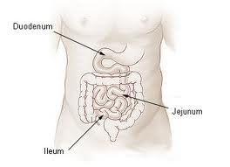
Distribution of 5-HT in body
95% 5-HT in GI tract
90% in Enterochromaffin cell
10% in Myenteric plexus
All serotonin in blood is derived
from GI tract.

Slide 5
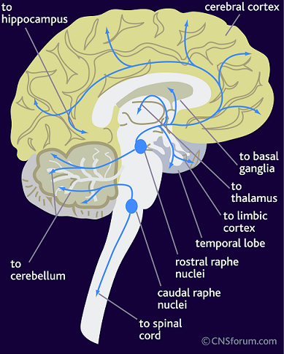
Distribution of Serotonergic neurons in Brain
5% serotonin found in CNS.
Rostral and caudal Raphe
nuclei.

Slide 6
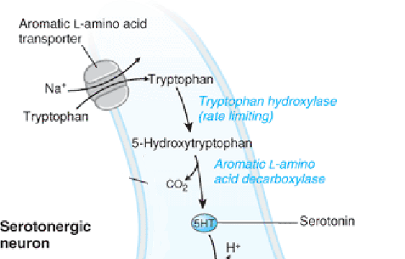
Biosynthesis of 5-HT

Slide 7
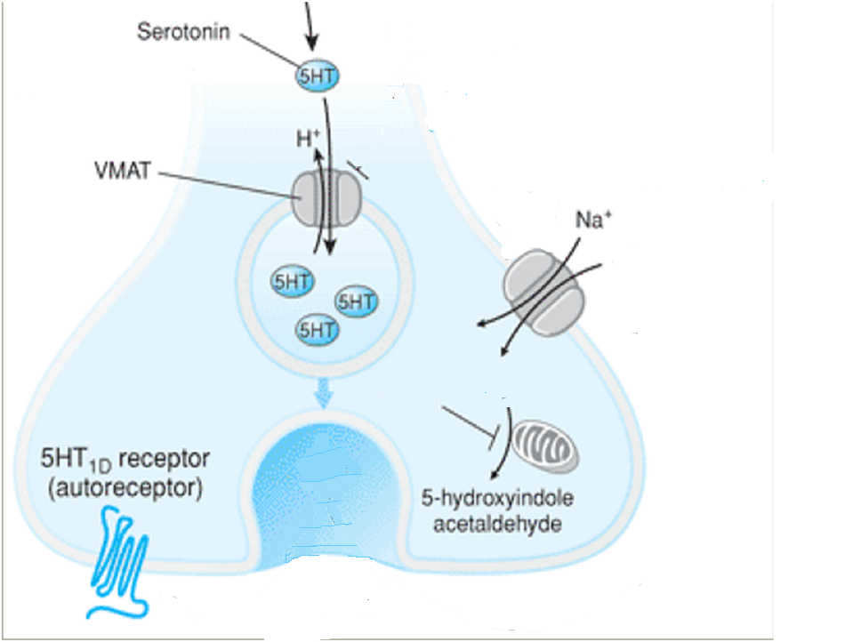

5-HT Neurotransmission
Action Potential
4. Reuptake
TCA, SSRI ,SNRI
1. Storage
Reserpine
3. Feedback inhibition
5. Degradation
Buspirone
MAO inhibitor
2.Release
7
7

Slide 8
SEROTONIN RECEPTORS

Slide 9
5HT RECEPTOR
5-HT1
5-HT2
5-HT3
5-HT4
5-HT5
5-HT6
5-HT7
5HT1A
5HT2A
5-HT1B
5-HT2B
The current classification system is proposed
by Hoyer in 1994 and is based on
Pharmacological properties
Second-messenger function
Amino acid sequence
5-HT1D
5-HT2C
5-HT1E
5-HT1F

Slide 10
5HT RECEPTORS
Receptor family | Potential | Type | Mechanism of action
5HT1 | Inhibitory | Gi/G0-protein coupled | ↓ cAMP
5HT2 | Excitatory | G Protien coupled | ↑ IP3 and DAG
5HT3 | Excitatory | Ligand gated Na+/ K+ channel | Depolarization of cell plasma membrane
5HT4 | Excitatory | Gs-Protein coupled | ↑cAMP
5HT5 | Inhibitory | Gi/G0-protein coupled | ↓cAMP
5HT6 | Excitatory | Gs-Protein coupled | ↑ cAMP
5HT7 | Excitatory | Gs-Protein coupled | ↑ cAMP

Slide 11
5HT1 RECEPTORS
Receptor | Location | Action
5HT 1A | CNS: Raphe nuclei, Hippocampus. PNS: Myenteric plexus Cholinergic neurons. | CNS: Aggression, Anxiety, Addiction, Appetite, Emesis, Impulsivity, Memory, Nociception, Sleep, Thermoregulation, Sexual behavior . CVS: Blood pressure, Vasoconstriction, Penile erection .
5HT1B/1D | CNS: Substantia Nigra , Cranial blood vessels PNS: Vascular smooth Muscle | CNS: Locomotion, Anxiety Vessels: Cerebral vasoconstriction
5HT1E | CNS: cortex , striatum | CNS: Memory
5HT1F | CNS: Spinal cord Hippocampus PNS: Uterus, mesentery, Vascular smooth Muscle | Trigeminal neuro inhibition in guinea pig and rat.

Slide 12
5HT2 Receptor
Receptor | Location | Action
5HT 2A | CNS: cerebral cortex PNS: GI, vascular and bronchial smooth muscle, platelets. | CNS: Anxiety, Appetite, Addiction, Cognition, Learning, Memory, Mood, Perception, Sexual behaviour, Sleep, Thermoregulation Smooth muscles: Contraction Vessels: Vasoconstriction, Vasodilation Platelets: Aggregation
5HT2B | CNS: cerebellum , hypothalamus PNS: Vascular endothelium, | CNS: Anxiety, Appetite . Gastrointestinal tract: GI motility Vessels: Vasoconstriction
5HT2C | CNS: choroid plexus, Hippocampus , hypothalamus | CNS: CSF secretion Vessels: Vasoconstriction, Penile erection

Slide 13
5HT3-7 Receptor
Receptor | Location | Action
5HT 3 | CNS: Area postrema PNS: Abdominal visceral afferent neuron | 1. Stimulate vomiting by acting on CTZ and by vagal neuro excitation 2. Stimulate nociceptive (pain mediating) nerve ending led to pain
5HT4 | CNS: Hippocampus PNS: GIT, | Neuronal excitation Increase GI motility
5HT5 | CNS: olfactory bulb | Unknown
5HT6 | CNS: caudate , putamen, Hippocampus PNS: Superior cervical ganglia | Modulation of CNS dopamine , Ach release .
5HT7 | CNS: hypothalamus PNS: gastrointestinal and vascular smooth muscle | Smooth muscle relaxation

Slide 14
Action on Gastrointestinal System
Increased gastrointestinal motility by direct action or by enteric plexuses through various receptors .
5HT4 - Contraction of lower esophageal sphicter.
Stimulate Ach release from enteric plexus causes increases peristalsis and secretion
5HT2A - Intestinal smooth muscle contraction
5HT3 - Fast depolarization of enteric plexus neurons , release of 5HT from enterochromaffin cell
5HT1 D - Relaxation of smooth muscles
5HT has ulcer protective property. Inhibit gastric secretion ( acid and pepsin ) and increase mucus.

Slide 15
Action on CNS
A multitude of brain functions are influenced by serotonin executed mainly via 5HT1A, 5HT1B/1D , 5HT2A receptors.
Sleep
Cognition
Sensory perception
Temperature regulation
Mood
Appetite
Sexual behaviour
Hormone secretion e.g. ACTH, CRH .
Nociception via 5HT 3 receptor
Emesis via 5HT3 receptor

Slide 16
Action on Cardiovascular System
Vasoconstriction specially on splanchnic, renal, pulmonary, and cerebral vasculatures .
Tachycardia in isolated heart ( direct as well as by releasing NA )
Bradycardia and hypotension on intact animal due (activation of chemoreceptor )
Action on BP : After i.v. 5HT Triphasic response is seen
Early sharp fall in BP – due to chemoreflex .
Brief rise in BP- vasoconstriction and increases cardiac output.
Prolonged fall in BP –arteriolar dilation and extravasation of fluid .

Slide 17
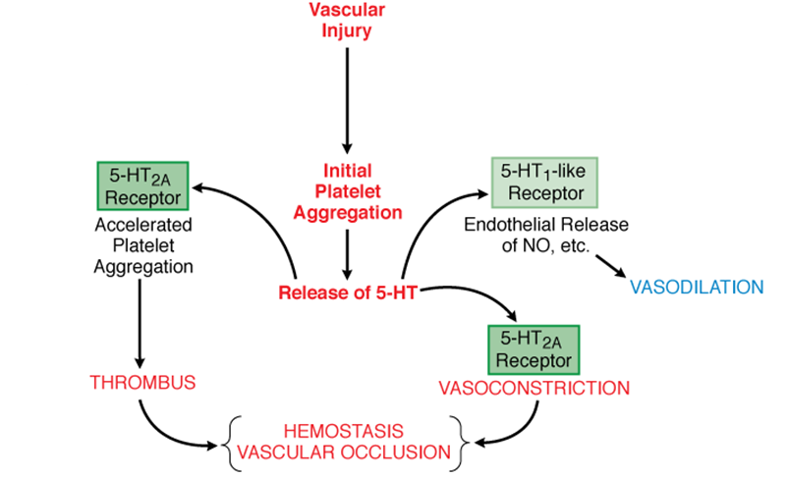
Action of 5HT on Platelet

Slide 18
Serotonin modulators
Storage inhibitor
Reserpine
Amphetamine
Degradation inhibitor
MAO inhibitor
Reuptake inhibitor
TCA
SSRI
SNRI
Serotonin receptor modulators
Receptor Agonist
Receptor Antagonist
Mixed action

Slide 19
Storage inhibitor
Amphetamine
Reserpine
Methylphenidate
Fenfluramine
Modafinil
MDMA

Slide 20
Storage Inhibitor
Drugs | Uses | Adverse effect
Amphetamine Methylphenidate | ADHD Narcolepsy | Abuse potential Hypertension Restlessness, insomnia , tremor, irritability, seizures, anxiety, paranoid , hallucinations , suicidal or homicidal intention
Fenfluramine Dexfenfluramine (Selective for 5HT ) | Was using for weight loss but withdrawal due to severe cardiac toxicity .
Modafinil (non amphetamine analogue→ blocks both NE & DA uptake) | Atypical depression , Narcolepsy, Obstructive sleep apnea . | No abuse potential, No insomnia

Slide 21
Storage Inhibitor
Drugs | Remark | Side effects
Methylene Dioxymeth amphetamine (MDMA) | 5HT storage inhibitor as well as a 5HT receptor Agonist Not used clinically but used as illicit drug as “ecstasy” | Abuse potential Hallucinations Water intoxication Heat stroke like condition
Reserpine | By Inhibiting VMAT 2 it block storage of monoamines and causes depletion of all monoamines . Was used as antihypertensive and antipsychotic agent | Psychotic depression Dizziness, nasal congestion Cardiac arrhythmia, GI hemorrhage,

Slide 22
Degradation inhibitor
MAO inhibitor
Selective MAO Inhibitor
Non selective MAO inhibitor

Slide 23
MAO Inhibitor
Drugs | Remark | Side effect
Iproniazid Tranylcypromine | Irreversible and nonselective inhibitor of MAO. | Postural hypotension Weight gain Dizziness Sexual dysfunction Headache ,insomnia Interactions with foods and drugs
Moclobemide Clorgyline | Reversible inhibitors of MAO- A Use for Moderate depression (Lacks the Anticholinergics, Sedative, Psychomotor and cardiovascular adverse effect) | Nausea, Dizziness, Headache, Insomnia, Excitement

Slide 24
Reuptake
inhibitor
TCA
SSRI
SNRI

Slide 25
Tricyclic antidepressants
TCA | Clinical Uses | Side effects
Imipramine Amitriptyline Clomipramine Doxepine Amoxapine | Depression Migraine headaches Neuropathic pain Enuresis (Imipramine) Obsessive-compulsive disorder(clomipramine) | Cardiac arrhythmia Anticholinergic effects Sedation Mental confusion Postural hypotension Increased appetite weight gain
Notes:
Block uptake of NE & 5HT into their resp. neurons n inhibiting their respective transporters…NERT and SERT..

Slide 26

Selective serotonin reuptake inhibitors
First-line agents for the treatment of depression, anxiety, and obsessive-compulsive disorder.
Selectively inhibit reuptake of serotonin and thereby↑ synaptic serotonin ↑ 5HT receptor activation .At high doses, it also bind NE transporter.
Anticholinergics symptoms
Cardiac arrthymias
Postural hypotension
Sedation
Interfere with psychomotor function
Seizure

Slide 27
Selective serotonin reuptake inhibitors
Drugs | Clinical use | Adverse effect
Fluoxetine Fluvoxamine Paroxetine Sertraline Citalopram Escitalopram | Depression Anxiety Obsessive compulsive disorder Post-traumatic stress disorder Chronic Pain syndromes | Serotonin syndrome from concomitant administration of other Serotonergic drugs.(MAOI,Pethidine, Tramadol) Sexual dysfunction, Gastrointestinal distress Precipitate mania in a bipolar patient

Slide 28
Serotonin-Norepinephrine Reuptake Inhibitors (SNRIs)
SNRI drugs | Clinical uses | Adverse effect
Venlafaxine Duloxetine Milnacipran | Major Depression Anxiety Panic disorder Fibromyalgia | Hepatitis, rise in BP, weight loss, Gastrointestinal distress, blurred vision, nervousness, sexual dysfunction .
Sibutramine | Weight loss | Withdrawn due increases incidence of cardiovascular events and stroke
Notes:
Duloxetine also indicated for→ panic attacks, diabetic neuropathic pain,stress urinar incontinence in women..

Slide 29
Atypical antidepressant
Drugs | Clinical use | Adverse effect
Bupropion Inhibits neuronal uptake of 5HT, dopamine, and NE. | Mild Depression Smoking cessation | Tachyarrhythmia, hypertension, seizure , insomnia. Fewest sexual dysfunction
Mirtazapine Blocks 5HT2A, 5HT2C, and the α2-adrenergic autoreceptor and increasing NE neurotransmission. | Mild Depression | Agranulocytosis, seizure, Hyperlipidemia, constipation Sedation and appetite stimulant.
Trazodone Nefazodone Block 5HT2A receptors and α blocker | Depression Insomnia (Trazodone) | Trazodone- Priapism , sedation , Postural hypotension , Nefazodone-Hepatotoxicity
Notes:
Bupropion can also cause release of DA and NE.rather excitant than sedative..

Slide 30
Atypical antidepressant
Tianeptine is a selective serotonin reuptake enhancer (SSRE)
This drugs increases uptake of serotonin .
Enhances extracellular concentration of dopamine in the nucleus
accumbens and modulates the D₂ and D₃ dopamine receptors .
Drugs | Clinical use | Adverse effect
Tianeptine | Anxiodepressive with psychosomatic symptoms | Dry mouth , drowsiness, insomnia, tremors, bodyache.

Slide 31
Serotonin receptor modulators
Receptor Agonist
Mixed action e.g.
Ergot alkaloids
Receptor Antagonist

Slide 32
5HT Receptors | Drugs
5HT1A | Azapirones
5HT1B/1D | Triptan
5HT1F | Lasmiditan
5HT2A | LSD, Mescaline, Psilocin
5HT2C | Lorcaserin
5HT4 | Cisapride and Tegaserod
Receptor Agonist

Slide 33
Azapirones 5HT1A (Partial agonist )
Azapirones | Clinical uses | Side effects
Buspirone Gepirone Ipsapirone | Anxiety Adjuvant antidepressant | Dizziness, confusion, headache, excitement Rarely Myocardial ischemia, cerebrovascular accident
Buspirone is non-sedating with moderate anti anxiety properties.
Not produced tolerance or physical dependence.
Notes:
5HT1A agonism→ reduces activity of dorsal raphe serotonergic neurons;

Slide 34
Triptans (5HT1B/1D Agonist)
Drugs | Remark | Side effects
Sumatriptan Naratriptan Rizatriptan Almotriptan Eletriptan Zolmitriptan | Use for Migraine headaches MOA : Vasoconstriction of extracranial vessels Block Trigeminal nerve transmission Suppress inflammation Advantage of newer drugs : (Improved oral bioavailability , Lesser oral dose ,Cross BBB , lesser side effect) | Flushing, nausea, Dizziness , Muscle weakness. Coronary artery spasm, Hypertensive crisis, Cerebrovascular accident,
Triptans are most useful for acute migraine attacks when taken at the onset of an episode rather than as prophylaxis

Slide 35
(5HT₄R agonist) Prokinetics drugs
Cisapride
5HT₄R agonist that also enhances acetylcholine release from the myenteric plexus.
Induces gastric motility, LES tone improved ,oesophageal tone augmented.
Withdrawn from U.S.in 2000 due to QT prolongation and cardiac arrhythmias.
Tegaserod is a 5-HT₄ agonist for the management of irritable bowel syndrome and constipation .
Withdrawn due to Increased risks of heart attack and stroke .

Slide 36
(5HT₄R agonist) Prokinetics drugs
Mosapride :
Congener of cisapride with same action but devoid of QT prolongation.
Used for GERD, Irritable bowel syndrome and Dyspepsia
Side effects - Diarrhea, Abdominal Pain
Prucalopride :
Selective 5-HT₄ receptor agonist . Induced colonic motility
Approved in Europe in 2009 and in Canada 2011 , not yet in US .
Approved in Europe for the symptomatic treatment of chronic constipation in whom laxatives fail to provide adequate relief.
Clinical trials shows no significant activity on QT interval .
Side effects – Headache, Abdominal pain, Nausea and Diarrhoea

Slide 37
Serotonin receptor modulators
Receptor Agonist
Mixed action e.g.
Ergot alkaloids
Receptor Antagonist

Slide 38
Drugs | Receptors
Ketanserine | 5HT2A , 5HT2C , α1Adrenergic
Ondansetron | 5HT3
Atypical antipsychotic | 5HT2A, 5HT2C , Dopaminergic receptor
Cyproheptadine | 5HT2A , H1
Pizotifen | 5HT2C , H1 ,
Receptor Antagonist

Slide 39
5HT Antagonist
Drugs | Receptors | uses | Side effects
Ketanserin Ritanserin | 5HT2A > 5HT2C antagonist and weak α1 , H1 and dopaminegic blockade | Glaucoma , Hypertension Raynaud's phenomenon | Orthostatic hypotension, ventricular tachycardia , Flushing, Rash
Ondansetron Granisetron | It blocks 5-HT3 receptors on vagal afferents in the g.i.t. as well as in NTS and CTZ | Potent anti-emetic for chemotherapy and post operative nausea . | Cardia arrhythmia, Bronchospasm Increased liver enzymes, constipation, diarrhea, headache

Slide 40
5HT Antagonist
Drugs | Receptors | uses | Side effects
Cyproheptadine | H1 and 5HT2A antagonist | Apart from in allergies off -label use are Postgastrectomy dumping syndrome, Intestinal hypermotility Migraine prophylaxis | Sedation, Dizziness, dry eyes, dry mouth, Urinary retention and hesitancy, Weight gain
Pizotifen | 5HT2C , H1 | Prevention of migraine and cluster headache | sedation, dry mouth and weight gain

Slide 41
ATYPICAL ANTIPSYCHOTIC
Drugs | Receptors | uses | Side effects
Clozapine | D1–D5, 5-HT2, α1, H1, muscarinic receptors | Refractory Schizophrenia | Agranulocytosis ( Clozapine) Mild extrapyramidal symptoms, QT prolongation, Anticholinergic symptoms, Sedation, weight gain
Risperidone | D2, 5-HT2, α1, α2, H1 | Psychotic disorders Bipolar disorder
Quetiapine | D1, D2, 5-HT1, 5-HT2, α1, α2, H1 receptors
Ziprasidone | D2, 5-HT1, 5-HT2, α1, H1 receptors
Aripiprazole | D2 and 5-HT1A partial agonist and 5-HT2A antagonist
Notes:
Ziprasidone agonist at 5HT1A and antagonist at 5HT1D; also block 2A/2C
Clozapine→ agranulocytosis, hypersalivatin, wt gain, diabetes
Quetiapine→sedation, postural hypotension
Ziprasidone→ anta at 5HT 1D and aginist at 5HT1A; nausea vomiting
Aripiprazole→ dyspepsia, constipation…no sedation

