Slide 1

LOCAL ANAESTHETICS

Slide 2
Local Anaesthetics
Drug which upon topical application or local injection causes reversible loss of sensory perception, especially pain in restricted area of the body
Blocks generation and conduction of nerve impulse

Slide 3
History
Cocaine :
First local anaesthetic
Discovered by German, Albert Niemann (1860)
Isolated from the leaves of coca
First clinical use in 1884 by Sigmund Freud and Karl Kollar in ophthalmology as a topical ointment

Slide 4
Classification
Injectable :
Low potency, short duration:
Procaine
Chloroprocaine
Intermediate potency and duration :
Lidocaine (Lignocaine)
Prilocaine
High potency, long duration :
Tetracaine Ropivacaine
Bupivacaine Dibucaine

Slide 5
Classification
Surface anaesthetics :
Soluble Insoluble
cocaine Benzocaine
Lidocaine Butylaminobenzoate
Tetracaine Oxethazaine
Benoxinate
Mepivacaine, Etidocaine, Atracaine, Dyclonine, Proparacaine

Slide 6
Other drugs
Propranolol
Chlorpromazine
H1 antihistamine
Quinine
Cooling : Ice
CO2 snow
Ethylchloride spray.

Slide 7
Chemical classification
Ester linked LAs :
Cocaine Procaine
Chloroprocaine Tetracaine
Benzocaine
Amide linked LAs :
Lidocaine Bupivacaine
Dibucaine Prilocaine
Ropivacaine

Slide 8
Comparison between Ester linked and Amide linked LA
Ester linked LA | Amide linked LA
Less intense shorter duration of anaesthesia | More intense longer lasting anaesthesia
Hydrolysed by plasma esterases | Not Hydrolysed by plasma esterases
High risk for hypersensitivity reactions | Rarely causes hypersenesitivity reactions

Slide 9
Mechanism of Action
LAs block the conduction by decreasing the entry of Na+ ions during the upstroke of Action Potential
As concentration of LA , the rate of rise of AP and maximum deporalization decreases
LAs interacts with receptor situated in the voltage sensitive sodium channel and raise the threshold for opening

Slide 10
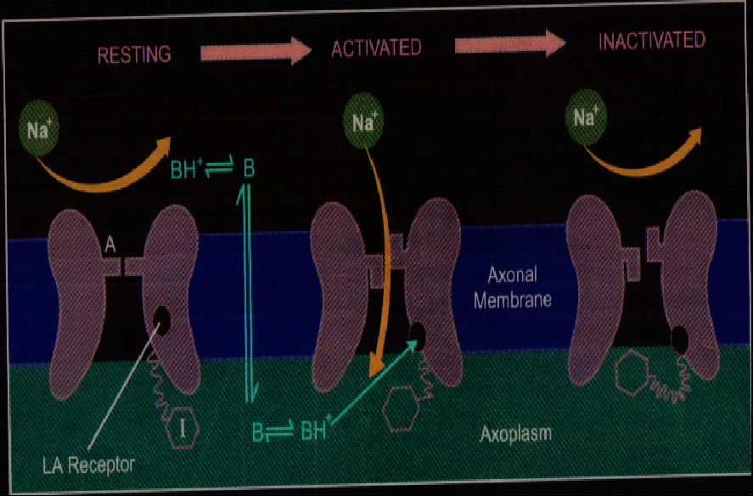

Slide 11
LAs binds more avidly to the activated and inactivated states of the channel rare than to the resting state
Blockade develops rapidly when the nerve is stimulated repeatedly
Degree of blockade is frequency dependent
Exposure to higher concentration of Calcium reduces inactivation of Na channels and lessens the degree of blockade

Slide 12
Local Action
No / minimal local irritant action
Blocks sensory nerve endings, nerve trunk, neuromuscular junction, ganglionic synapse and receptors
Acetylcholine release from motor nerve endings
Sensitivity to LA : determined by diameter and type of fibre
Myelinated fibres are blocked earlier than non myelinated fibre
Smaller fibres are more sensitive than the larger fibres

Slide 13
Autonomic fibres are more susceptible than somatic fibres
Order of blockade : pain- temperature- touch-deep pressure sense
Tongue : bitter taste – sweet – sour- salty
Fibres first blocked are last to recover
Nerve trunk : location of fibres determines the latency, duration and depth of local anaesthesia
outer fibres are affected earlier than the core fibres

Slide 14
No adequate pain control in inflamed tissues
Inflammation lowers pH of tissues – LAs ionized hindering diffusion into axolemma
Blood flow to inflamed area is increased and the rapid removal of LAs from the site
Effectiveness of Adr injected with LA is reduced at the inflamed site
Inflammatory products may appose LA action

Slide 15
Addition of vasoconstrictor (Adrenaline – 1:50,000 to 1:200,000)
Prolongs duration of action
Enhances the intensity of nerve block
Reduces systemic toxicity of LAs
Provides more bloodless field for surgery
Increases the chances of subsequent local tissue edema and necrosis and delay wound healing by reducing the O2 supply
May rise BP and promote arrhythmia

Slide 16
Systemic action CNS
All LAs produce sequence of stimulation followed by depression
Cocaine : powerful CNS stimulant causes Euphoria – excitement – mental confusion – restlessness – tremors and twitching of muscles – depression – death in dose dependent manner
Other LAs : At safe clinical dose – little CNS effect Higher dose – CNS stimulation followed by depression

Slide 17
Early neurological symptom of overdoses
Circumoral numbness, abnormal sensation in the tongue, dizziness, blurred vision, tinnitus followed by drowsiness, dysphoria and lethargy
Still higher dose : excitation, restlessness, agitation, muscle twitching, seizures and finally unconsciousness

Slide 18
CVS : Heart : cardiac depressant
- higher dose or I.V injection – decrease automaticity, excitability, contractility, conductivity and prolong effective refractory period
- anti arrhythmic action (procainamide)
- high plasma concentration – QT interval is prolonged and can induce cardiac arrhythmias
Bupivacaine : more cardiotoxic
ventricular tachycardia or fibrillation
Lidocaine : little effect on contractility and conductivity
minimum pro arrhythmic potential
used as anti arrhythmic

Slide 19
Blood vessels : fall in BP due to sympathetic blockade
higher concentration – direct relaxation of arteriolar smooth muscle
Bupivacaine more vasodilatory
Prilocaine least vasodilatory
toxic doses : cardiovascular collapse
cocaine : sympathomimetic property
local vasoconstriction and marked rise in BP and tachycardia

Slide 20
Pharmacokinetics
Soluble surface anaesthetics are rapidly absorbed for mucous membrane and abraded skin
Rate of absorption depends on the blood flow to the injected area
LAs being lipophilic - widely distributed and rapidly enters highly perfused organs
LAs rapidly but temporarily bound to tissues, especially nerves at the site of injection

Slide 21
Ester linked (Procaine)- rapidly hydrolysed by plasma pseudocholine esterases and esterases in liver
Amide linked (Lidocaine) – degraded only in liver by dealkylation and hydrolysis and is hepatic blood flow dependent
Oral ingestion (Procaine and Lidocaine) : high first pass metabolism in liver
hence not active orally for antiarrhythmic purposes

Slide 22
Adverse Effects
I.V route – related to intrinsic anaesthetic potency of LAs
Local/ Regional : rate of absorption and metabolism
Rapidly absorbed slowly metabolised drugs are more toxic
CNS effects : light headedness, dizziness, auditory and visual hallucination, mental confusion, disorientation, shivering, twitching and convulsions and respiratory arrest.
- can be prevented and treated with diazepam

Slide 23
CVS : bradycardia, hypotension, cardiac arrhythmias and vascular collapse
LA injection : painful, low local tissue damage
delays wound healing
Addition of vasoconstrictor – enhances the local tissue damage. Also should be avoid in regions with end arteries
Hypersensitivity reaction : rashes, dermatitis, asthma, angioedema and rarely anaphylaxis
common with ester linked LA
Methylparaben – preservative in LA

Slide 24
Precautions and Interactions
Before injecting an LA aspirate lightly to avoided intravascular injections
Inject slowly and do not exceed the maximum safe dose especially in children
Propranolol and other β blockers may reduce the metabolism of Lidocaine and other Amides LAs by reducing hepatic blood flow
Vasoconstrictor containing LAs should be avoided for patients with IHD, cardiac arrhythmias, thyrotoxicosis, uncontrolled HTN and those on β blockers and TCAs

Slide 25
Features | GA | LA
Site of action | CNS | Peripheral nerves
Area of body involved | Whole body | Restricted area
Consciousness | Lost | Unaltered
Care of vital functions | Essential | Usually not needed
Poor health patient | Risky | Safer
Use in non-cooperative patients | Possible | Not possible
Major surgery | Preferred | Cannot be used
Minor surgery | Not preferred | Preferred

Slide 26
COCAINE
Natural alkaloid from Erythroxylon coca
Medical use limited to surface or topical anesthesia (corneal or nasopharyngeal)
Never inject → it is a protoplasmic poison & causes tissue necrosis
Unique drug of Abuse in producing significant tolerance on repeated use
Avoid adrenaline because cocaine already has vasoconstrictor properties

Slide 27
Cocaine stimulates
Vagal centre → Bradycardia
Vasomotor Centre → Rise in BP
Vomiting Centre → Nausea & vomoting
Temperature Regulating Centre → Pyrexia
In Periphery →it blocks uptake of NA & Adr into Adrenergic nerve endings
sympathomimetic effect,potentiation of directly acting sympathomimetics &suppression of indirectly acting sympathomimetics

Slide 28
PROCAINE
Topically ineffective
Used for infiltration because of low potency and short duration but most commonly used for spinal anaesthesia
Adrenaline used to prolong effect
Systemic toxicity negligible because rapidly destroyed in plasma
Procaine penicillin

Slide 29
LIDOCAINE
Most widely used LA
Effective by all routes.
Injected around a nerve , blocks conduction within 3min,whereas procaine may take 15min.
Good alternative for those allergic to ester type
Vasodilation in the injected area
More potent than procaine but about equal toxicity
Quicker CNS effects than others (drowsiness, mental clouding, altered taste and tinnitus)

Slide 30
Overdose (muscle twitching, cardiac arrhythmia, fall in BP, coma and respiratory arrest)
Antiarrhythmic
Available as Injections, topical solution, jelly and ointment etc.
Transdermal patch → burning pain due to postherapeutic neuralgia
Use : surface application , infiltration , nerve block , epidural , spinal & intravenous regional block anaesthesia

Slide 31
BUPIVACAINE
No topical effect
Slower onset and long acting amide
Unique property of producing analgesia without significant motor blockade (popular drug for analgesia during labor)
High lipid solubility, high distribution in tissues and less in blood (benefit to fetus)
Used for infiltration, spinal, nerve block and epidural
More cardio toxic than other LA (prolong QT interval)
Available as 0.25%, 0.5% inj.

Slide 32
PRILOCAINE
Similar to lidocaine but does not cause vasodilation at the site of infiltration
Has lower CNS Toxicity due to larger volume of distribution
Its metabolite has potential to cause methhaemoglobnaemia
Use : Infiltration , Nerve block ,& Intravenous regional anaesthesia

Slide 33
EMLA = Eutectic Mixture of Local Anaesthetics
Eutectic Mixture → Lowering of melting point of two solids when they are mixed together. This happens when lidocaine and prilocaine are mixed in equal proportion at 25◦C
The resulting oil is emulsified into water to form a cream that is applied under occlusive dressing for 1hr before procedure
Anaesthesia upto 5mm last for 1-2hr after removal
Used as alternative for lidocaine infiltration
Use : cannulation , split graft harvesting , & other superficial procedures

Slide 34
ROPIVACAINE
Long acting but less cardiotoxic
Blocks Aδ & C fibres ( involved in pain transmission ) more completly than Aβ fibres which control motor function.
Continuous Epidural Ropivacaine is used for relief of postoperative & labour pain
DIBUCAINE
Most potent , most toxic , & longest acting LA
As surface anaesthetic on less delicate mucus membrane ( Anal canal)

Slide 35
TETRACAINE
Highly lipid soluble PABA ester
More potent & more Toxic
Both Surface & Conduction block anaesthetic
Use : restricted to topical application → eye , nose , throat , tracheobronchial tree & rarely for spinal & caudal anaesthesia of longer duration

Slide 36
BENOXINATE :
Good surface anaesthetic for the eye,has little irritancy
0.4% solution produces corneal anaesthesia sufficient for tonometry without causing mydriasis or corneal damage
Bendzon 0.4% eyedrops
BENZOCAINE & BUTYLAMINOBENZOATE:
Long lasting anaesthesia without systemic toxicity
PABA derivative → antagonize sulfonamides locally
Used as lozenges for stomatitis , sore throat as dusting powder / ointment on wounds /ulcerated surfaces & as suppository for anorectal lesions

Slide 37
OXATHAZAINE :
Potent topical anaesthetic
Effective in anaesthetising gastric mucosa
Along with antaacids ,it affords symptomatic relief in gastritis , GERD & heartburn in pregnancy

Slide 38
CLINICAL APPLICATIONS (TECHNIQUES) OF LOCAL ANAESTHESIA
SURFACE ANESTHESIA (Topical)
Mucous membranes and abraded skin
No loss of motor function
Onset & duration depends on site , drug , its conc. , & form
Lidocaine 10% spray →acts within 2-5min in throat produces anaesthesia for 30-45min
Addition of phenylephrine can cause mucosal vasoconstrition & prolong topical anaesthesia
Only Eutectic preparation anaesthetize intact skin

Slide 39
SITE | DRUGS | FORM | PURPOSES
EYE | TETRACAINE 1-2% BENOXINATE 0.4% | OINTMENT , DROPS DROPS | TONOMETRY , SUGERY TONOMETRY
NOSE , EAR | LIDOCAINE 2-4% TETRACAINE 1-2% | DROPS | PAINFUL LESIONS , POLYPS
MOUTH , THROAT | BENZOCAINE LIDOCAINE 2% | LOZENGES RINSE SOLUTION | STOMATITIS , SORE THROAT PAINFUL ULCERS
PHARYNX , LARYNX , TRACHEA , BRONCHI | LIDOCAINE 4 -10% TETRACAINE 1-2% | SPRAY | TONSILLECTOMY , ENDOTRACHEAL INTUBATION ENDOSCOPIES

Slide 40
ESOPHAGUS STOMACH | OXETHAZAINE 0.2% | SUSPENSION | GASTRITIS , OESOPHAGITIS
ABRADED SKIN | TETRACAINE 1% BENZACAINE 1-2% BUTEMBEN 1-2% | CREAM , OINTMENT ,DUSTING POWDER | ULCERS , BURNS , ITCHING DERMATOSIS
INTACT SKIN | EUTECTIC PREPARATION 5% | CREAM UNDER OCCLUSION | I.V CANNULATION , SKIN SURGERY
URETHRA | LIDOCAINE 2% | JELLY | FOR DILATATION & CATHETERISATION
ANAL CANAL RECTUM | LIDOCAINE 4% DIBUCAINE 1% BENZOCAINE 5% | OINTMENT , CREAM SUPPOSITORY | FISSURES , PAINFUL PILES ,SURGERY , PROCTOSCOPY

Slide 41
INFILTRATION ANESTHESIA
Dilute solution of LA is infiltrated under the skin in the area of operation → blocks sensory nerve endings
Immediate onset & shorter duration
Used in minor surgery → Incisions, Excisions, hydrocele, herniorrhaphy, etc.
Motor function not lost
Most LA’s used
Eg : Lidocaine 30-60min
Bupivacaine 90-180min

Slide 42
CONDUCTION BLOCK
LA is injected around nerve trunks → Area distal to injection is anaesthetised & paralysed
Lidocaine (1-2%)with intermediate duration of action
Bupivacaine produce longer lasting anaesthesia
Field block
Nerve block

Slide 43
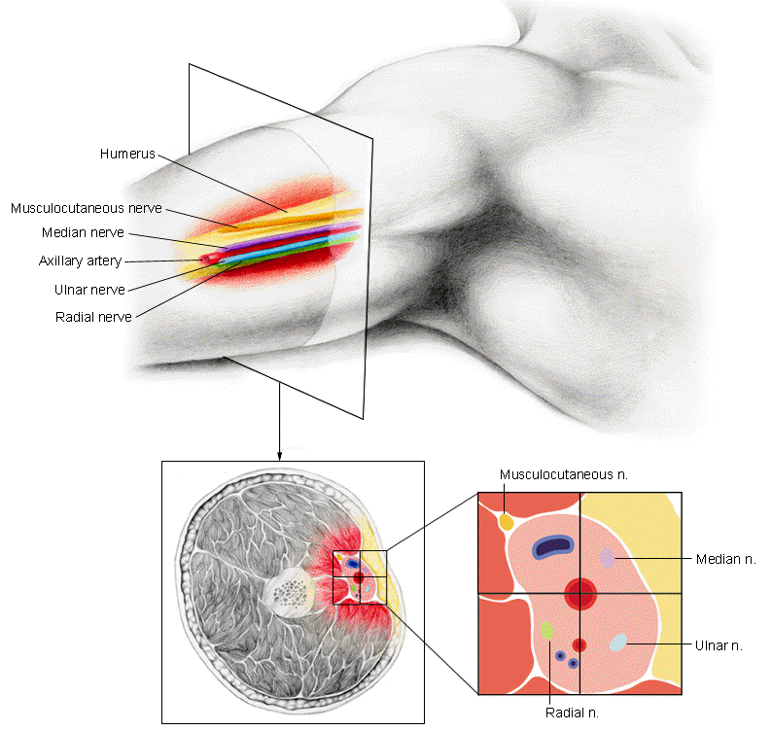
Conduction block

Slide 44
Field block:
Injection of LA subcutaneously → All nerves coming to that particular field is blocked
Aim is to anaesthetize the region distal to the site of injection
Anaesthesia starts 2-3 cm distal to site of injection
Examples – forearm, anterior abdominal wall, scalp and lower extremity

Slide 45
Nerve Block:
LA is injected around the nerve trunks or plexuses
Muscles supplied by injected nerve or plexus are paralysed
Area of anaesthesia is larger than amount of drug used
Lasts longer than the field or infiltration methods
Flooding technique for plexus block
Used for tooth extraction , operations on eye , limbs , abdominal wall , fracture setting , trauma to ribs , neuralgias , persistent hiccup
Motor paralysis provides muscle relaxation during surgery
Eg : lidocaine,bupivacaine,

Slide 46
Examples:
Frequently performed nerve block : Facial , lingual , ulnar , intercostal , sciatic , femoral, brachial plexus.
Trigeminal nerve blocks (face)
Ophthalmic nerve block (eyelids and scalp)
Supraorbital nerve block (forehead)
Maxillary nerve block (upper jaw)
Sphenopalatine nerve block (nose and palate)
Cervical plexus block and cervical paravertebral block (shoulder and upper neck)

Slide 47
SPINAL ANAESTHESIA
Site of injection – Subarachnoid space between L2-3 or L3-4
Site of action – Nerve root in the Cauda Equina
Level of anaesthesia – vol. & speed of injection; specific gravity of drug solution with CSF and posture of patient. Drug solution → hyperbaric(in 10% glucose) or isobaric with CSF
Lower limbs & hind limbs are anaesthetised

Slide 48
Level of sympathetic block is 2 segments higher & level of motor paralysis is 2 segments lower than cutaneous analgesia
Uses – lower limbs, pelvis, lower abdomen, prostatectomy fracture setting and obstetric procedures
Advantages : safe , good analgesic & muscle relaxant without loss of consciousness.less cardiac , pulmonary , renal disease
Drugs - Lidocaine, tetracaine ,bupivacaine

Slide 49
DRUG | CONCENTRATION (%) | VOLUME (ml) | TOTALDOSE (mg) | DURATION OF ACTION (min)
LIDOCAINE | 1.5-5 | 1-2 | 25-100 | 60-90
BUPIVACAINE | 0.5-0.75 | 2-3 | 10-25 | 90-120
TETRACAINE | 0.25-0.5 | 1-3 | 5-15 | 90-180

Slide 50
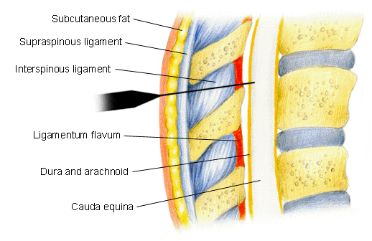
Spinal anesthesia
Here, the local anesthetic is injected into the subarachnoid space of the spinal cord

Slide 51
COMPLICATIONS OF SPINAL ANAESTHESIA
Respiratory paralysis
Hypotension
Spinal headache
Cauda Equina syndrome
Septic meningitis
Nausea & vomiting

Slide 52
C/I SPINAL ANAESTHESIA
Hypotension & Hypovolemia
Uncooperative or mentally ill pts
Infants & Children
Bleeding diathesis
Raised intracranial pressure
Vertebral abnormalities eg: kyphosis , lordosis , etc,.
Sepsis at injection site

Slide 53
EPIDURAL ANESTHESIA
LA is injected into spinal dural space → acts on nerve roots ( epidural as well as subarachnoid space & small amount diffuse to intervertabral foramina to produce multiple paravertabral blocks
3 categories 1)thoracic
2) lumbar
3) Caudal
Lidocaine, bupivacaine, ropivacaine

Slide 54
THORACIC:
Analgesia in middle & lower dermatome.
For pain relief in thoracic / upper abdominal surgery.
LUMBAR:
Lower abdomen , pelvis & hind limbs.
CAUDAL:
Injection given in sacral canal through sciatic hiatus.
Anaesthesia in pelvic &n perineal region .
Used in vaginal delivery , anorectal & genitourinary operations.
Greatest seperation between sensory & motor block → 0.25% of Bupivacaine

Slide 55
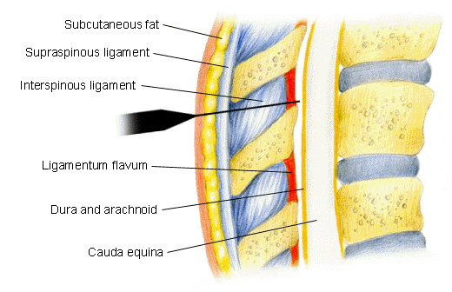
Epidural Anesthesia
This is accomplished by injecting a local anesthetic into the peridural space, a covering of the spinal cord

Slide 56
INTRAVASCULAR INFILTRATION ANAESTHESIA
Regional anaesthesia (Intravenous)
Injection of LA in a vein of a torniquet occluded limb
20-40ml of 0.5% lidocaine → produces anaesthesia within 2-5mns & lasts for 5-10mins after deflating torniquet
Bupivacaine is not used (cardiotoxicity)
Mostly limited to upper limb
Orthopaedic procedures

Slide 57
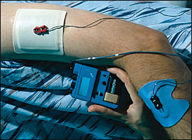
Newer Techniques of LA
Iontophoresis: Lidocaine-soaked sponges

Slide 58
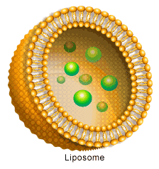
Newer Techniques of LA
Liposomes: Liposomal Bupivacaine Formulation

