Slide 1
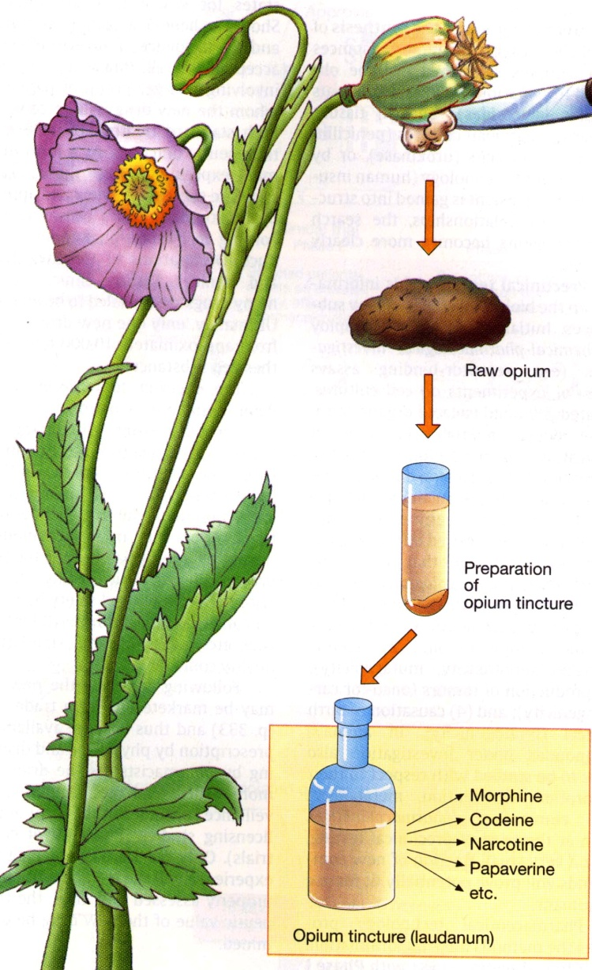
OPIOID ANALGESICS
DR.R.RAMYA
DEPARTMENT OF PHARMACOLOGY

Slide 2
Nociception is a consequence of tissue injury (trauma, inflammation).
It causes the release of chemical mediators (ACh, PGE, NA, 5-HT, glutamate, bradykinin, endogenous opioids, adenosine).
They have neuronal or non-neuronal origin. These mediators activate nociceptors.
Nociceptors are pain-receptors. Nociceptors transmit information by thin myelin (A-delta) and non-myelin (C) fibers to the spinal cord and brain.

Slide 3
MAIN TYPES OF PAIN
Acute pain- (defined as < 3 months duration) fast conducting myelin A-delta fibers.
Treatment - The narcotic and sometimes non-narcotic
Chronic pain (defined as > 3 months duration) is
transmitted principally by slow conducting non-myelinated C fibers.
Analgesics and adjuvant drugs (antidepressants or neuroleptics
Neuropathic pain follows damage of the nervous system.
some antidepressants and carbamazepine
Transient pain is provoked by activation of nociceptors
in the skin and other tissues in the absence of tissue
damage.(no treatment).

Slide 4
Algesia (Pain) is the most common symptom for which patients
see a doctor. Different types of drugs are used for
treatment of pain. In general, they include:
Analgesics- Drugs, relieving pain
Ø opioid/narcotic analgesics
(morphine, fentanyl, etc): act chiefly in the CNS
Ø non opioid/non-narcotic analgesics
(, Aspirin, paracetamol,): act chiefly peripherally

Slide 5
Opioid analgesics

Slide 6
History of Opioids
Opium is extracted from poppy seeds (Paper somniforum)
Used for thousands of years to produce:
Euphoria
Analgesia
Sedation
Relief from diarrhea
Cough suppression
Morphine was isolated from opium in the early 1800’s by from Frederic Sertűrner, and since then has been the most effective treatment for severe pain

Slide 7
Poppy

Slide 8
Terminology
“opium” is a Greek word meaning “juice,” or the exudate from the poppy
“opiate” is a drug extracted from the exudate of the poppy
the opioid category includes not only the opiates but also semi-synthetic non-alkaloids and even endogenous peptides.

Slide 9
Natural opioids occur in 2 places:
1) In the juice of the opium poppy (morphine and codeine)
2) As endogenous endorphins
All other opioids are prepared from either morphine (semisynthetic opioids such as heroin) or they are synthesized from precursor compounds (synthetic opioids such as fentanyl)

Slide 10
Opium contains two groups of alkaloids:
with phenanthrene structure
morphine,
codeine,
thebaine- non analgesics
Morphine and codeine are narcotic analgesics;
with benzoisoquinoline structure (non analgesics).
papaverine - vasodilator;
noscapine -antitussive

Slide 11
Introduction - Opioid receptors
µ - high affinity for morphine.
K - affinity for dynorphin A.
δ high affinity for Leu/Met enkephalins.
Orphan opioid receptor-like (ORL) receptors are structurally similar to the μ opioid receptor but are insensitive to opioid ligands, including naloxone.
Endogenous opioid peptides
Endorphines
Enkephalins
dynorphins

Slide 12
Effects are mediated via opioid receptors
μ (mu): mediate analgesia
at the supraspinal level
δ (delta): analgesia in the periphery
κ (kappa): analgesia at the spinal level
ORL1 (opioid receptor like 1): dependence

Slide 13
Endogenous opioid peptides are:
a) enkephalins activate μ and δ-receptors;
b) endorphins activate μ, κ and δ-receptors;
c) dynorphins activate μ, κ and δ-receptors.
d) nociceptin – ORL1 (tolerance)
Opioid peptides act in CNS as:
- neurotransmitters
- modulators of response (usually inhibitory)

Slide 14
Classification
Natural opium alkaloids
morphine, codeine
Semisynthetic
diacetyl m(heroin), pholcodeine
Synthetic
pethidine (meperidine), fentanyl, methadone, dextropropoxyphene, tramadol

Slide 15
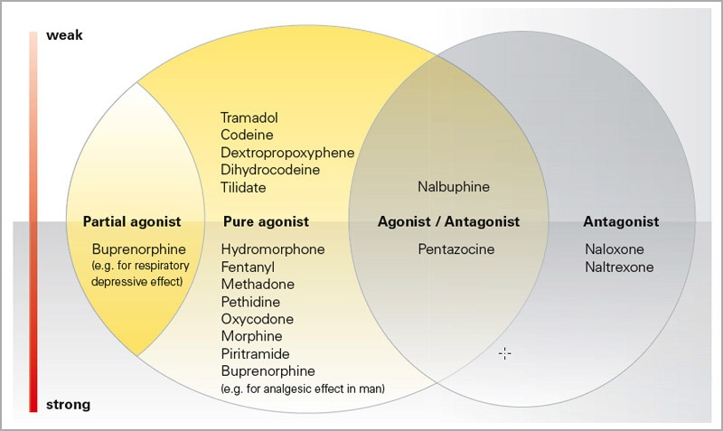

Slide 16
Actions of Morphine
1.CNS
A) Depressant effects 1) analgesia – dull , poorly localized visceral pain ,nococeptive pain Site
spinal- substantia gelatinosa and inhibit excitatory NTs and subs P
supraspinal – medulla, midbrain, limbic s.,cortex
2) sedation
3)mood and subjective effects- calming effect , loss of apprehension, Pleasurable (“high”), rapid iv- “kick”,/ “rush” euphoria
RS dep
Cough centre – most sensitive than RS centre
Temperature regulating centre- hypothermia
Vasomotor centre- fall in BP

Slide 17
B)Stimulant actions
1) CTZ – vomiting.Emetics are contraindicated in poisoinig.
2)Edinger westphal nucleus of 3rd nerve – miosis(pin point pupil).
3)Vagal centre – bradycardia
4)Cortical areas and hippocampal cells – rigidity , immobility – catalepsy, proconvulsant action- (inhibition of GABA)
Kidney- release ADH amd reduce urine volume.

Slide 18
2)CVS
VD due to a) histamine release b) dep. of VMC c) directly decreasing tone of BVs.
Shift of blood from pulmonary to systemic circuit. Postural hypotension –impairment of v,reflexes.
Co2 retention leads to rise in ICT-cerebral VD.
3.GIT –constipation, Spasm of ileocaecal and anal sphinters
4.Others –
1)biliary tract – spasm of sphin.of Oddi. - intrabiliary presure – biliary colic
2) UB – tone of detrusor and sphincter is increased- urgency and difficulty in micturition.
3)bronchi –bronchoconstriction

Slide 19
PKs
High FPM ., oral BA 1/6 to ¼ of the dose.
30% bound to plasma proteins.
crosses the placenta.
M- glucuronide conjug. – morp-6- glucuronide (active metabolite). T1/2- 2to3hrs.
Elimination- complete , noncumulative.
Enterohepatic circulation.

Slide 20
Adverse effects
Adverse effects- sedation, Mental clouding, lethargy , dysphoric in some subjects.
Vomiting-rare
constipation- common.
RS dep, blurring of vision, u.retention (elderly).c) utricaria, itch, swelling of lips-histamine release

Slide 21
Acute morphine poisoning -
50mg –toxic
s/s-extensions of p.actions: stupor, coma, shallow/ occ.breathing, cyanosis, pinpoint pupil, in BP, convulsions, pul.edema.
Rx –ABC (iv fluids, VCs) maintanance, G.lavage with KMnO4, NALOXONE iv 0.4-0.8mg repeated every 2-3mts

Slide 22
Adverse effects
Tolerance and dependance – high , MOA: PK- (enhanced metabolism), mainly PD- (cellular tolerance).
Cross tolerance with opioids &CNS depressants
More psychological & phy.dependence.
Withdrawal – marked drug seeking behaviour. Lacrimation,anxiety, fear, gooseflesh,

Slide 23
Precautions and Contraindications
3B and 5H conditions
Babies ( Infants) and elderly – more RS depressoin
Bronchial Asthma
Emphysema, pul.fibrosis, cor pulmonale,
Biliary colic –( spasm of sphinter of Oddi)
Undiagnosed abdominal pain
Head injury ( CO2, ICT,RS dep, V,miosis interfere with assessment)
Hypotensive states, hypovolaemia( postural hypotention)
Hepatic damage
Hypertrophy of prostate - Elderly male
Hypothyroidism,
Kidney disease
Unstable personalities

Slide 24
Interactions
Phenothiazines, TCAs,MAO inhibitors, amphetamine and neostigmine potentiate morphine and other opioids.
Morphine retards absorption of orally administered drugs by delaying gastric emptying.

Slide 25
Uses of opioids
1)analgesic
MI
Post operative Pain
Cancer pain
Patient controlled anaesthesia
Morphine- In emergency & neurogenic shock
2.Preanaesthetic medication, balanced A, surgical analgesia (fentanyl, morphine or pethidine)
3.Relief of anxiety and apprehension – internal bleeding , MI
4.Acute LVF ( cardic asthma)
a)reducing preload,
b)shift blood from pul. to systemic circuit
c) allays air hunger by dep . RS centre
d)inhibits symp.stimulation
5.Cough- codeine
6.Diarrhoea- diphenoxylate and loperamide

Slide 26
Antagonists δķ
Ago-antagonist – (k analgesics)
Nalorphine, Pentazocine,
Butorphanol
Partial/weak µ agonist – Buprenorphine
Pure antagonists –
Naloxone, Naltrexone
Nalmefene,
Alvimopan, Methylnaltrexone bromide

Slide 27
Ago-antagonist -Pentazocine
Weak µ antoganism and strong ķ agonist action
30mg=10mg of morphine,
High First pass metabolism.
Use:
Post operative and pain due to burns , trauma, fracture, cancer.
SE- Nausea, sedation, dizziness, sweating
Tachycardia, rise in BP due to sympathetic. Stimulation
Respiratory depression (100mg)

Slide 28
Lower doses pleasurable, higher doses become unpleasant and psychotomimetic effects
Lower abuse liability
CI-
MI, coronary ishaemia,
epilepsy, psychosis
Morphine addicts
Use – severe visceral pain

Slide 29
Butorphanol
k analgesic -2mg = 30mg of pentazocine
Less dysphoric and psychotomimetic
Neither substitute for nor antagonize morphine
1-4mg i.m. or i.v. for pop.
Nasal inhalation
Greater analgesia in women than men
CI- cardiac ischaemia
Use:
Post .o and renal colic

Slide 30
Buprenorphine
25 times more potent, slower onset, LA
Less constipation.
More postural hypotension
Ppts withdrawal effects
0.2-0.4 SL route, Transdermal patch
t1/2-40hrs E- bile
0.3 – 0.6mg i.m., s.c.
Use- Biliary colic
Substitute for morphine bcz low degree of dependence

Slide 31
Pure opioid antagonists-Naloxone
High FPM
competitive antagonist of all opioid receptors
No physical/psychological dependence/ withdrawl symptoms.
0.4-0.8 mg i.v. antagonizes all actions of morphine
4-10mg antagonizes actions of pentaz, nalorphin
0.4mg i.v. ppts morphine withdrawal syn. Lasts 2-3hrs
Use
Blocks placebo, acupuncture and stress induced analgesia showing involvement of endogenous opioids peptides.
1)DOC for M.poisoning 0.4-0.8 mg i.v. every 2-3mts,max 10mg
Reverse neonatal asphyxia during labour(due to opioid use).
Opioid overdose.

Slide 32
Naltrexone
Oral, More potent ,
T1/2 – 3hrs, 6-Naltrexal - metobolite
LA – 1 to 2 days 50mg /d
USE –
to prevent opioid addiction
Alcohol craving is reduced.
Side Effects
Nausea , Headache,
hepatotoxicity

Slide 33
Nalmefene
Oral , more Bioavailability
Long acting
No hepatotoxity

Slide 34
Alvimopan, Methylnaltrexone bromide
Do not cross BBB
Methylnaltrexone - Used to relieve severe costipation due to opioids
Alvimopan -- Post operative ileus after bowel resection

Slide 35
Endogenous opiod peptides
Endorphines – beta Endorphine from POMC which also gives gamma - MSH, ACTH lipotropins .
Enkephalins - met-ENK. , leu-ENK
Dynorphins - A&B from prodynorphin. More potent on k receptors

Slide 36
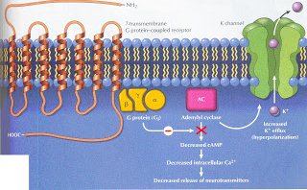

Slide 37
