Slide 1

ANTI EPILEPTICS

Slide 2
Epilepsy
A seizure means a paroxysmal abnormal discharge at high frequency, from an aggregate of neurons in cerebral cortex
Epilepsy is a condition characterized by recurrent episodes of such seizures
Convulsions are involuntary, violent and spasmodic or prolonged contractions of skeletal muscles.

Slide 3
Types
Generalised seizures :
Generalised tonic clonic seizures (grandmal epilepsy) : commonest, last for 1-2 mins
Aura – cry – unconsciousness- tonic spasm of the body muscles – clonic jerking followed by prolonged sleep and depression of all CNS functions
Myoclonic seizures : shock like momentary contractions of muscles of the limb or the whole body

Slide 4
Absence seizures (petit mal) : seen in children last about ½ mins
momentary loss of consciousness, patient apparently freezes and stares in one direction no muscle component or little b/L jerking
EEG : characteristic 3 cycles per sec spike and wave pattern
Atonic seizures ( akinetic seizures) : unconsciousness with relaxation of all muscle due to excessive inhibitory discharge
patient may fall

Slide 5
Infantile spasm (hypsarrhythmia) : seen in infants. Probably not a form of epilepsy.
intermittent muscle spasm and progressive mental deterioration
diffuse changes in interseizure EEG are noted
Partial seizures :
Simple partial seizures (cortical focal epilepsy): lasts for ½ - 1 min. often secondary
convulsions are confined to a group of muscle or localized sensory disturbances depending upon the area of cortex involved in the seizures
no loss of consciousness

Slide 6
Complex partial seizures ( temporal lobe epilepsy) :
Attacks of bizzare and confused behaviour and purposeless movements, emotional changes lasting 1-2 mins along with impairment of consciousness. Aura often precedes.
Simple partial or complex partial secondarily generalised :
partial seizure occurs first and evolves into GTCS with loss of consciousness

Slide 7
Causes of Seizures or Epilepsy
Genetic or hereditary (Primary)
Brain lesions mainly due to birth trauma
Infections like cerebral meningitis and abscess
Metabolic disorders : lack of oxygen, alkalosis, hypoglycaemia, hypocalcaemia, hyperpyrexia and vitamin B6 deficiency
Sudden drug withdrawal after abuse
Flashes of light and loud noises

Slide 8
Classification
Barbiturates : Phenobarbitone
Deoxybarbiturate : Primidone
Hydantoin : Phenytoin
Fosphenytoin
Iminostilbene : Carbamazepine
Oxcarbazepine
Succinimide : Ethosuximide
Aliphatic carboxylic acid : Valproic acid
divalproex

Slide 9
Benzodiazepines : Clonazepam Diazepam
Lorazepam Clobazam
Phenyltriazine : Lamotrigine
Cyclic GABA analogues : Gabapentin
Pergabalin
Newer drugs : Topiramate zonisamide
Levetiracetam Vigabatrin
Tiagabine Lacosamide

Slide 10
Mechanism of Action of Antiepileptics
Inhibition of use dependent Na channels:
Phenytoin Carbamazepine Valproate Topiramate Lamotrigine
Enhancement of GABAnergic action :
BZD – facilitates GABA
Phenobarbitone – facilitates as well as mimics GABA
Valproate – (+) GAD, (-) GABA-T

Slide 11
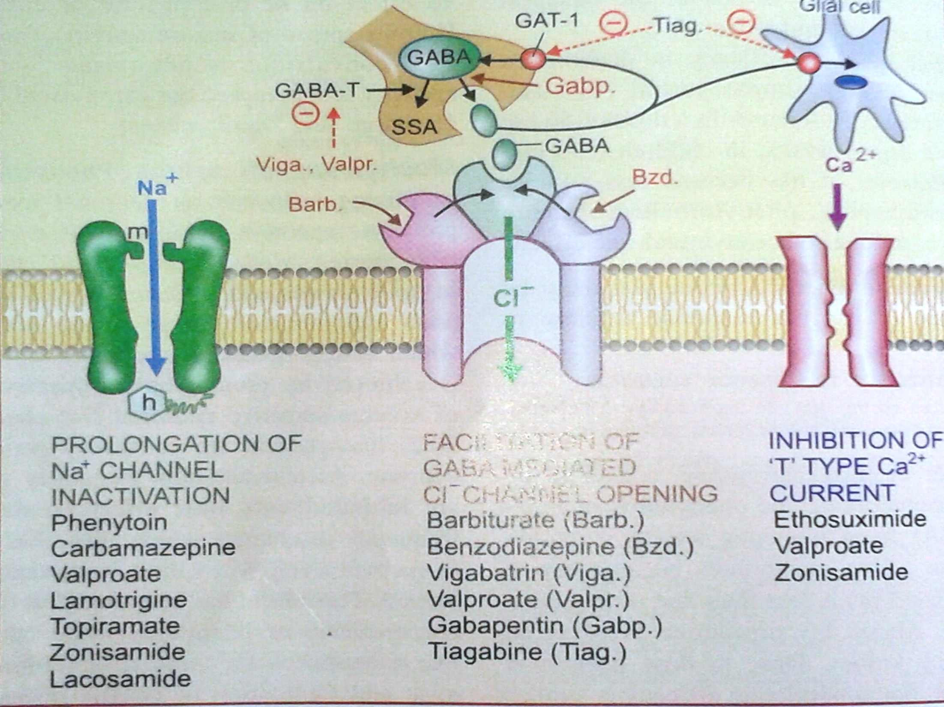

Slide 12
Vigabatrin - (-) GABA-T
Gabapentin – promotes GABA release
Tiagabine – blocks uptake of GABA into neurons
Blockade of NMDA and AMPA receptors:
Felbamate – blocks NMDA receptors
Phenobarbitone
Topiramate blocks AMPA receptors
Lamotrigine
Valproate – inhibits glutamate synthesis

Slide 13
Blockade of voltage gated N-type of Ca channels :
Lamotrigine Gabapentin
Selective binding to synaptic vesicular protein:
Levetiracetam
By blocking the effect of neurotrophic factors:
Lacosamide
Inhibition of T-type ca channels :
Ethoxusimide

Slide 14
Phenytoin - diphenylhydantoin
Oldest non sedative antiepileptic drug
MOA :
At therapeutic plasma level (10-20mcg/ml) : blocks use dependent Na channels
At higher dose : also reduces the influx of calcium and supress repetitive firing of neurons

Slide 15
Both these actions decreases the Glutamate release.
PK : oral absorption is slow but complete
not given i.m or i.v
90- 92 % PPB . T ½ - 12 - 24 hrs
potent enzyme inducer – CYP3A4 and glucuronyl transferase enzymes
metabolites excreted in urine
Excretion is dose dependent and flows mixed order kinetics

Slide 16
Adverse Effects
At therapeutic level : gingival hyperplasia and coarsening of facial features
- megaloblastic anaemia
- vitamin k and vitamin D deficiency
- hirsutism
- hyperglycaemia
- decrease ADH release
- hypersensitivity reactions
- withdrawal seizures
Foetal Hydantoin Syndrome : cleft lip, cleft palate and congenital heart disease

Slide 17
Overdose toxicity
CNS : cerebellar and vestibular manifestations – ataxia, vertigo, diplopia, nystagmus.
Drowsiness, behavioural alterations, mental confusion, disorientation and rigidity
GIT : epigastric pain, Nausea, vomiting.
CVS : fall in BP, arrhythmias on i.v inj - continuous ECG monitoring required
I.V inj – local vascular injury – intimal damage and thrombosis of vein – edema and discolouration of the injected limb . Rate of injection should not exceed 50 mg/min

Slide 18
Interactions
Increases the metabolism of corticosteroids, OCPs, doxycycline, rifampicin, theophylline, levodopa, vit D and vit K
Enzyme inhibitors like disulfiram, cimetidine, warfarin, INH, chloramphenicol decreases the metabolism of phenytoin
Carbamazepine and phenytoin or phenobarbitone and phenytoin increases the metabolism of each other
Sodium valproate displaces the protein bound phenytoin and inhibits its metabolism also

Slide 19
Uses
First line anti epileptic drug
complex partial seizure- 1st DOC
Generalised tonic clonic and status epilepticus – 2nd DOC
Trigeminal neuralgia – 2nd DOC
Ventricular arrhythmias due to digitalis toxicity
Enhances wound healing

Slide 20
Fosphenytoin
Water soluble prodrug of phenytoin
Can be given i.v
Rapidly converted to phenytoin
Less damage to intima
Can be injected at faster rate of 150 mg/min without continuous ECG monitoring
Can be injected both with saline and glucose

Slide 21
Phenobarbitone
First efficacious anti epileptic introduced in 1912
MOA : at therapeutic level:
- enhances the GABA mediated inhibitory effect by increasing duration of cl channel opening
- inhibits glutamate mediated excitatory effects by blocking the AMPA receptors
At higher dose : blocks L-type of calcium channels and use dependent NA channels

Slide 22
Has wide spectrum anticonvulsant property
Rises the seizure threshold and limits the spread and suppress seizures
PK : slow complete oral absorption
metabolised in liver as well as excreted in kidney unchanged
potent enzyme inducer
t ½ - 80-120hrs
steady state conc achieved after 2-3 weeks of therapy and maintained with single daily dose

Slide 23
Adverse Effects : sedation
Behavioural abnormalities, diminution of intelligence, impairment of learning and memory, hyperactivity in children
Mental confusion in adults
Rashes, megaloblastic anaemia, osteomalacia
USES : cheapest and least toxic antiepileptic
Broad spectrum : GCTS, SPS, CPS
60 mg 1-3 times a day in adults
children 3-5 mg/kg
Status Epilepticus : i.m or i.v but slow response

Slide 24
Primidone
Deoxyphenobarbitone
Metabolised to phenobarbitol and phenyethyl malonamide
T ½ - 6-14 hrs
1/3rd of drug is excreted unchanged by kidney
A/E : similar to phenobarbitone
anaemia, leukopenia, psychotic reaction and lymph node enlargement

Slide 25
Carbamazepine
Chemically related to Imipramine
Introduced in 1960 for Trigeminal neuralgia
Now first line anti epileptic drug
MOA : blocks the use dependent Na channels and inhibits the repetitive firing of the neurons in the brain
- lithium like therapeutic effect in mania
- antidiuretic action

Slide 26
PK : oral absorption slow and variable
75% PPB
metabolised in liver : oxidation – active metabolite – 10-11 epoxy carbamazepine; hydroxylation – inactive metabolite
enzyme inducers – CYP3A4 and CYP2C9
t ½ - 20 -40hrs initially then decreases to 10-20hrs on chronic medication due to autoinduction of metabolism

Slide 27
Adverse effects :
dose related neurotoxicity – sedation, dizziness, vertigo, diplopia, ataxia
Higher dose : vomiting, diarrhoea, worsening of seizures
Acute intoxication: coma, convulsions, cardiovascular collapse
Hypersensitivity reactions – rashes, photosensitivity, lupus like syndrome.
Rarely Agranulocytosis and Aplastic anaemia

Slide 28
water retention and hyponatremia in elderly patients
minor foetal malformations. Doubles when combined with valproate
Interactions :
- Enzyme inducer – reduces the efficacy of haloperidol, OCPs, Lamotrigen, Valproate and Topiramate
- Metabolism of carbamazepine
induced by phenobarbitone and phenytoin
inhibited by Erythromycin, fluoxetine, INH

Slide 29
USE : 1st DOC : partial seizures and GCTS
C/I in Absence seizure
1st DOC : Trigeminal neuralgia and other neuropathic pain
manic depressive psychosis
Oxcarbazepine : converted to active metabolite by glucuronide conjugation
1 ½ times less potent
lesser adverse effects, better tolerated
more hyponatremia

Slide 30
Ethosuximide
Pure petit mal drug
MOA : inhibits low threshold T-type of calcium channels
PK : complete absorption on oral ingestion
not protein bound
metabolised in liver and excreted in urine
t ½ - 48hrs (adults) 32hrs (children)
evenly distributed in the body
salivary titres reflects plasma conc accurately

Slide 31
A/E : GIT distress, headache, dizziness, hiccups, lethargy and euphoria, inability to concentrate.
hypersensitivity reactions like rashes, DLE and blood dyscrasias, bone marrow depression
lesser teratogenic - preferred in pregnancy
D/I : valproic acid inhibits metabolism
Uses : Absence seizures
dose : 20-30 mg/kg/day

Slide 32
Valproic acid
Broad spectrum antiepileptic action
MOA :
(i) blocks use dependent Na channel
(ii) increase GABA activity by activating glutamic acid decarboxylase and by inhibiting GABA transaminase
(iii) decreasing excitatory NT glutamate release in brain
(iv) blocks T-type Ca channels

Slide 33
PK : oral absorption is 80%
food delays absorption but toxicity is reduced when given after food
90-95% PPB
potent enzyme inhibitor
metabolised in liver and excreted in urine
t ½ - 10- 15hrs but anticonvulsant effect lasts longer
A/E : anorexia, vomiting, diarrhoea, heart burn – mild and common S/E
Alopecia, curling of hair, weight gain, and increase bleeding tendency

Slide 34
Hypersensitivity reaction - rashes and thrombocytopenia – rare
Asymptomatic rise in serum transaminase is noted hence LFT monitoring is advised
Spina bifida and Neural tube defects
D/I : potentiates the CNS depressant effect of Phenobarbitone and BZD
increases plasma concentration of Phenobarbital and Lamotrigine
decreases the metabolism as well as displaces phenytoin from PPB sites

Slide 35
concurrent administration of clonazepam and valproate is C/I - precipitate absence status
foetal abnormalities common when valproate and carbamazepine is given together
Uses : DOC for absence seizure
Alternate/adjuvant : GCTS, SPS, CPS
Myoclonic and atonic seizures – control incomplete. But its DOC
Manic and bipolar illness
Panic attack
Migraine prophylaxis

Slide 36
Divalproex
Semisodium valproate
Coordination compound of valproic acid with sodium valproate (1:1)
Slow oral absorption
Better gastric tolerance

Slide 37
BENZODIAZEPINES
CLONAZEPAM :
Prominent anticonvulsant property
Blocks PTZ seizures
Acts by enhancing frequency of GABA induced cl- channel opening
Pk : good oral absorption , 80% plasma protein bound , completly metabolised in liver & excreted in urine
T1/2 → 24hrs

Slide 38
USES :
Absence seizures
As adjuvant in myoclonic & akinetic seizures
Infantile spasms
Acute mania
ADR:
Sedation & dullness
Tolerance with chronic therapy
Lack of concentration , irritability , temper & other behavioural abnormalities
Motor disturbances & ataxia
Salivation & increased respiratory secretions

Slide 39
CLOBAZAM :
1,5 benzodiazepine
Pk : oral bioavailability → 90% , T1/2 → 18hrs
active metabolite is produced
Uses :
As adjuant to other antiepileptics drugs such as Phenytoin , Carbamazepine , Sodium Valproate , in refractory Epilepsy
Useful in partial , secondarily generalised tonic-clonic , absence , & atonic seizures
Refractory seizures

Slide 40
DIAZEPAM:
First line drug for emergency control of convulsions eg : status epilepticus , Tetanus , Eclampsia , Convulsant drug poisoning
0.2 – 0.5 mg/kg I.V followed by repeated doses if required
Maximum 100mg/day
Rectal instillation → Febrile convulsions in children
ADR : Thrombophlebitis , marked fall in BP , respiratory depression ,

Slide 41
LORAZEPAM :
Better than Diazepam in Status Epilepticus or for Emergency control of convulsions
0.1 mg/kg is given i.v at rate not exceeding 2mg / min
Lesser side effects

Slide 42
PHENYLTRIAZINE
LAMOTRIGINE :
Broad spectrum Anti epileptic
Carbamazepine like action profile
Prolongation of Na⁺ cannel inactivation & suppression of high frequency firing
Directly blocks voltage sensitive Na⁺ channels → stabilizes presynaptic membrane & preventing release of excitatory neurotransmitters, mainly Glutamate & Aspartate
S/E → sleepiness, Dizziness , diplopia,ataxia,& vomiting. Rash may be severe condition in children requiring withdrawal

Slide 43
Pk : well absorbed orally , metabolised completly in liver . T1/2 → 24hrs but reduced to 16hrs in pts receiving Phenytoin , Cabamazepine , Phenobarbitone
Valproate inhibits glucuronidation of Lamotrigine
USES :
As an add on therapy in refractory cases of partial & GTCS
Absence , akinetic or myoclonic Epilepsy

Slide 44
CYCLIC GABA ANALOUGUES
GABAPENTIN :
Lipophilic GABA derivative crosses to the Brain & enhances GABA release but does not act as agonist at GABA_{A} receptor
Modifies maximal electro shock as well as inhibits PTZ seizures
Modulates a subset of neuronal voltage sensitive Ca²⁺ channel which contain α2δ-1 subunits → entry of Ca²⁺
Pk : well absorbed orally , excreted unchanged in urine, T1/2 → 6hrs

Slide 45
S/E → mild sedation , dizziness, & unsteadiness
Dose : 100,300,400mg cap
USES :
Gabapentin reduces seizure frequency in refractory partial seizures with or without generalisation
SPS & CPS
Neuralgic pain due to diabetic neuropathy & postherapetic neuralgia
Some prophylactic effect in migraine
Alternative for phobic states

Slide 46
PREGABALIN :
New congener of gabapentin
USES :
Neuropathic pain such as diabetic neuropathy , postherapetic neuralgia , complex regional pain syndrome & chronic pain
S/E → poor concentrtion rashes & allergic reactions
Dose : 75 – 150 mg BD

Slide 47
FELBAMATE
MOA :
Blocks NMDA receptors by antagonism at glycine site
Useful in Refractory cases
Broad therapeutic profile
Indications : Partial seizures , Atypical absence seizures , GTCS
T ½ is 20 hrs
Dose : 2000 – 4000 mg/day
CAUSES: severe hypersensitivity reactions aplastic anemia, hepatotoxicity ↑
↑↑ plasma phenytoin & valproic acid
↓↓ carbamazepine levels

Slide 48
TOPIRAMATE :
Weak carbonic anhydrase inhibitor
Broad spectrum anticonvulsant
MOA :
Prolongation of Na+ channel inactivation
GABA potentiation by a postsynaptic effect
Antagonism of glutamate receptors
neuronal hyperpolarization through certain k+ channel
USES :
Refractory SPS ,CPS , GTCS
Myoclonic seizures
Prophylaxis for migraine

Slide 49
ZONISAMIDE :
Newer anticonvulsant with weak carbonic anhydrase inhibitor
Prolongation of inactivation of Na⁺ channel inactivation resulting in suppression of repetitive neuronal firing
Suppress T-type of Ca²⁺ currents in certain neurones
Pk : well absorbed orally , excreted unchanged in urine , T1/1 → 60 hrs
S/E → somnolence , dizziness , headache , irritability , anorexia , metabolic acidosis & renal stones
C/I → in pts sensitive to sulfonamides

Slide 50
LEVITIRACETAM
MOA unknown
May modify synaptic release of glutamate / GABA by binding to a specific synaptic protein labelled ‘SV₂ A’
S/E → sleepiness , dizziness, weakness , & rarely behavioural changes , driving may be impaired
USES : CPS, GTCS , & Myoclonic epilepsy
C/I → children below 4 yrs

Slide 51
TIAGABINE :
Potentiates GABA mediated neuronal inhibition by depressing GABA transporter GAT-1 which removes synaptically released GABA into neurones & glial cells
Maximal electro shock & kindled seizures are suppressed
S/E → mild sedation , nervousness , asthenia , amnesia , & abdominal pain
USES → as an add – on therapy for partial seizures with or without secondary generalisation when not adequately controlled by standard antiepileptics drugs

Slide 52
VIGABATRIN ( γ vinyl GABA ) :
Inhibitor of GABA - Transaminases , the enzyme which degrades GABA
Anti convulsant action → Increase in synaptic GABA concentration.
S/E → visual field contraction & production of behavioural changes , depression or psychosis
USES : Refractory epilepsy especially CPS with or without generalisation

Slide 53
LACOSAMIDE :
It acts by enhancing Na+ channel inactivation & suppressing repetitive firing neurones
Metabolised by CYP2C19 & excreted in urine
ADR: Ataxia , Vertigo ,Diplopia,Tremor ,Depression , & Cardiac arrythmias
Dose : 50 mg BD increases upto 200mg BD

Slide 54
TREATMENT
Choice & Dose of drug
Initial treatment :
A single Tonic – Clonic seizure may not merit initiation of anti-epileptic therapy
A seizure diary should be maintained
Drug withdrawal
Pregnancy
Dose regulation

Slide 55
EFFECTIVE PLASMA LEVELS
DRUG | Effective Level(ug/ml) | TOXIC LEVEL (ug/mL)
Carbamzepine | 5 - 10 | >12
Phenytoin | 10 – 20 | >20mild >35 severe
Phenobarbital | 10 – 30 | >30 mild >60 severe
Ethosuximide | 50 -100 | > 100
Valproic Acid | 40 - 100 | > 100

Slide 56
 | TYPE OF SEIZURES | FIRST CHOICE DRUGS | SECOND CHOICE DRUGS | ALTERNATIVE/ADD –ON DRUGS
1 | GTCS SIMPLE PARTIAL WITH OR WITHOUT GENERALISATION | Carbamazepine Phenytoin | Valproate Phenobarbitone | Lamotrigine Gabapentin , Topiramate , Primidone , Levitiracetam
2 | COMPLEX PARTIAL WITH OR WITHOUT GENARALISATION | Carbamazepine Valproate Phenytoin | Gabapentin Lamotrigine levitiracetam | Clobazam Zonisamide Topiramate
3 | ABSENCE | Valproate Ethosuximide | Ethosuximate lamotrigine | Clobazam Clonazepam
4 | MYOCLONIC | Valproate | Lamotrigine Topiramate | Levitiracetam Clonazepam
5 | ATONIC | Valproate | Clonazepam Clobazam | Lamotrigine
6 | FEBRILE SEIZURES | Rectal Diazepam | - | -
7 | STATUS EPILEPTICUS | Lorazepam diazepam | Fosphenytoin Phenobarbitone | General anaesthetics

Slide 57

THANK YOU

