Slide 1

ANTIPARKINSONIAN DRUGS

Slide 2
Parkinsonism
Extrapyramidal motor disorder characterized by rigidity, tremor and hypokinesia with secondary manifestations like defective posture and gait, mask like face and sialorrhoea; dementia may accompany.
If untreated symptom may progress over several years to end stage disease in which patient may become rigid, unable to move, unable to breathe properly

Slide 3
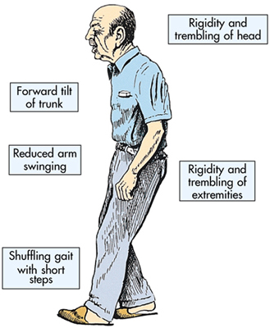

Slide 4
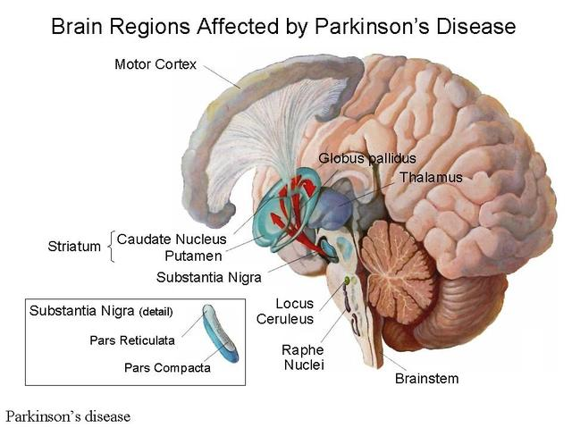

Slide 5
Parkinsonism
Progressive degenerative disorder
Mostly affecting older people
First described by James Parkinson in 1817
Primary or idiopathic parkinsonism : cause unknown. Multifactorial
Eg : genetic predisposition and aging of brain due to free radical damage to dopaminergic neuron in basal ganglia

Slide 6
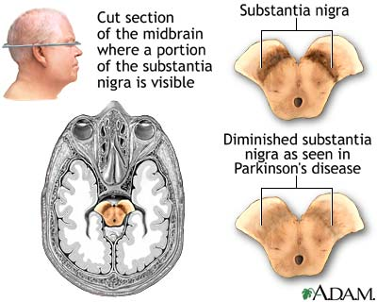

Slide 7
Secondary parkinsonism
Drugs
Toxins : MPTP, manganese, CO, methanol
Metabolic disorder : hypoparathyroidism, hypothyroidism, acquired hepatocerebral degeneration
Vascular
Post encephalitic parkinsonism and infectious diseases
Normotensive hydrocephalus
Post traumatic encephalopathy
Space occupying lesios
Paraneoplastic

Slide 8
Drug induced parkinsonism
Neuroleptics : Haloperidol, Risperidone, Chlorpromazine, Thioridazine, Olanzepine
Antiemetic : Prochlorperazine
GI motility drug : Metachlopramide
Reserpine
Tetrabenazine
Cinnarizine
Flunarizine

Slide 9
Lesion : degeneration of neurones in substantia nigra pars compacta (SN-PC) and nigrastriatal (dopaminergic) tract
DA in striatum – controls muscle tone and coordinates movements
An imbalance between DA (inhibitory) and cholinergic (excitatory) system in striatum occurs giving rise to motor defects

Slide 10
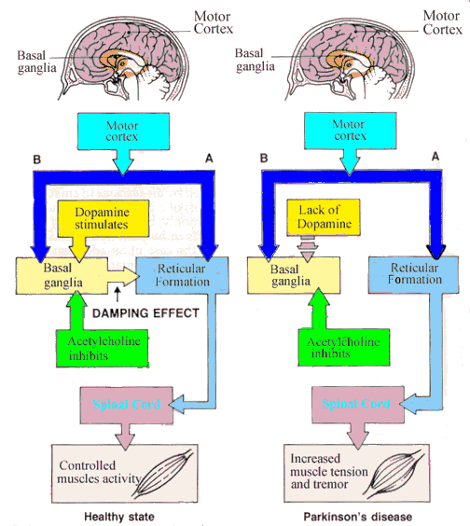

Slide 11
Dopamine receptors
D1, D2, D3, D4 and D5
All are G protein coupled receptors
D1 and D5 – excitatory – acts by increasing cAMP formation and PIP2 hydrolysis
mobilising intracellular CA2+
activate protein kinase C

Slide 12
Dopamine Receptors
D3, D4, D5 – inhibitory – acts by inhibiting adenylyl cyclase/ opening K+ channels/ depressing voltage sensitive Ca2+ channels
D1 and D2 - Striatum – involved in therapeutic response to levodopa
Stimulation of excitatory D1 and inhibitory D2 produce net effect of smoothening the movements and reducing muscle tone

Slide 13
Dopamine receptors
D2 – SN-PC and in pituitary
D3 – predominates in nucleus accumbans and hypothalamus
D4 and D5 – Neocortex, midbrain, medulla and hippocampus.

Slide 14
classification
Drugs affecting brain dopaminergic system
(a) Dopamine precursor : Levodopa
(b) Peripheral decarboxylase inhibitors : Carbidopa , Benserazide
(c) Dopaminergic Agonists : Bromocriptine,
Ropinirole, Pramipexole
(d) MAO-B inhibitor : Selegiline
Rasagiline

Slide 15
classification
(e) COMT inhibitors : Entacapone, Tolcapone
(f) Glutamate ( NMDA receptor ) antagonist (dopamine facilitator ) : Amantadine
Drugs affecting brain cholinergic system :
(a) Central anticholinergics :
Trihexyphenidyl (Benzhexol) Procyclidine Biperiden
(b) Antihistaminics : Orphenadrine
Promethazine

Slide 16
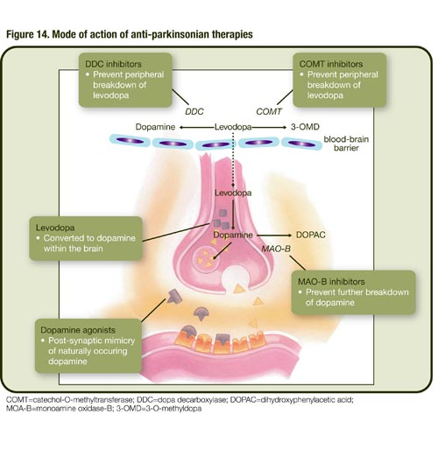

Slide 17
Levodopa
Immediate precursor transmitter Dopamine
More than 95% of oral dose is decarboxylated in the peripheral tissues mainly gut and liver
Acts on heart, blood vessels, CTZ and other peripheral organs
1-2% of levodopa enter the brain and then converted to DA which is stored and released as transmitters
DA cannot cross BBB but L-dopa can cross BBB

Slide 18
CNS Action
Marked symptomatic improvement occurs
Hypokinesia and rigidity are the first to resolve later tremors resolve
Secondary symptoms like posture, gait, handwriting, speech, facial expression, mood and interest in life normalises gradually
Therapeutic benefit declines as disease advances
Effect on behaviour – ‘general alerting response’ progresses to excitement – frank psychosis
Disproportionate increase in sexual activity
Dementia progresses to psychiatric symptoms

Slide 19
CVS
Peripherally formed DA causes tachycardia – β adrenergic receptors
Postural hypotension common – central action – decrease sympathetic outflow from brain
Gradual tolerance occurs to both cardiac stimulant and hypotensive actions

Slide 20
Endocrine
CTZ
Nausea and vomiting
Tolerance develops gradually to this action
Acts on pituitary mammotropes – inhibits prolactin release and somatotrpes – increase GH release
During levodopa therapy the prolactin levels fall but there is no increase in GH levels

Slide 21
Pharmacokinetics
Rapidly absorbed from small intestine by active transport process meant for aromatic aminoacids
Undergoes high first pass metabolism in G.I.T mucosa and liver
About 1% of administered L-dopa enter brain
T ½ - 1-2 hrs
Metabolite excreted in urine after conjugation

Slide 22
Adverse effects
Frequent and often troublesome
Dose related , usually reversible
Some are prominent in the beginning of the therapy while others appear later
At initiation of therapy – s/e can be minimized by starting with low dose
- Nausea and Vomiting
- Postural hypotension
- cardiac arrhythmias

Slide 23
Adverse effects
- Exacerbation of angina
- Alteration in taste sensation
After prolonged therapy :
(i) abnormal movements(dyskinesia) – facial tics, grimacing, tongue thrusting, choreoathetoid movements of limbs
worsens with time and all patient develop after few years of therapy
dose limiting side effects – dose reduction decreases the severity
no tolerance develops

Slide 24
(ii) Behavioural effects :
range from mild anxiety, nightmares, etc to severe depression, mania, hallucination, mental confusion or frank psychosis
due excessive DA in limbic system
contraindicated in patient with psychotic illness
(iii) Fluctuation in motor performance :
seen after 2-5 yrs of therapy
‘end of dose ‘ deterioration ( wearing off) which is initially gradual, develops into rapid ‘switches’ or ‘on –off’ effect

Slide 25
Abnormal movements can jeopardise the ‘on’ phase
Probably the reflection of progression of the disease – progressive degeneration of neurons
ability to regulate storage and release of DA is lost
DA synthesised in moment to moment basis
rapid and unpredictable fluctuation in motor control

Slide 26
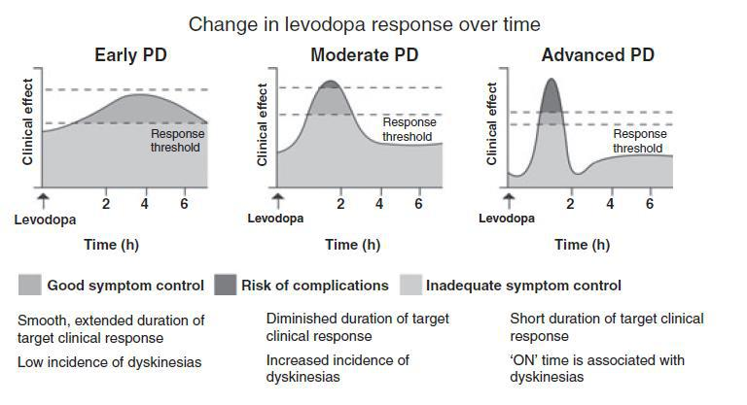

Slide 27
Dose fractionation and more frequent administration tends to diminish these fluctuation for a time
Cautious use needed in elderly , patients with IHD, CVD, psychiatric diseases, renal and hepatic diseases, peptic ulcer, glaucoma and gout.
May cause mydriasis
Abnormalities in smell and taste, hot flushes
Mild but transient increase in blood urea, serum transaminases, alkaline phosphatase and bilirubin

Slide 28
Interactions
Pyridoxine : abolishes the therapeutic effect
Phenothiazines, Butyrophenones, Metoclopramide reverses the therapeutic effect of L-dopa by blocking the DA receptors
Domperidone – blocks the DA effect on CTZ prevents CTZ induced vomiting and nausea
Reserpine abolishes the L-dopa action by preventing the entry of DA into synaptic vesicles

Slide 29
Interactions
Non selective MAO inhibitors : prevents degeneration of DA and NA . Hypertensive crisis
Antihypertensive drugs – postural hypotension caused by L-dopa is accentuated
Atropine and Anti parkinsonian anticholinergic drug - additive therapeutic action with low dose of L-dopa but retards it absorption – more time available for peripheral degradation – reduced efficacy

Slide 30
Contraindication
Psychosis
Narrow angle glaucoma
Cardiac arrhythmias
Melanoma

Slide 31
PERIPHERAL DECARBOXYALASE INHIBITOR
Carbidopa and Benserazide
Extracerebral dopadecarboxylase inhibitor
Do not penetrate BBB & do not inhibit levodopa into dopamine in brain
Administered along with Levodopa they increase its T1/2 in periphery & make it more of it available to cross blood brain barrier & reach its site of action.

Slide 32
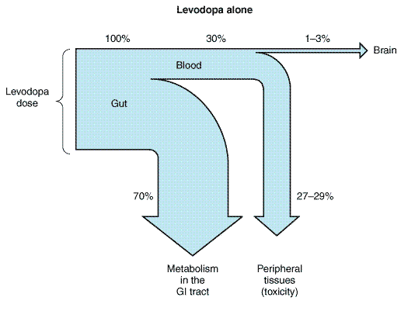
Levodopa – carbidopa

Slide 33
Benefits of the combination:
Plasma T1/2 of Levodopa is prolonged & its dose is reduced to approximately 1/4th
Systemic concentration of Dopamine is reduced→therapeutic conc. of levodopa can be attained quickly
Cardiac complications minimised
Pyridoxine reversal of dopa effect does not occur
On & Off effect is minimised since cerebral Dopamine levels are more sustained
Degree o f improvement may be higher

Slide 34
Problems not resolved or accentuated are
Involuntary movements
Behavioural abnormalities
Excessive day time sleepiness
Postural hypotension
Co – careldopa
Dose :
0.4-0.8 g of levodopa along with 75-100mg carbidopa or 100-200mg benserazide in 3-4 divided doses

Slide 35
DOPAMINERGIC AGONISTS
BROMOCRIPTINE :
Potent D2 agonist & D1 partial agonist & antagonist
Improvement in 1-2hr & lasts for 6-10hrs
High doses : vomiting , hallucination , hypotension , nasal stiffness , conjuctival injection
Fall in BP with first dose in pts on antihypertensives
Use : as a supplement to Levodopa to improve control & smoothen on & off fluctuation
Dose : 1.25mg once at night upto 5mg TDS

Slide 36
ROPINIROLE & PRAMIPEXOLE:
Selective D2D3 agonist with negligible affinity for D3 receptors
Better tolerated with few G.I symptoms than Bromocriptine
Slower rate of neuronal degeneration.
Pk :Rapid oral absorption , 40% plasma bound , extensively metabolised , mainly by hepatic CYP1A2, to inactive metabolites , T1/2 → 6hrs
S/E → nausea , dizziness, hallucinations , & postural hypotension . Episodes Day time sleep
USE : Restless leg syndrome , management of motor fluctuation & reducing frequency of On & Off effect
Dose : Ropinirole : 0.25mg TDS – 1-2mg TDS
Pramipexole : 0.125mgTDS – 0.5-1.5mg TDS

Slide 37
MAO – B INHIBITOR
Selegiline :
Selective & irreversible MAO – B inhibitor
At low doses does not interfere with peripheral metabolism of dietary amines
Accumulation of CAs hypertensive reaction does not develop
Intracerebral degradation of DA is retarded
High dose → Hypertensive interaction with levodopa & indirectly acting sympathomimetic amines

Slide 38
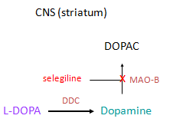
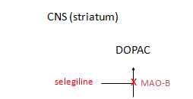

Slide 39
With levodopa , it prolongs levodopa action , attenuates motor fluctuation & decreases wearing off effect
Permits 20-30% reduction in levodopa dose
In advanced cases with on-off effect are not improved & the peak dose levodopa side effects may be worsened
Adverse effect :
- Postural Hypotension , nausea , confusion , accentuation of levodopa induced involuntary movements, & psychosis.
- Selegiline is partly metabolised by liver into amphetamine → insomnia & agitation

Slide 40
C/I :
Convulsive disorders
D/I :
With Pethidine : favours its metabolism to norpethidine → Excitation , Rigidity , Hyperthermia , Respratory depression
RASAGILINE :
5 times More potent, long acting
given once a day in the morning
does not produce excitatory side effects
DOSE: 1 mg od in the morning

Slide 41
COMT INHIBITORS
Potent , selective & reversible COMT inhibitors
COMT has role degradation of DA in brain as well as, it preserve DA formed in striatum & supplement of the peripheral effect
Used to smoothen wearing off , increase ‘on’ time , improve activities of daily living and allow levodopa dose to be reduced
Worsening of levodopa adverse effects occurs when COMT inhibitors are added
Use :
Enhance & prolong the therapeutic effect of levodopa- carbidopa in advanced & fluctuating PD
Dose : Entacapone : 200mg max 1600mg /day
Tolcapone : 100 – 200 mg BD or TDS

Slide 42
COMT inhibitors
Periphery
CNS (striatum)
3-O-Methyldopa
DOPAC
tolcapone
x
selegiline
x
COMT
MAO-B
-
DDC
L-DOPA
L-DOPA
Dopamine
carbidopa
x
tolcapone
x
DDC
COMT
Dopamine
3-Methoxy tyramine

Slide 43
GLUTAMATE ANTAGONIST
AMANTADINE:
Presynaptic synthesis & release of dopamine in the brain & has Anticholinergic property
Antagonist action on NMDA glutamate receptors, through which striatal dopaminergic system exerts its influence
Serves to suppress motor fluctuations & abnormal movements
S/E : insomnia , restless , confusion, nightmares , anticholinergic effect & rarely hallucination
Charecteristic side effect is local release of CAs→ post capillary vasoconstriction is livedo reticularis & edema of ankles
Use :To supplement levodopa in advanced cases
Dose 100mg BD

Slide 44
CENTRAL ANTICHOLINERGICS
High central : peripheral anticholinergic action ratio than atropine
Reduce unbalanced cholinergic activity in the striatum of parkinsonian pts
10-25% reduction in parkinsonian symptoms lasting for 4-8hrs after a single dose
Tremor is benefitted than rigidity
Hypokinesia is affected least
Only effective drug in drug induced parkinsonism
Better tolerated & their sedative action helps
S/E → impairment of memory , organic confusional states, & blurred vision , common in elderly. Urinary retension in elderly males

Slide 45
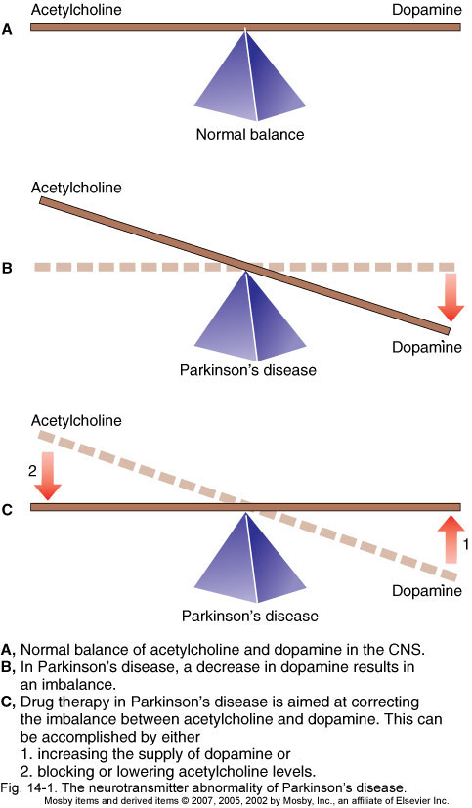

Slide 46
TRIHEXYPHENIDYL :
Commonly used drug
Low dose in 2-3 divided portions per day & gradually increase till side effects are tolerated
Dose : 2-10mg/day
Procyclidine : 5-20mg/day
Biperidine : 2-10mg /day oral , i.m , or i.v
Orphenedrine : 100-300mg /day
Promethazine : 25-75mg /day

Slide 47

THANK YOU

